Slide 1
C A N A D A

Slide 2
THE NATIONAL FLAG OF CANADA

Slide 3
MAP OF CANADA

Slide 4
C A N A D A
AREA
9,976,185 Km
POPULATION
27 MILLION PEOPLE
THE INUIT – ESKIMOS
ENGLISH, FRENCH
OTTAWA
TORONTO,MONTREAL,QUEBEC,
VANCOUVER, CALGARY, WINNIPEG
THE BRITISH QUEEN
ORIGINS OF THE PEOPLE
LANGUAGES
CAPITAL CITY
THE LARGEST CITIES
HEAD OF STATE

Slide 5
CANADIAN NUTURE Lakes

Slide 6
LAKE ONTARIO

Slide 7
ROCKY MOUNTAINS

Slide 8
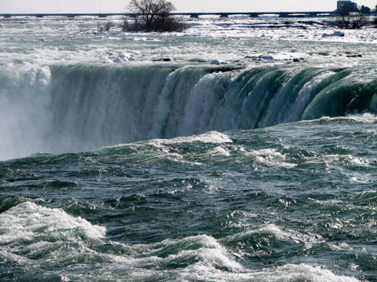
THE NIAGARA FALLS

Slide 9
SEA OTTERS

Slide 10
SEALS

Slide 11
ONTARIO

Slide 12
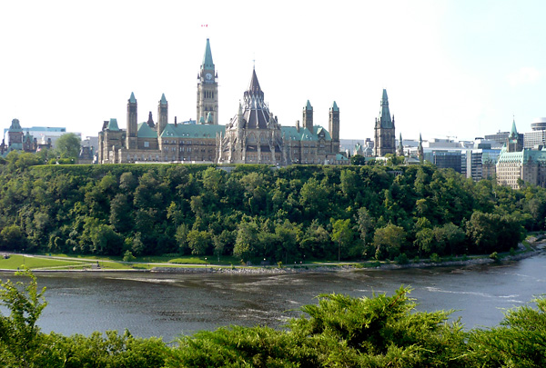
OTTAWA – CAPITAL CITY

Slide 13
OTTAWA – CAPITAL CITY

Slide 14
TORONTO

Slide 15
TORONTO

Slide 16
QUEBEC

Slide 17
QUEBEC CITY

Slide 18
MONTREAL

Slide 19
ALBERTA

Slide 20
CALGARY

Slide 21
BRITISH COLUMBIA

Slide 22
VANCOUVER

Slide 23
VANCOUVER

Slide 24
MANITOBA

Slide 25
WINNIPEG

Slide 26
ANSWER THE QUESTIONS!
How many provinces has Canada got?
10 provinces and 2 territories
How many provinces are more inhabited?
five;
There are cities in these provinces.
Ontario: -Ottawa, Toronto
Quebec:
Montreal, Quebec city
Alberta: Calgary
British Columbia:
Vancouver
Manitoba: Winnipeg
Why?
Name these provinces
And their large cities !

Slide 27
Sing the song!
MY COUNTRY IS CALLED
CANADA
BUT I CALL IT – HOME!

