Slide 1
5 класс
Учебник «HappyEnglish.ru»
К.Кауфман
Учитель английского языка Родионова Диана Георгиевна .

Slide 2
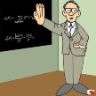
Приветствие. Greetings.
Речевая зарядка.
«Отгадай слово»- “Who are these people?”
Сценка : “What’s your job?”
Аудирование текста: “Misha’s family”.
Правда или неправда. True or False.
Заполни таблицу. Complete the table.
Projects: «My Family and me»
Подведение итогов урока.
Домашнее задание.

Slide 3
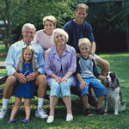
Today is Monday.
Class work.
The theme of the lesson is
“My Family”.

Slide 4
2. Warming up. The poem: Good Rules.
My sisters and brothers
All go to school.
We help one another.
It is a good rule.
We help our mother,
When she washes or cooks,
Together with father
We like to read books.

Slide 5
My Mum’s father is my ……….
My Dad’s mother is my ………
My Mum’s brother is my ………
My Dad’s sister is my ………..
My brother’s mother is my ……..
My granny’s son is my ……….
My Mum’s son is my ………..
My Dad’s daughter is my …….

Slide 6
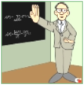
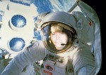
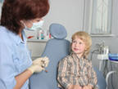
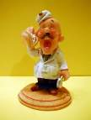
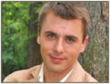
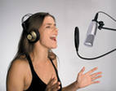
A teacher
A driver
A manager
A cosmonaut
A cook
A singer
An officer
A famer
A dentist
An actor
A doctor
A cleaner

Slide 7
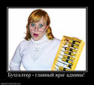
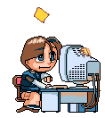
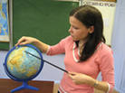

Slide 8
Misha’s family.

Slide 9
1. How old is Misha?
2. What is his mother’s name?
3. What is his sister’s name?
4. What is his father’s name?
5. Who is Pafnutiy?

Slide 10
Misha has got a big family.
His Dad’s name is Alex.
Misha’s Mum is a teacher.
Misha has got a brother.
Misha’s grandparents are in Rostov.
Misha is eleven.
He is good at school.
Misha has got a dog.
It’s name is Pafnutiy.

Slide 11
Misha’s family is not big.
Misha’s father’s name is Alex.
Misha’s mother is a doctor.
Misha has got a sister.
His grandparents are in Rostov.
Misha is ten.
He is good at school.
Misha has got a cat.
His cat’s name is Pafnutiy.

Slide 13
Misha’s family | How old is he(she, it)? | What is his ( her, its) name? | What’s her (his) job? | Details
father
mother
sister
grandfather |  |  | _________
grandfather |  |  | _________
Misha
cat | ________ |  | ________

Slide 14
Misha’s family | How old is he(she, it)? | What is his (her, its name)? | What is his (her) job? | Details
father | 40 | Alex | a businessman | busy
mother | 40 | Anna | a doctor | nice
sister | sixteen | Masha | a pupil | clever, nice
Grandfather | very old | Pavel | ______ | kind
Grandmother | 60 | Inna | ______ | kind
Misha | 10 | _____ | a pupil | is good at school
cat | _____ | Pafnutiy | ____ | fat and funny

Slide 16
The presentation
is made by
Kristina Reizvich
Lyceum # 1- 2010

Slide 17
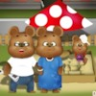
My mother` s name is Lyudmila .
She has got brown hair, grey-green eyes.
My mother is very beautiful.
I love her very much.
My mother works in а military base. She likes cooking and working on a computer.
My father`s name is Sergey.
He has got blond hair and green eyes.
He is not very tall.
My father is very sporty and clever.
I love him too. My father is a military man.
He is fond of sport and works hard.

Slide 18
My brother`s name is Anton. He is four.
He is short. My brother has got grey-blue eyes
and blond hair.
He goes to the kinder garden
and likes it very much.
He is fond of playing
with toy cars and my mobile phone.
He is the best.

Slide 19
My name is Kristina .
I`m a pupil .
I study at school in the 5th form.
I`m fond of English .

Slide 20
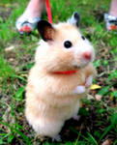
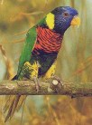
I have got two pets:
a parrot Kapitalina
and a hamster Foma.
Kapa is two and Foma is one .
I love my pets very much.

Slide 21
I love my family very much because it is friendly and happy!!!

Slide 22
Лицей №1 им.Г.С.Титова
Презентацию подготовил Суслов Никита
5 «Б» класс
Краснознаменск

Slide 23
My name is Nikita.
I am ten.
I study in the fifth form.
I often play hockey.
I like playing computer games, walking in the yard and drawing.

Slide 24
My mum’s name is Natasha.
She is 42.
She is very kind, beautiful and funny.
She is a housewife.
She always helps me because she loves me))

Slide 25
My dad’s name is Ivan.
He is 52.
He is hardworking, brave, intelligent and caring.
He likes hockey, basketball and swimming.

Slide 26
I like my Dad.
We often play football, ice-skate, watch TV and swim together.

Slide 27
Her name is Julia.
She was born 18 years ago.
She is a second-year student at MIIT.
Swimming and running are her hobbies.

Slide 28
My Mom and my sister run the house,
do shopping and like talking together.

Slide 29
My family is friendly.
We spend a lot of time together.
I like my family and
they love me to)))

Slide 30
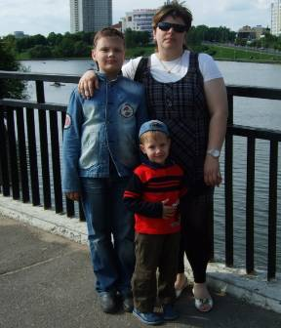

Slide 31
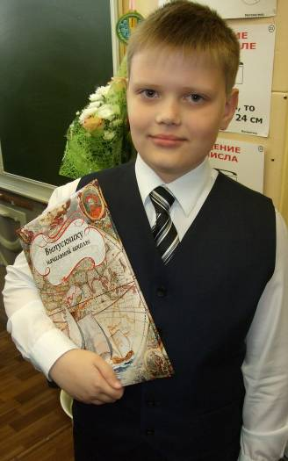
My name is Alex. My surname is Trushkevich. I am eleven. I’m a pupil. My family is not very big. I have got a mother, a father and a brother.

Slide 32
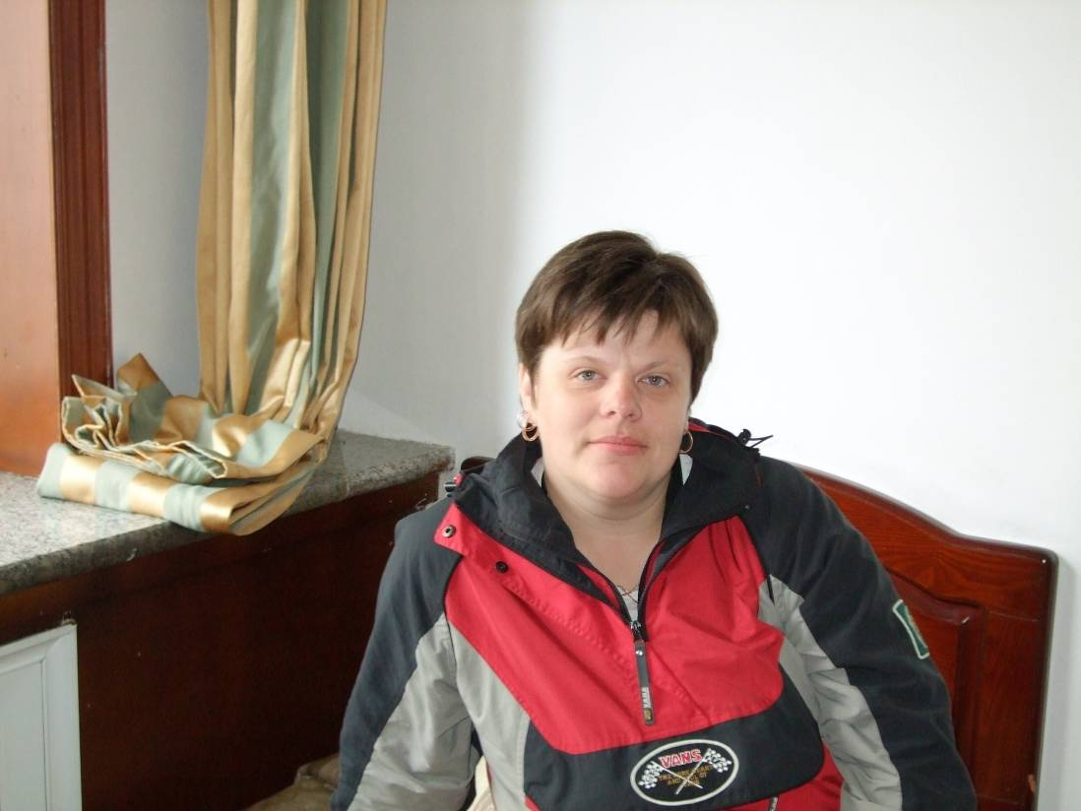
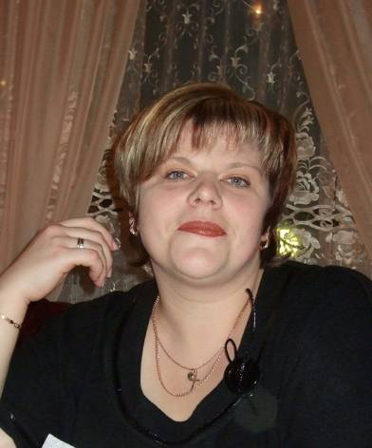
This is my mother.
My mother’s
name is
Valentina.
She is thirty –five
She is very kind.

Slide 33
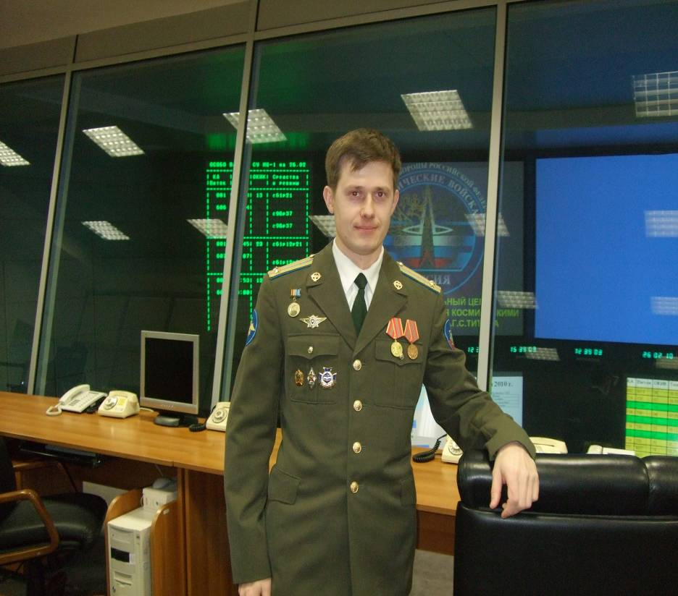
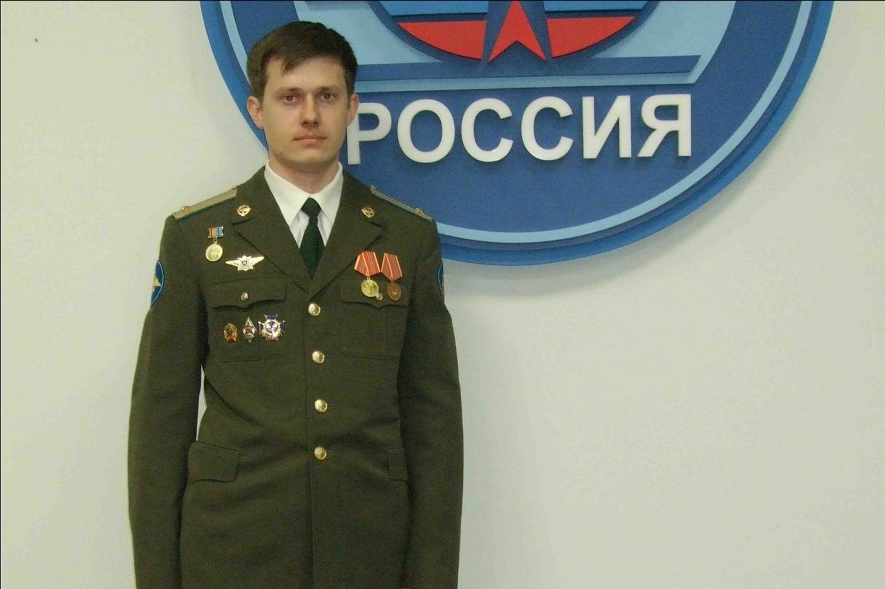
This is my Dad.
His name is Alexander.
He is thirty- five.
He is an officer.
I love my father very much.

Slide 34
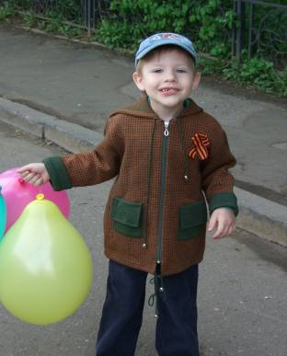
This is my brother.
My brother’s name is
Maxim.
I call him Max. He is funny.
He is five, almost six.
He likes to play computer games.

Slide 35
My family is very friendly. We like to spend time together.
We like to watch TV, to work and to play in the country.
I love my family very much.
THE END

Slide 36
What is Kristina's mother’s name?
Has she got a brother or a sister?
What pets has she got?
What is Nikita’s Dad’s name?
What does he like to do with his father?
How old is his mother?
What is his sister’s name?
What is Alex’s mother’s name?
How old is his father?
His brother is six, isn’t he?

