Slide 1
Alexander the Great leads Greeks to victory over the Persian Empire
Teacher: Shplatova M. E. Pupils:
Morozov S.
Pesterev M.
Class: 9 “A”
School: 787
2011/2012

Slide 2
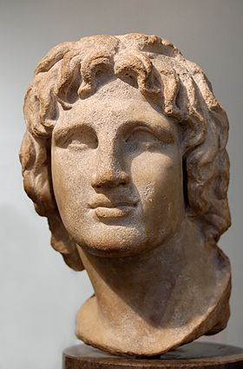
Alexander the Great (Alexander III of Macedon) was born on the 20th or the 21st of July in 356 BC in Pella, the Kingdom of Macedon. He was the son of Philip II, the King of Macedon. Alexander the Great became the creator of one of the largest empires in ancient history.
Alexander III of Macedon (356 –323 BC)

Slide 3
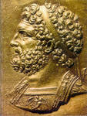
Alexander was tutored by the famous philosopher Aristotle. In 336 BC he succeeded his father to the throne after he was assassinated. Alexander inherited a strong kingdom and an experienced army. In 334 BC he invaded Persian-ruled Asia Minor and began a series of campaigns lasting 10 years.
Philip II, the King of Macedon
(382—336 BC)

Slide 4
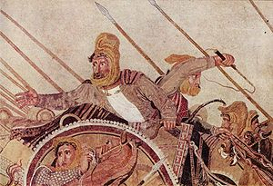
Darius III was born in 380 BC. He is also known by his given name of Codomannus. He was the last king of the Achaemenid Empire of Persia from 336 BC to 330 BC.
Alexander broke the power of Persia in a series of decisive battles. The most known is the Battle of Issus near the Pindar River in 333BC. Alexander’s army attacked the Persian army under the command of Darius III. The Persians began to retreat under the onslaught of the Greeks and the Macedonians. Alexander saw Darius, who was in his golden chariot, and rushed to kill his enemy.
Darius III (380–330 BC)

Slide 5
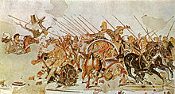
But Darius ran away from the battle-field, having left the wounded soldiers, guards and even his wife, 2 daughters and mother. When Alexander came into the camp-tent that looked like a palace the King of Macedon said: “Well, it probably means to reign!” Darius offered a peace treaty to Alexander: the concession of the lands he had already conquered, and a ransom of 10 000 talents for his family. But Alexander III replied that since he was the King of Asia, he demanded unconditional surrender from Darius III.

Slide 6
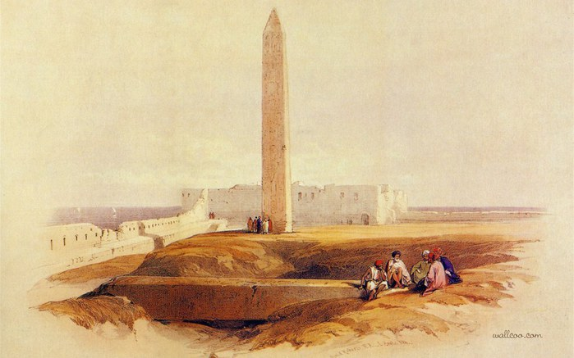
The 2nd famous battle is the Battle of Gaugamela in 331 BC. It was after his march to Egypt, where Alexander was regarded as a liberator from the Persian’s expansion. There he was also pronounced the King of Egypt and the Son of Amun – the God of Thebes. During his stay in Egypt, Alexander founded Alexandria-by-Egypt, which became the capital of the Ptolemaic kingdom after his death.
336 г. до н.э.

Slide 7
Two general military leaders met again in northern Iraq. The army of Darius III consisted of 1000000 warriors. But the king made the great mistake when he had ordered his army to wait for the enemy all night long. The army of Alexander III wasn’t going to attack them at night. The Macedonians was ordered to rest in order to muster the strength. Once again, the Persians were defeated by Alexander III. Darius III left the battle-field again. He was abandoned by everyone and killed by his satrap Bessus.

Slide 8
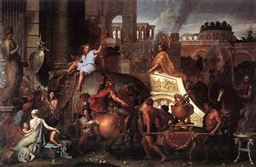
After the battle there was the only one master – Alexander the Great who conquered the Persian Empire and the Macedonian Empire now stretched from the Adriatic Sea to the Indus River. Then Alexander III captured Babylon, Susa and Persepolis – the capital of Persia – with their treasures. The cities were robbed; many men were crucified and sold into slavery. Alexander died from fever on the 10th or the 11th of June in 323 BC in Babylon. He survived Darius for 7 years.
Entry of Alexander into Babylon (1664) by
Charles Le Brun

Slide 9
Glossary
Alexander III of Macedon [ælɪg'zɑ: ndə], ['mæsɪdn] – Александр Македонский, правил 336 - 323 гг. до н. э.
Darius III [də'rʌɪəs] - Дарий III, иначе Дарий Кодоман, персидский царь, правил в 336 - 330 гг. до н. э.
Pella – г. Пелла древний македонский город.
the Kingdom of Macedon – древнее государство Македония
Philip II ['fɪlɪp] – Филипп Второй
Aristotle ['arɪstɒt(ə)l] – древнегреческий философ (384 – 322BC).
to assassinate [ə'sæsɪneɪt] – убить
to inherit [ɪn'herɪt] – наследовать
Asia Minor [eɪʃə'maɪnə] – Малая Азия (полуостров на западе Азии, на территории Турции).
Persia ['pɜ:ʃə], [-ʒə] – Персия (современный Иран).
decisive [dɪ'saɪsɪv] – решающий
the Battle of Issus near the Pindar River – битва при г. И́ссе у р. Пиндар – сражение между македонской армией Александра Великого и персидским войском царя Дария в Киликии (Турция).
to retreat [rɪ'tri:t] – отступать
onslaught ['ɔnslɔ:t] – стремительная атака
concession [kən'seʃ(ə)n] – уступка
ransom ['ræn(t)s(ə)m] – выкуп
talent ['tælənt] – талант – единица массы и счётно-денежная единица, использовавшаяся в античные времена в Европе, Передней Азии и Северной Африке.

Slide 10
unconditional – безоговорочный
to surrender – сдаваться
the Battle of Gaugamela – битва при Гавгамелах 1 октября 331 до н. э., где войска Александра Македонского окончательно разгромили персидскую армию царя Дария III (древнее селение в Месопотамии, в районе современного города Эрбиль (Ирак).
the Son of Amun – Амон, в египетской мифологии бог солнца
Thebes [θi:bz] – г. Фивы в Египте
Alexandria-by-Egypt – г. Александрия, основан в 336 г. до н. э.
the Ptolemaic kingdom [tɔlə'meɪɪk] – относящийся к Птолемеям (царская династия в эллинистическом Египте).
to muster – собирать
Bessus (Artaxerxes V), Бесс (Артаксеркс V) — персидский царь, правил в 330 -329 гг. до н. э.
satrap - глава сатрапии, правитель в Древней Персии. Назначался царём и обычно принадлежал к высшей знати. На своей территории ведал сбором налогов, содержанием армии, был верховным судьёй и имел право чеканить монету.
the Adriatic Sea – Адриатическое море (часть Средиземного моря между Апеннинским и Балканским пол-ми)
the Indus River ['ɪndəs] – р. Инд
to crucify – распинать
Babylon ['bæbɪlɔn] – г. Вавилон в Месопотамии, на левобережье Евфрата, в 80 км к Югу от Багдада (Ирак). Известен с XXIII в. до н.э. В XIX—VI вв. до н.э. столица Вавилонии и Нововавилонского царства; в 331 г. до н.э. захвачен Александром Македонским, который планировал сделать его своей столицей (умер здесь). Упоминается в Библии в связи с сооружением Вавилонской башни, в окрестностях находились висячие сады Семирамиды (IX—VII вв. до н.э.) – одно из 7 чудес света. Археол. раскопки с 1899 г., обнаружены руины крепостных стен, храмов, дворцов и др.
Susa – г. Сузы, резиденция царей Древней Персии
Persepolis – Персеполь, древнеиранский город, к северо-востоку от Шираза. Основан в конце 6 в. до нашей эры. Одна из столиц Ахеменидов. В 330 до нашей эры был захвачен А. Македонским, сожжен и заброшен.

Slide 11
Список литературы
Энциклопедия для детей: Т. 1 (Всемирная история). – Сост. С. Т. Исмаилова. – М.: Аванта + , 1994. – 704 с.: ил.
www. wikipedia. org

