Slide 1
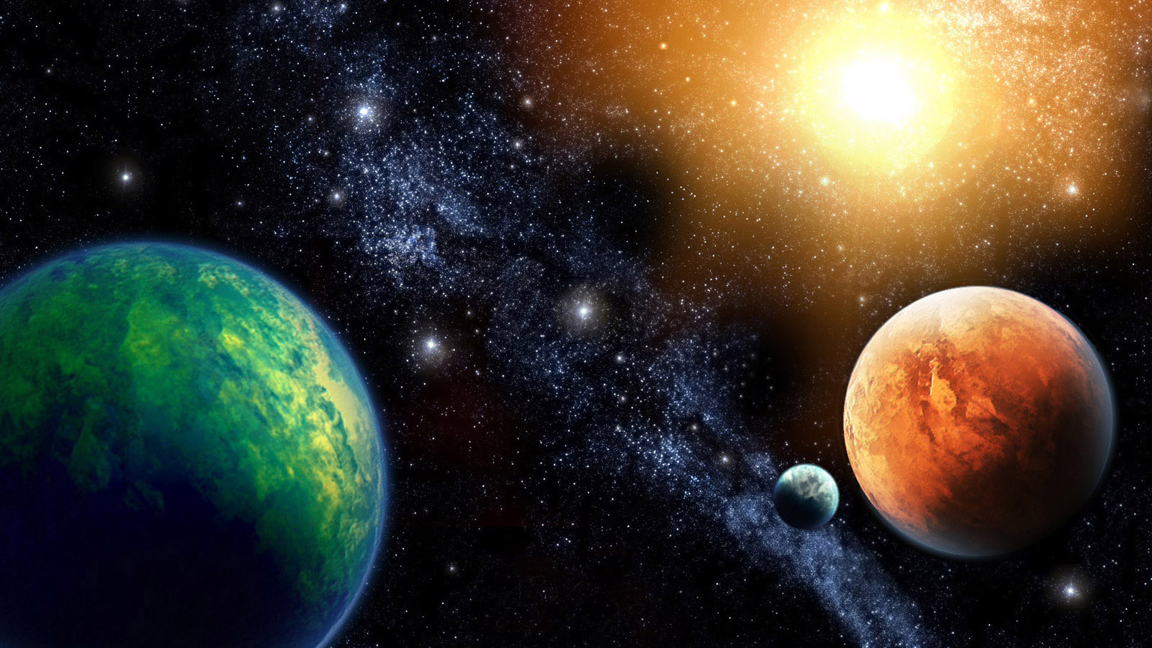

Slide 4
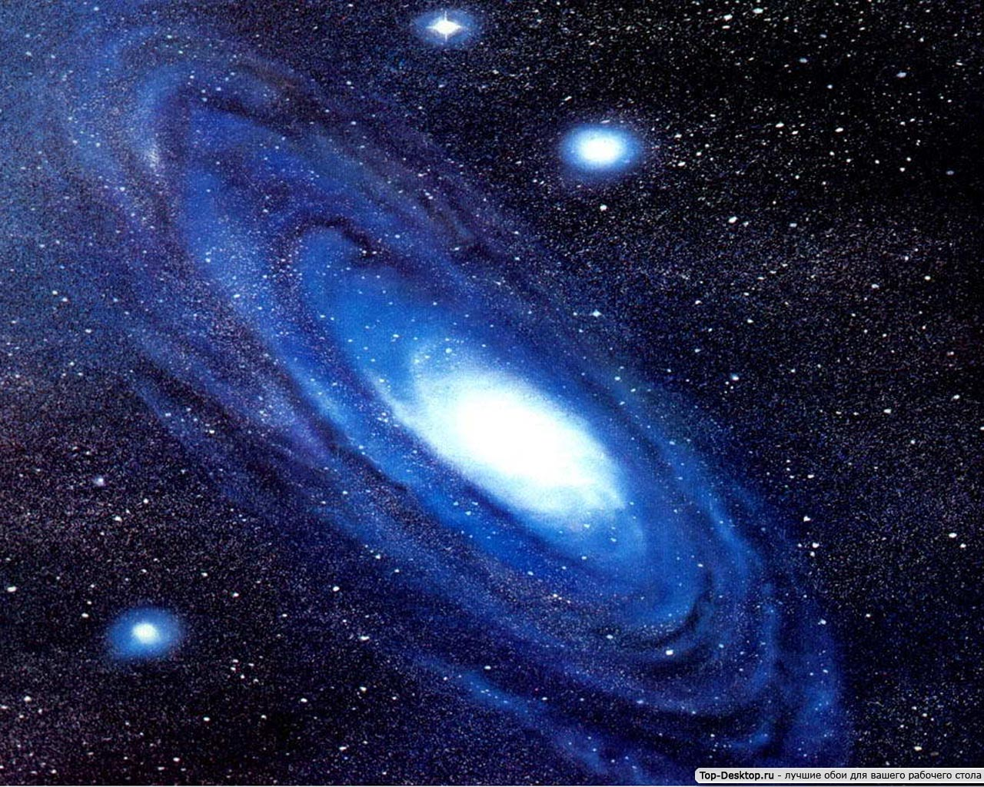
1 | 2 |  | 4 | 5 | 6
5 | 4 | 3 |  | 1 | 0
3 | 4 |  | 6 | 7 | 8
1 | 2 | 3 |  | 5 | 6
 | 1 | 2 | 3 | 4 | 5
 | 5 | 4 | 3 | 1 | 2

Slide 5
1 | 2 | 3 | 4 | 5 | 6
5 | 4 | 3 | 2 | 1 | 0
3 | 4 | 5 | 6 | 7 | 8
1 | 2 | 3 | 4 | 5 | 6
0 | 1 | 2 | 3 | 4 | 5
6 | 5 | 4 | 3 | 1 | 2

Slide 6
10-6= 5+2=
4+3= 3+5=
0+2= 6-3=

Slide 7
10-6=4 5+2= 7
4+3=7 3+5=8
0+2= 2 6-3=3

Slide 8
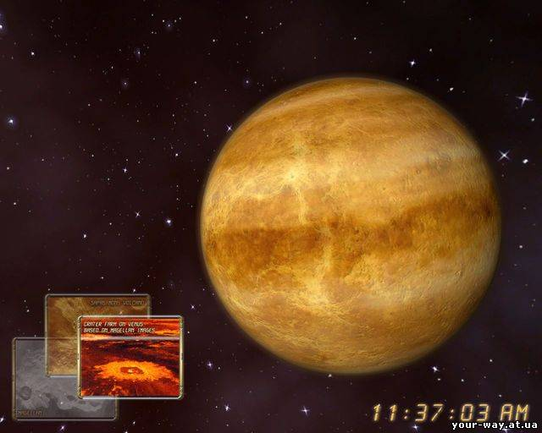
4-в
2-н
8-р
7-е
3-а

Slide 9
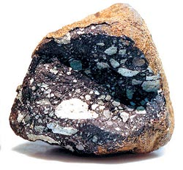

Slide 10
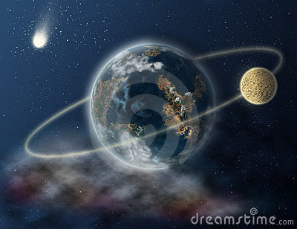

Slide 11
? =

Slide 13
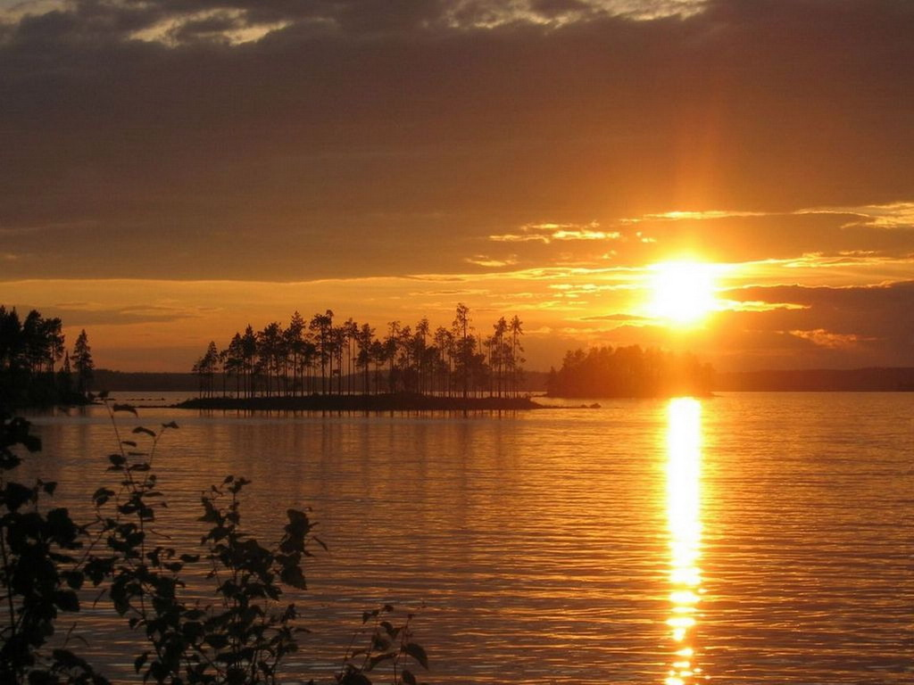
10, 9 7,5
4, 3 2, 6
1,8 3,5

Slide 14
