Slide 1
My dear north land

Slide 2
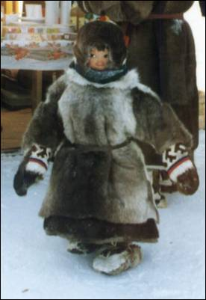
One Nenets
wears
winter coat
and walks well
with white deer
in winter.

