Slide 1
I can play the ….
Урок английского языка в 3 классе
Учебник « Millie- 3»
Программа Азаровой С.И.
Разработано учителем английского языка МОУ Докучаевской СОШ
Дубровиной Еленой Алексеевной

Slide 2
Read the words
Swim
Skip
Write
Catch a ball
Dance
Sing
draw
Fly a kite
Ride a bike
Bounce a ball

Slide 3
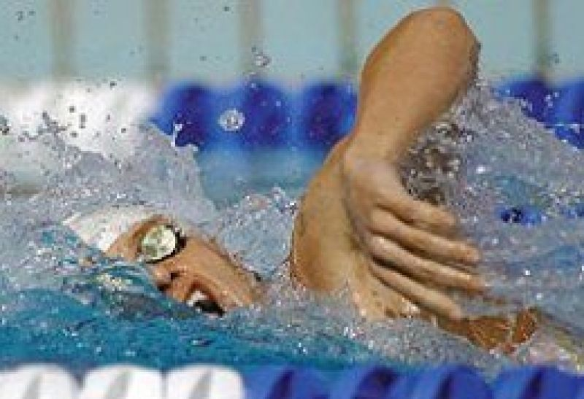
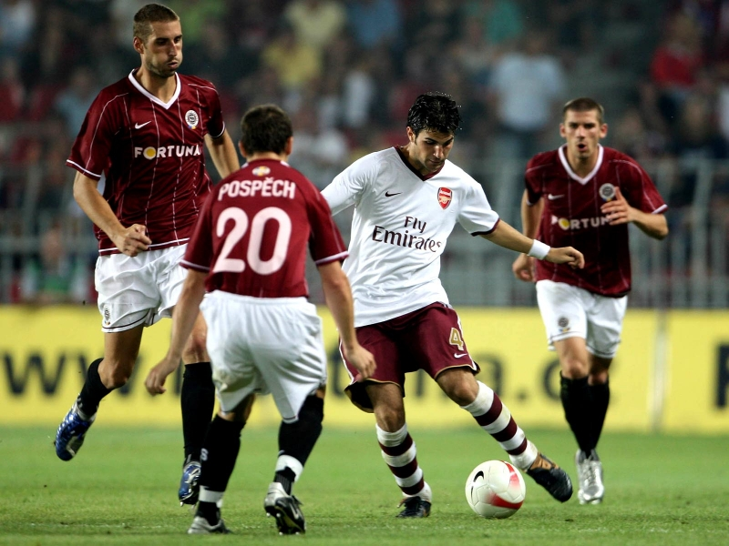
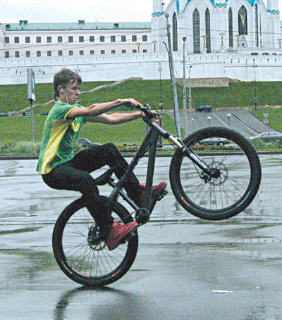
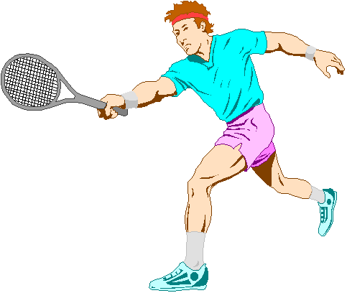


Slide 4
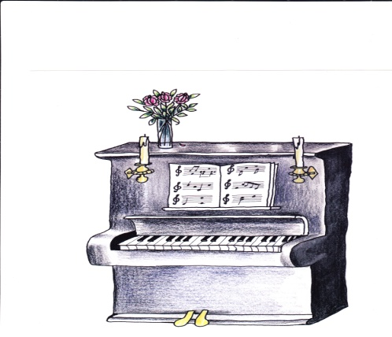
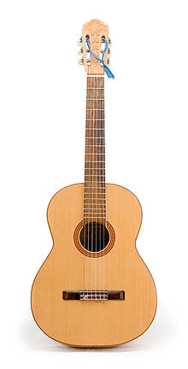
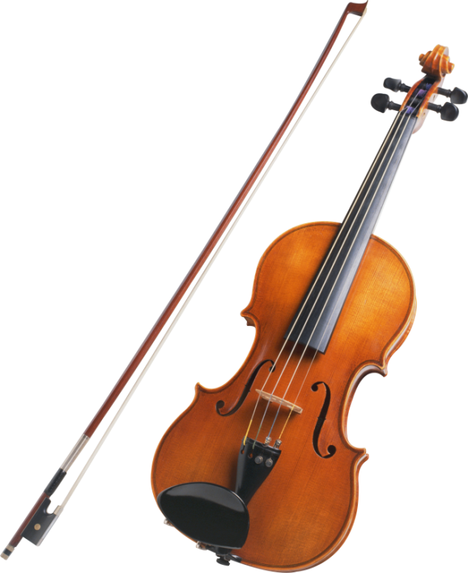
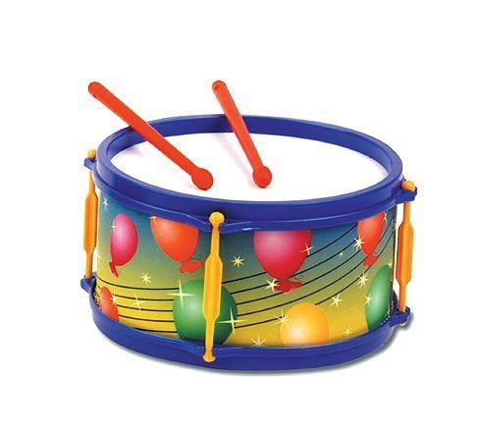
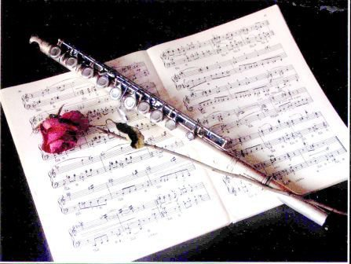
piano guitar
drum
violin
flute

Slide 5
Let’s sing a song
I am the Music Man ,
I come from down your way
And I can play.
What can you play?
I can play the piano.
I am the Music Man ,
I come from down your way
And I can play.
What can you play?
I can play the big bass drum.
I am the Music Man ,
I come from down your way
And I can play.
What can you play?
I can play the violin
I am the Music Man ,
I come from down your way
And I can play.
What can you play?
I can play the guitar.
I am the Music Man ,
I come from down your way
And I can play.
What can you play?
I can play the flute.

Slide 6
 | violin | drum | guitar | flute | piano
Wendy
Steve
Mike
Martha
Miriam
Miss Fun

Slide 7
Make up your dialogues
Can you play …….. violin ?
drum ?
flute ?
guitar ?
piano ?
Yes, I can. I can play….
No, I can’ t. I can’t play…..

