Slide 1
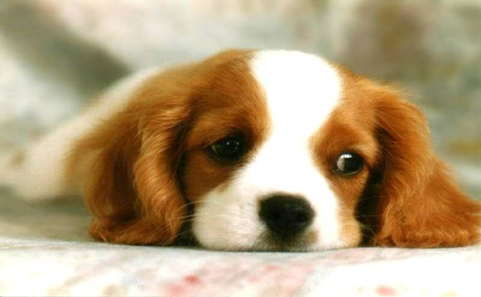
THE DOG
The dog is our good friend. It is very clever. The dog knows and loves its master and the friends of his family. It likes to eat meat and drink milk. There are many kinds of dogs.

Slide 2
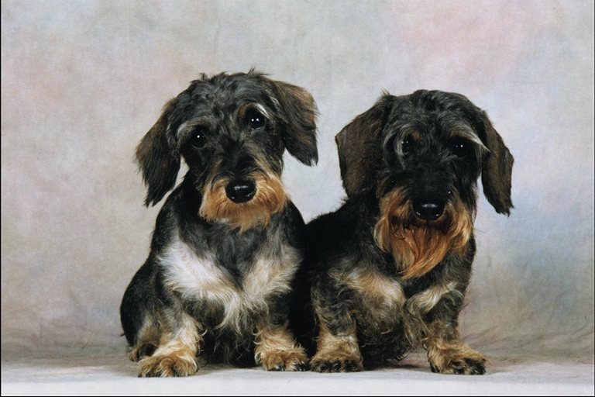
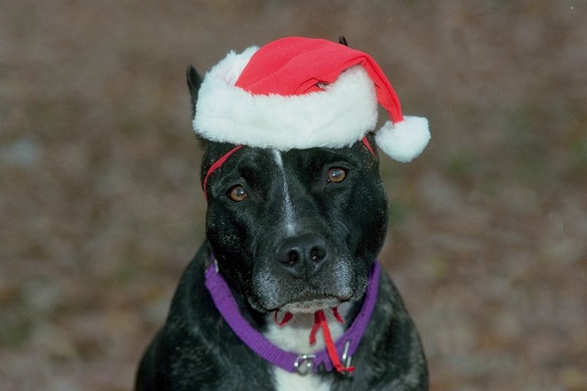
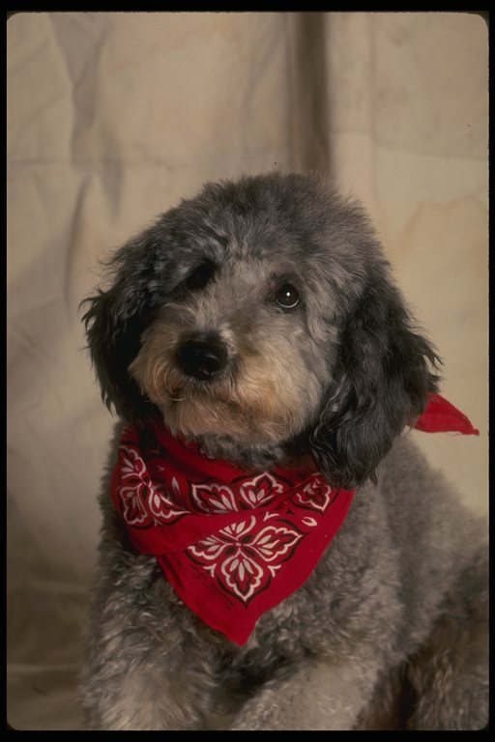
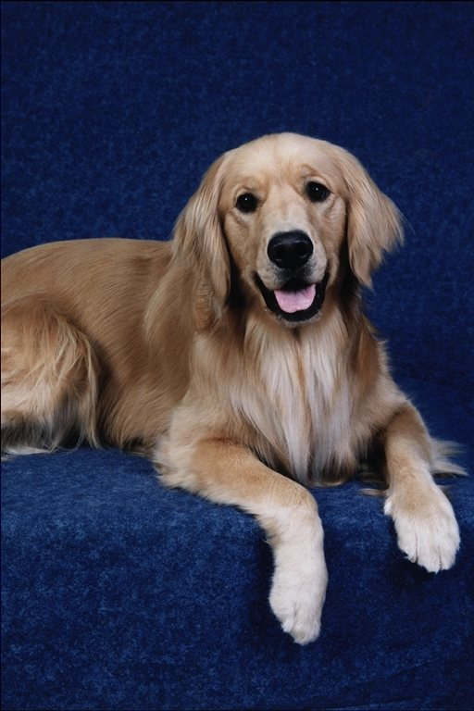

Slide 3
THE CAT
Cats are very nice and clever animals. We love cats very much. There are many kind of cats: white cats, grey cats, black cats. Cats can be short – haired and long haired. They know and love their homes.

Slide 4
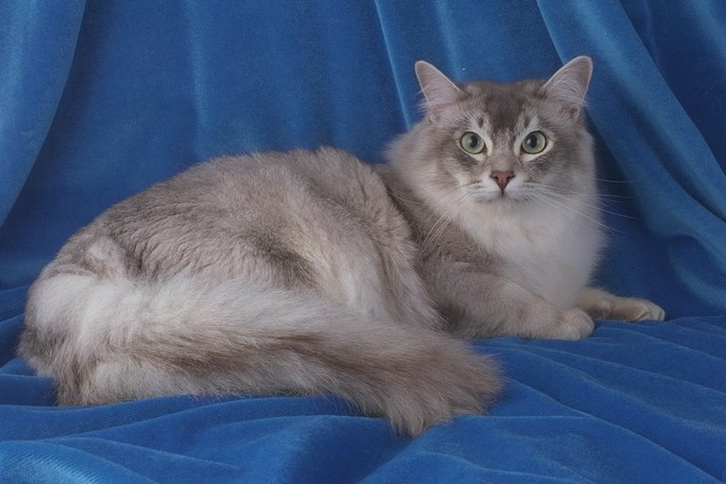
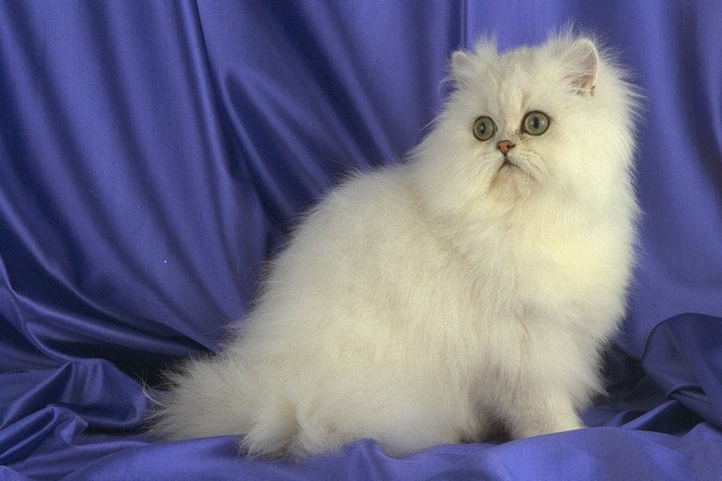
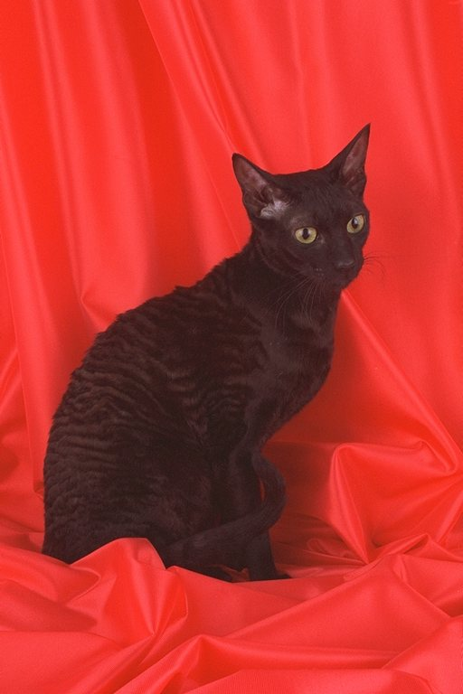
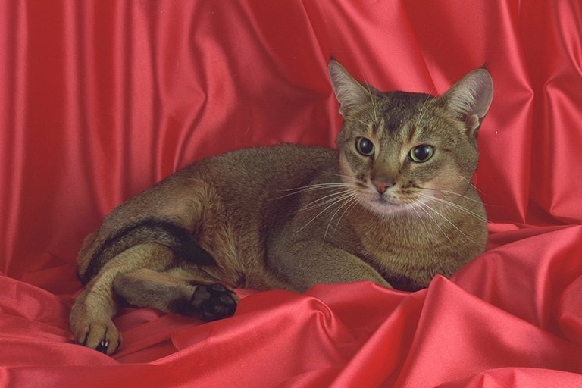

Slide 5
THE HAMSTER
The hamster is a clean and friendly animal. It sleeps in the day and eats and plays at night. It likes to eat lettuce, carrots, apples and nuts. You must have a nice cage for your hamster. Hamsters like to play and run.

Slide 6
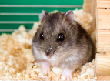
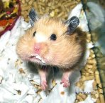
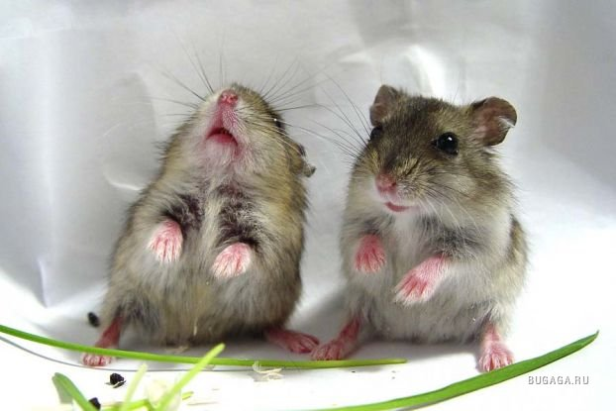
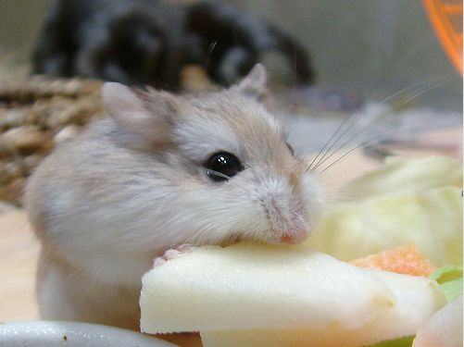
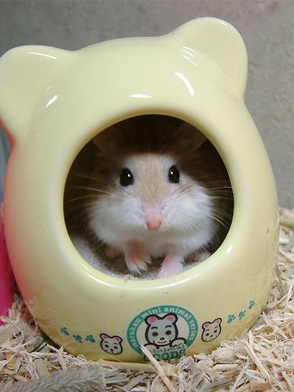
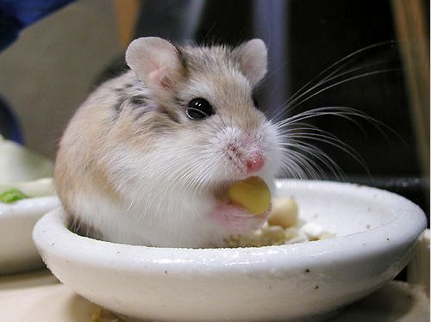

Slide 7
THE PARROT
They are big, nice and clever birds. Parrots can be of different colours: blue, green, yellow, red and white. We can teach it to talk. It can repeat the words it hears. The parrot can be very tame.

Slide 8
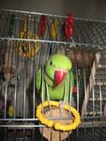
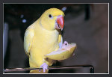
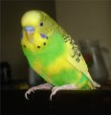
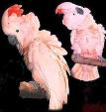
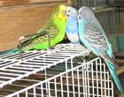

Slide 9
