Slide 1
Protection of Environment

Slide 2
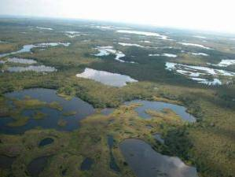
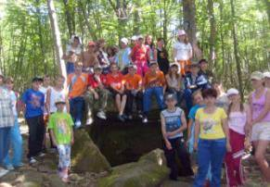
Oh, Russia, I’m in love with you!
Remember, Russia, you are great
Not in the field of battles past
But in the lush green fields of wheat
And forests, gardens, free of dust.
I love you deeply, dear land,
Your lakes with shores of fine sand,
Your rivers, valleys, hills and seas;
Your songs and dances; birds in trees;
Your sunrise is a splendid sight
Which always gives me such delight!

Slide 3
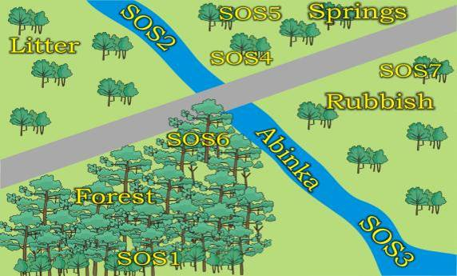
Litter is left.
The water is polluted.
Fires are started.
Trees are cut down.
Birds and animals are frightened.
The air is polluted.

Slide 4
1. People, don’t harm plants!
2. People, help to keep all water clean!
3. People, protect animals and fish!
4. People, clean springs!
5. People, plant trees and flowers!
6. People, take care of birds and animals!
7. People, take litter home!

Slide 5
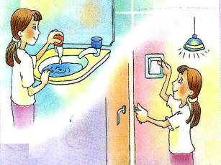
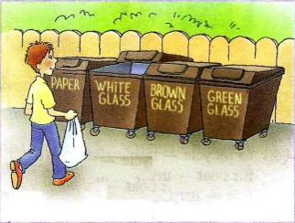
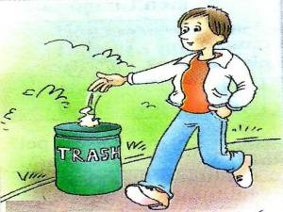
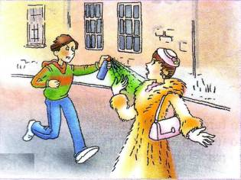
People never forget to turn off lights and water!
People sort their rubbish!
Nobody wears fur coats. They don’t want to kill animals for clothes!
Nobody drops litter!

Slide 6
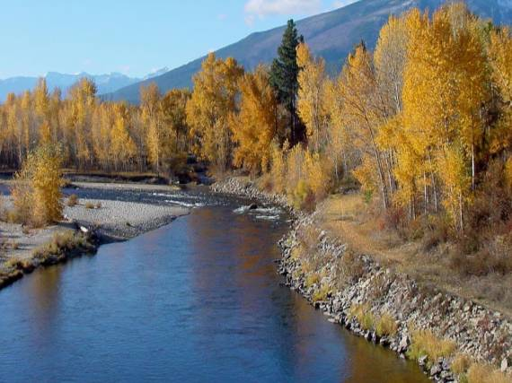

Slide 7
1.Do not pick wild flowers.
2.Do not litter the ground with tins, paper and bottles.
3.Do not frighten animals.
4.Do not harm plants.
5.Feed birds and help them.
6. Plant trees and flowers.
7.Recycle used materials such as metal, bottles and paper.
8.Clean rivers and springs.

Slide 8
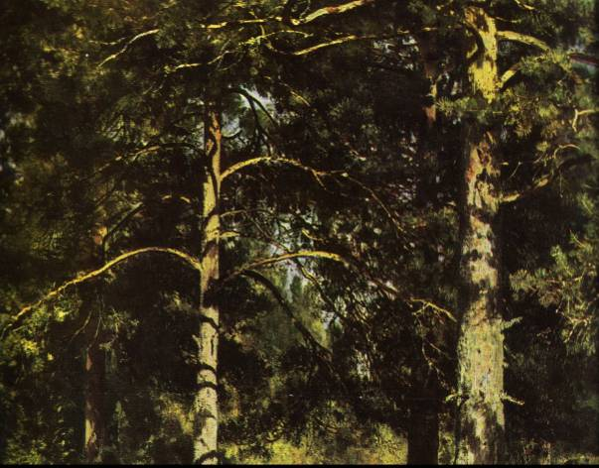
I. Shishkin “The Pine-Trees in the Sunlight”.

Slide 9
I promise to be
Natures best friend.
I promise to be
Sorry for animals
I promise not to drop
in the street
I promise not to harm plants
I promise to turn
water off.
I promise to feed birds.

Slide 10
ABINSK IS THE GARDEN CITY OF KRASNODAR REGION –
KEEP IT CLEAN AND GREEN!

Slide 11
Презентация подготовлена на лексическом материале учебника “Happy English.ru” 7 класс (авт. К.И. Кауфман, М.Ю. Кауфман)

