Slide 1
Check yourself

Slide 2
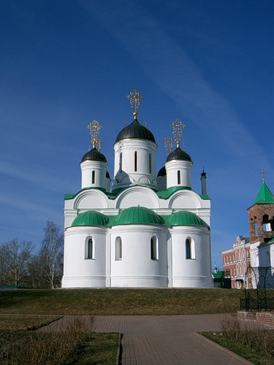
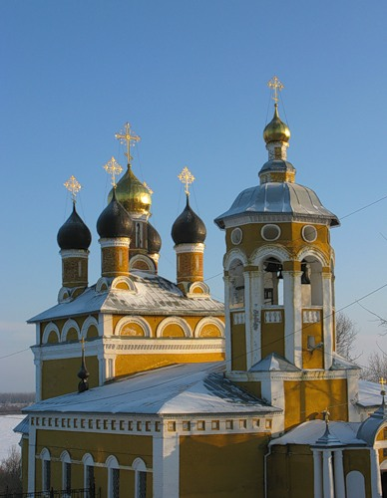
1) There are a lot of churches in our town.

Slide 3
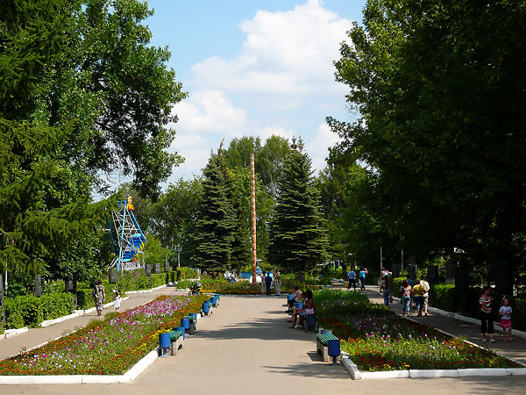
2) There are many squares, parks and beautiful streets.

Slide 4
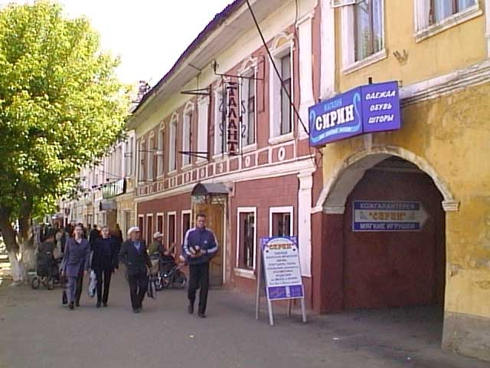
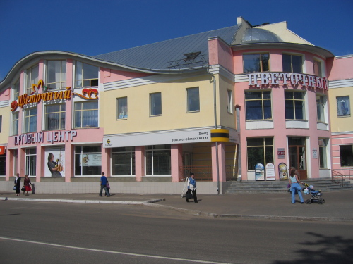
3) A lot of new and old buildings, shops, cafes, offices are located here.

Slide 5
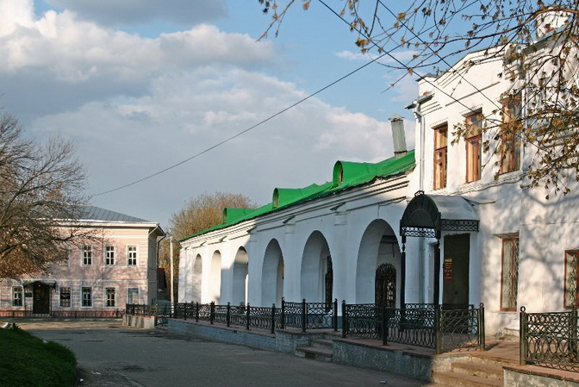
4) There is a market in the centre of the town.

Slide 6
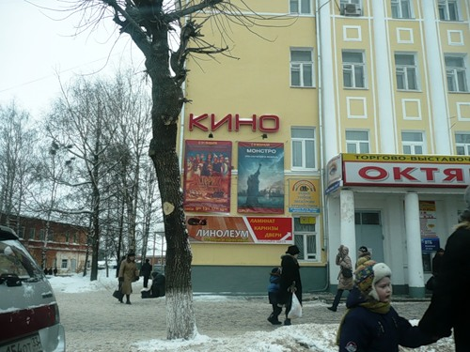
5) Is there a cinema near your school?

Slide 7
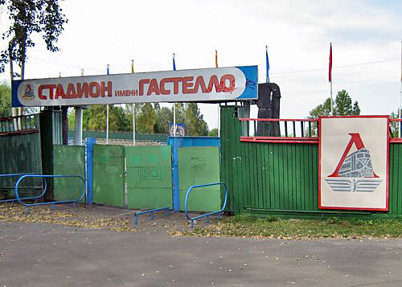
6) Are there sports grounds or swimming pools in your town?

Slide 8
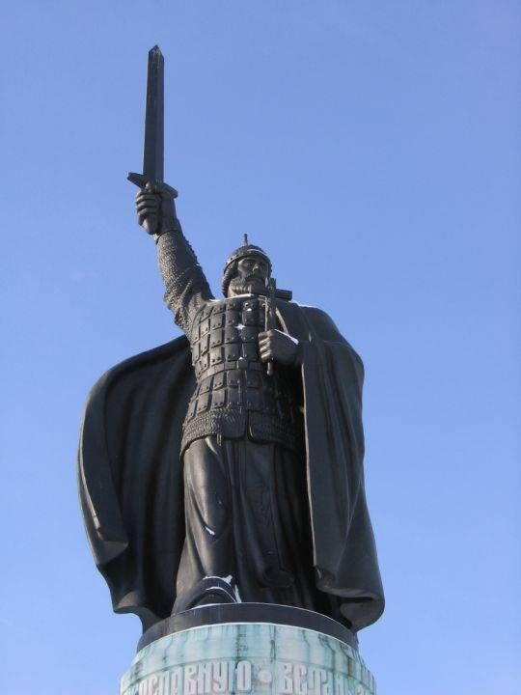
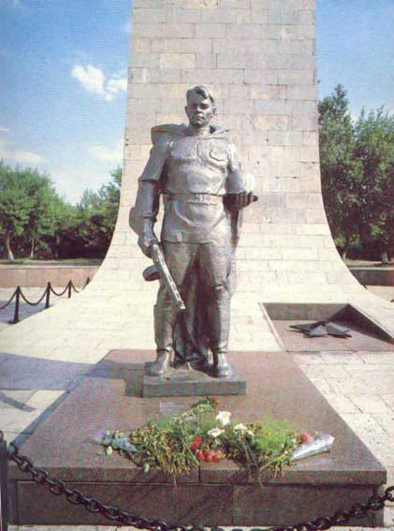
7) What historical monuments are there in Murom?

Slide 9
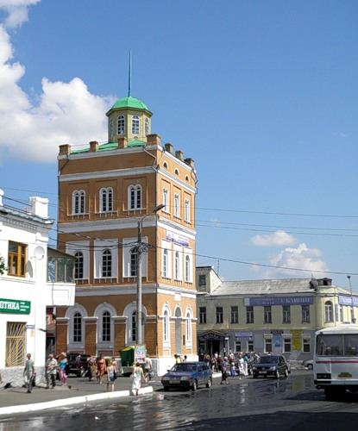
8) There is no theatre in our town.

Slide 10
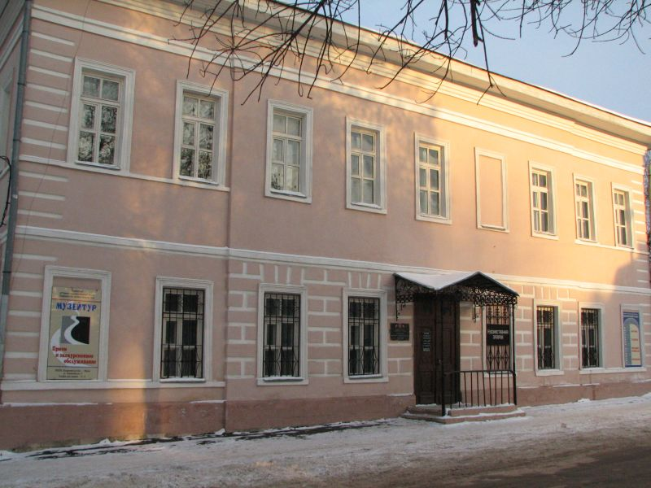
9) There are no Repin’s pictures in the museum.

Slide 11
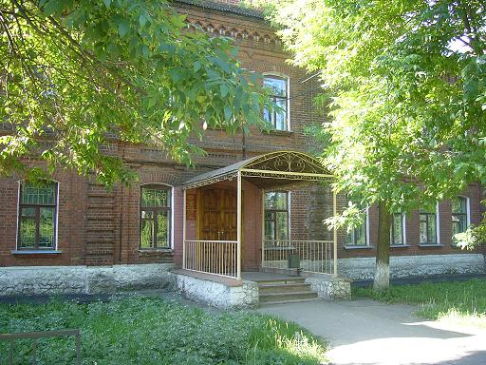
10) What colleges does your town have?

