Slide 1
Выполнила: учитель английского языка МБОУ «СОШ №10» г. Стерлитамака, РБ
Хабибуллина Э. Ш.

Slide 2
Little Linda lost her locket,
Lovely , lucky, little locket.
Lately Linda found her locket
Lying still in Linda’s pocket.

Slide 3
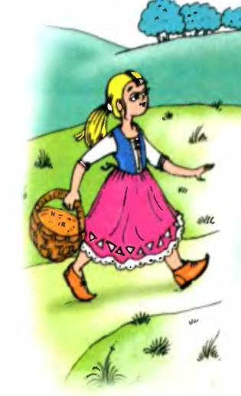
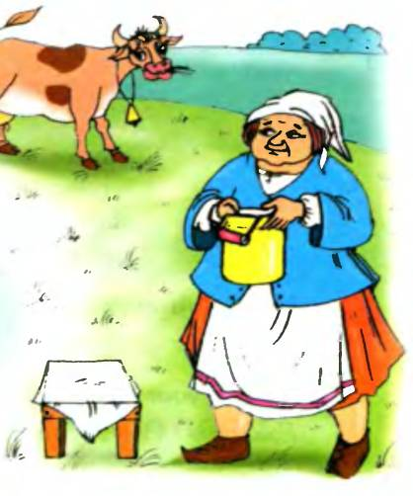

Slide 4
Madame Tussaud’s
Madame Tussaud’s Museum is a museum of wax figures in London.
It was founded by wax sculptor Marie Tussaud.

Slide 5
Marie Tussaud was born in Strasburg in 1761. Her mother worked as a housekeeper for Dr. Philippe Curtius in Bern, Switzerland, who was a physician skilled in wax modelling. Curtius taught Tussaud the art of wax modelling.
In 1842, she made a self portrait which is now on display at the entrance of her museum.

Slide 6
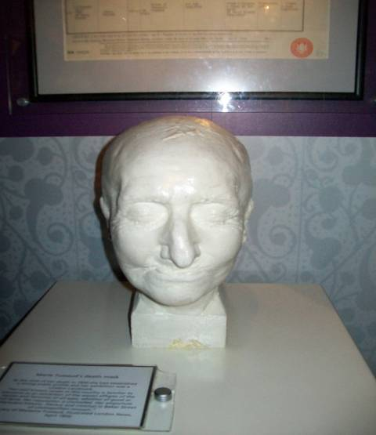

Slide 7
Madame Tussaud’s Museum consists of several halls with wax images of outstanding political characters,

Slide 8
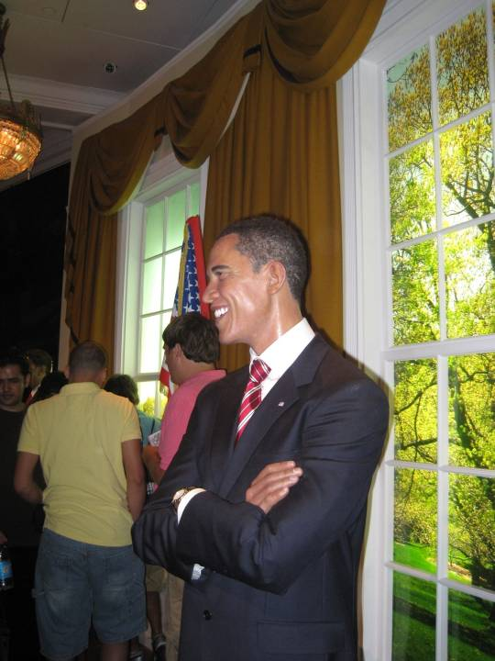

Slide 9
Charles Dickens
poets and writers,

Slide 10
world famous film stars and musicians

Slide 11
The Beatles

Slide 12
There is a special place for the Queen’s family:

Slide 13
the Queen , her husband

Slide 14
their children and other members of the Royal family.

Slide 16
One of the main attractions of the museum was the Chamber of Horrors. This part of the exhibition included victims of the French Revolution and newly created figures of murderers and other criminals.

Slide 17
The name is often credited to a contributor to Punch in 1845

Slide 18
Madame Tussaud's wax museum has now grown to become a major tourist attraction in London. It has expanded and will expand with branches in Amsterdam, Bangkok, Berlin, Dubai, Hamburg, Hollywood, Hong Kong, Blackpool, Las Vegas, Moscow, New York City, Shanghai, Vienna and Washington, D.C.

Slide 19
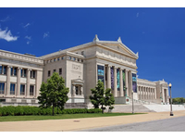

Slide 20
Hyde park

Slide 21
Regent’s park
You can also visit Regent’s park where you will find London zoo

Slide 22
London Zoo

Slide 24
Kensington Gardens

Slide 25
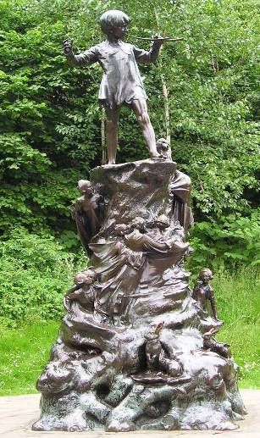
You can see the statue of the famous fairy tale
hero, Peter Pan in Kensington Gardens.

Slide 26
Thanks for attention!

