Slide 1
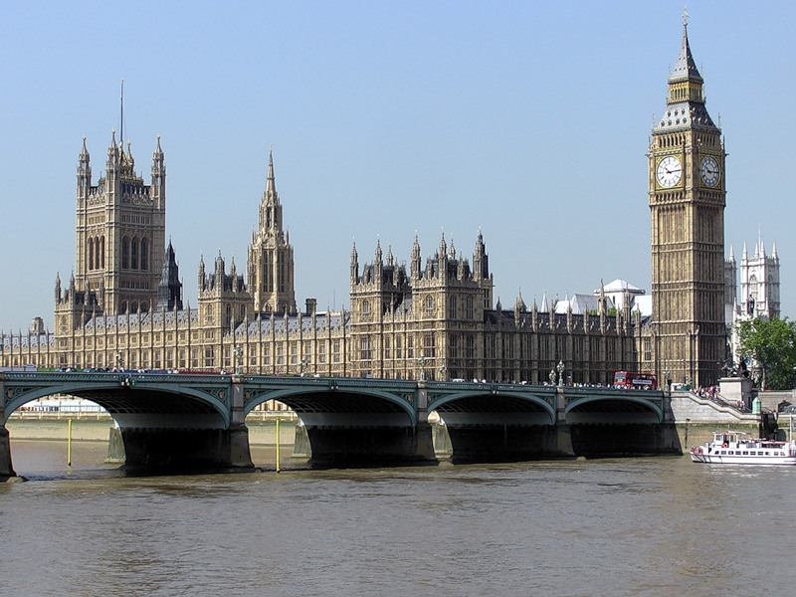
The Royal Family

Slide 2
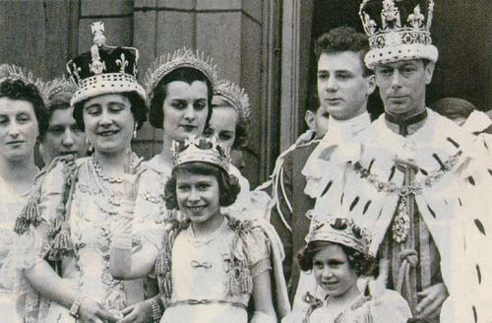
At present the British royal family is headed by Queen Elizabeth. When the Queen was born on the 21st of April 1926, her grandfather, King George V, was on the throne and her uncle was his heir. The death of her grandfather brought her father to the throne as King George VI.

Slide 3
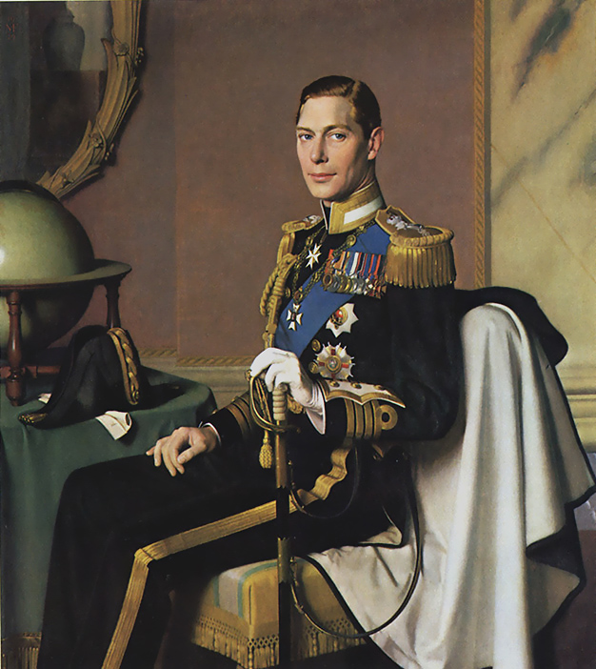

Slide 4
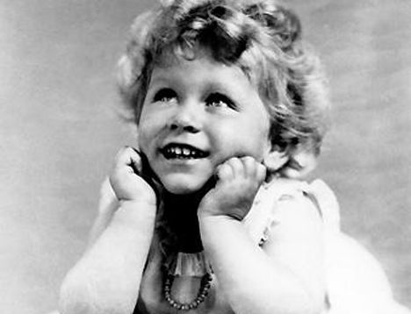
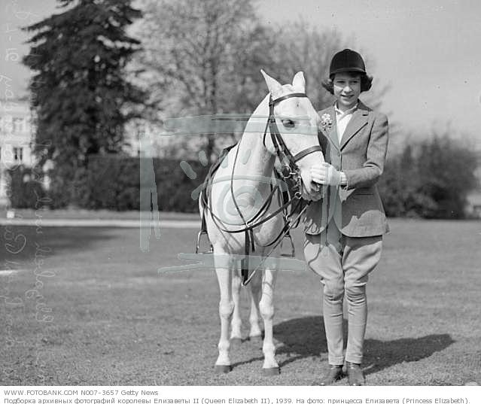
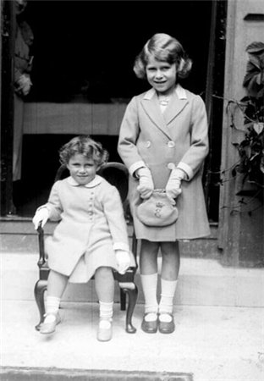
As a child she studied constitutional history and law as well as art and music. In addition she learned to ride a horse. As she grew older she began to take part in public life, making her first broadcast at the age of 14.

Slide 5
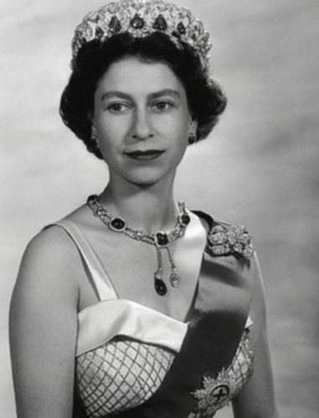
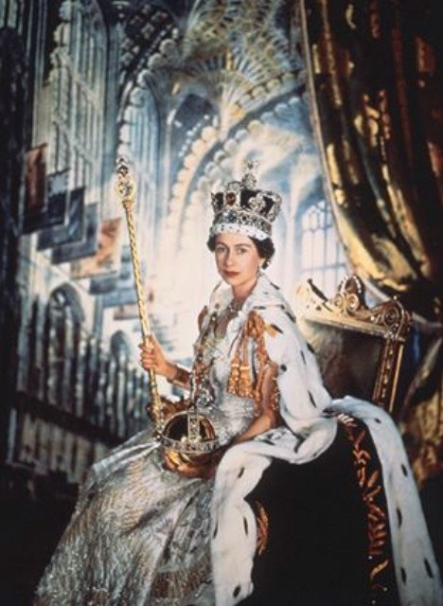
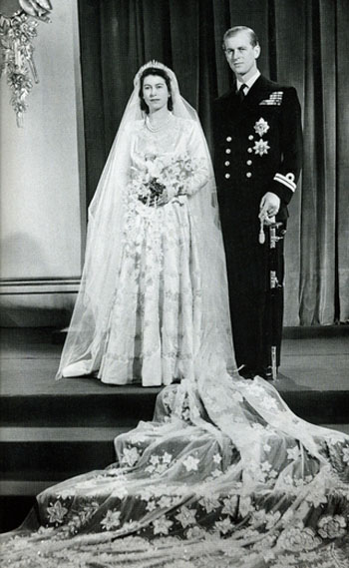
The marriage of the young Princess Elizabeth to Philip, Duke of Edinburgh took place in November 1947. She came to the throne after her father's death in 1952 and was crowned in Westminster Abbey in June 1953.

Slide 6
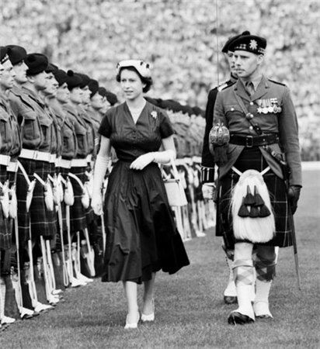
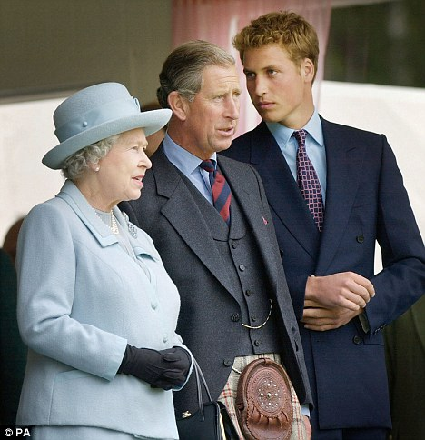
Among Queen Elizabeth's many duties are the regular visits she makes to foreign countries. The Queen has allowed the BBC to make a documentary film about the every day of the royal family. She also started the tradition of the "walkabout”, when she walks among the public crowds and stops to talk to some people.

Slide 7
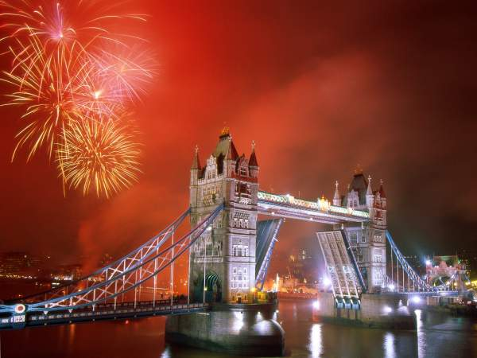
The annual Christmas broadcast made by the Queen on radio and television has become a traditional and popular feature of the season, and there were widespread celebrations and special programmes of events in 1977 to mark her Silver Jubilee.

Slide 8
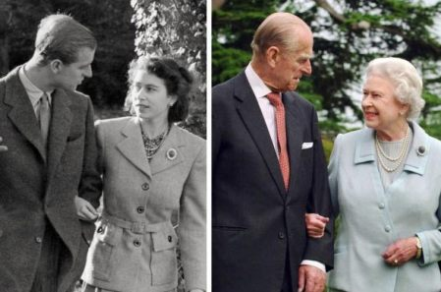
The Queen's husband, Duke of Edinburgh, was born in 1926 and served in the Royal Navy. He takes a great deal of interest in industry, in the achievements of young people and in saving raise wild animals from extinction.

Slide 9
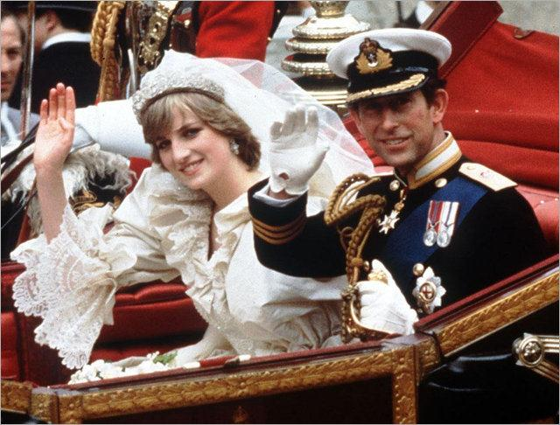
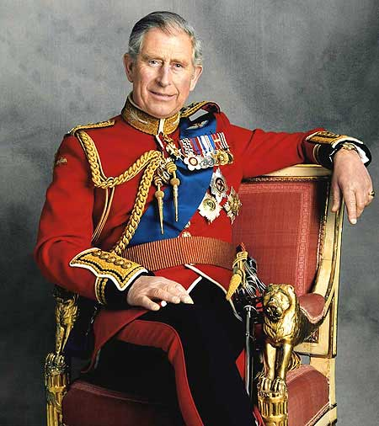
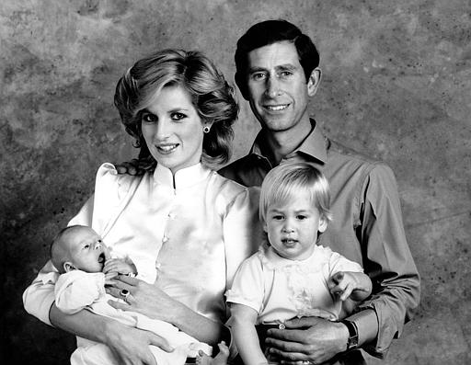
The Queen's heir is Charles, Prince of Wales, who was born in 1948, married Lady Diana Spencer and has two children, Prince William and Prince Harry. The Prince of Wales is well-known as a keen promoter of British interests.

Slide 10
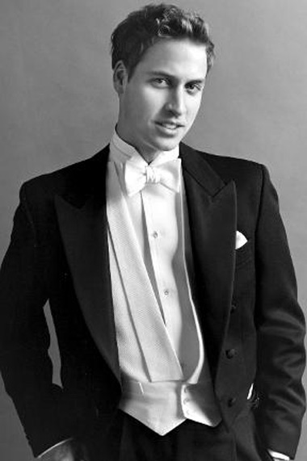
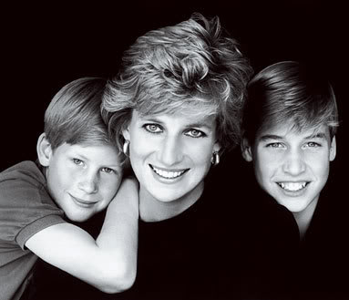

Slide 11
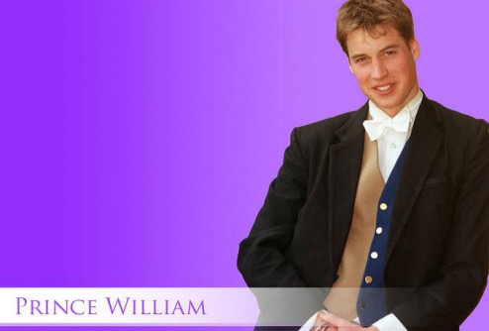
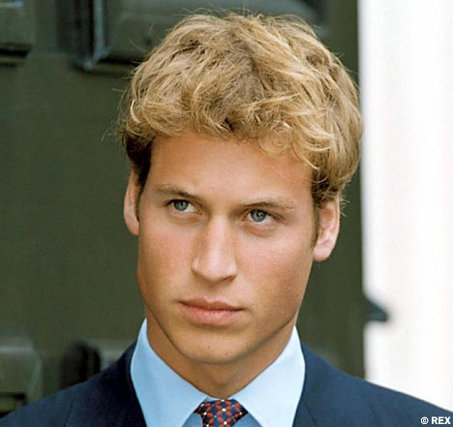
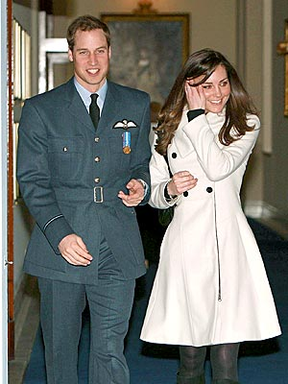
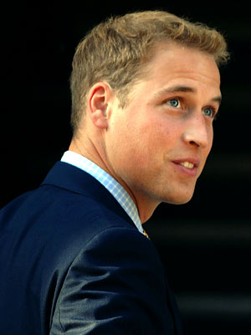

Slide 12
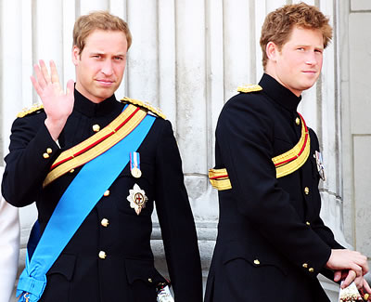
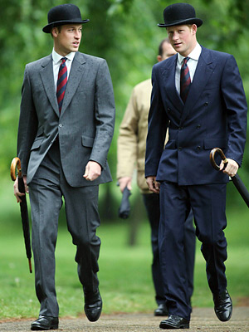
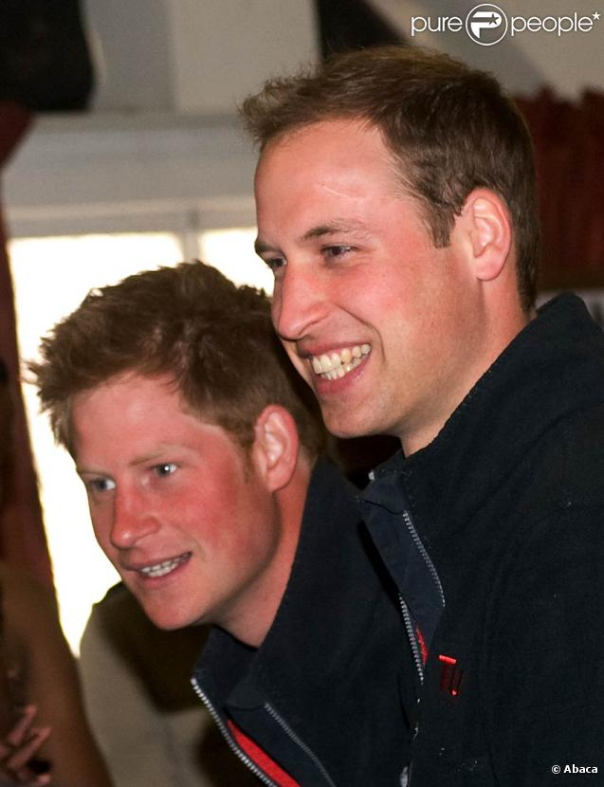
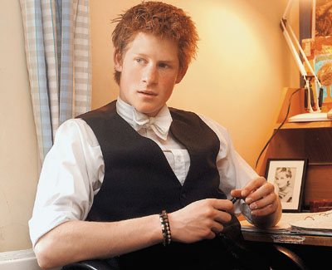

Slide 13
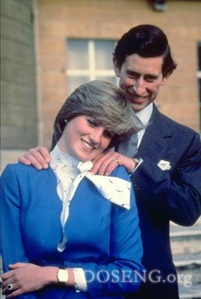
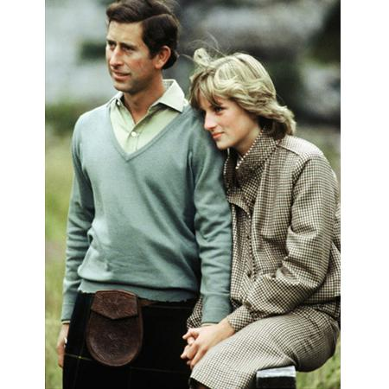
In recent years he has become outspoken on such controversial topics as modern architecture, violence in films and on television, and the standard of English teaching in schools. His wife Diana, Princess of Wales (often called in mass media Princess Di), won the affection of many people by her modesty, shyness and beauty. Unfortunately, she died in a car accident in August, 1997.

Slide 14
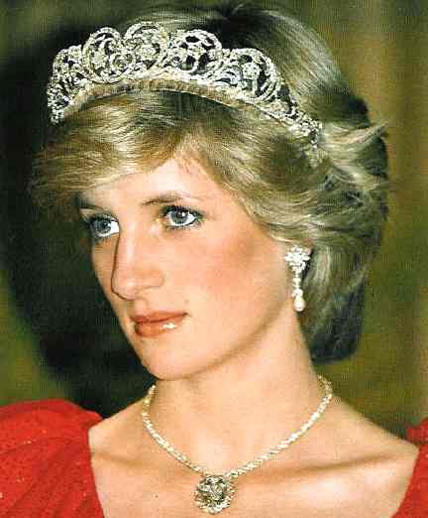
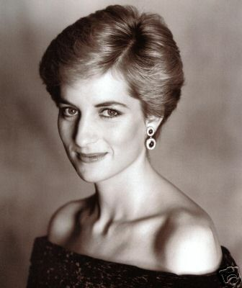
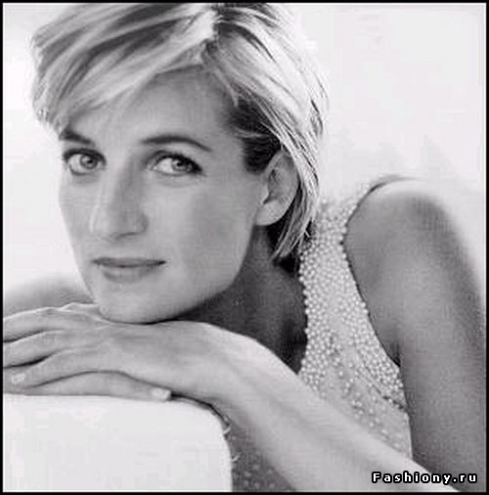
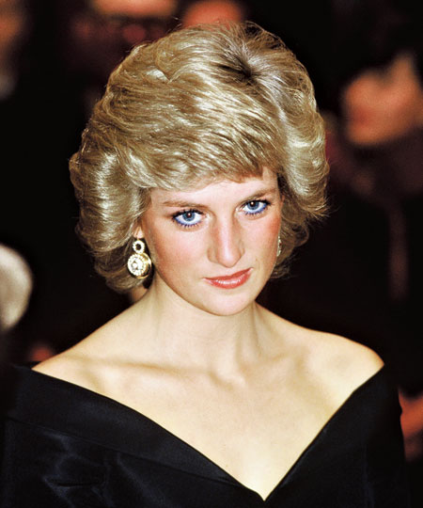
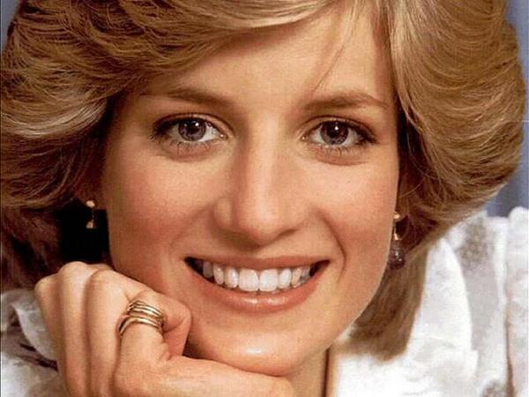

Slide 15
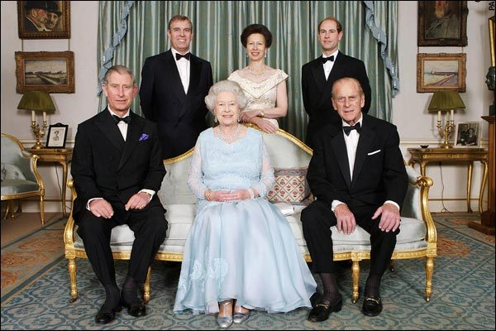
The Queen's other children are Princess Anne (born in 1950), Prince Andrew (born in 1960) and Prince Edward (born in 1964).

Slide 16
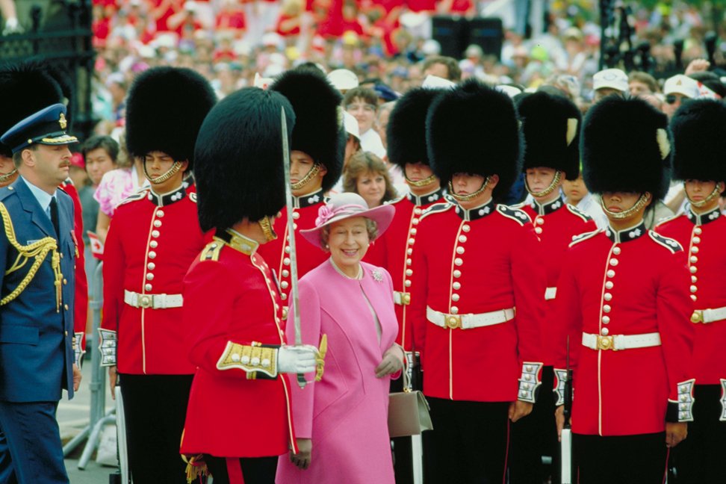
The Queen is widely known for her interest in horses and horse-racing. She is now president of the Save the Children Fund, and chancellor of the University of London.

Slide 17
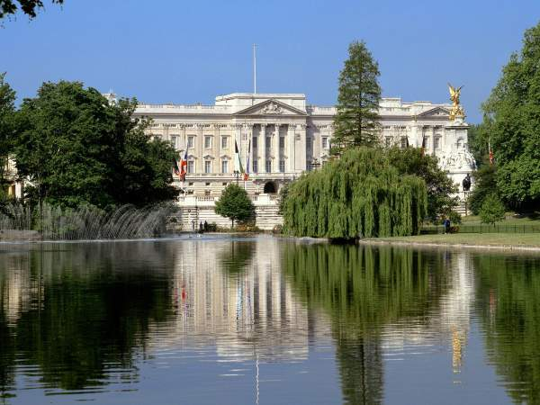
Prince Andrew, Duke of York, served as a helicopter pilot in the Royal Navy. In 1986 he married Miss Sarah Ferguson (Fergie, for short) and has two daughters.
Prince Edward is keen on the theatre. This interest began while he was at university and he is now working for a theatrical company.

Slide 18
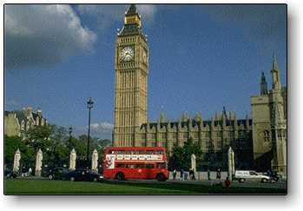
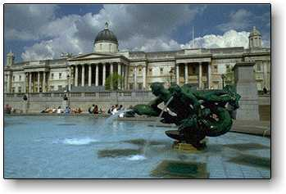
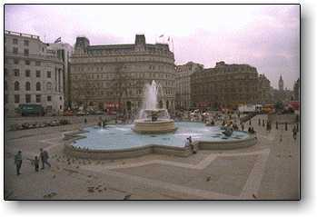
The Queen Mother, the widow of the late King George VI, celebrated her one hundred birthday in 2000 and died in 2002. The Queen's only sister, Princess Margaret, Countess of Snowdon, is well-known for her charity work.

