Slide 1
Биография успешного человека
Выполнил учитель английского языка Тулисова Н.В.

Slide 2
Цели и задачи урока:
Цель урока: расширение кругозора учащихся о стране изучаемого языка
а) формирование и развитие интеллектуальных способностей учащихся;
б) совершенствование умения и навыков практического владения английским языком.
Образовательные задачи:
Развивать умения в составлении предложений по прослушанному;
Развивать способности к догадке;
Практиковать внимание и память.
Воспитательные задачи:
Воспитывать уважение к выдающимся личностям различных государств;
Воспитывать интерес и уважение к истории и культуре государств;
Воспитывать гордость к гражданам собственной страны.
Лингвистические задачи:
Формировать интерес обучающихся к стране изучаемого языка;
Познакомить с различными историческими и культурными данными.
Оборудование урока: магнитофон с диском, интерактивная доска, мультимедийный проектор, презентации, раздаточный материал.

Slide 3
Фонетическая отработка лексики
{I} Bill, Dickens, Christie, Bronte, Lincoln
{I:} Neil, Stephen, Louis, Spielberg
{ЗE} Chaplin, Streisand, Agatha, Graham
{а:} Charlotte, Barbara, Charles, Armstrong, Charlie
{ei} Chase, Gates, Abraham, Streisand, James

Slide 4
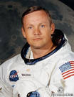
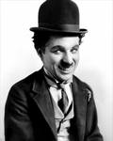
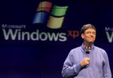
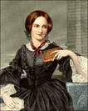
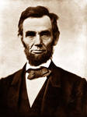
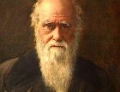
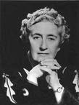
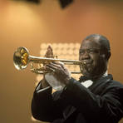
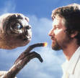
Match the names and surnames of some famous persons and tell me who they are

Slide 5
Associations
literature
space
science
cinema
sport
history
talented businessman

Slide 6
Проверка домашнего задания
Read the story about your classmate.
You mustn’t call his|her name.
You must use as many adjectives as possible.
All the rest try to guess who is described?

Slide 7
Work in pairs (Ex 9 p 95)
I believe that
It seems to me that a successful person
should…
In my opinion
As I see it
For example: I believe that a successful person should be ambitious

Slide 8
Group work (Ex 10 p 96)
Traits of character you
should develop (be more…)
Traits of character you
should get rid of (be less…)

Slide 9
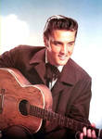
Listening

Slide 10
Listening
He was called the “King of … ”
He was born in … in …
When he was … his family moved to …
He recorded his first song in …
He sold …. of records.
He appeared in … films.
He was the most popular … of his day.
He died in …
His … are popular today.
1. Rock’ n’ roll
2. Mississippi, 1935
3. 13, Memphis
4. 1954
5. millions
6. 33
7. Performer
8. 1977
9. songs

Slide 11
Физминутка
Remember the adjectives connected with the topic “Who is a successful person?”
Call one word after another by chain.
If you don’t remember anything, you must sit down.
Don’t repeat the words.
The winner is a person who will stand alone. He will get “a five”.

Slide 12
Отработка информации
Gather the information about Walt Disney, Mother Teresa and Slava Polunin.
Write it on the blackboard.

Slide 13
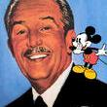
Walt Disney

Slide 14
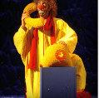
Slava Polunin

Slide 15
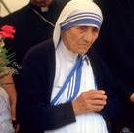
Mother Teresa

Slide 16
Чтение текста с полным пониманием
Do you think Walt Disney, Mother Teresa and Slava Polunin were successful? Why?
Is there anything in the text that surprised you?
Did you learn anything from the text? What?

Slide 17
Учебный диалог
Ex 12 p 97. Write down 5 comprehension questions on each text.

Slide 18
подведение итогов урока
What new names did you hear about?
Why were they successful?
What were their mottoes?
Are you a successful person?
What are your ambitions now?
Will your classmates be successful in future and why?
Would you like next generation to read about your biography in English textbooks?

Slide 19
HOMEWORK
Ex 13 p 97. Tell your classmates about a successful person whom you respect. He\she can be a world famous person or just your relative or neighbour. Use the list of words and phrases you’ve made in Ex 9 p 95.

