Slide 1
SPORT IN MY LIFE

Slide 2
“Winners never quit;
quitters never win”
Победители никогда
не сдаются;
трусы никогда
не побеждают.

Slide 3
1. The Olympic Games 2. Different Kinds of Sport 3. Sport Quiz 4. Max’s Story 5. Sport in My Life 6. Postcard to a pen-friend

Slide 4
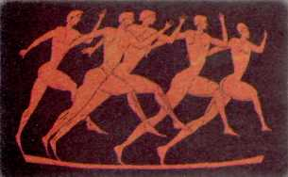
According to historic records, the first Olympic Games were held in 776B.C. in Olympia, Greece. The Games were held every four years in honour of the
king of the gods,
Zeus.

Slide 5
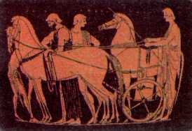
For 1000 years the Games were at regular intervals of four years. Special messengers were sent out in every direction to announce the beginning of the Games and to signal an end of all wars until after the Games.
In A.D. 393,
the Byzantine Emperor
Theodosius I banned the
Games.

Slide 6
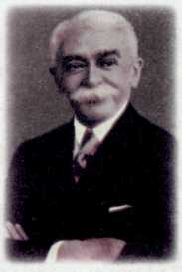
In 1894 Baron Pierre de Coubertin
wrote a letter to the athletic organizations
of every country. He became a founder of
the modern Olympic movement.
Two years later the first
modern Olympic Games
took place in Greece.

Slide 7
The modern Olympic Games are still held
every fourth year, but were interrupted in
1916, 1940 and1944 by World Wars.
Russia joined the Olympic Games in
1952. Since then Russia has won many
gold, silver and bronze medals. In 1980
Moscow hosted the twenty-second summer
Olympic Games.

Slide 8
In 2014 Sochi will host
the twenty-second winter
Olympic Games.

Slide 9
Badminton Chess Athletics
Sky-diving Baseball Water polo
Basketball Canoeing Boxing
Sailing Cycling Equestrian
Football Gymnastics Handball
Ice hockey Cricket Judo
Golf Shooting Skiing
Swimming Slalom Tennis
Figure skating Curling Archery
Table tennis Taekwondo Volleyball
Bobsledding Wrestling Weightlifting

Slide 10
Match the sports in the left box and the items in the right box. (Some items connect with more than one sport.)
Tennis
Baseball
Basketball
Motor racing
Sky-diving
Cycling
Running
Golf
Ice hockey
Football
a bicycle boots
a bat trainers
a shirt skates
a car socks
a ball shorts
a club a helmet
a stick a racquet
a parachute
You
need
a ball
to play
football.

Slide 11
READING (sport quiz)

Slide 12
Check your answers
1 | 2 | 3 | 4 | 5 | 6
F | D | G | B | A | E
Chess | Basketball | Softball | Baseball | Football | Cricket
C – Table tennis is extra.

Slide 13
SPORT IN MY LIFE

Slide 14
What kind of sport do you play?
I play… / I do … / I like …
What qualities does this kind of sport require and develop?
I need…
It develops…
How does sport help you?
It helps me to …

Slide 15
We will go to Sochi! We’ll play a lot of sports! We’ll win a lot of medals! We’ll have a lot of joy!

Slide 16
LISTENING (Max’s story)

Slide 17
Hello. My name is Max. Not long ago I decided to lead healthy life. Let me tell you something about it. I don't get up very early but I begin my day with exercises. I go out and run about my house twenty times. Then I get hungry and have breakfast. I have a big glass of orange juice and then a cup of tea. At about one I have my lunch. At lunch I eat a lot of vegetables: cabbage, carrots, peas, fresh cucumbers, a piece of rye bread and a cup of tea without sugar, of course. Sometimes I don't have any lunch but it is not healthy at all. It happens when I am busy in the city. I don't like to have meals in public places. I sometimes have dinner in the evening when I'm hungry or when I have guests at home. I don't like to receive guests because we usually eat a lot of meat and fish and other heavy things which don't help you to be fit. My motto is "Eat to live, but not live to eat."

Slide 18
SPORT IN MY LIFE

Slide 19
Sport
School
Reading
Museums
Friends
Family
Theatre
Girl/boyfriend
Put numbers from 1 to 8 to rank the importance of the following things

Slide 20
HOME TASK (postcard to a pen-friend)

Slide 21
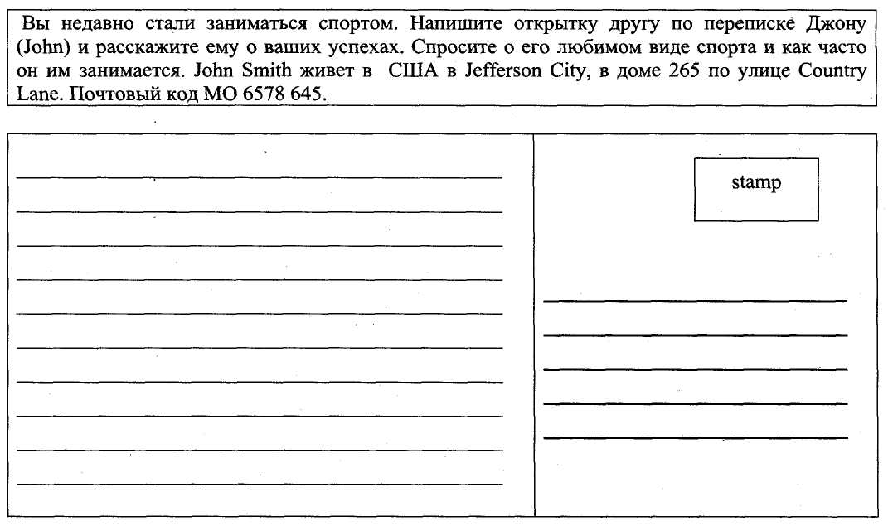

Slide 22
Goodbye Thank you for your work

