Slide 1
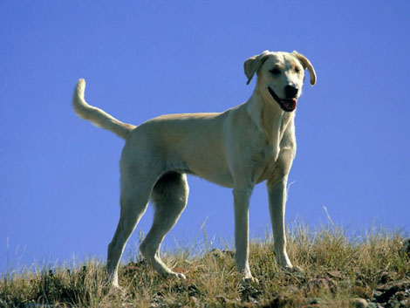
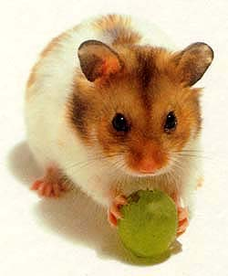
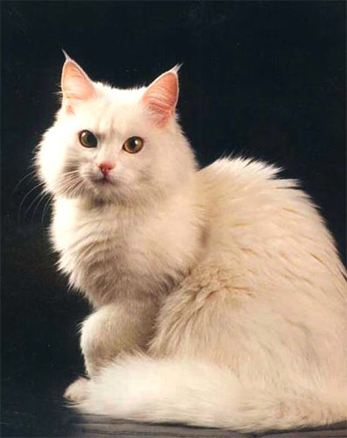
Animals are our friends, aren’t they?

Slide 2
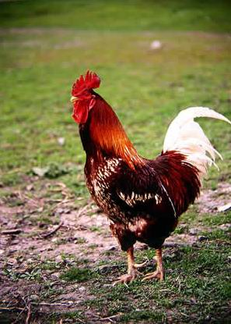
Birds
a beak
a tail
feathers
wings
claws

Slide 3
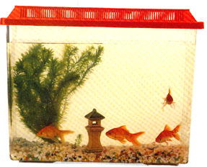
Fish
scales
fins

Slide 4
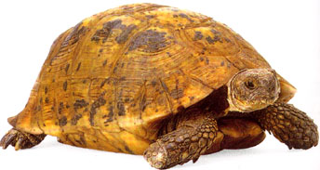
Reptiles
a shell

Slide 5
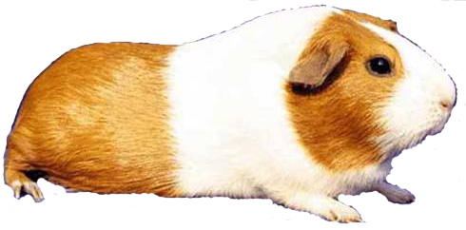
Mammals
fur

Slide 6
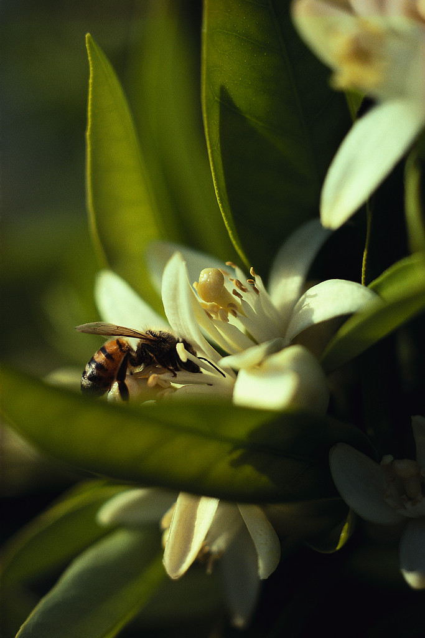
Insects
6 legs
wings

Slide 7
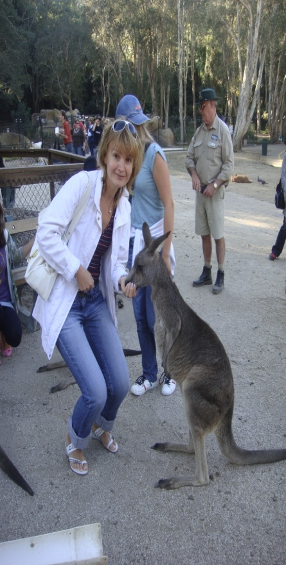
My favourite animal
My favourite animal is a kangaroo.
It lives in Australia.
It has got a big body, a small head,
two ears and a long tail.
It has got fur on its body, too. It has got a pocket to carry babies!
It can run and jump very fast!
I like this animal because it is funny but very strong.

