Slide 1
SCHOOL № 10
Petropavlovsk-Kamchatsky

Slide 2
The Best School in the World

Slide 3
History of our school
Our school was founded in 1961. It is one of the oldest schools in Kamchatka.
It is not large, but it is very beautiful. Light and cosy.

Slide 4
Our timetable
We study in the 9th form.
Usually we have six lessons a day.
They are Russian, Literature, English, Maths, History, Geography, PE, IT and others.

Slide 5
Our classrooms
There are 17 classrooms in our school.
We are ready to study day and night!

Slide 6
Sport life
Our gym is not large, but we like to spend our free time there.
We are very sporty.
We like PE!
We usually take part in different competitions.

Slide 7
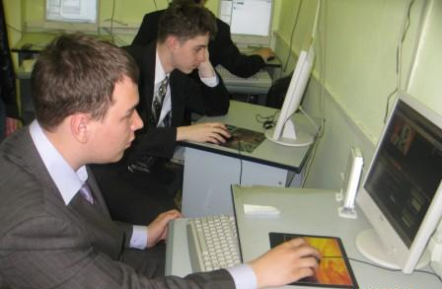
We have modern equipment to study

Slide 8
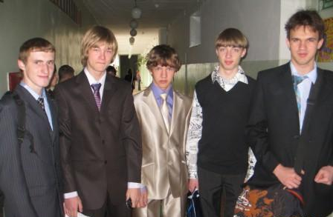
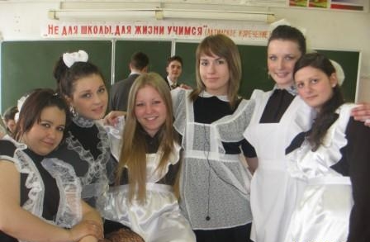
School uniform
We usually don’t have uniform.
But we are ready to dress up.

Slide 9
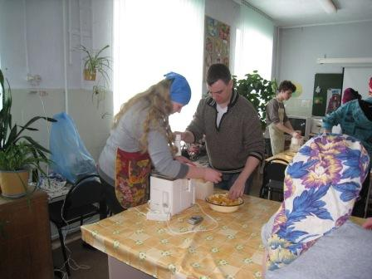
Sometimes we have unusual lessons

Slide 10
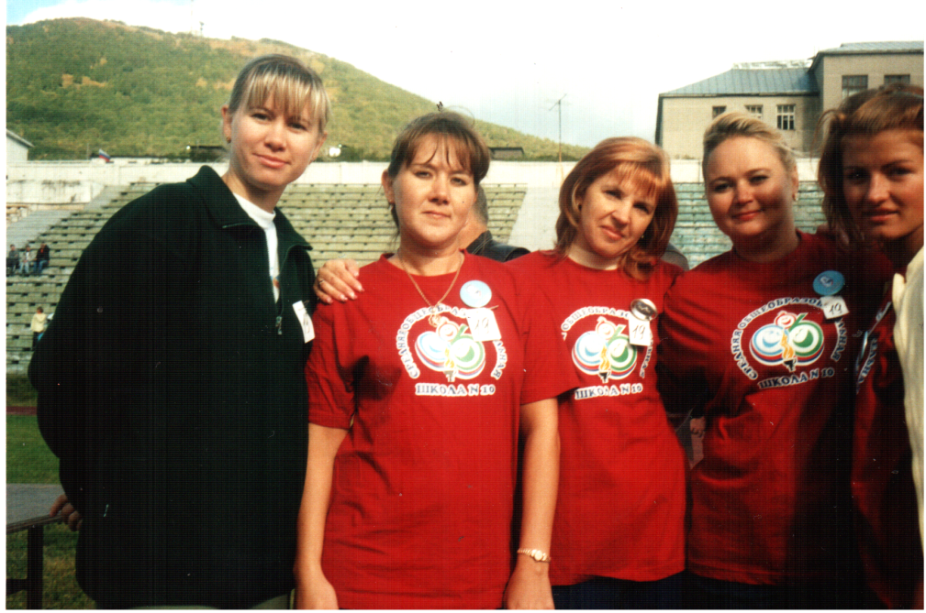
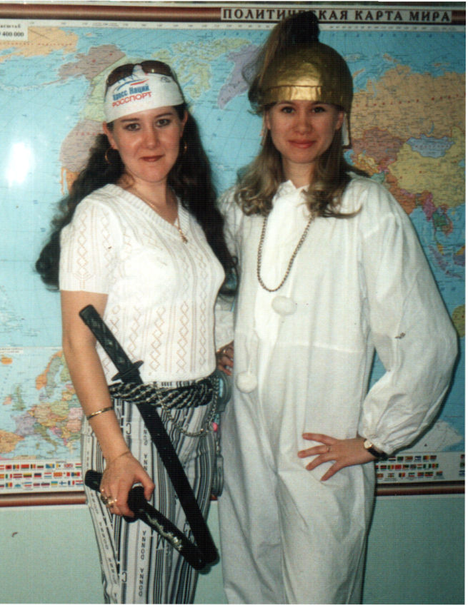
Our teachers are nice, sporty and creative

Slide 11
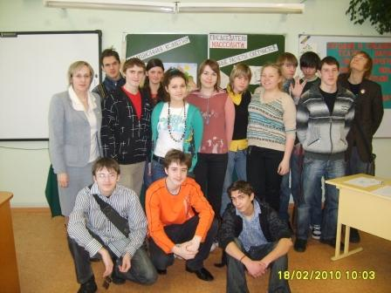
Welcome to our school!

