Slide 1

Developing writing skills of learners of the primary, secondary and higher stages coinciding demands and specification of the writing part of the United State Exam and the State Final Certification in the process of teaching English.
Norilsk, 2010

Slide 2
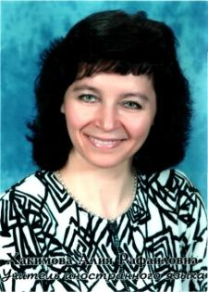

THE AUTHOR
OF THE PROJECT:
Khakimova Alla
English Teacher
Grammar School № 42
29 years
102-625-215

Slide 3
Analysis situation
Not all learners have an opportunity and suitable conditions to fulfill home tasks developing writing skills
On account of different learners’ language levels not all of them cope with tasks aiming at developing writing skills

Slide 4
Course books that we work with include insufficient amount of exercises aiming at developing writing skills. In some cases incorrect tasks wording do not assist effective developing of skills and do not correspond principles of teaching writing skills. They consist of similar boring types of exercises which can help neither a student nor a teacher. And that’s why the teacher has to use different sources and work out additional activities which help them to increase students’ motivation for developing student’s writing skills.

Slide 5
Expected introduction of obligatory exam for Final English Test of graduates from the secondary and higher stages makes urgent to pay special attention to developing creative writing skills
In undivided classes with more than 24 learners’ it is difficult to give feedback to every student because of the lack of time. Additional writing tasks help to involve great number of students and evaluate every of them consequently solve this problem.

Slide 6
Problem
Insufficient amount of tasks developing writing skills containing in course books of different authors makes it urgent to work out, select and supply the series of exercises which will help to improve the situation for successful passing of the USE and the SFC

Slide 7
Reasons
Incorrect and not clear tasks in the course books
Lack of writing tasks which should develop writing skill
National authors’ course-books for preparation to the Russian State Exam are not effective
Inconsistency of tasks in the course book to the Russian State Standards

Slide 8
Project idea
To work out of the series of tasks aiming at developing learners’ writing skills corresponding demands of size the United State Exam and the State Final Certification.

Slide 9
The aim of the project
To improve conditions for successful learner’s acquiring writing skills and successful passing through the writing part of the United State Exam and the State Final Certification at the expense of working out the series of tasks.

Slide 10
Objectives
To analyze own teaching situation
To analyze national course-books and teaching aids preparing to the United State Exam and the State Final Certificate.
To analyze methodological literature where new tendencies, principles and approaches of developing writing skills are reflected
To work out resourced materials meeting demands of the National Standards in writing.
(a booklet or a CD disk)

Slide 11
Literary review
Jeremy Harmer
teaching skills
communication skills and language proficiency
pedagogical reasoning skills
decision making and contextual knowledge
subject matter knowledge

Slide 12
Sara Cushing Weigle
a comprehensive overview of the research
scoring procedures for writing tests
practical advice for designing tasks
consideration of the effects of technology on writing tests

Slide 13
Sally Burgess and Katie Head
containing a broad collection of articles
provides issues and practices in the teaching of English
provides an overview of current approaches

Slide 14
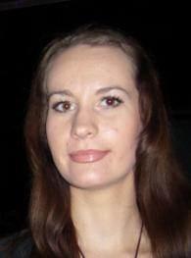



Volokitina Ekaterina:
“Enjoy English 2” by Biboletova
“Enjoy English 3” by Biboletova
“Enjoy English 4” by Biboletova

Slide 15
Analysis of book “Enjoy English” by Biboletova M.Z.
Unit 1: Speaking about seasons and the weather

Slide 16
Unit 2: Enjoying your home

Slide 17
Unit 3: Being happy in the country and in the city

Slide 18
Unit 4: Telling stories

Slide 19
Outcome
As the result of our project we created a brochure or a CD with exercises which can be used on the lessons. The materials of the project can be used as a part of a writing lesson or as a part of the elective course.

Slide 20
Demonstration Sample:
Pre-writing tasks
Look at the pictures and choose one with your favourite season.
winter summer spring autumn

Slide 21

You have a list of hobbies. Choose from the list the most interesting and the most boring activities.
Ski
Toboggan
Play snowballs
Make a snowman
Play hockey
Skate
Jump
Swim
Dive
Run

Slide 22
You have a letter from our foreign friend, read it and complete the sentences.
“Brazil has a warm climate. The _______ isn’t very cold. In _______and _______it is warm, but rainy. In _________ it’s nearly always hot and sunny. Sometimes, it rains suddenly and then the sun comes out again! Summer is my ________ season. I love ________ and sunbathing at the beach. We have lots of fun there.”
Alex

Slide 23
While-writing task
Write a short paragraph about the different seasons in your country. Write which is your favourite season and what you like doing then. Use the text as a model.
“In Finland the weather is very cold in the winter and very warm in the summer. The winter is very long and there are days when the sun doesn’t appear at all. The summer is short, but it’s warm, because the days are so long. The sun shines all day and night for most of the summer. I like winter the best because there is always snow and I often go skiing”.
Alice.

Slide 24

Post-writing tasks
Change the letters with your classmate and read them. Let’s discuss in pairs what your favourite season is and what you like doing?
Let’s play a guessing game. Read your letter and let the rest guess what season it is.

Slide 25

Pre-writing tasks
Put missed letter in the words. Translate from English into Russian.
T_ll, sl_m, thi_, f_t, pu_p, fun_y, _ice, me_ry, ki_d, a_gry, ba_, s_d.

Slide 26

Number the activities from interesting to boring
Watch TV
Walk with friends
Read a book
Play computer game
Clean the room
Do homework
Go to school

Slide 27

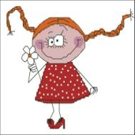
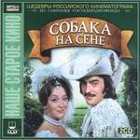

Look at the people shown on the pictures. How do they look like? Describe them.

Slide 28

Post writing task
Change the letters with your classmates and read them aloud. But don’t pronounce the name of your classmate. Try to guess who wrought this letter.

Slide 29
While-writing task
Write a letter to a pen-friend

Slide 30
Pre-writing tasks
Choose the right variant how you should congratulate each other on the Christmas.
Merry Christmas
Happy Day
Happy New Year
Good morning

Slide 31
What should you do to get presents on the Christmas? Choose the activities.
Go to school
Read, write and count
Clean the room
Miss the lessons
To do the washing up
Choose the right surname of Santa.
Little, Crause, Brown, Clause.

Slide 32
While- writing tasks
Fill in the gapes: Clause, brother, go to school, count, clean the room, Christmas, skates, Merry. 20 December
Dear Santa ______,
My name is Ann. I have got a ______ . His name is Ben. We like to ______ . We can read, write and______ . We help our mum. I ____________ . I like to skate. Ben likes to ride a bike.
We like ________ . We would like Christmas presents. I would like new _____ . Ben would like a new bike. Come and see us. We have got a nice Christmas tree, a lot of sweets, apples and oranges.
_____ Christmas.
With love,
Ann and Ben.

Slide 33
Post-writing tasks
Which present would you like to get on the Christmas? Let’s discuss in group of three.

Slide 34



“Enjoy English” by M. Z. Biboletova

Slide 35
Course Book Analysis
Lack of postcards, greetings, forms, quotations, reviews and resumes

Slide 36
Literary review
Ken Hyland
Three Approaches to Writing
Examining texts in various ways
Creating texts
Creating coherent texts

Slide 37
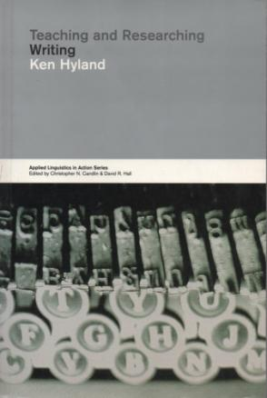
Process View of Writing
Problem-solving
Writing is:
Generative
Recursive
Collaborative
Developmental

Slide 38
Prewriting:
brainstorming
free writing
clustering
topic analysis
organizing
planning
Appreciation:
Evaluating the final product
publication
Writing:
drafting
unblocking techniques
Process Stages and Writing Techniques
Publication:
proofreading
polishing
Editing:
cutting deadwood
strengthening sentences
improving style
Rewriting:
identifying focus
identifying structure
revising on different levels
adapting writing for speaking

Slide 39
Writing in different genres
What is the purpose of this piece of writing?
Function
Who is it written for?
Context
How should I sound?
Attitude
What should this piece of writing look like?
Purpose

Slide 40
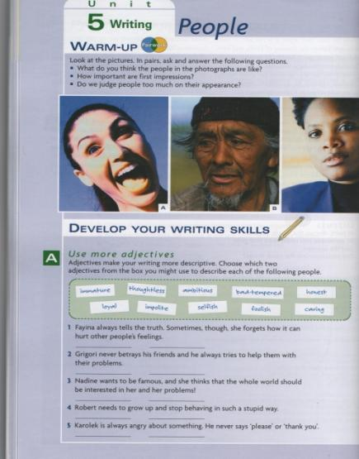
Demonstrative Task
Pre-writing activities include answering questions, filling in gaps,

Slide 41
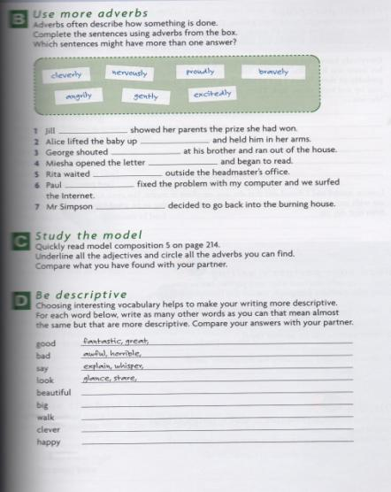
Demonstrative Task
underlining sentences in a model composition and finding synonyms.

Slide 42
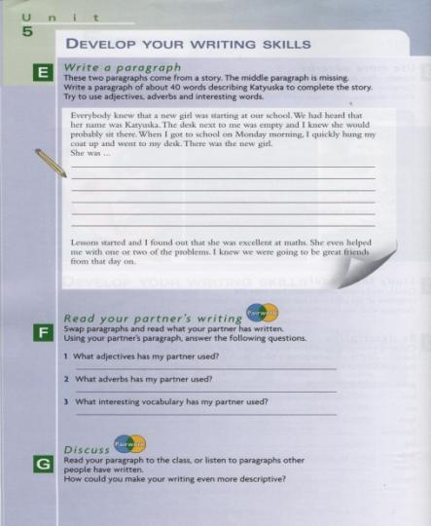
Demonstrative Task
While-writing activity is writing a missing paragraph into the text.
Post-writing activity is to read partner’s paragraph, answer questions and discuss paragraphs in class.

Slide 43
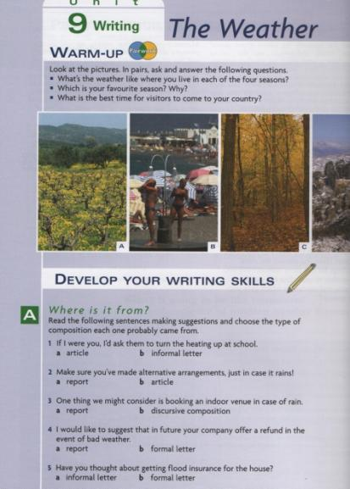
Demonstrative Task
Pre-writing activities include answering questions, choosing genre,

Slide 44
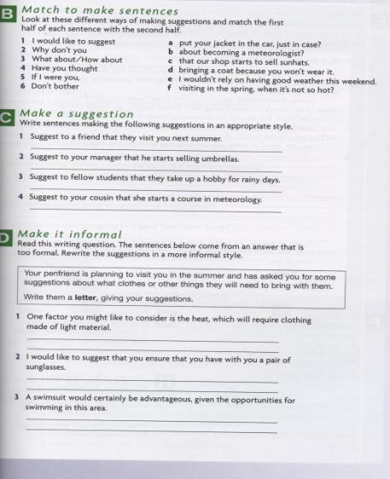
Demonstrative Task
matching to make sentences, making suggestions and inversions.

Slide 45
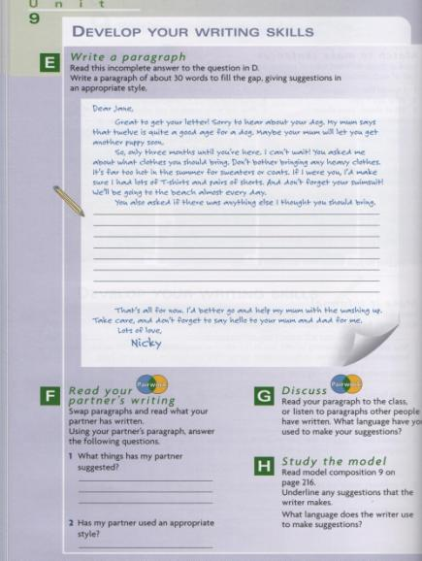
Demonstrative Task
While-writing activity is to write a short missing paragraph in the text. Post-writing activities are to read partner’s paragraph, answer questions and discuss it in class.

Slide 46



Writing skills according to New State Standards
WRITING :
Resume or СV;
Formal and informal transactional letters; letters-application
Filling in the forms; writing biographies;
Writing letters, articles, reports to magazines and newspapers;
Reviews on the film or on the book;
Writing stories and description of pictures, events from real life;
Writing instructions;
Writing report of competitions, exhibitions;
Writing compositions, essays ,…

Slide 47
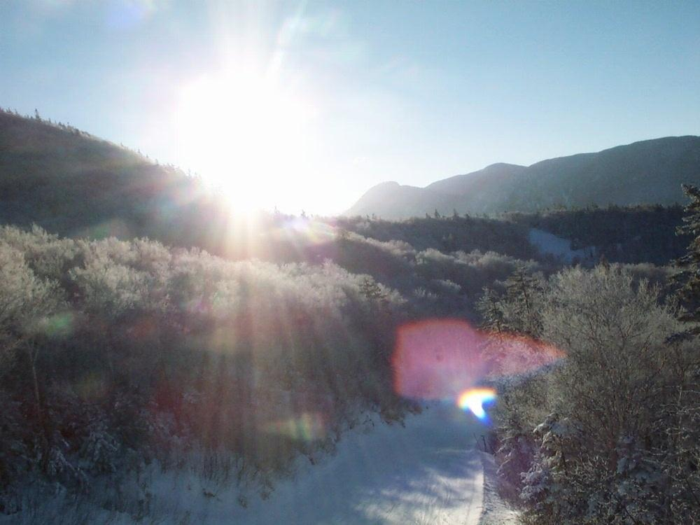
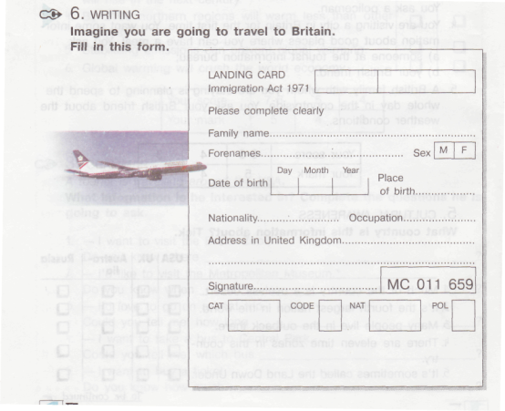
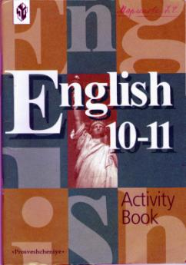

Sample of writing exercises from “Happy English ”by V.P.Kuzovlev
4. WRITING
Read the advertisement. Write to a firm (or shop) and ask for more
information about this electric device and its functions.

Slide 48


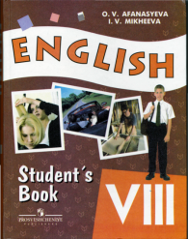
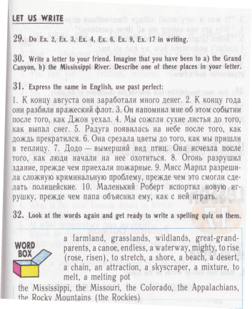
Sample of writing exercises from “English ”by I.N.Vereshchagina and O.V.Afanasyeva
Writing
Do these exercises in writing: 9, 10, 16, 18, 19, 20B, 28, 31, 33, 38, 45.
Put in prepositions where necessary.
1. Please help Michael, he is not coping ... the translation. 2. Can I ask you a question? What do you feel... learning two or three foreign languages at school? 3. Tanya always makes notes ... new useful words that she finds in books. 4. How many new words can you learn ... a time? 5. If you don't know what book to choose in the library you can always ask ... information. 6. When we talk to Englishmen or Americans we practise ... our English. 7. I never have a problem ... memorizing poems but I know that a lot ... students find it hard. 8. Are you happy... the way you are taught English? 9. The text was so difficult that I couldn't get the idea ... it, though I read it three times. 10. You can use an old idiom and sound funny if you don't keep yourself... up-to-date. 11. I must say I was quite disappointed ... the film we saw yesterday. 12. My parents will be disappointed ... me if I am late.
66. Complete the sentences.
1. What do you feel about
going... playing... doing... changing using ...
2. I'm afraid I have a problem
learning ... understanding. reading... memorizing... finding... with
project work
Prepare some material about your school for the Open House Day. Use photographs and pictures, make it look as attractive as possible. Work in small groups.

Slide 49

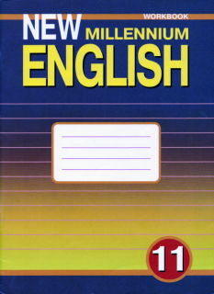


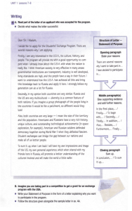
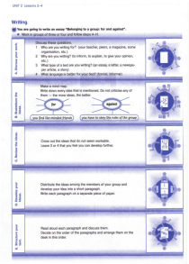
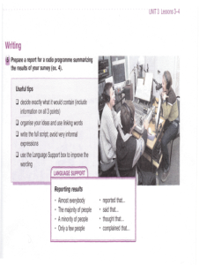
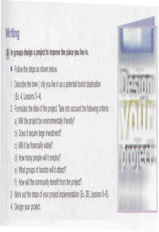
Sample of writing exercises from “New Millennium English ”by O.L.Grosa

Slide 50

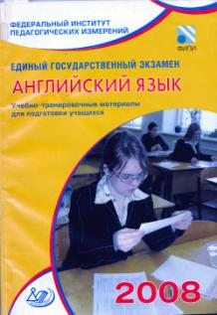


Sample of writing exercises from additional aids for preparing to exam for 8,9,11 grades.
You have 20 minutes to do this task.
You have received a letter from your American pen friend Larry who writes:
... I have to think about pocket money all the time. My parents try to make me earn it by doing the housework. They try to make me save up and then buy some big thing. But I need pocket money for the cinema and ice-cream and other treats like that. Do you have to 'earn' your pocket money in any way? Or do your par­ents just give it to you? What do you spend your pocket money on? What do your parents think of the way you spend it?
Write back soon,
Larry
Write back to Larry answering his questions. Write 100 -140 words. Remember the rules of letter writing.
You have 40 minutes to do this task. Comment on the following statement.
Some parents think that having a computer at home will help their children to get a better education, others are afraid that children will only play videogames.
What can you say for and against having a computer at home? Write 200 - 250 words.
Use the following plan
Introduction (State the problem).
Arguments "for".
Arguments "against".
Conclusion.

Slide 51



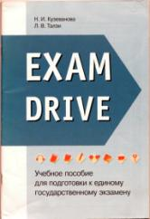

Sample of writing exercises from additional aids for preparing to exam for 9,11 grades.
You have 20 minutes to do this task.
You have received a letter from your English-speaking pen friend Bryan who writes
Write a letter to Bryan. In your letter answer his questions
ask 3 questions about organic food.
Write 100-140 words.
Remember the rules of letter writing.
You have 40 minutes to do this task. Comment on the following statement.
Some schools have a hostile attitude to their students carrying mo­bile phones. On the other hand, it is not safe sending kids out with­out mobiles. Besides, mobiles are considered to be a communication tool.
What is your opinion? Which point of view do you agree with?
Write 200-250 words.
Use the following plan:
make an introduction (state the problem)
express your personal opinion and give reasons for it
give arguments for the other point of view and explain why you don't agree with it
draw a conclusion

Slide 52
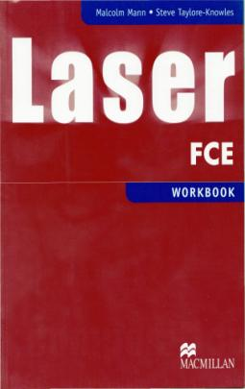
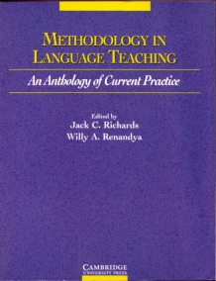
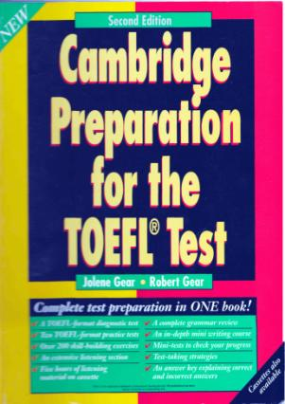
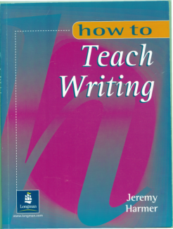
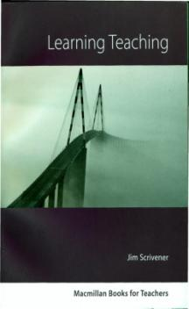
Methodology and course-books
of foreign authors

Slide 53
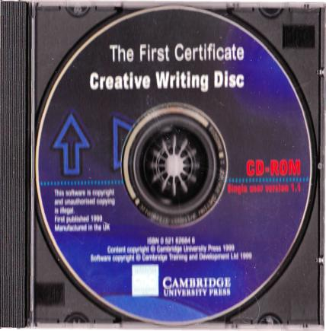

Modern and out- of date aids in teaching

Slide 54
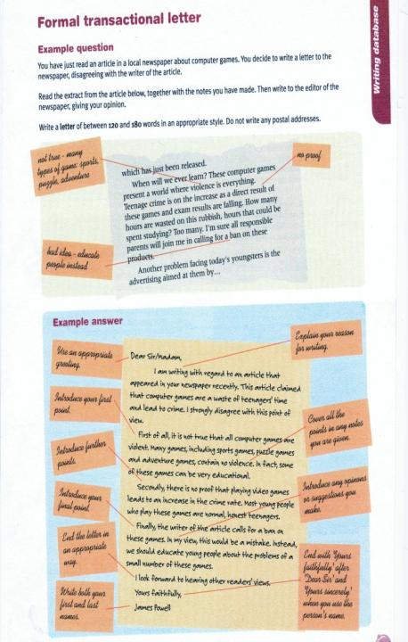
Language notes
Giving opinions and advice
You can use these words and expressions to give your balanced opinion:
On the whole, ...
Overall, ...
On balance, ...
You can use these words and expressions to contrast advantages and drawbacks:
On the other hand, ...
But ...
However, ...
You can use these expressions to give advice:
If I were you, I'd ...
You could do worse than ...
You should ...
Model answer
Dear ...
I have mixed feelings about my time in Colorado but overall I enjoyed myself. The landscape is superb and the children were nice. We spent a lot of time hiking in the mountains. That was wonderful.
On the other hand, the company was not brilliant. They did not pay for my flight until six months after I got back from the States. It was very hard work too. I only had five days off in the entire two months I was there and as you are living in the camp you never really get a break. The pay wasn't very good but I didn't have to spend much. The accommodation they provided was in old tents, but it was perfectly OK.
If you want to be in the mountains and you like being with children, then you could do worse. Make sure they pay for your air fare in advance.
Good luck with the application! Give me a ring if you want any more information.
Best wishes,

Slide 55
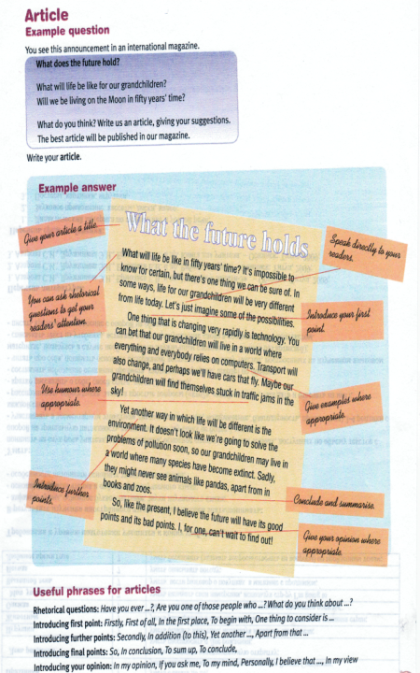
Writing plan
This is an article for people to read in the magazine, so the style should be neutral or informal, and as interesting (and amusing?) as possible. Remember that in order to write a winning article you need to make your description extra special, so it seems different from all the other articles the magazine will receive.
Don’t forget that your article must be between 120 and 180 words.
Describe the restaurant in general terms.
Describe the atmosphere, the food and drink and special features that you like.
Conclude by explaining why it is your favourite restaurant.
Language notes
In a restaurant: chef, waiter, waitress, owner, proprietor, customer, clientele, bill, service, service charge, tip, menu, wine list, expensive, cheap, popular, exclusive, glamorous, elegant, relaxing, cheerful, exotic, traditional
Model answer
My favourite restaurant
My favourite restaurant isn't expensive and glamorous but it is popular and always full of people. The position is wonderful, right by the sea near Sorrento in southern Italy. On summer evenings you can sit outside overlooking the harbour, and in winter the atmosphere in the restaurant is warm and cosy, with the tables lit by candlelight.
The food is freshly cooked and the dishes are simple. The menu has a choice of about five starters, main dishes and desserts - and they are all mouth-watering. Everything I have tried has been delicious - attractive, tasty and well-cooked. There is a good selection of wine and the waitresses are all polite, friendly and efficient. In such a place you would expect to pay a lot, but we are always pleasantly surprised by the bill.
I won't tell you exactly where it is, because I want to keep it special for me and my friends.

Slide 56
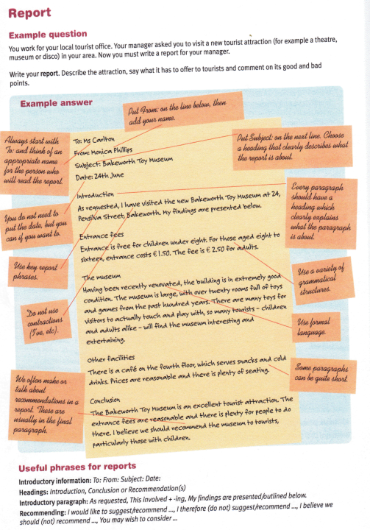
Writing plan
This is a report, so your information needs to be organised clearly and the style should be formal or neutral. You may want to use headings to show how the information is divided up. You don't need to say who the report is to and who it is from.
Don't forget that your report must be between 120 and 180 words.
Describe the traffic conditions in your area.
Describe any problems there are.
Make at least one suggestion for an improvement in the traffic conditions.
Conclude with your opinions.
Language notes
Report-writing
The aim of this report is ...
As requested, I have done some research into ...
I summarise below the principal facts as well as some recommendations.
Useful phrases
In relation to ...
In contrast with ...
As far as ... is concerned ...
In spite of ...
In an attempt to ...
I would recommend ...These recommendations would ...
The passive
Railway lines have been phased out.
The bus service must be improved.
Cycle lanes should be created.
Cars have been diverted from the centre.
Cities should be saved for people rather than cars.
Useful vocabulary
traffic: congested, jammed, blocked, stationary, at a standstill; motorway, dual carriageway, main road, minor road, side street, junction, traffic lights, roundabout, one-way system, speed limit, traffic jam, rush hour, peak times, pollution, exhaust fumes, commuters, cycle lanes, bus lanes, multi-storey car parks, park and ride, car sharing, pedestrian areas.

Slide 57
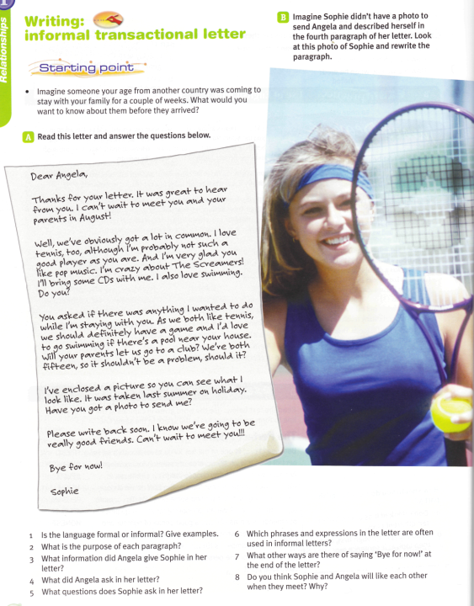
Pre – writing:
Brainstorming (imagine someone coming to your place for a holiday. What would you show him/her?
-Read the letter, answer the questions .
While – writing:
- Write your answer to the letter, giving replies to the questions.
Post – writing:
-Make sure that you have:
-Used formal language,
-Reffered to all the notes,
-Added some other relevant information,
At least four main paragraphs,
Reffered to the received letter

Slide 58
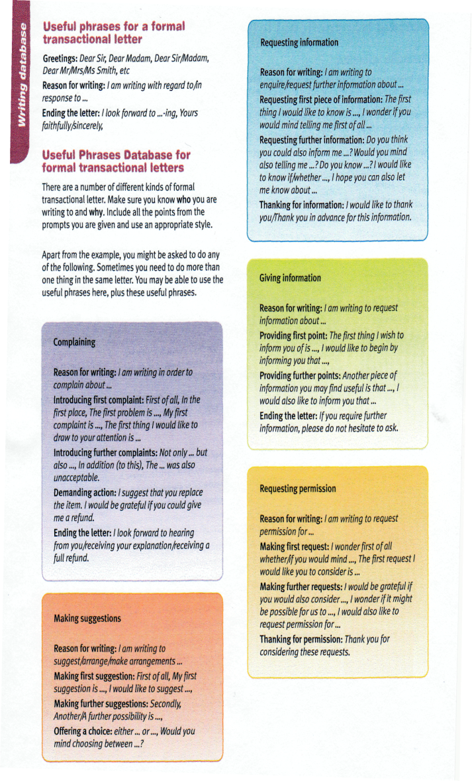

Slide 59
Assessment Criteria and Procedures
During the course students create an extensive body of writing from numerous informal writing assignments and 4-10 formal writing assignments. Near the end of the term, students select 3-5 pieces from this body of writing and collect them in a writing portfolio as a representative product of their writing ability.
The MINIMUM criteria for a favorable evaluation of a writing portfolio are listed below.

Slide 60

Content and Ideas
A relatively successful attempt is made to clarify and focus the topic.
Ideas are presented in a reasonably clear and considered manner.
An attempt is made to develop most of the ideas presented.
Ideas are at least occasionally original.
The writer is basically in control of the ideas presented.
Organization
An introduction and conclusion are recognizable.
At least some main ideas attempt to support the central topic.
At least some main ideas are supported with relevant details.
Transitions sometimes work effectively.
The essay sometimes moves along at an effective pace, even though at other times it may bog down or hurry.

Slide 61
Style
The language basically is clear and communicates ideas, even though it may not always be fresh or specific.
Sentences are functional.
The sentence structure usually conveys relationships between ideas.
Competent control of simple sentence structure is evident, though control of complex sentence structure may sometimes be deficient.
Attempts are made to vary sentence structure.
The tone is basically consistent and controlled.
Grammar
Paragraphing is basically proficient, though paragraphs may sometimes run together or begin in the wrong place.
Terminal punctuation is often correct, though internal punctuation may be faulty or missing altogether.
Spelling is usually correct, or reasonable phonetic, on common words.
Problems with usage are not severe enough to distort meaning.
Moderate editing would be required to polish the text.

Slide 62
Objectives
The student will be able to write reasonably well-focused, well-organized, and stylistically and grammatically proficient paragraphs.
The student will be able to write reasonably well-focused, well-organized, and stylistically and grammatically proficient 2-3 page expository essays.
The student will be able to write proficient paragraphs and essays in an in-class exam setting.
The student will be able to use the writing process to initiate ideas, to create and revise drafts, and ultimately to produce a relatively polished product.

Slide 63

Thank you for your attention!

