Slide 1
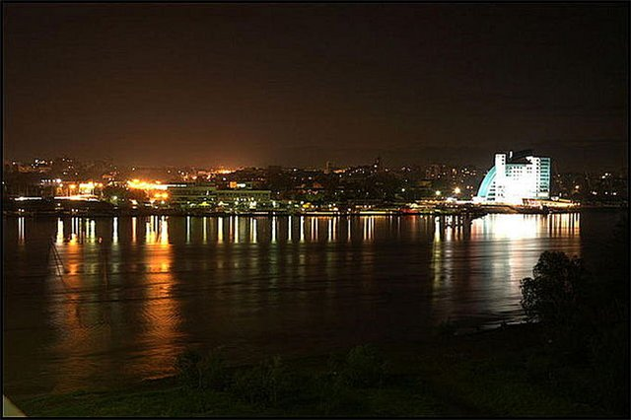
Reading
Visiting Barnaul
Writing

Slide 2
Label the paragraphs with these headings
Para1
Eating out
Introduction
Para2
Things to see / do
Main body
Para3
name, location
Para4
recommendation
Para 5
Edicational / facilities
Conclusion

Slide 3
Answer the questions:
1) Which city is described, and where is it situated?
2) What makes it an interesting city?
3) Which places does the article suggest tourists to visit?
4) What establishments make Barnaul a scientific and cultural centre?
5) Where can visitors try traditional meals?
6) What recommendation does the writer make?

Slide 4
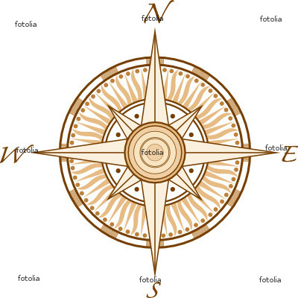
Study TIP
Phrases of Location
To describe the location of a place you can use the following phrases:
[Name] is / is situated / located
in the east/west/south/north of
in the south-east/north-west/etc of
on the east/west/etc coast of
in the centre/heart/middle of

Slide 5
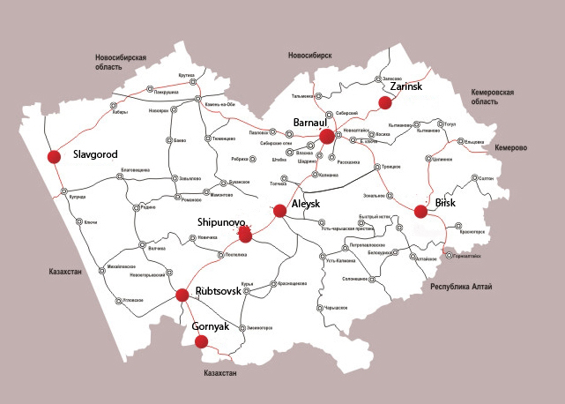
Look at the towns on the map and correct the statements

Slide 6
Study Tip
To make a description of a place more vivid, we can refer to our senses
Describe: - sights
- sounds
- smells

Slide 7
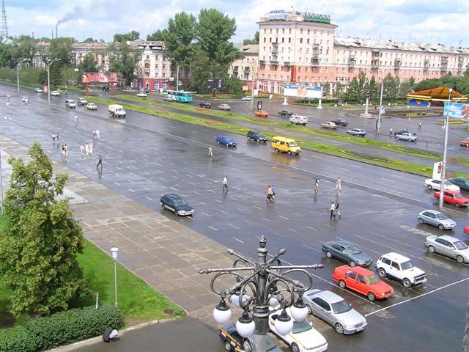
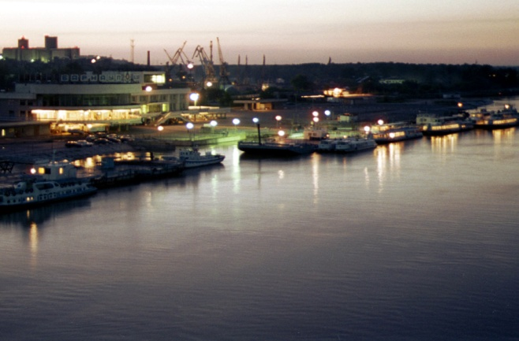
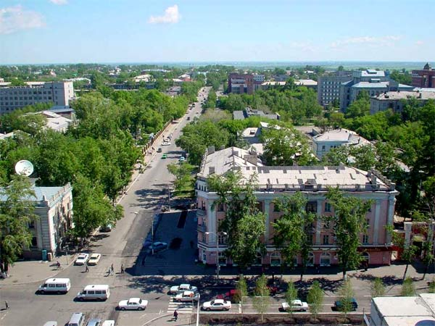
Match photos with words referring to
-sight
sound
smell
crowds or activity

Slide 8
A descriptive article about a place
PLAN
Introduction
Paragraph 1: name, location
↓↓
Main body
↓↓
Paragraph 2: sights to see, things to do
Paragraph 3: entertainment, eating out
↓↓
Conclusion
Paragraph 4: comments/recommendation

