Slide 2
Тема урока: The Birthday of Winnie-the-Pooh "День рождения Винни-Пуха"

Slide 3
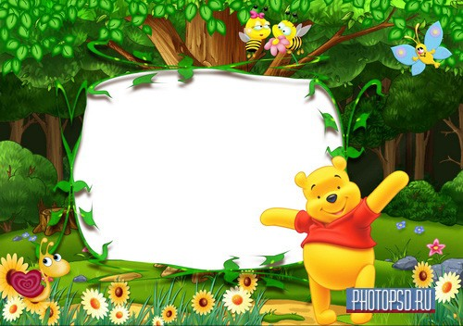
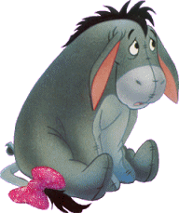
carrot,
porridge,
meat,
honey,
Piglet,
Tiger,
Rabbit,
Winnie-the-Pooh

Slide 4
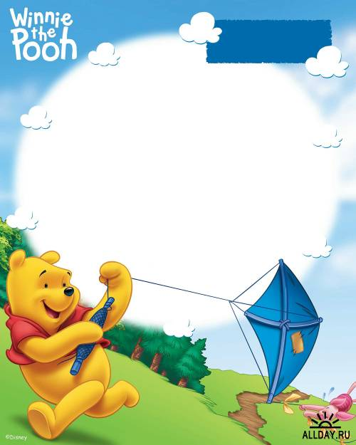
carrot
porridge
honey
meat
Rabbit likes _____.
Tiger likes______ .
Piglet likes ______.
Winnie-the-Pooh likes _____ .

Slide 5
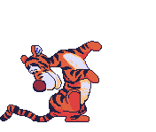
- Good-morning, Piglet!
- Good-morning, Winnie-the-Pooh!
- How are you?
- Fine, thanks and you?
- I'm well. Come in please.
- Thank you.

Slide 6
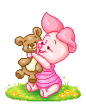
Clap, clap, clap your hands
Clap your hands together,
Stamp, stamp, stamp your feet
Stamp your feet together.

Slide 7
November 20, 2009
Dear Winnie - the - Pooh,
Happy birthday to you.
I wish you happiness, love and luck.
Best wishes, Kanga

Slide 8
Best wishes, the 5th grade.
Dear Winnie - the - Pooh,
November 20, 2009
We wish you happiness and health.
Happy birthday to you.

Slide 9
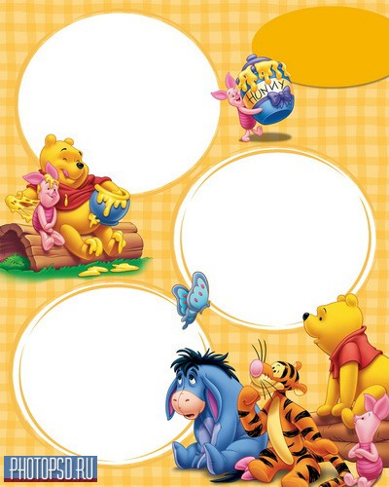
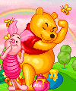
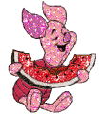
It is small and grey.
It can jump and run.
It can’t swim.
It likes milk and fish.
It is a tiger.
It is a rabbit.
It is a cat.
It is a cow.
It is a dog.
It has long ears.
It can run and jump.
It likes carrots and cabbage.
It is very big and strong.
It lives in the forest.
It has big teeth.
It likes meat.

Slide 10
