Slide 1
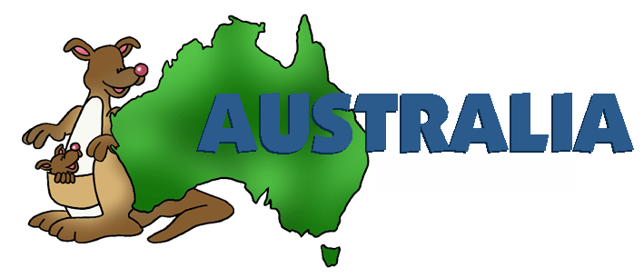
Welcome to Australia

Slide 2
Australia is the world's largest island and the smallest continent. It is situated in the Southern Hemisphere comprising the mainland of the Australian continent, the island of Tasmania and numerous smaller islands in the Indian and Pacific Oceans.

Slide 3
Australia , officially the Commonwealth of Australia, consists of 6 states and 2 territories: Australian Capital Territory, New South Wales, Northern Territory, Queensland, South Australia, Tasmania, Victoria, Western Australia. It is situated in the southwestern of the Pacific Ocean. The area of this country is 7000000 square kilometers.

Slide 4
On 1 January 1901, the six colonies became a federation and the Commonwealth of Australia was formed. The Commonwealth of Australia is a self-government federal state. Officially the chief of state is Queen of England ELIZABETH II; represented by Governor General, the head of government is Prime Minister. The language of Australia is English. The official currency is Australian dollar. The population of the country is about 22 million.

Slide 5
The capital of the country is Canberra, this city became a capital in 1927. The population of Canberra is about 300 000 people.

Slide 6
There are no industrial plants in the town. Federal government works in Canberra. It is an international city, full of diplomats and government offices.
The House of Parliament
The National Library in Canberra

Slide 7
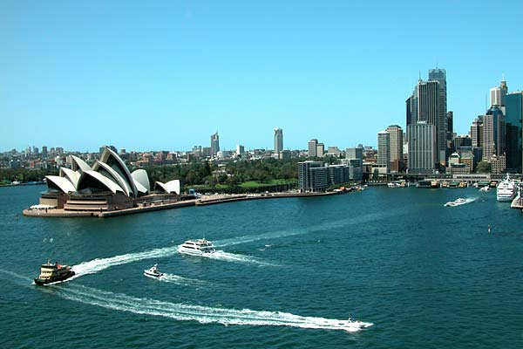
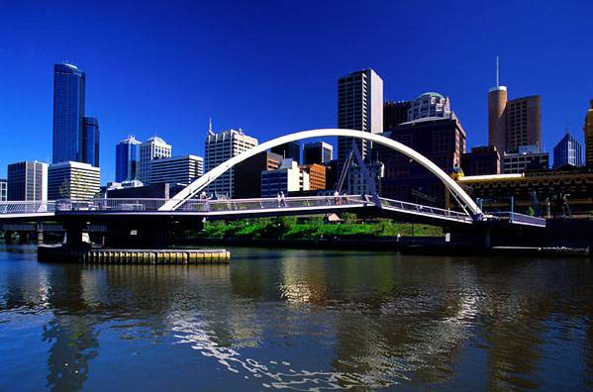
There are two big industrial cities in Australia: Sydney and Melbourne

Slide 8
Sydney
Opera House in Sydney
Royal Botanic Gardens

Slide 9
Melbourne
Captain Cook’s cottage,
Fitzroy Gardens
Royal Exhibition - East Buildings

Slide 10
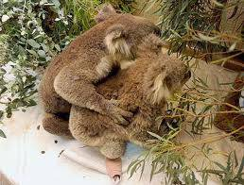
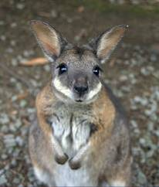
The animals’ world of Australia

Slide 11
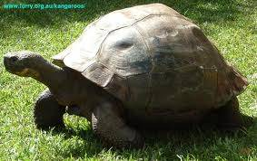
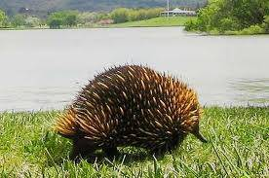
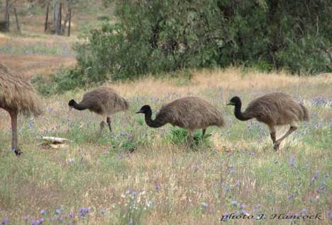
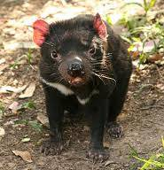
The animals’ world of Australia

Slide 12
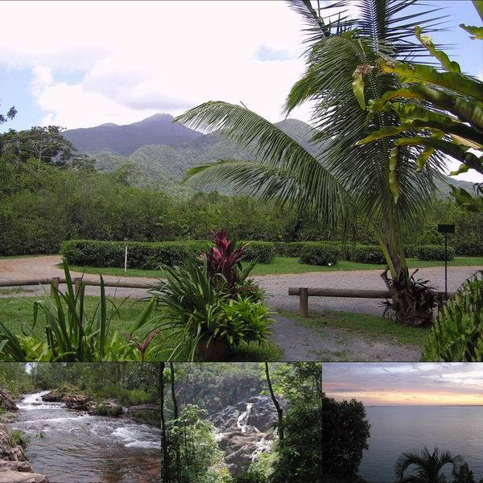
Australian nature

Slide 13
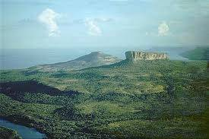
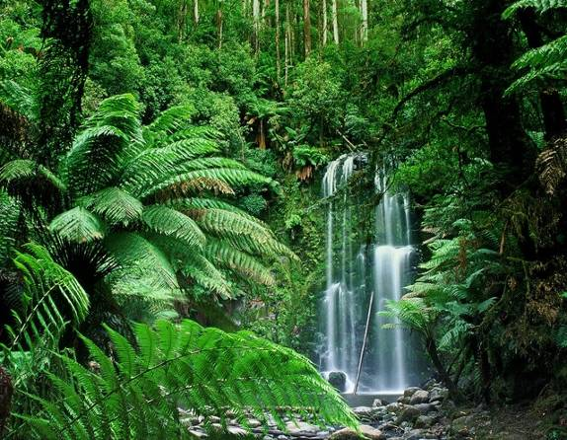
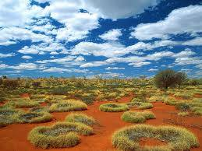
Australian nature

Slide 14
The Geographical names:
Australia/o'streilìə/, the Commonwealth of Australia,
Australian, Hemisphere /'hemì¸sfìə/,
Tasmania /tæs'mənìə/,
the Indian /'ìndìən/ and Pacific/pæ'sìfìk/ Oceans,
The Dutch/'dΛt∫/,
Canberra /'kænbərə/, Sydney /'sìdnì/,
Melbourne /'melbən/, Adelaide /æ'dələìd/,
Perth /'pəө/, Brisbane /'brìzbən/,
the Murray /'mΛreì/, the Murrumbidgee /mΛrΛm'bìdјì/
and the Darling /'da:lìŋ/ rivers.

Slide 15
Read the sentences and say if they are true or false
Australia is situated in Asia. It’s washed by the Arctic and the Atlantic oceans.
The Urals are in Australia. They are the highest mountains.
The Murray is the longest Australian river.
Australia is an unusual country. It has different climatic regions, from warm to tropical and subtropical. January is the hottest month in the country.
Australia is the country of sports. Ice-hockey is the national sport game in Australia, because ice-hockey was born there.
Australia is famous for unusual birds, animals, plants, trees, flowers. A kangaroo is a symbol of the country.
Green, white and blue are the colors of the Australian flag
People from France were the first settlers in Australia.
Australia is the smallest continent. It is the 6th in size after Russia, Canada, China, the USA and Brazil.
For the first time Australia was discovered by Dutch travelers. But they didn’t like this land and came back to Europe. Captain Cook hosted the British flag in 1770.

Slide 16
Look at the examples and make the sentences with these words
Melbourne is the second biggest city in Australia.
Melbourne is Australia’s second biggest city.
Western Australia/ big/ state of the country
Queensland/ large/ Australia’s / state/ two
South Australia/ four/ state/ large/ in Australia
The Murray/ river/ Australia’s/ long
The Darling/ in Australia/ long/ three/ river
Mount Townsend/ mountain/ Australia’s/ high/ two
Perth/ five/ in Australia/ city/ big

