Slide 1
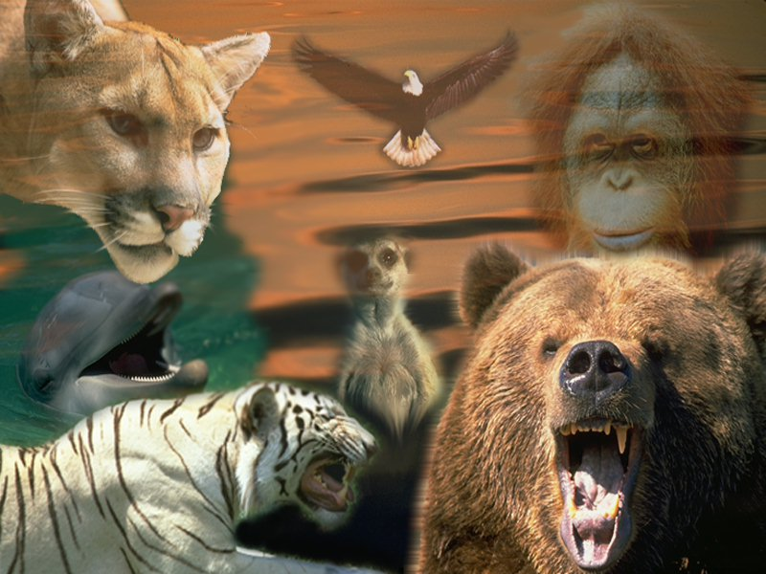
WE GO to the ZOO

Slide 2
Remember :
Protect wildlife, plants and trees.
Do not kill animals.
We must save wild animals.
Help to keep water clean.
ALL PETS NEED LOVE AND CARE !

Slide 3
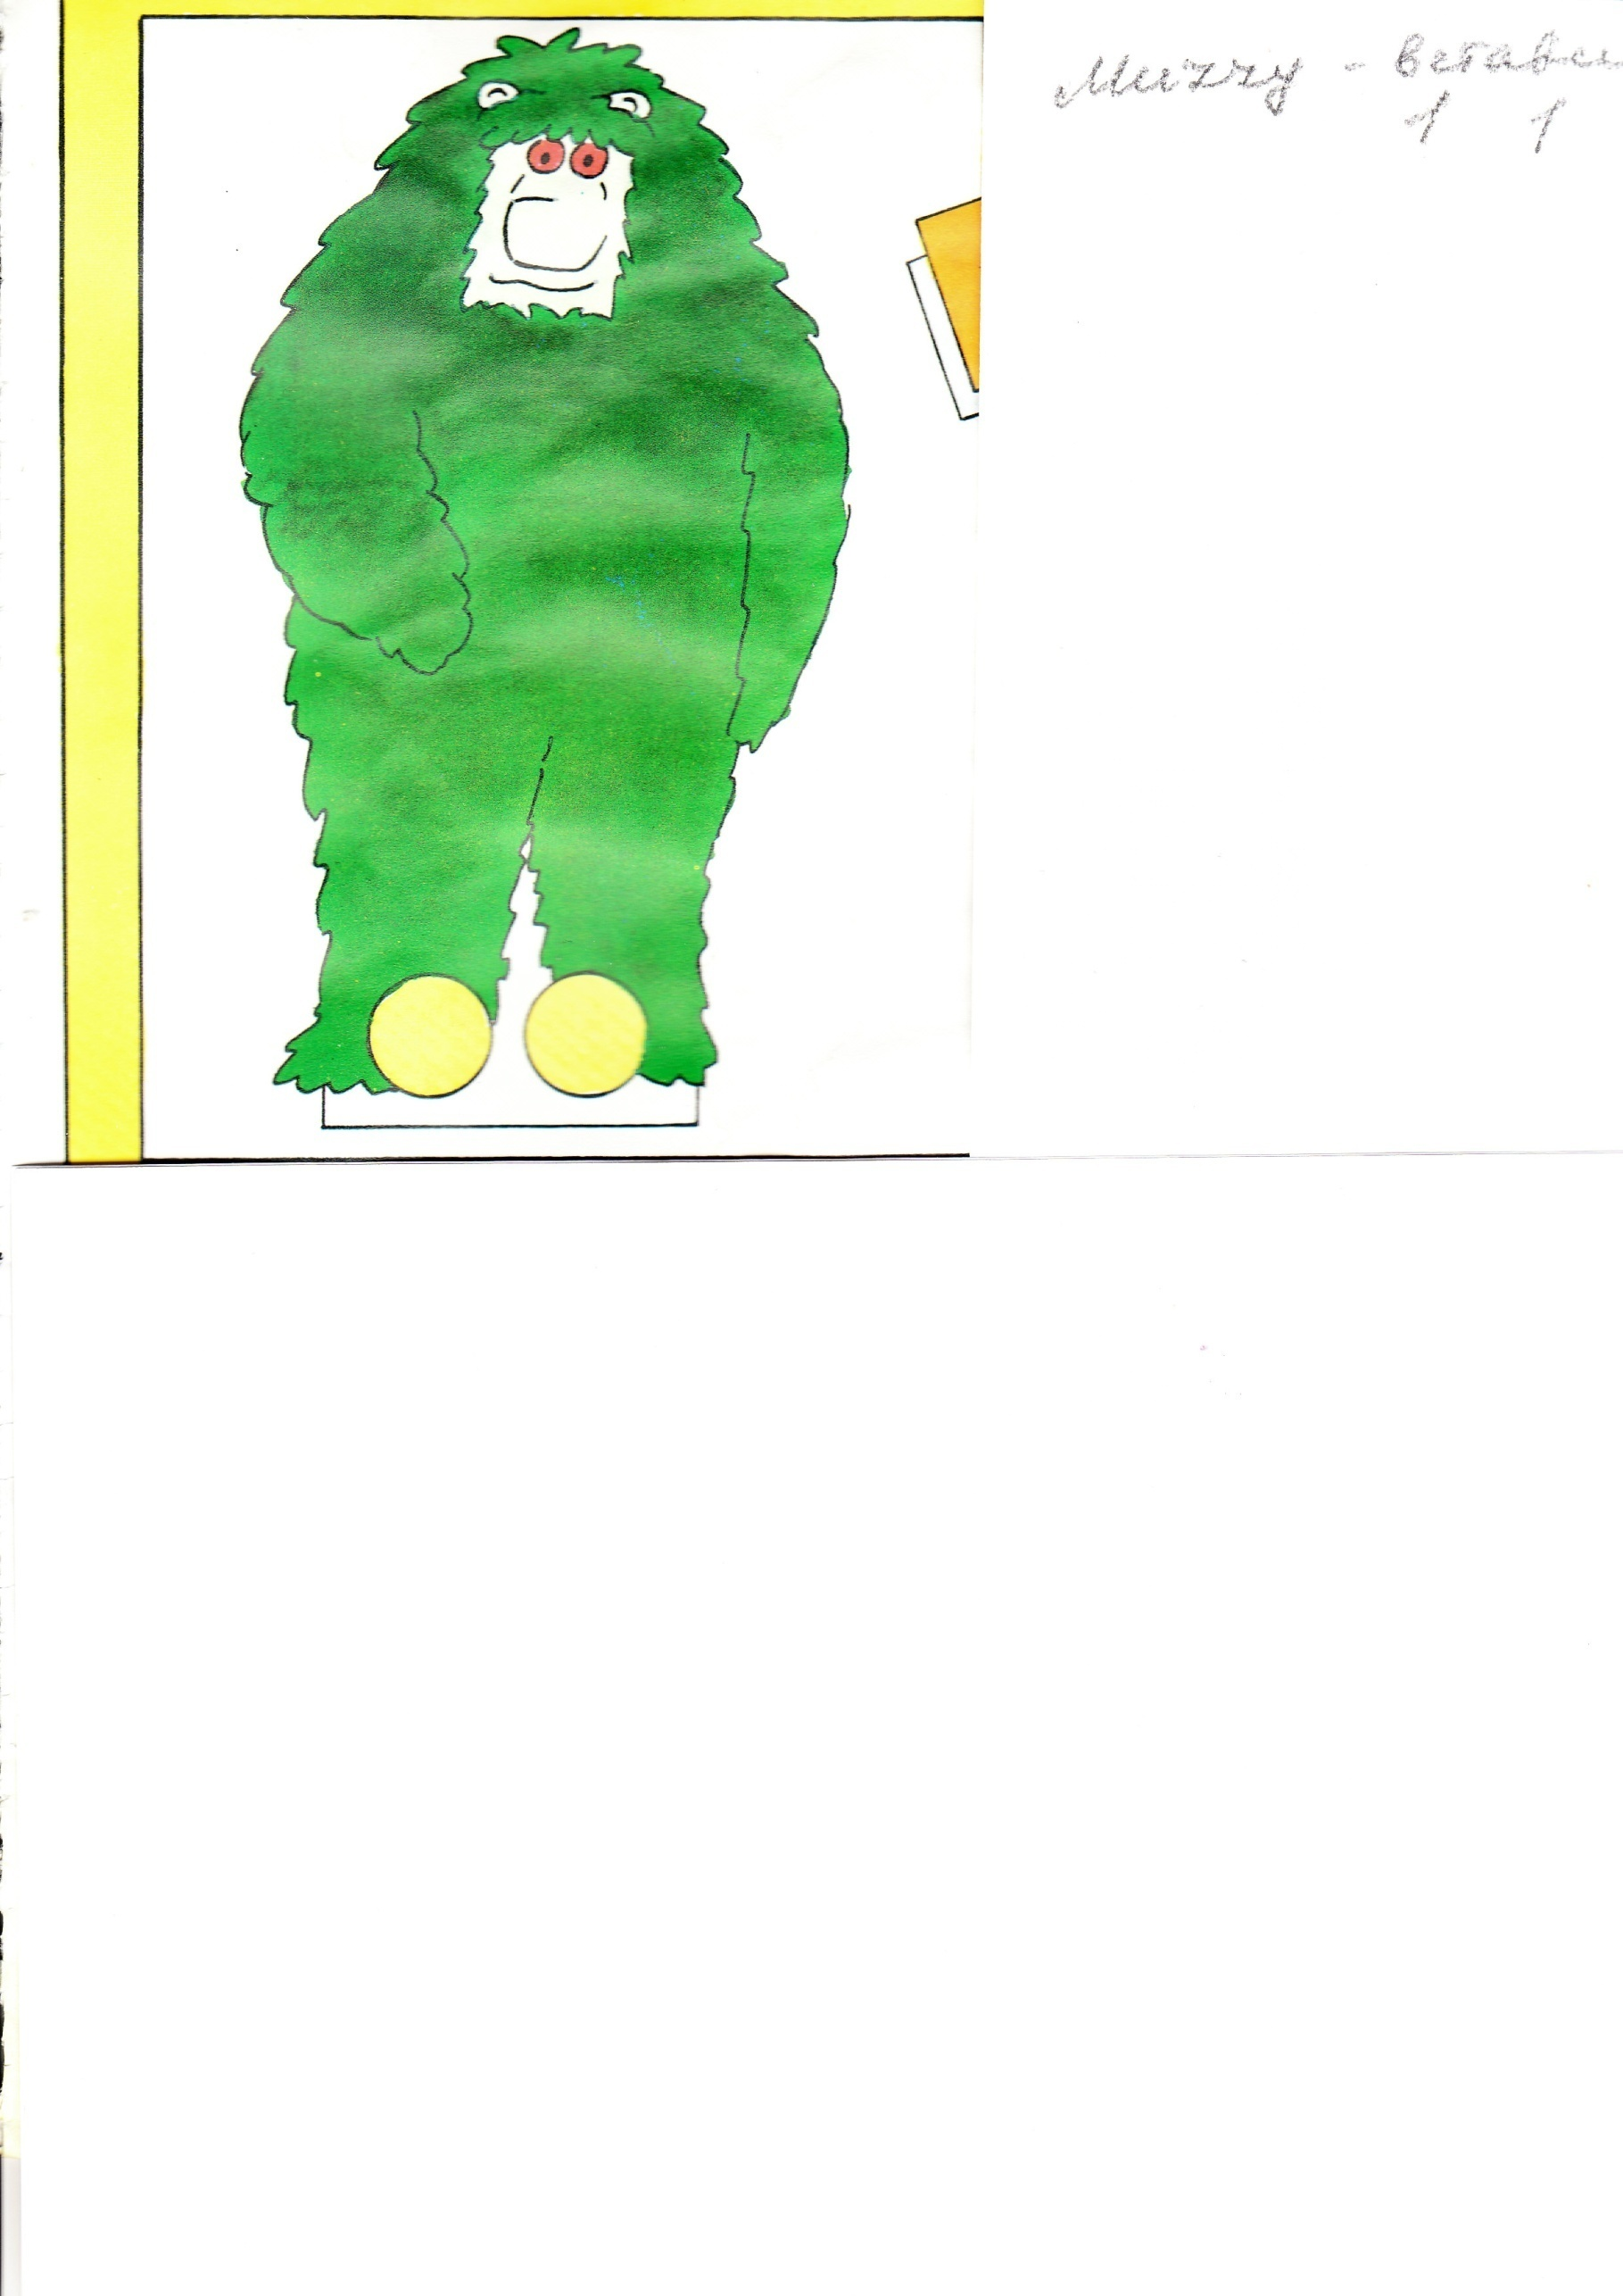
LETTER
“Hello, boys and girls!
I’m an animal. My name is Muzzy.
I like to jump, dance , run and climb trees.
I like to eat very much. I have riddles for you.
I invite you to go to … ( Guess ! ) Best wishes,
Muzzy. “

Slide 4
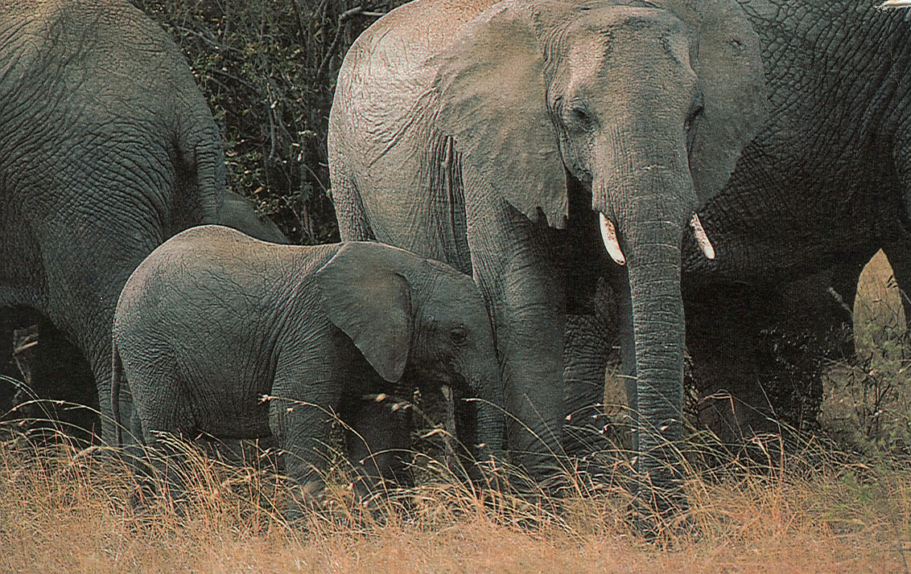
This animal is not very rare
It is huge and it hasn’t got wings
It has got big ears
It lives in Africa
It can run very fast
People ride this animal
It is an...
ELEPHANT.

Slide 5
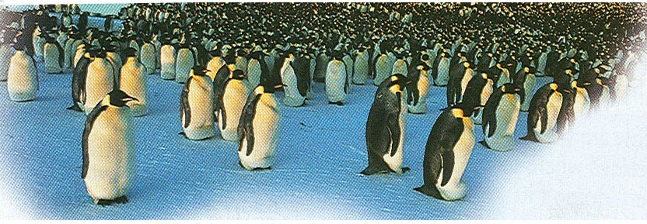
This animal is black and white.
It isn't very rare.
It has got a big body and small head.
It is a bird but it can't fly.
It lives in Antarctica and South America.
It can't run fast but it can swim fast.
It is a...
penguin.

Slide 6
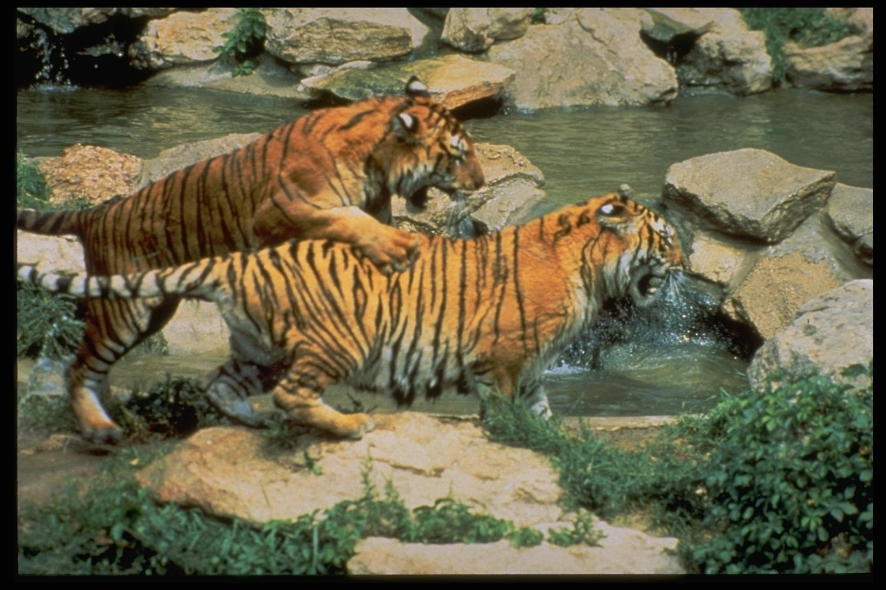
This animal is very big.
It is orange and black.
It can run very fast.
It lives in Asia.
It is now very rare.
It is a
TIGER

Slide 7
P R O V E R B S
If you run after two hares, you catch neither.
За двумя зайцами погонишься – ни одного не поймаешь.
To sell the bear’s skin before one caught the bear.
Делить шкуру неубитого медведя.
Curiosity killed a cat.
Любопытной Варваре на базаре нос оторвали.
The early bird catches the worm.
Кто рано встаёт, того удача ждёт.

Slide 8
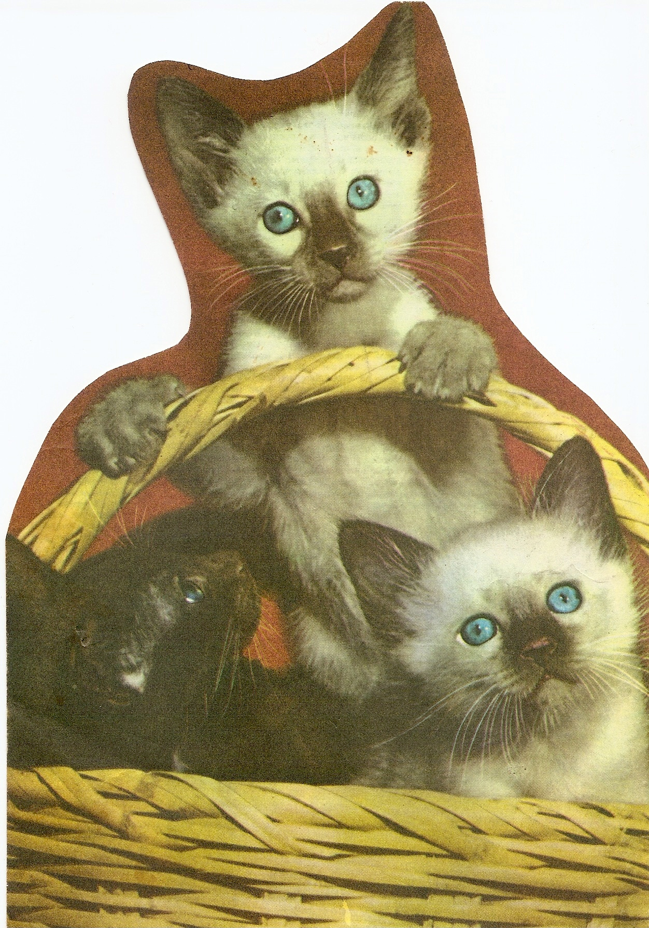
CATS

Slide 9
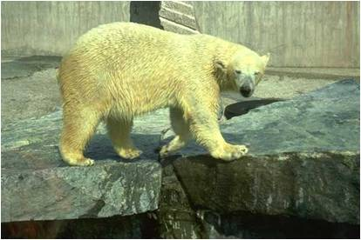
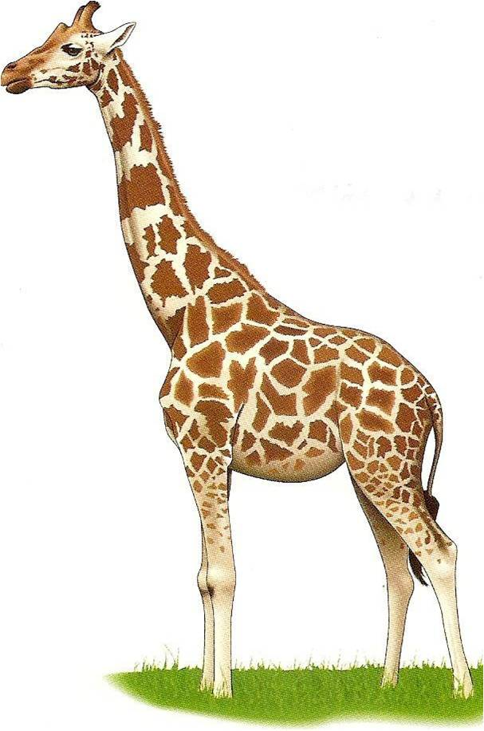
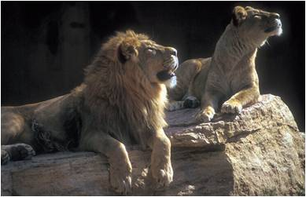
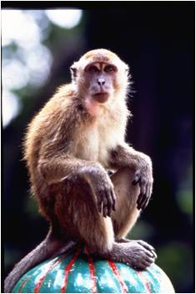

Slide 10
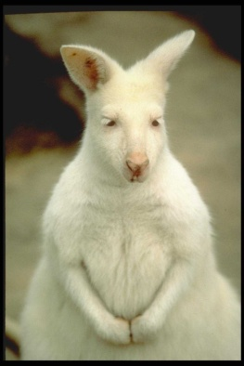
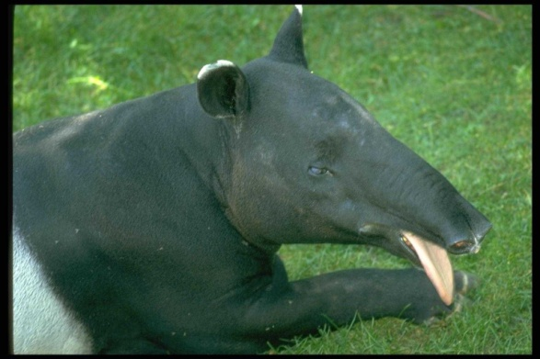
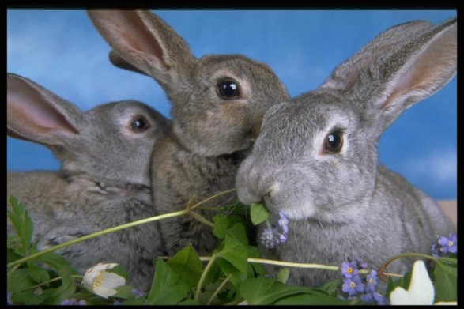
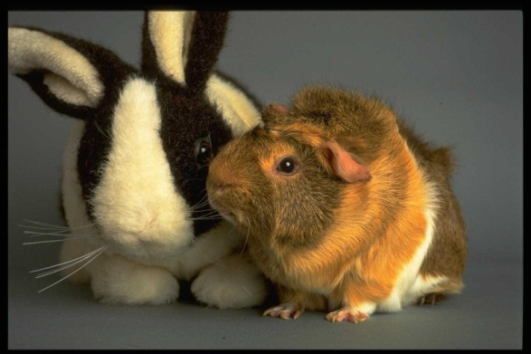
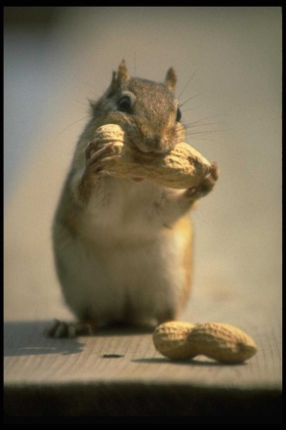
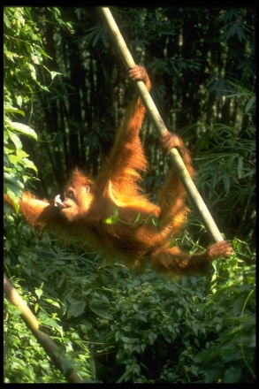
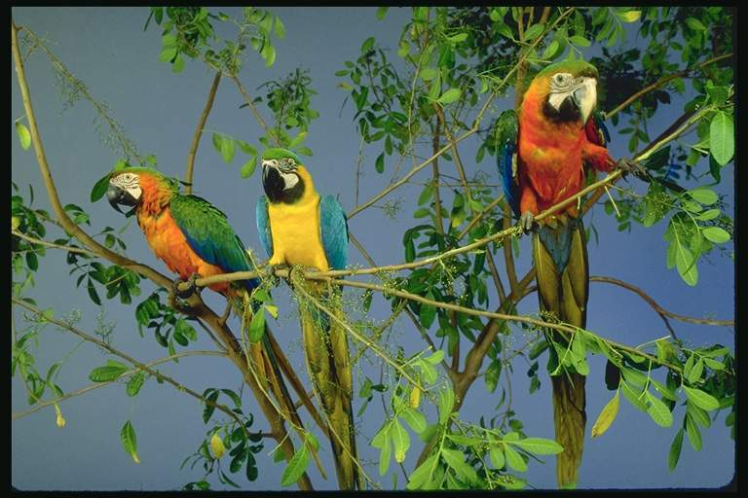
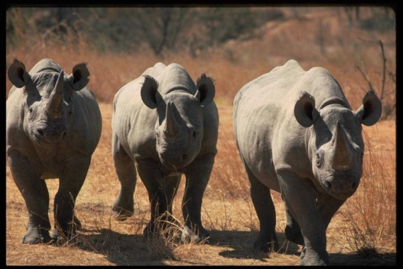
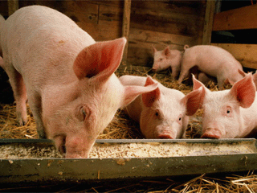
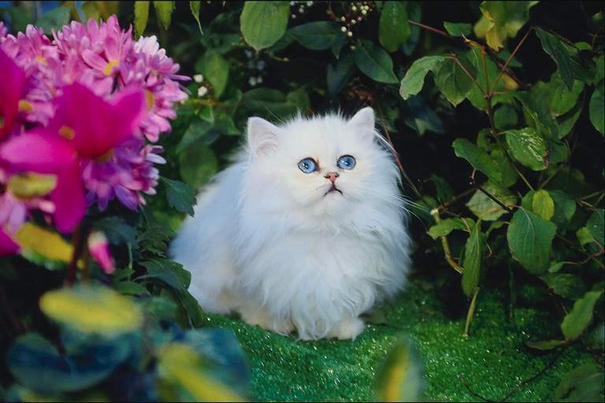
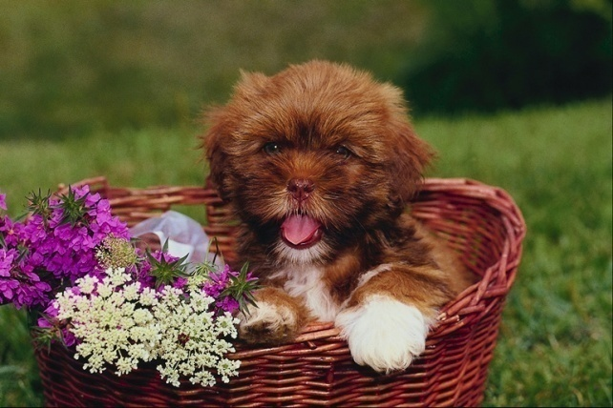
What is the author’s dream?

Slide 11
London Zoo

Slide 12
They say exotic animals were first taken to Britain in the thirteenth century when King Henry III received a gift of leopards and elephants.

Slide 13
The animals lived in the Tower of London in a special place.

Slide 14
Later the King of Norway presented Henry III with a polar bear.

Slide 15
Five hundred years later, Queen Charlotte was given the first zebra to come to Britain.

Slide 16
She kept it near Buckingham House.

Slide 17
Giraffes have been an attraction at London Zoo since four of them arrived in 1839.

Slide 18
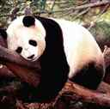
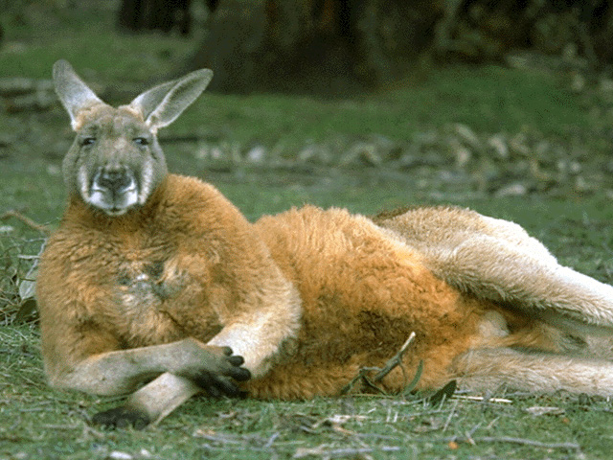
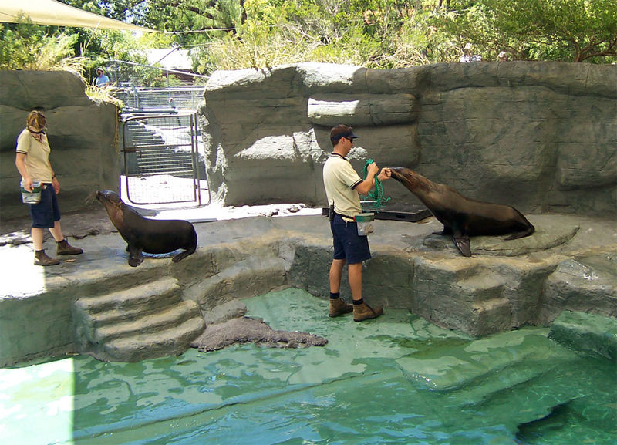
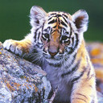
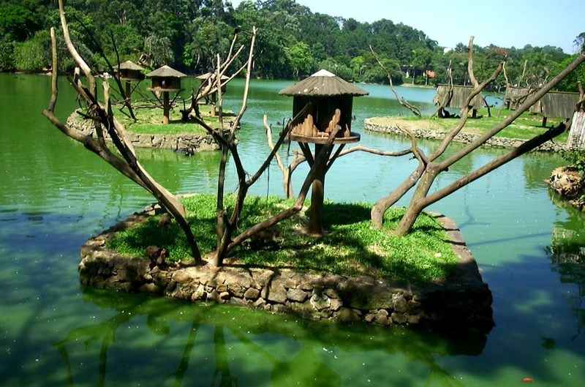
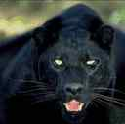
Today there are many thousands of exotic animals at London Zoo.

Slide 19
S O N G “ We’re going to the Zoo “

Slide 20
London Zoo

Slide 21
welcome
to our
ZOO

Slide 22
R U L E S
Please, do not feed the animals!
Don’t shout at the bear !
Don’t open the door of cage!
Don’t drop litter on the floor!
Don’t touch the lion’s hair !

Slide 23
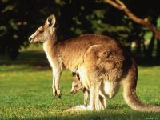
KANGAROO [kæŋgə’ru:]

Slide 24
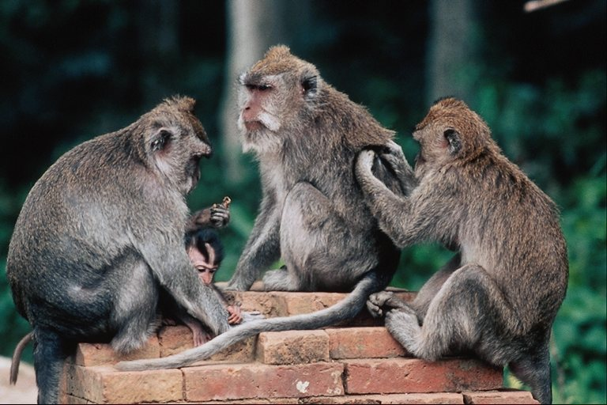

Slide 25
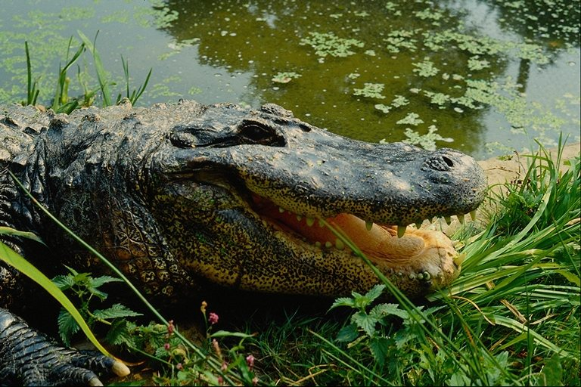

Slide 26
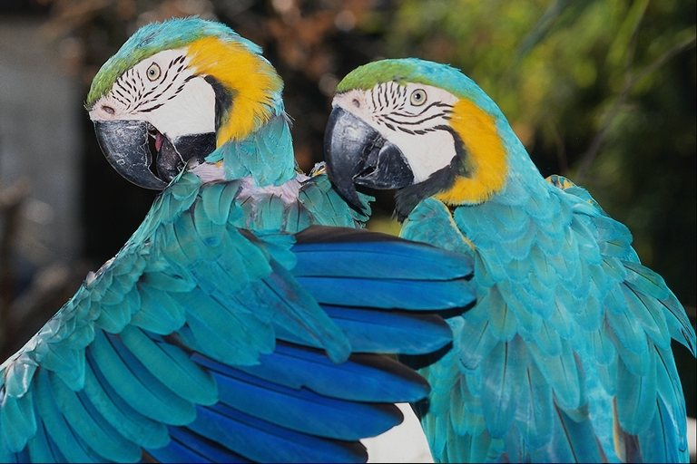
Parrots

Slide 27
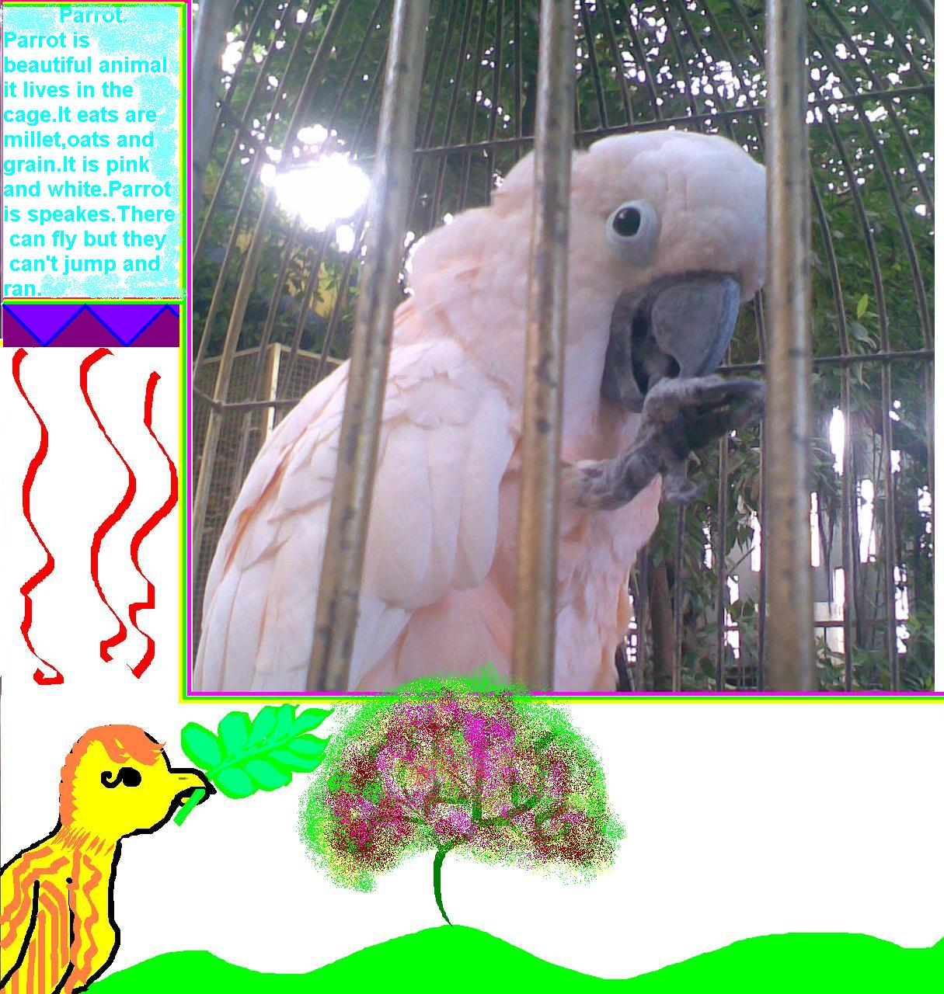
A parrot

Slide 28
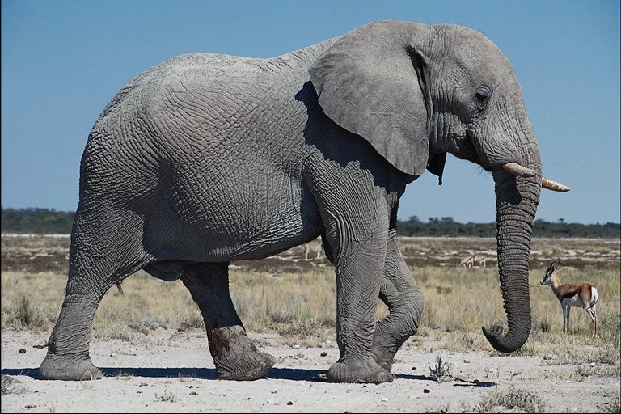

Slide 29
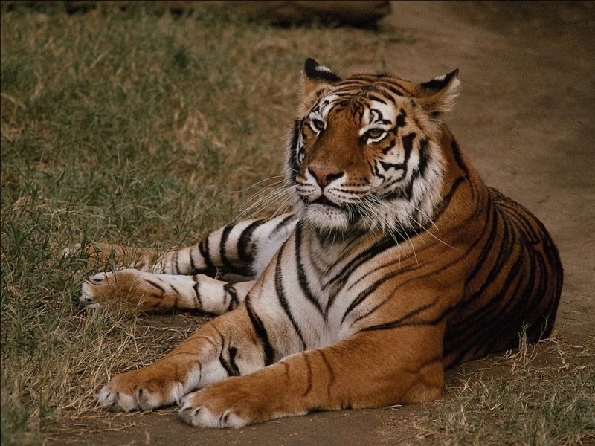
Tigers

Slide 30
Tigers

Slide 31
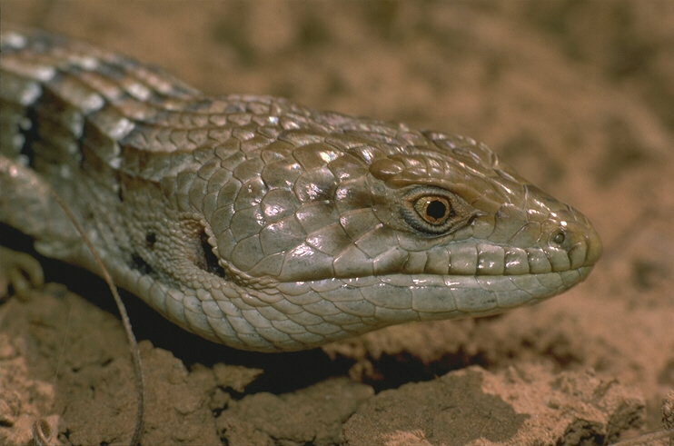
Snakes

Slide 32
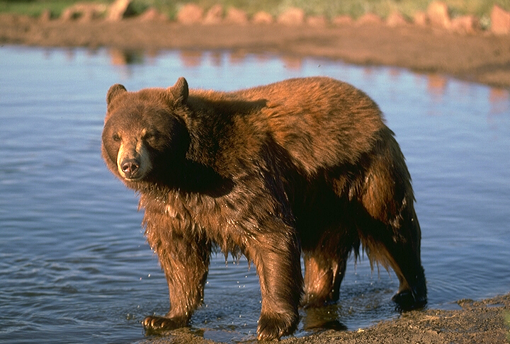
Bears

Slide 33
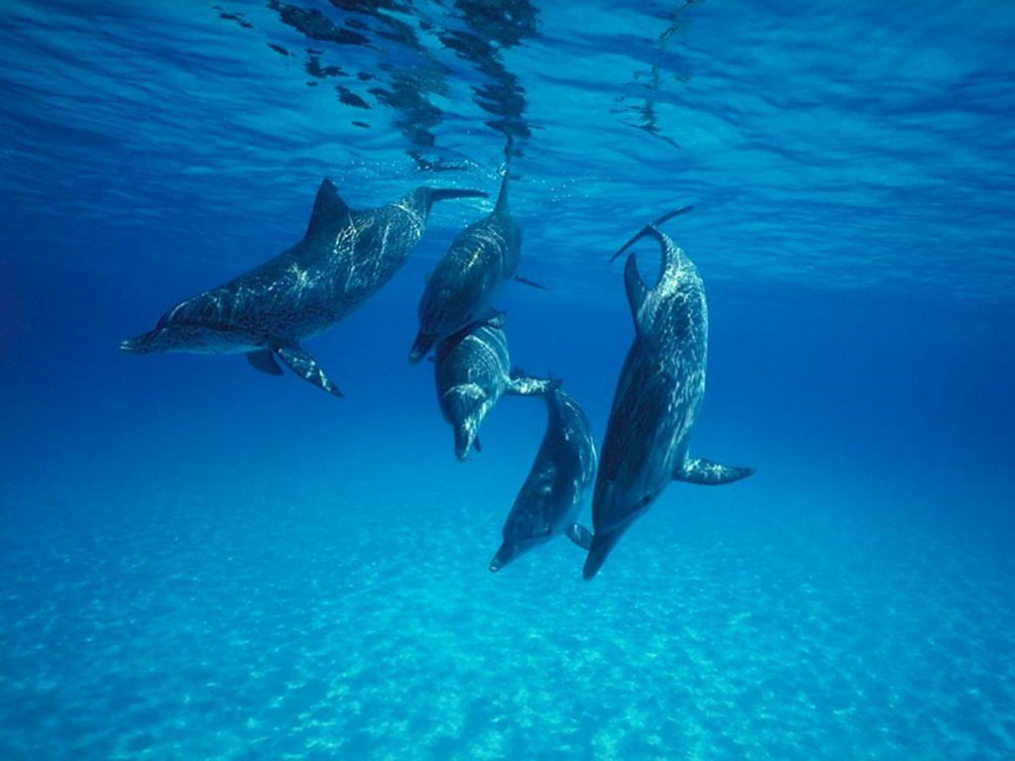
Dolphins

Slide 35
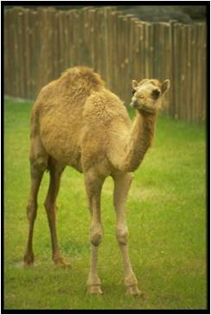
Camel
camel

Slide 36
It’s
interesting
to Know…

Slide 37
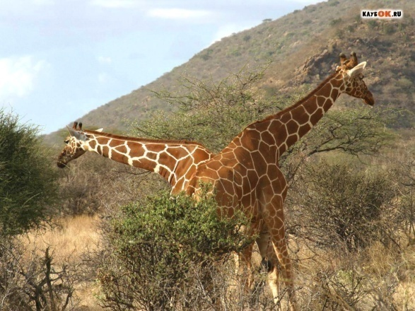
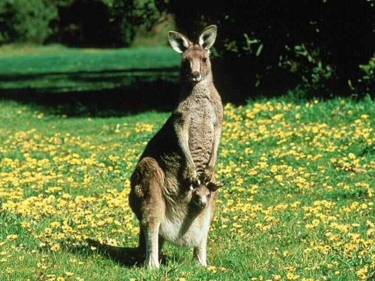
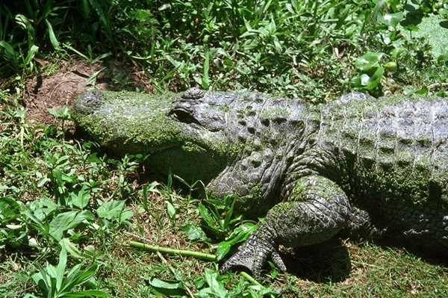
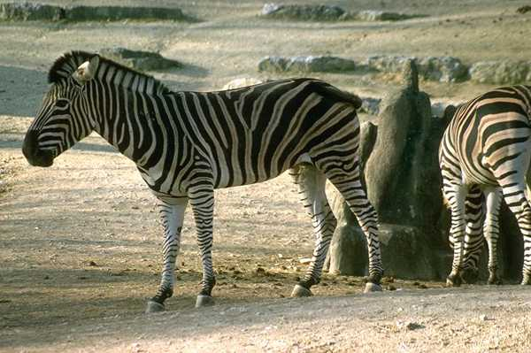
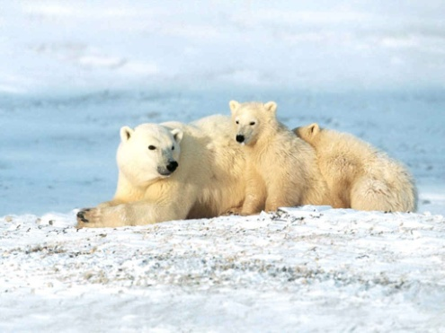
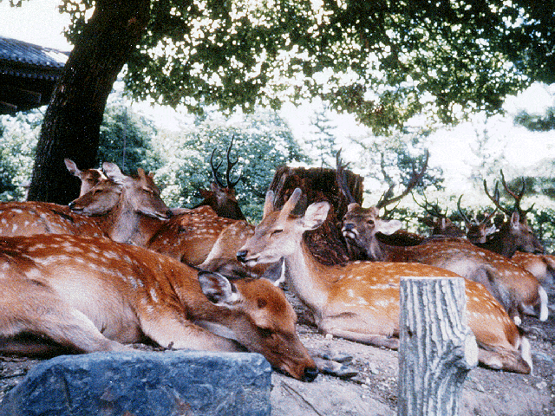
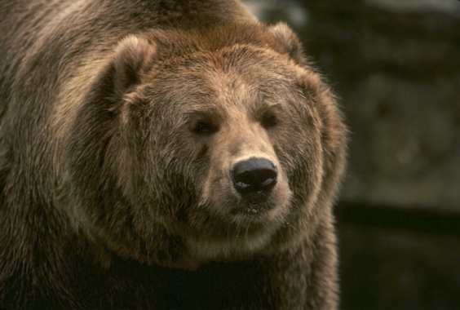
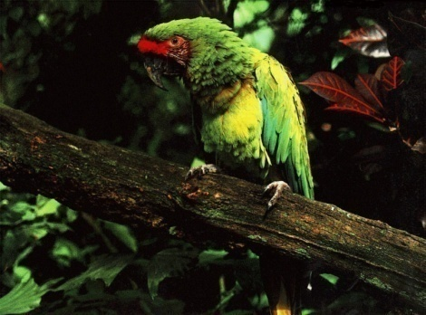
The World of Animals

Slide 38
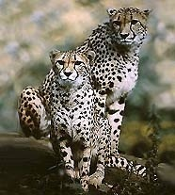
Gerards
The Fastest

Slide 39
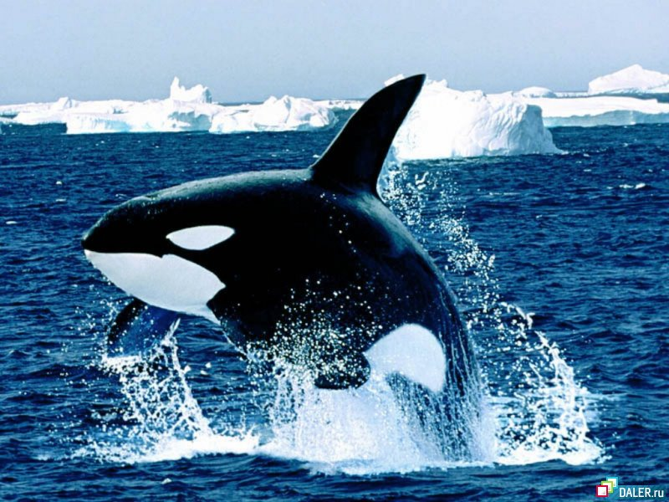
WHALE

Slide 40
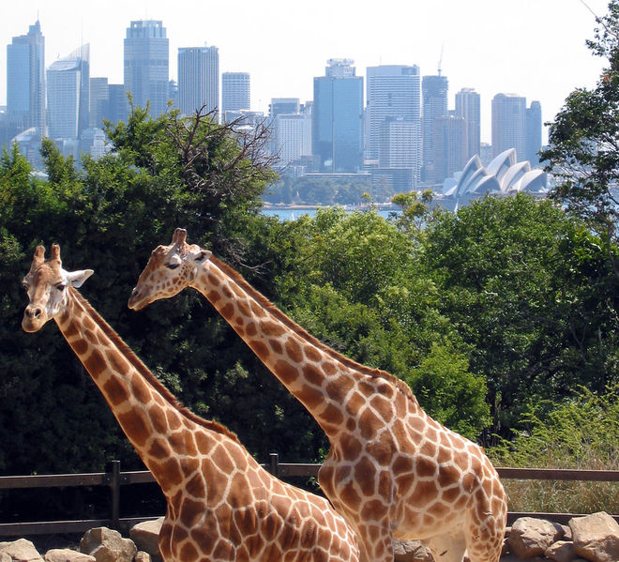
The tallest animal

Slide 41
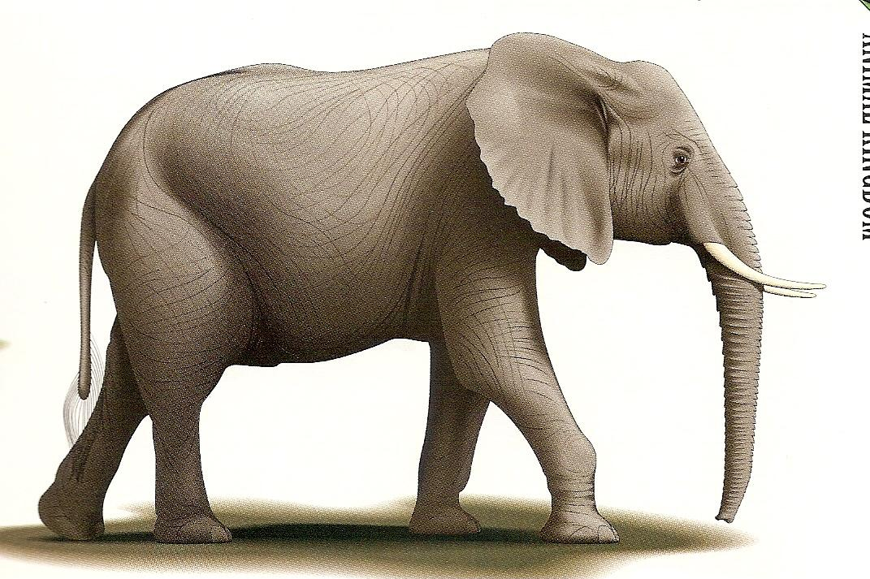
ELEPHANT
The best eater

Slide 42
The hardiest animal
camel
Camel

Slide 43
MOUSE

Slide 44
White Tigers

Slide 45
T E S T

Slide 46
Nominations
The 1st place
a short tail
big ears
sharp tusks

Slide 47
Crossword
7
1
C A T
2
L I O N
3
G I R A F F E
4
M O N K E Y
5
L E O P A R D
6
W H A L E
1. This domestic animal likes milk.
5. The fastest animal.
2. It is the King of the animals.
6. This animal lives in
seas and oceans
3. The highest animal in the world.
4. The funniest animal.

Slide 48
Thank you for your
work! Good luck!

