Slide 1
Charitable fund of Prelate Vasiliy Velikiy.

Slide 2
10 декабря в Санкт-Петербурге состоялся благотворительный концерт в помощь детям с онкологическими и офтальмологическими заболеваниями
On December, 10th 2010 in northern capital the charitable concert within the limits of the program «In support of activity of Russia on struggle against children's oncological and ophthalmologic diseases» has taken place.

Slide 3
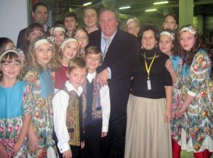
Среди организаций, при поддержке которых проходил концерт, почетное место занял Благотворительный фонд Святителя Василия Великого/
Among the organizations with which support took place a concert, the place of honor was occupied with Charitable fund of Prelate Vasiliy Velikiy.

Slide 4
Vladimir Putin took part in this concert

Slide 5
He sang a song about our Motherland.

