Slide 1
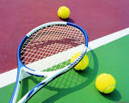
Sport in our life

Slide 2
Sport plays a very important role in our life.
Many people go in for sports because it helps to be healthy.

Slide 3
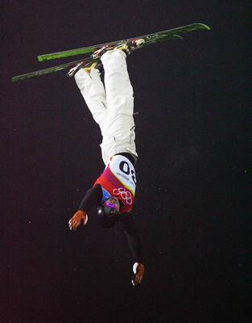
Popular sports in the World are figure skating, rowing, swimming, ice-skating, boating, running.

Slide 4
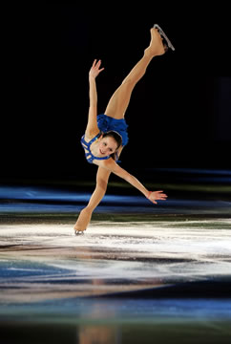
The most popular sport in the World is figure skating.

Slide 5
Popular games in the World are football, basketball, golf, chess, tennis, ice hockey, rugby, volleyball.
The most popular game is football.

Slide 6
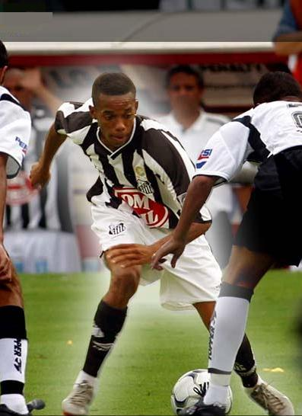
Football is a game invented and developed in England.
A game is played between two teams of eleven players who kick a ball around a field trying to score a goal.

