Slide 1
“I love English”
[Appearance, Have/Has got, Prepositions of places]
Made by Shoeva Elena
[ ГОУ ЦО №1445]

Slide 2
Introduce yourself
What is your name?
How old are you?
Where do you live?
What’s your favourite colour (number)?
Have you got a mother(father, little sister etc)?
Have you got blue eyes(big nose, long hair)?

Slide 3
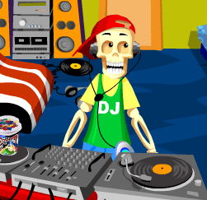
Let’s recite a poem and play!
I am a bony skeleton.
I have a smiling mouth.
I have no nose,
I have five bony fingers
And five bony toes.
Hop, hop, hop!
Jump, jump, jump!
Go, go! Bump, bump, bump!

Slide 4
Riddles ( about your classmates): Who is he/she?
She is a girl. She has got fair and long hair.
She has got blue eyes and small ears. Her nose isn’t big. She is nice and pretty.
He is a boy. He is not tall but strong. He has got short fair hair. He has got a smiling mouth. His nose is not big. He can play hockey.

Slide 5
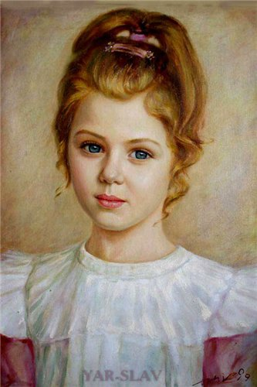
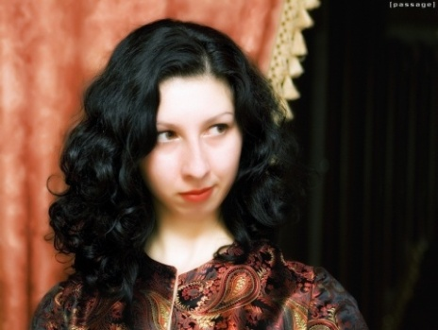
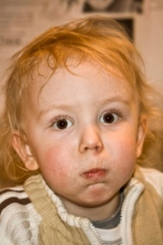
Let’s check! (Game:”Postman”)
She is a girl. She is nice. She has got long fair hair. She has got big, blue eyes.
She has got a nice mouth. She has got a small ears.
She has got long, black hair. She has got a long nose.
She has got green eyes. Her mouth isn’t small. She is not old.
He is not old. He has got dark hair. He has got a long nose. His mouth is big. He is merry.
He is a baby-boy. He has got short fair hair. He has got a small nose. He has got big brown eyes. He is funny. He is little.
His mouth is not big.

Slide 6
Sing and do!
This is my house,
This is the door!
The windows are clean,
And so is the floor.
As tall as can be
Outside there’s a chimney,
With smoke that goes up
Come and see!

Slide 7
Rabbit visits Winnie ( a dialogue by heart)
R. – Good morning, Winnie!
W.- Good morning, Rabbit!
Would you like some tea and sweets?
R.- I’d like some cabbage and a big red carrot,
please.
W.- Here you are . Help yourself!
R.-Thank you, Winnie.
W.-You are welcome!
R.- I must go home. Goodbye!
w.- That’s a pity. Bye-bye!

Slide 8
Game : “Where’s my cassette?”
In- в;
On- на;
Under- под.
Is it on the table?
Is it under the chair? Yes it is/ No, it isn’t
Is it in the box?
Is it on the shelf?

Slide 9
The end.
You are well done!
Thank you for your attention!

