Slide 1
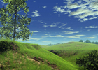
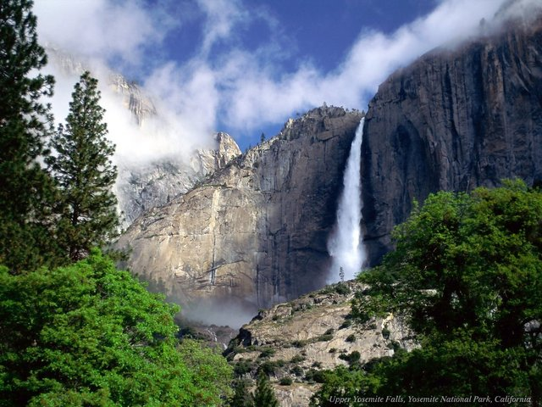
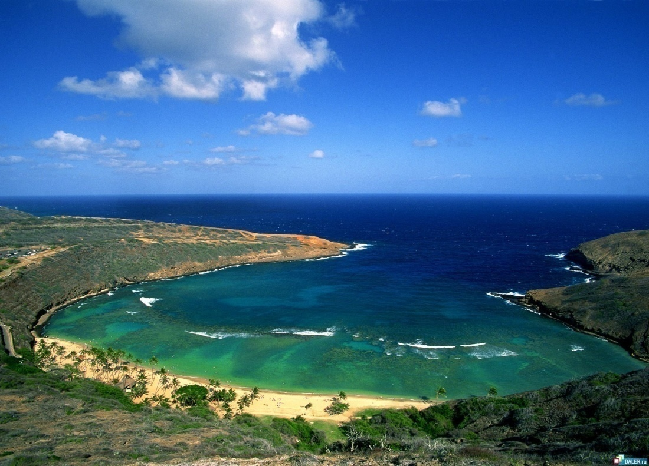
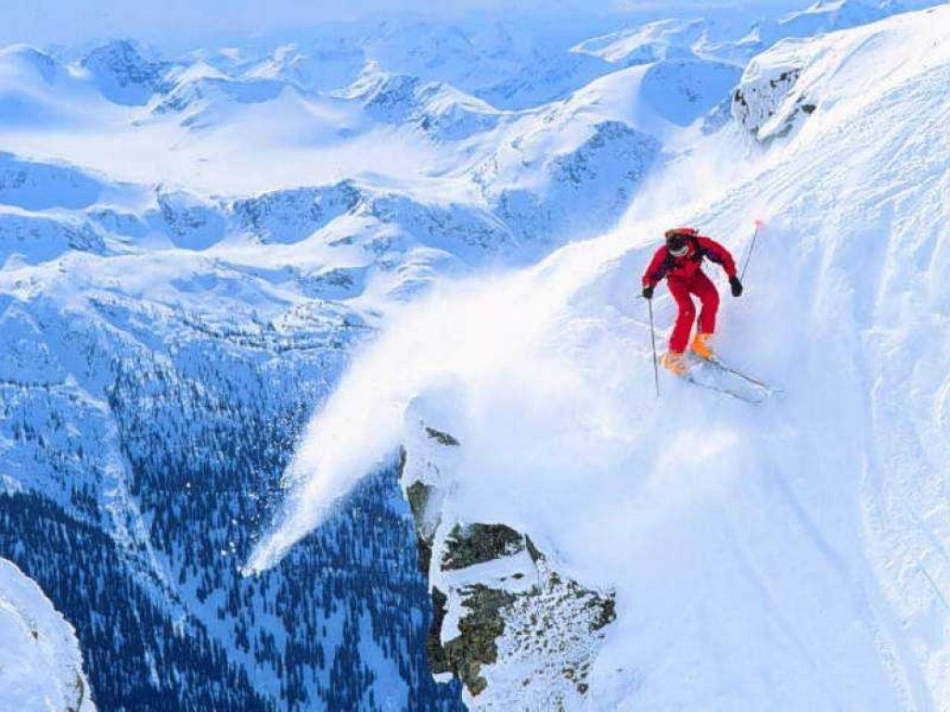
The Earth is our home

Slide 2
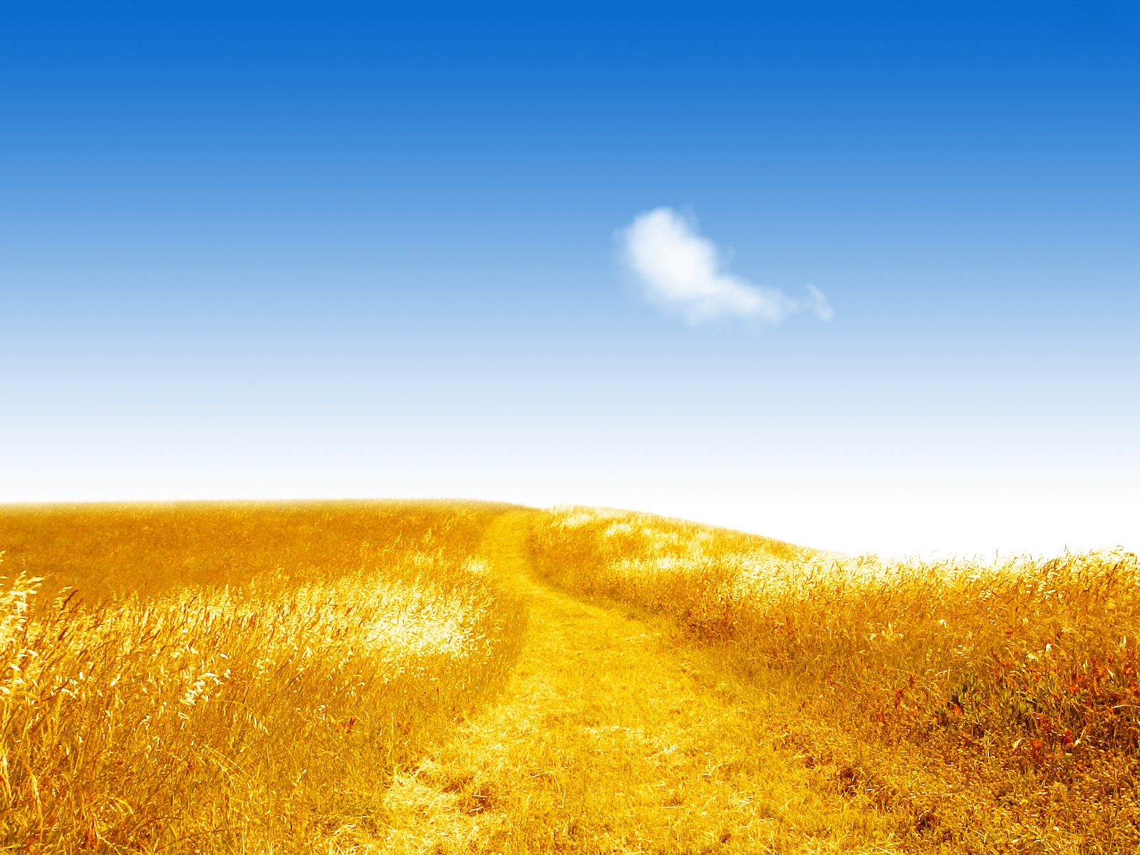
The Earth is a garden
It’s a beautiful place
For all living creatures
For all the human race
Helping Mother Earth
We can peacefully roam
We all diverse a place
We can call our home

Slide 3
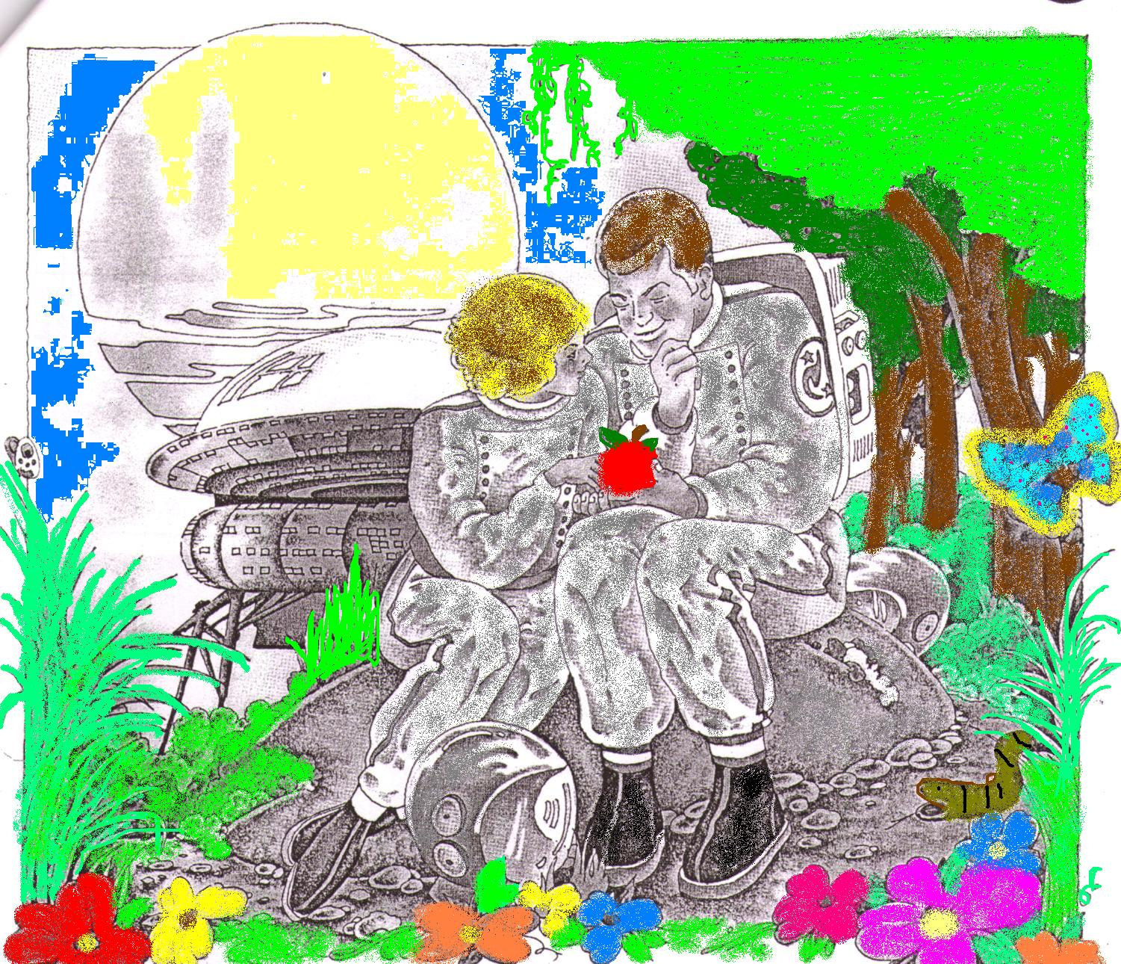
THE NEW PLANET
to descend - спускаться
helmets - шлемы

Slide 4
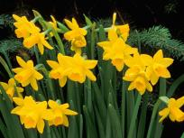

Slide 5
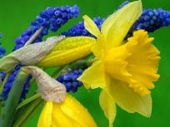
The Daffodils
I wandered lonely as a cloud
That floats on high o’er vales and hills ,
When all at once I saw a crowd ,
A host of golden daffodils ;
Beside the lake , beneath the trees ,
Fluttering and dancing in the breeze .
Continuous as the stars that shine
And twinkle on the Milky Way ,
They stretched in never –ending line
Along the margin of a bay .

Slide 6
