Slide 1
СHOOSE THE RIGHT WORD
ЭЛЕКТИВНЫЙ КУРС

Slide 2
CONTENTS
Занятие 1. Small, little, big; large, great
Занятие 2. To speak, to talk, to say, to tell,
Занятие 3. Arm, hand, leg, foot, paw
Занятие 4. To go, to come, to walk
Занятие 5. Home, house, food, meal
Занятие 6. Heavy, difficult, light, easy
Занятие 7. To do, to make
Занятие 8. To learn, to study, to teach
Занятие 9. Forest, wood; country, village ; bank, shore, coast
Занятие 10. High, tall, last, latest
Занятие 11 Road, path, way.
Занятие 12. To wait, to expect
Занятие 13. To raise, to pick up, to lift
Занятие 14. Games, sports; work, job
Занятие 15. Ground, earth, land; across, over, through
Занятие 16. To swim, to borrow, to lend
Занятие 17. Урок – защита проектов

Slide 3
ЗАНЯТИЕ 1 SMALL, LITTLE, BIG, LARGE, GREAT

Slide 4
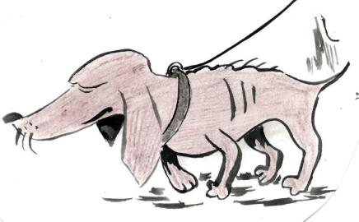
SMALL, LITTLE
Remember:
little - маленький ( по возрасту)
Small – маленький
( по росту, по размеру)
This dog is not little, it is old, but it is very small.
Proverb
Politeness costs little but yields much
Вежливость ничего не стоит, но дает много.

Slide 5
Remember:
to be small for one's age быть малого роста для своего возраста
Little by little мало-помалу, постепенно
little finger мизинец
little toe мизинец на ноге
little things мелочи

Slide 6
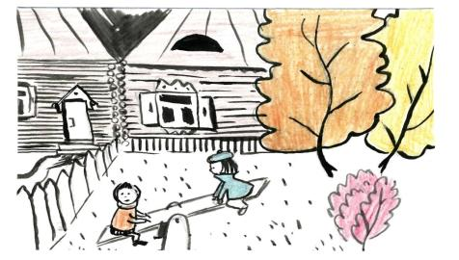
BIG, LARGE, GREAT
Remember:
big большой (по объему, размеру, росту)
large большой (по площади), широкий, занимающий много места; многочисленный
greatбольшой(великий,выдающийся)
Our room is large. There are two big tables and twelve chairs in it. There are portraits of our great scientists on the wall.
Kate and Liza are great friends. They often play together. Liza likes to play in Kate's yard, because it is large: there is much place there for the girls to run about.

Slide 7
Remember:
big repair капитальный ремонт
large businessman крупный делец
large majority значительное большинство
big meal обильная еда
large masses of population широкие массы населения
great grandfather прадед
great-hearted великодушный

