Slide 1
HOW DO ELDERLY PEOPLE LIVE ?

Slide 2
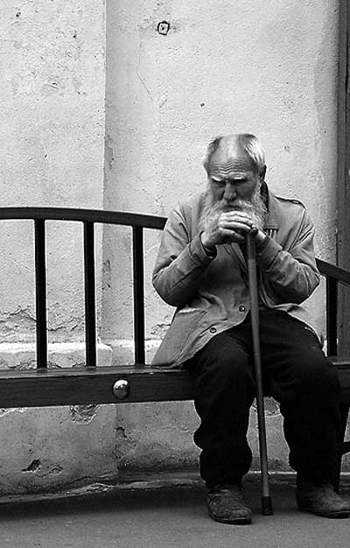
"The state is judged as it treats its elders"

Slide 3
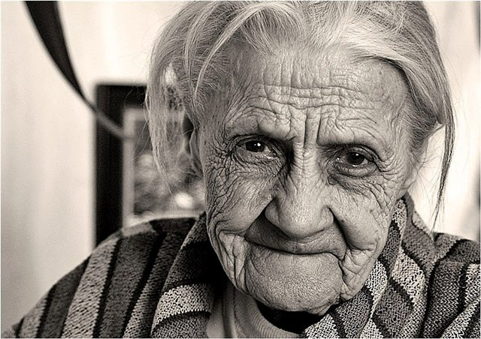

Slide 4
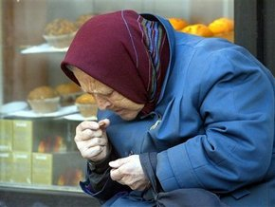

Slide 5
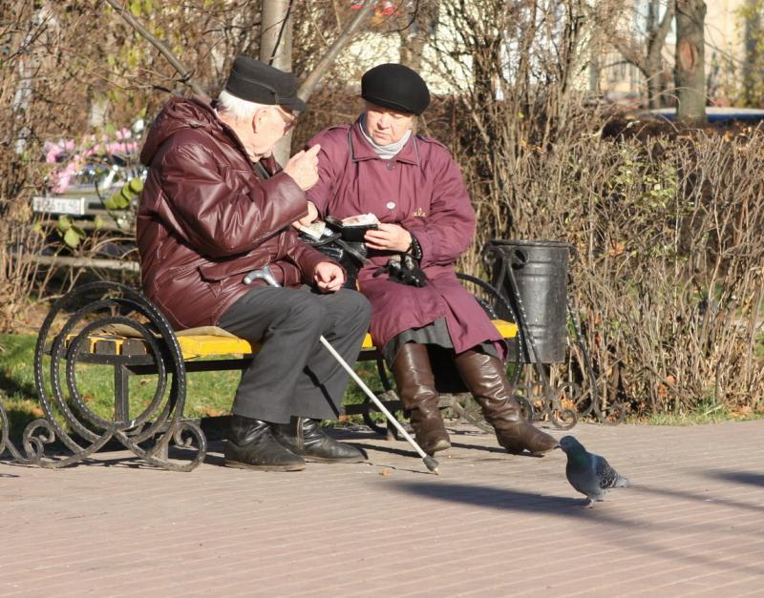

Slide 6
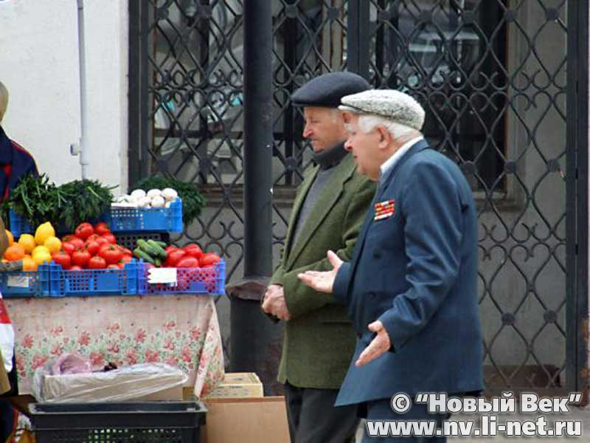

Slide 7
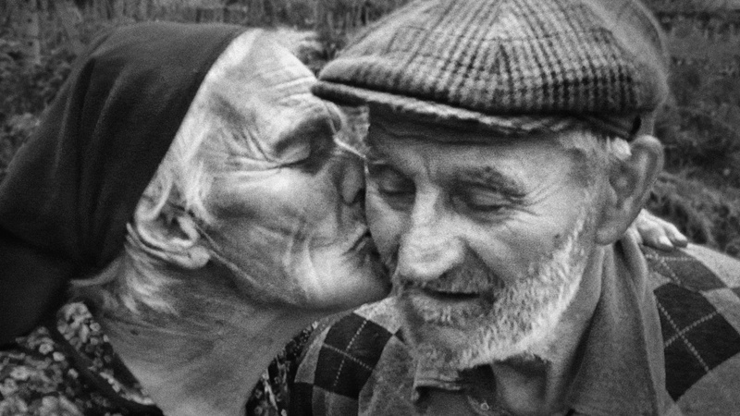

Slide 8
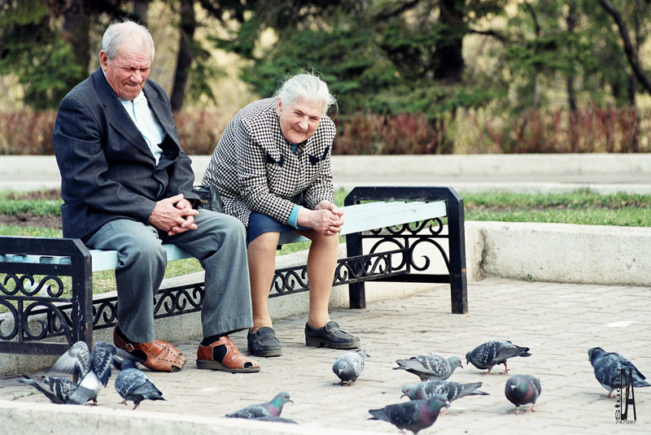

Slide 9
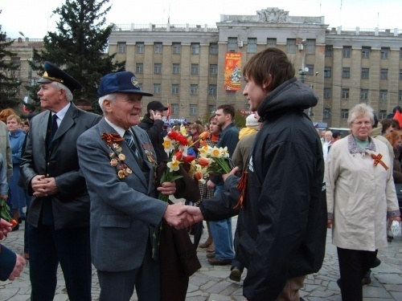

Slide 10
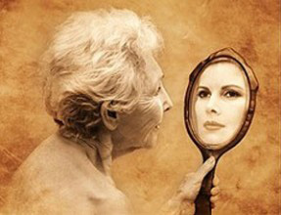

Slide 11
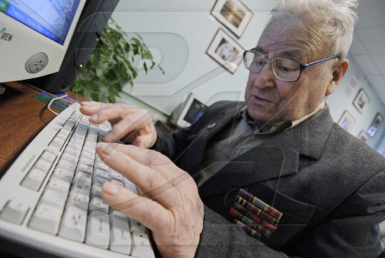

Slide 12
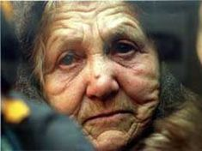

Slide 13
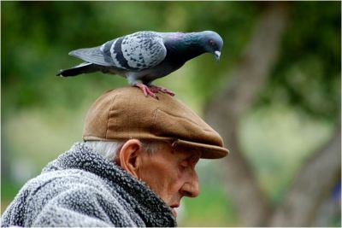

Slide 14
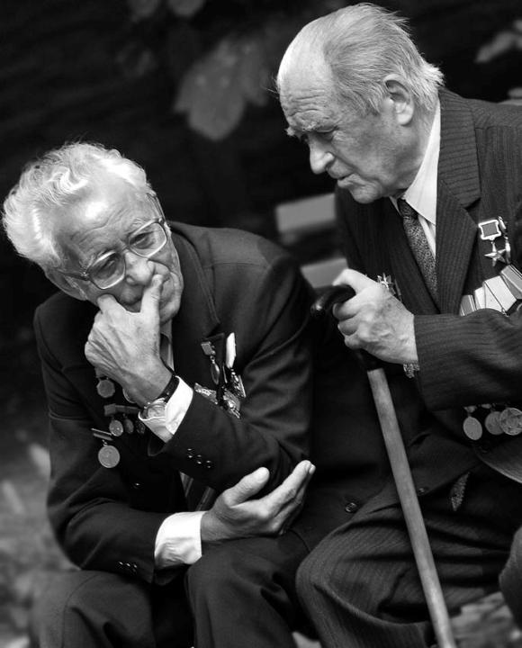

Slide 15
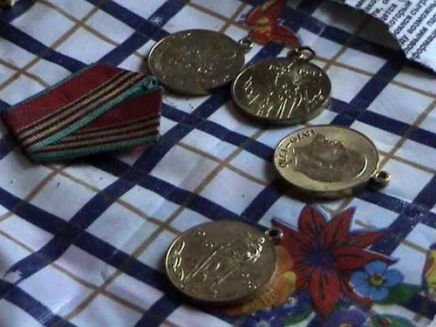

Slide 16
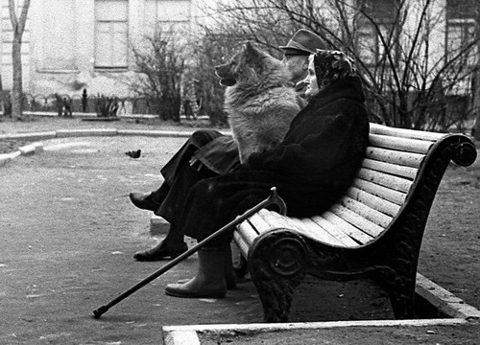

Slide 17
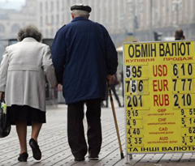

Slide 18
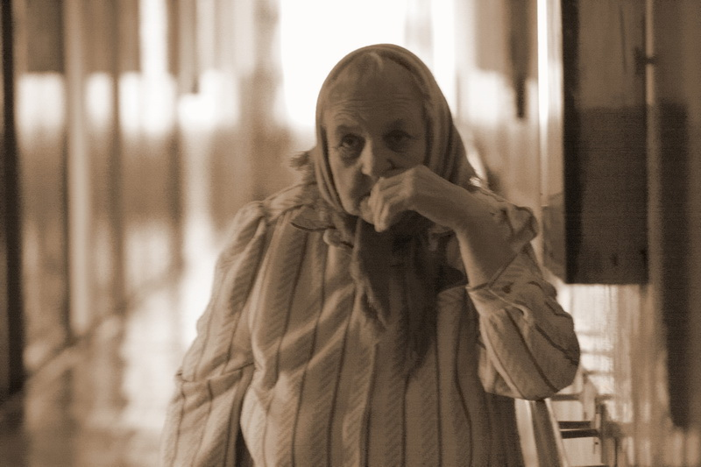

Slide 19
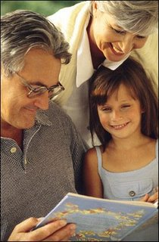
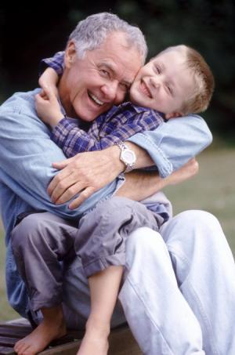

Slide 20
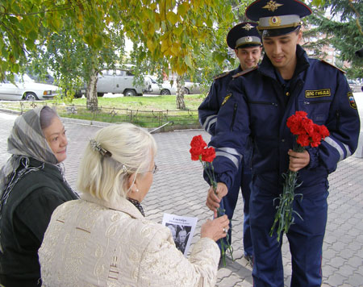

Slide 21
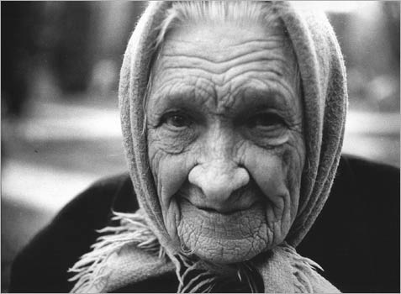

Slide 22
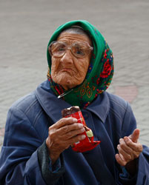
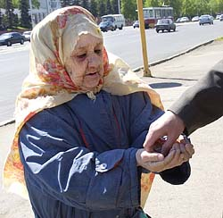

Slide 23
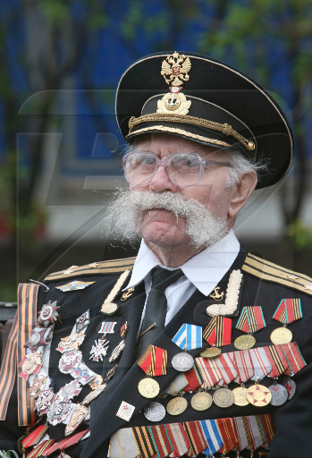

Slide 24
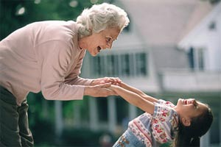

Slide 25
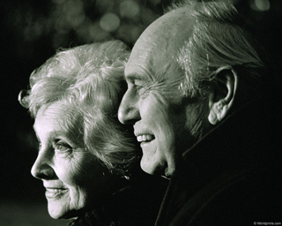

Slide 26
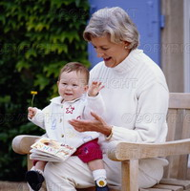
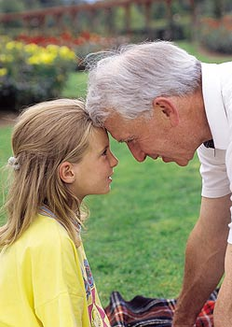

Slide 27
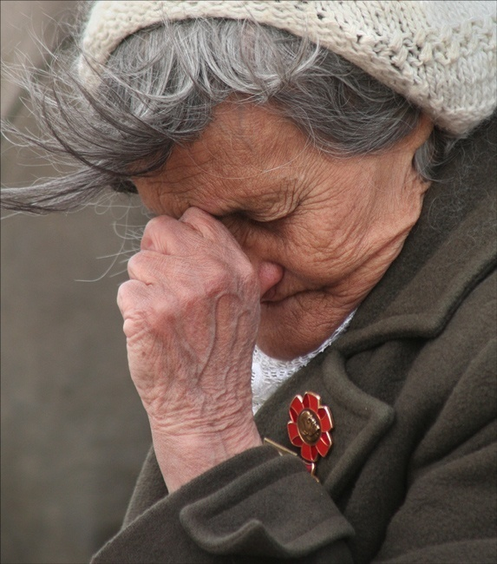

Slide 28
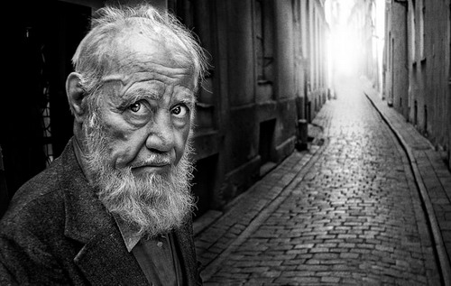

Slide 29
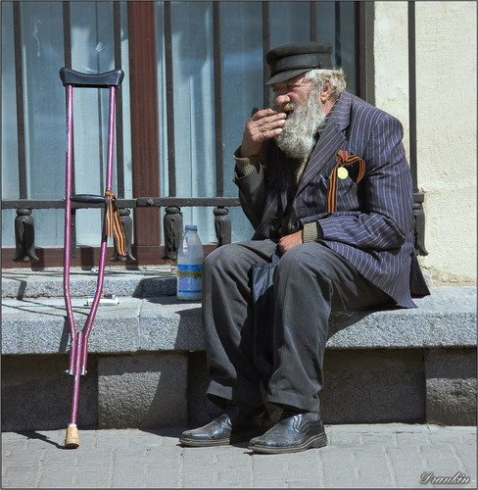

Slide 30
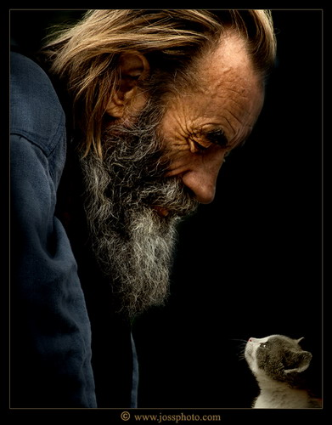
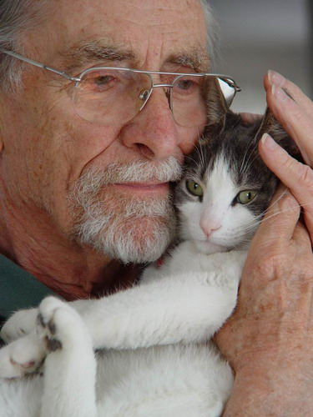

Slide 31
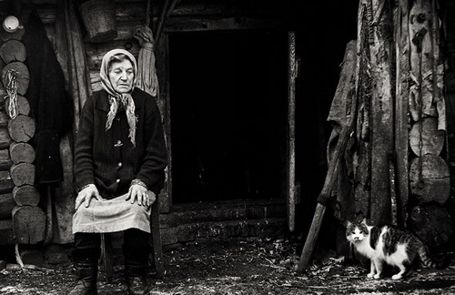

Slide 32
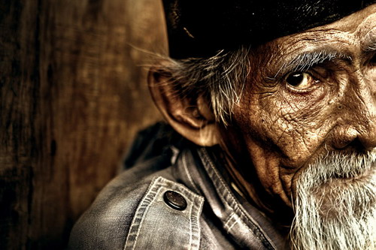

Slide 33
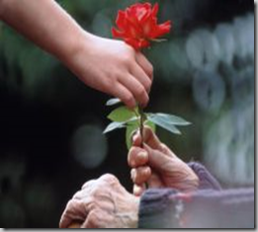

Slide 34
How do elderly people live?
What are good and bad points about being old?
How does the government care for the war veterans?
What state of health do the elderly people have ?
Do the elderly people satisfy of their health?
How do the elderly people spend their free time?
What could you buy for elderly people’s salary?

Slide 35
Some privileges the war veterans have in our country and in Germany.
Russia
Germany
Retirement pension+ invalidity pension.
2. 50% reduced payment for housing, telephone and public utilities.
3. Free medical care, wheelchairs, Free accommodation in a health resort.
4. Free return passage by sea, by air or by railroad once a year.
5. Housing, telephone, etc. without going on a waiting list.
6. Free of charge assistance about the house for a certain group of people with disabilities.
No special privileges. Ordinary invalidity pensions. No increment to a pension. Retirement is possible at the age of 60 (not at 65)
No privileges of this kind.
3. Medical service at a reduced price. There are no health resorts in Germany.
Air, railroad and other kinds of tickets at a reduced price.
No privileges of this kind.
6. Free of charge nursing and assistance in entertainment organizations only for people with disabilities living below the poverty level.

Slide 36
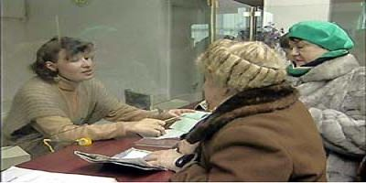

Slide 37
What could you buy for your salary?
The salary is about 8, 000 rubles

Slide 38
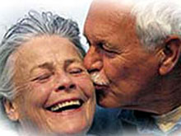
Good points about being old
The elderly…
Do not have to go to work
Have adult children, who are not a burden any more
Have a lot of time to meet with friends, read, travel, go in for sports, work in their garden
Get wiser, have more experience and the ability to help with advice

Slide 39
How do the elderly people spend their free time?

Slide 40
Some kinds of children’s share for elderly people

Slide 41
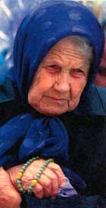
Bad points about being old
Elderly people…
Become ill and disabled
Become a burden to children
Suffer the fear of death
Have financial problems
Become incapable of living independently, need regular care and nursing
Lose friends and spouses
Live a boring life

Slide 42
Invalidity groups

Slide 43
Do the elderly people satisfy of their health?

Slide 44
What state of health do the elderly people have?

Slide 45
Different sphere of life’s satisfaction.

Slide 46
In spite of abundant of information we gathered and statistic data the main result of our investigation is the conclusion:
First of all elderly people need our love and attention.
So. Stop wasting your time speaking about all the-things-around with your so-called “friends”.
Give you grannies just a little bit of your attention and that’s will make their days longer.
Don’t expect any feedback from them. Elderly don’t make a choice and all of us have to sip from this cup.
Please do not applaud. Just let you brains work.

Slide 47
Do you want to be honorable or stay in the line of people who forgot their own roots?

Slide 48
MAKE

Slide 49
YOUR

Slide 50
CHOICE

Slide 51
