Slide 1
«Travelling to two countries English and Mathematics»
маршруты путешествия

Slide 2
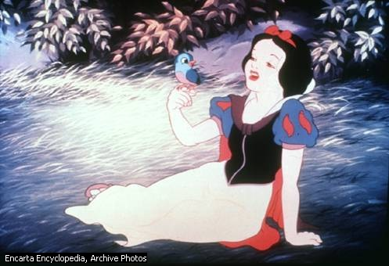
English Proverbs and Fairy Tails
Один за всех и все за одного
All for one and one for all
Одна голова хорошо, две лучше
Two heads are better than one
Третий лишний
Three’s a crowd
Ум хорошо, а два лучше
Four eyes see more than two
Кто хочет преуспевать, должен в пять вставать
He that will thrive, must rise at five
Один другого стоит
Six and half a dozen
Быть на седьмом небе
In the seventh heaven

Slide 3
Let’ revise the numbers
1-*ne
2-Tw*
3-T*ree
4-F*ur
5-F*ve
6-Si*
7-Sev*n
8-Ei*ht
9-Nin*
10-*en
11-*leven
12-T*elve
1-one
2-Two
3-Three
4-Four
5-Five
6-Six
7-Seven
8-Eight
9-Nine
10-Ten
11-Eleven
12-Twelve

Slide 4
I SEE…….

Slide 5
What’s in the boxes? Are they ……?

Slide 6
Guess the word
hen 57-34 when
hat 54 -34
Подумай, как образовано слово when из слова hen.
Образуй новое слово из слова hat .

Slide 7
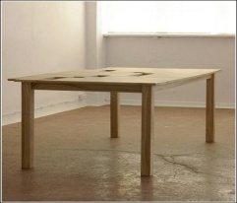
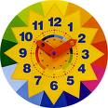
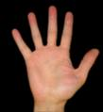
Riddles
I have four legs, but I can’t walk.
Two brothers but they don’t see each other.
One face, two hands. It goes, yet stands.
Two mothers have five sons with one name.

Slide 8
Guess the old English riddle
Мельник пришел на мельницу. В каждом из четырех углов он увидел по 3 мешка, на каждом мешке сидело по 3 кошки, а каждая кошка имела при себе троих котят. Спрашивается, много ли ног было на мельнице?

Slide 9
Let’s do tasks: 1.We can see two girls and four boys in the bus. How many children can we see in the bus? 2.Farther Frost has five dolls and seven cars in the bag. How many toys has he got?

Slide 10
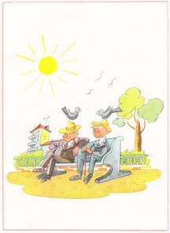
Назовите номера предложений, которые не соответствуют картинке.
1.It is a park.
2.It is a street.
3.The tree is white.
4.The sun is red.
5.The bench is black .
6.The house is big.
7.Two birds are in the sky.
8.Three birds are in the sky.
9.The men* are not old.
10. They are sad.

Slide 11
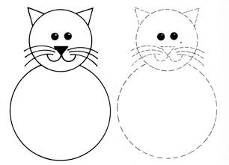
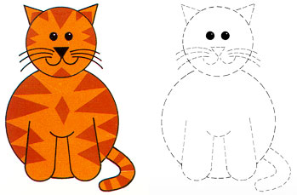
Let’s draw a cat.
My Pussy _____ a little cat. It is not _____, it is young. It is _____ and black. It is a good cat, it is not _____ . Pussy _____ fish, meat and milk. Pussy is not sad, it is _____ . I like _____ cat.

Slide 12
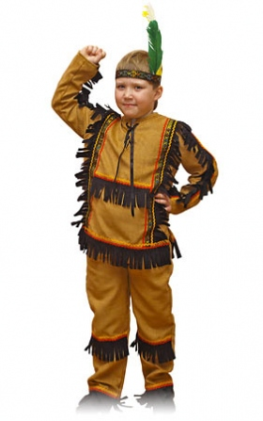
Let’s sing a song.
One little, two little,three little Indians,
Four little, five little, six little Indians,
Seven little, eight little, nine little Indians
Ten little Indians boys.
Ten little, nine little, eight little Indians,
Seven little, six little, five little Indians,
Four little, three little , two little Indians,
One little Indian boy.

Slide 13
Guess the Word
9 / 12, 9, 11, 5 / 5, 14, 7, 12, 9, 19, 8.
букве А соответствует цифра 1 и т.д.

Slide 14
Our homework:Ex.10 p.116 and the crossword.
 |  | o
 |  |  |  |  | n
 | f
 |  |  |  | e

