Slide 1
Christmas is on the air…

Slide 2
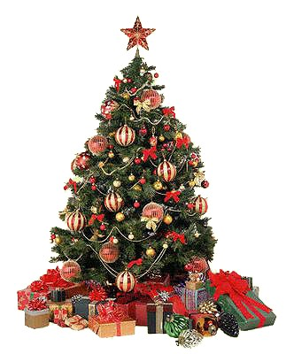
Christmas tree

Slide 3
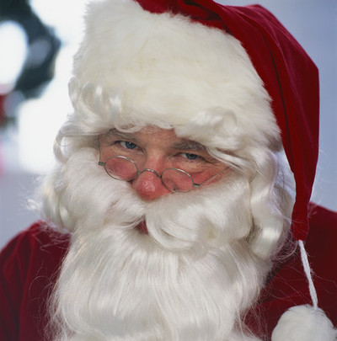
Santa Clause

Slide 4
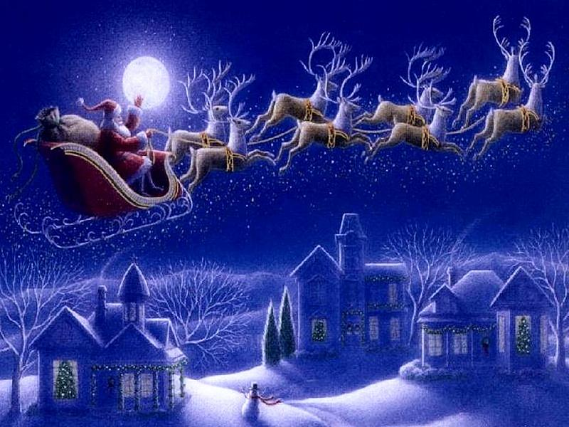
Santa’s Reindeers

Slide 5
Santa’s Reindeers
Dasher - Потрясающий
Dancer - Танцор
Prancer - Гарцующий
Vixen - Злобный
Comet - Комета
Cupid - Купидон
Dunder - Болван
Blixem - Молниеносный

Slide 6
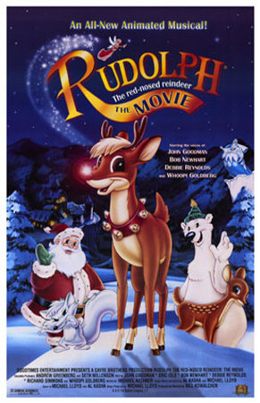
Rudolph – the
red-nosed reindeer

Slide 7
Santa’s Reindeers
Blixen
Comet
Cupid
Dancer
Dasher
Dunder
Prancer
Rudolph
Vixen

Slide 8
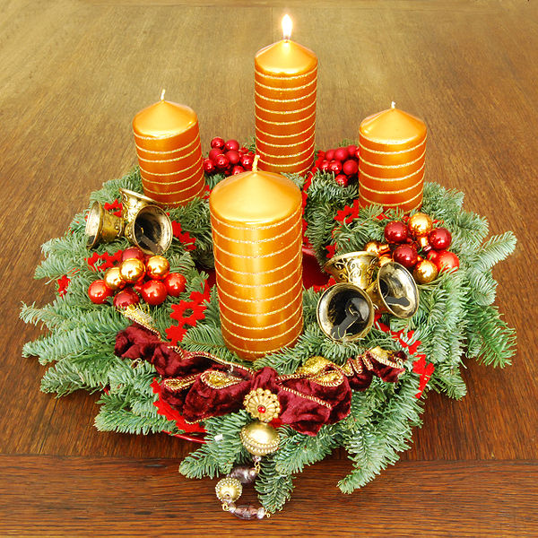
Advent Wreath

Slide 9
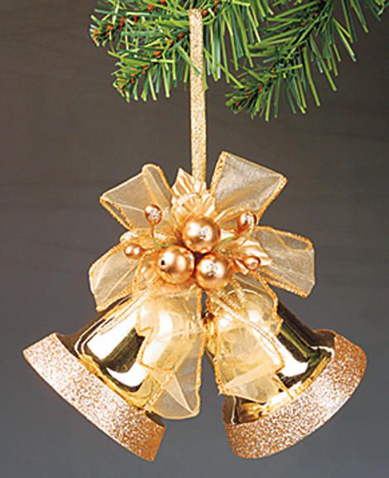
Bells

Slide 10
Candles

Slide 11
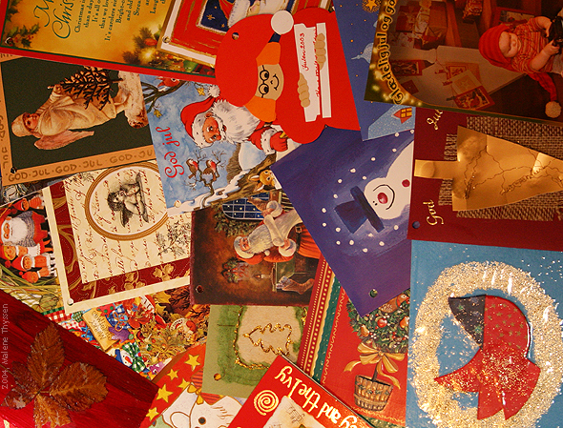
Cards

Slide 12
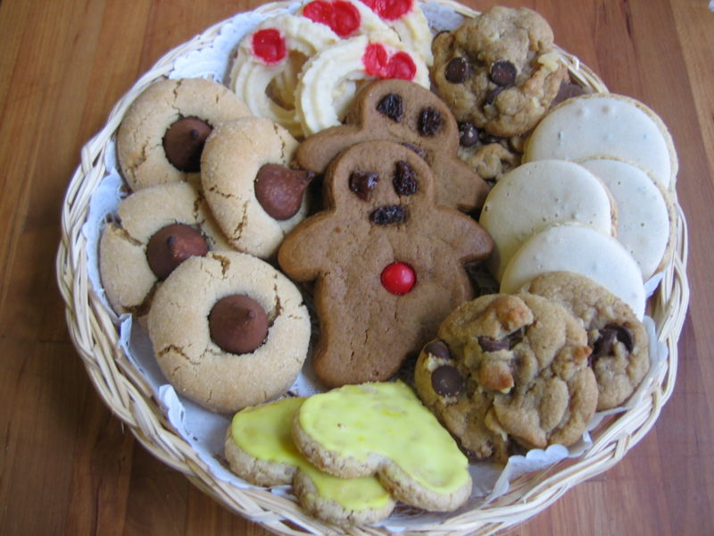
Cookies

Slide 13
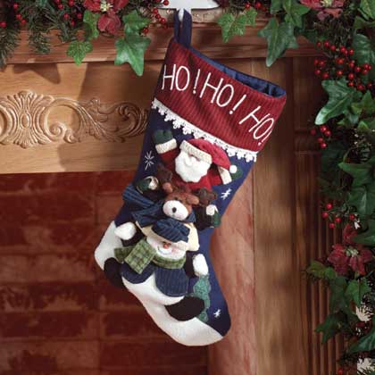
Stockings

Slide 14
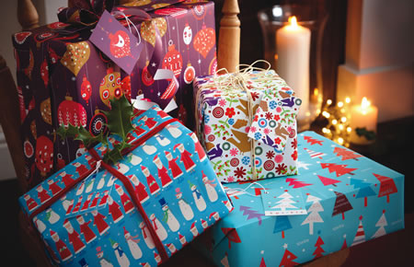
Gifts

Slide 15
Christmas
Christmas Tree
Santa Clause
Reindeers
Advent Wreath
Bells
Candles
Cards
Cookies
Stockings
Gifts

Slide 16
Merry Christmas!

