Slide 1
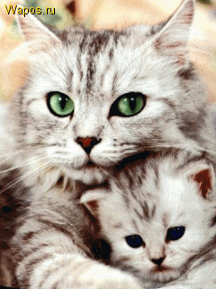
Family Relations
6 класс
УМК Биболетова М.З.
Выполнила:
учитель английского языка
Елшина Л.А.

Slide 2
Let’s train our tongue!
Grandmother, Father, cousin, mother,
elder sister, uncle, younger brother,
hand, husband, in hand, grandfather,
with, nephew, one, aunt, another.

Slide 3
Let’s train our tongue!
Father, mother,
Sister, brother.
Hand in hand
with one another.

Slide 4
Modal verb MUST
Помо
Помогает нам сказать, что кто-то что-то должен сделать
В предложениях:
Must + инфинитив без «to»
Must not + инфинитив без «to»

Slide 5
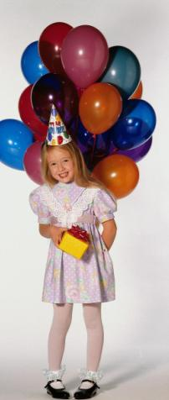
Parents’ responsibilities (обязанности) Ex.19,p.128
Parents must give their children more love.

Slide 6
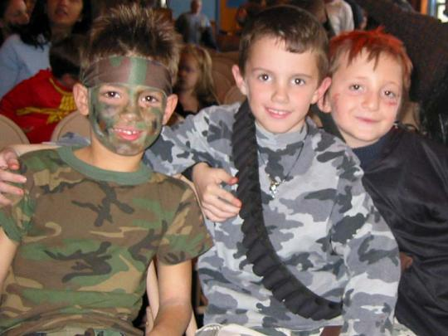
Parents’ responsibilities
Parents must give their children more freedom

Slide 7
Parents’ responsibilities
Parents must talk to their children more often

Slide 8
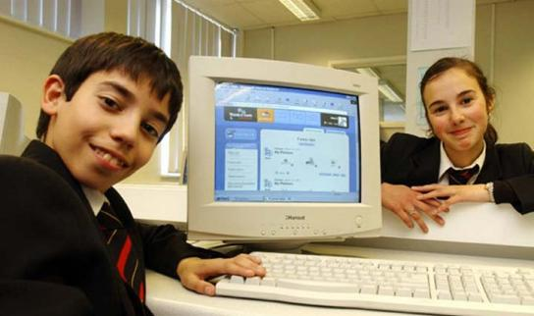
Parents’ responsibilities
Parents must help their children with problems they have at school.

Slide 9
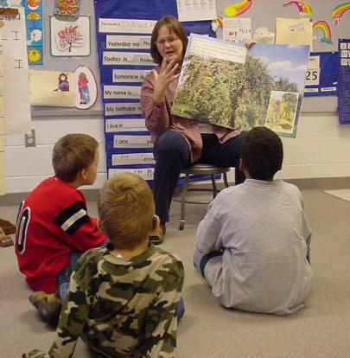
Parents’ responsibilities
Parents must be a good example to their children.

Slide 10
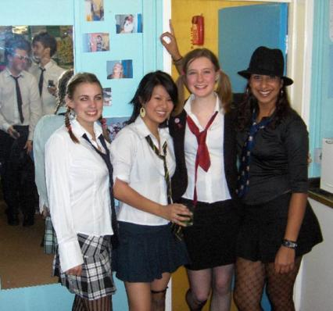
Parents’ responsibilities
Parents must try to understand their children.

Slide 11
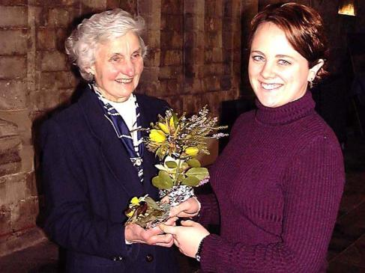
Children’s responsibilities Ex.20,p.129
Children must set the table before dinner and clear up after dinner every day.

Slide 12
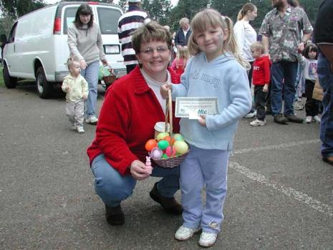
Children’s responsibilities
Children must make their beds.

Slide 13
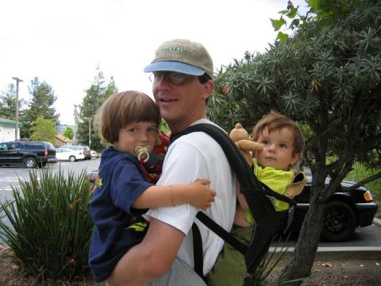
Children’s responsibilities
Children must do their homework by themselves.

Slide 14
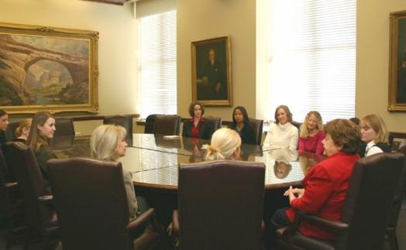
Children’s responsibilities
Children must help us with the washing up.

Slide 15
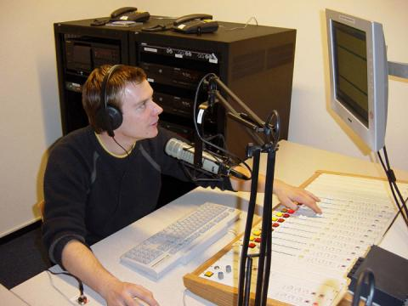
Children’s responsibilities
Children must take out the rubbish(мусор) early in the morning.

Slide 16
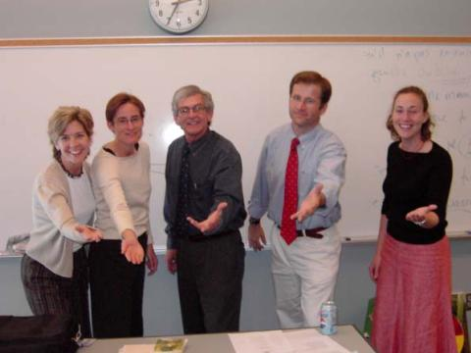
Children’s responsibilities
Children must help us at home and in the garden.

Slide 17
Homework
Ex. 3,p.139

