Slide 1
The 16th of December Classwork

Slide 2
Objectives
Skills development
Pupils will
express opinions about books
give advise about books using I’d recommend
write book reviews
Pupils will practice
reading for detailed information
writing book reviews

Slide 3
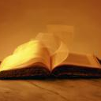
A book REVIEW
IS A DESCRIPTION OF A BOOK YOU HAVE READ AND WANT TO TELL OTHERS ABOUT

Slide 4
Vocabulary
title название
sentence предложение
character персонаж
opinion мнение
recommendation совет

Slide 5
1. WRITE THE TITLE AND THE WRITER 2. WRITE 3-4 SENTENCES ABOUT THE STORY - What is the story about? - who are the main characters? - what do the main characters do in the story? - who is your favourite character? 3. your opinion 4. your recommendation
FOUR STEPS TO WRITING A BOOK REVIEW

Slide 6
Choose a book and write a review

Slide 7
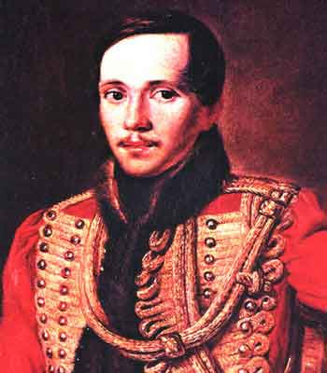
Mikhail yuryevich lermontov
Mikhail Lermontov was born in 1814 in Moscow. He was grown up by his grandmother in their country house Tarkchany. He was an only child. He always feels himself lonely. So he wrote such poems like “The Sail”, “The Cliff”, “The Clouds” etc.

Slide 8
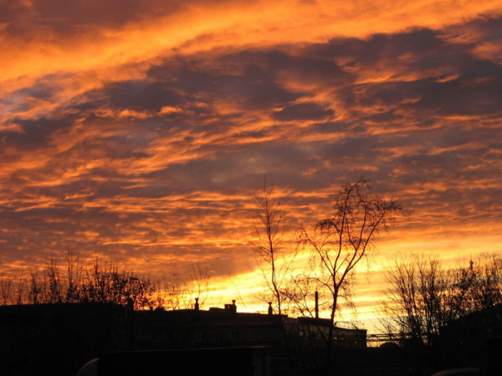
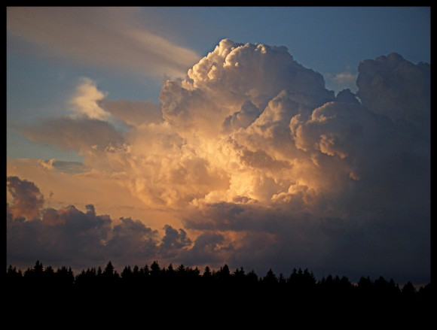
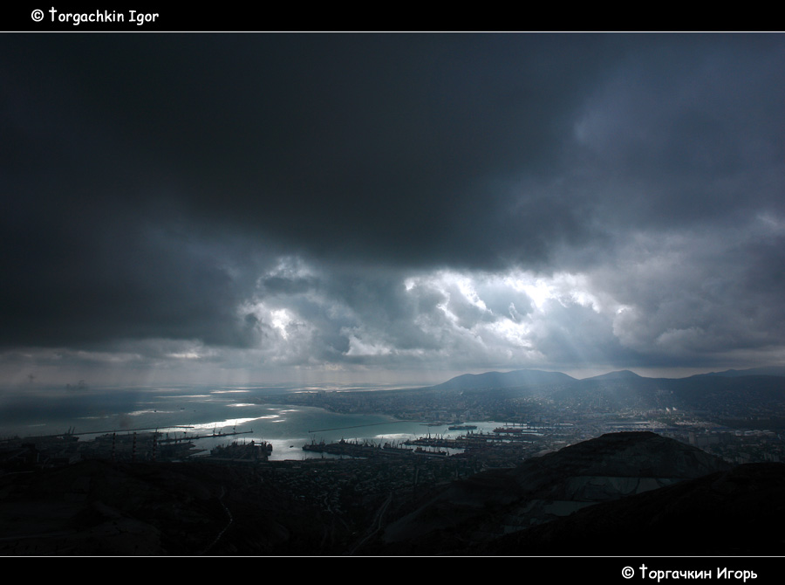
Тучи - The Clouds
Lermontov wrote this poem in 1840. In 'Clouds‘ the poet contrasted the clouds "free both to come and go, free and indifferent" to his fate in exile.

Slide 9
Тучи Тучки небесные, вечные странники! Степью лазурною, цепью жемчужною Мчитесь вы, будто как я же, изгнанники С милого севера в сторону южную. Нет, вам наскучили нивы бесплодные... Чужды вам страсти и чужды страдания; Вечно холодные, вечно свободные, Нет у вас родины, нет вам изгнания..
The Clouds
Clouds in the sky, you are
ceaselessly wandering, As pearly chains in the
azure steppes glimmering, Exiled as I have been, constantly hurrying From native North into South you
are quickening.
No, you were bored to death with these fields' fruitlessness With all these passions and alien misery, Ice cold eternally, in steady idleness You have no homeland and suffer no outlawry.

Slide 10
Homework
Repeat and learn new words by heart
Write the Review of your favourite book

