Slide 1
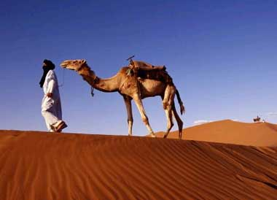
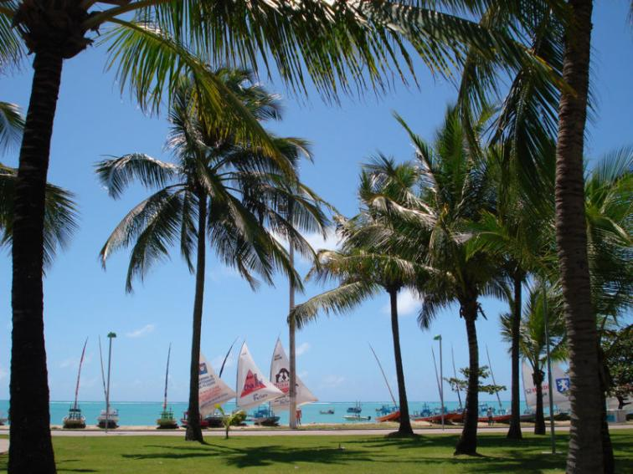
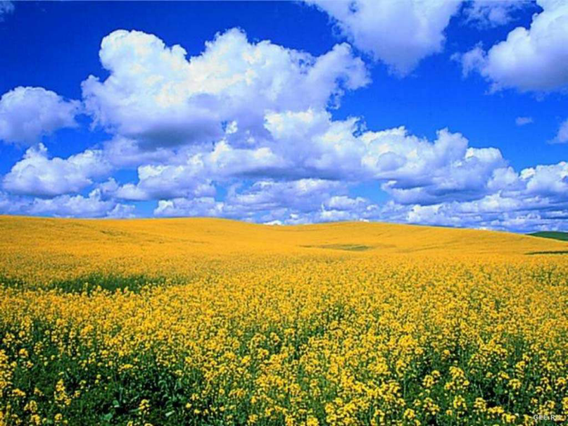
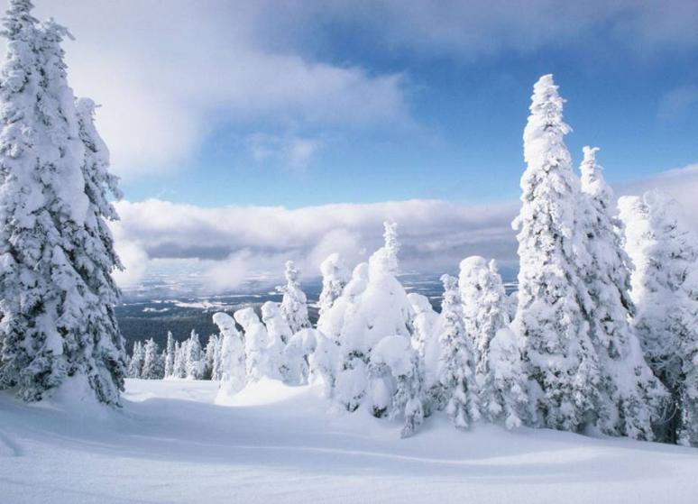
Countries
and
climates
Степанова
Татьяна Владимировна,
учитель английского языка
МОУ СОШ №9 г.Таштагола
Кемеровской области

Slide 2
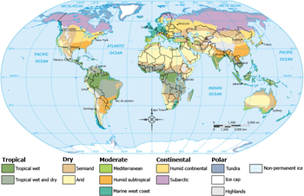
The route of our tour
Greenland
Egypt
Great Britain
India
Brazil
Spain

Slide 3
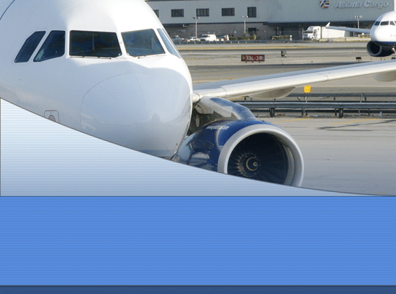
Have a good trip!

Slide 4
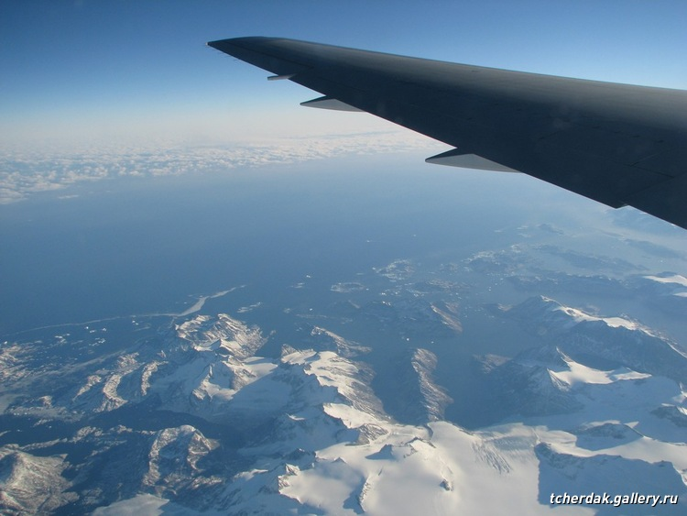
Greenland has a polar climate. The winters are very cold (-40˚C) with dry winds. The summers are short and cool (+8˚C).
Greenland

Slide 5
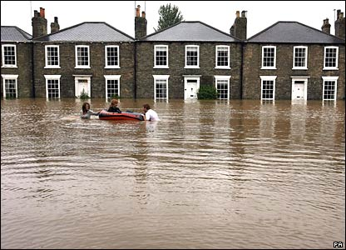
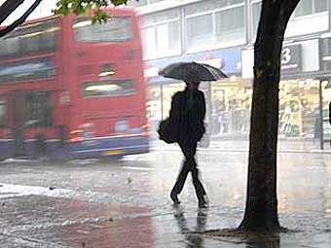
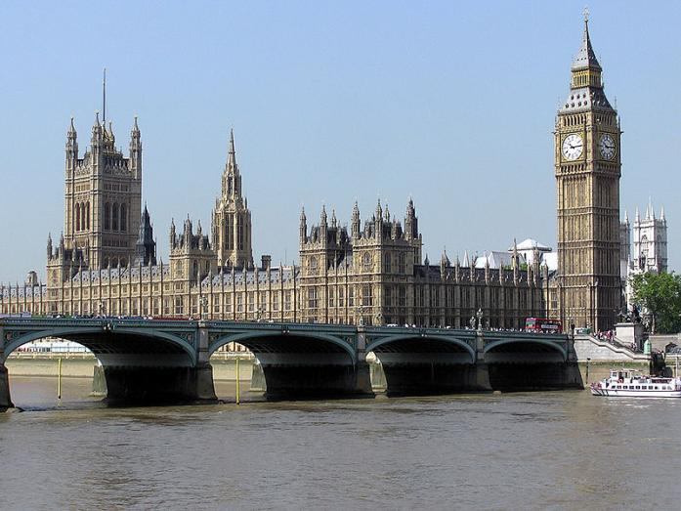
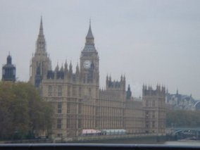
In Great Britain it is a cool temperate climate. They have rain almost all the year. The weather is foggy and wet. The summers are warm (+20˚C) and winters are not cold (-3˚C).There are often floods.
Great Britain

Slide 6
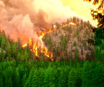
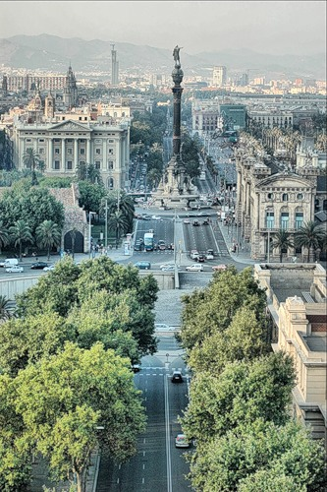
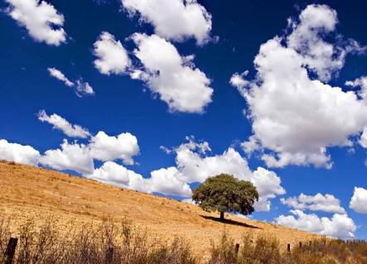
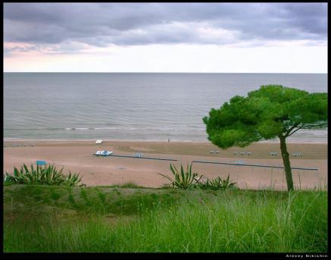
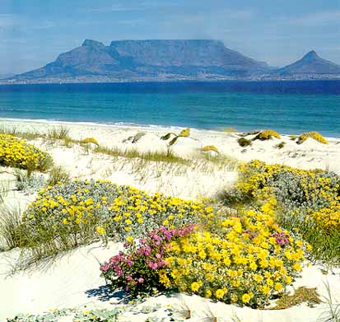
Spain has a warm temperate climate. It is very hot and dry weather in summer ( +40˚C). There are a lot of forest fires. The winter is not cold (+6˚C) but warm and wet. Sometimes it rains.
Spain

Slide 7
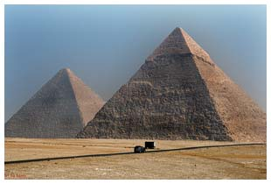
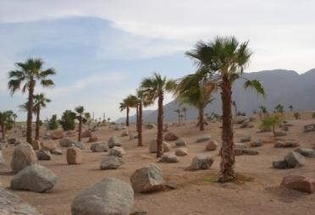
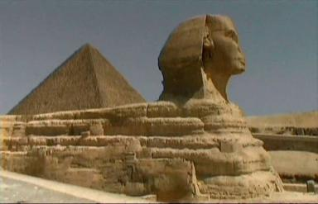
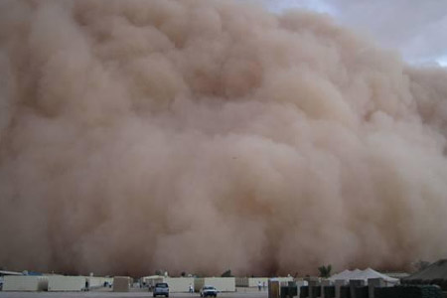
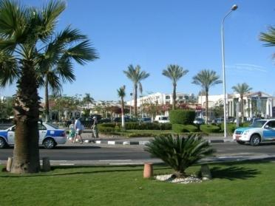
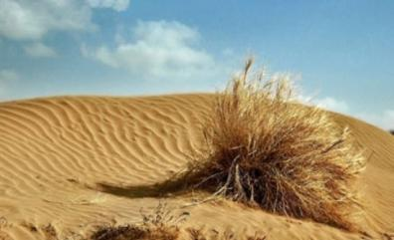
Egypt
Egypt is in a desert climate. It is very hot and dry during the day(+52˚C) but at night it gets very cold (- 2 ˚C). Sometimes they have sand storms.

Slide 8
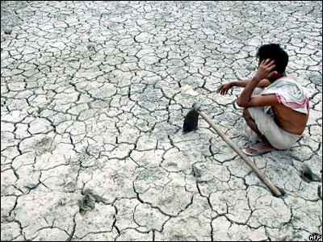
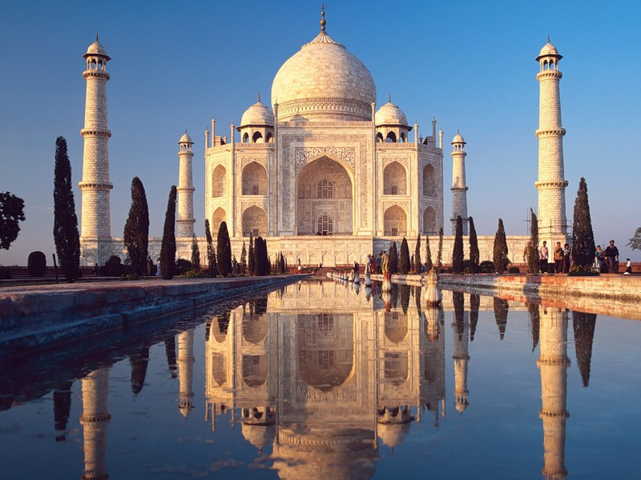
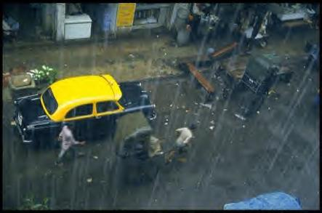
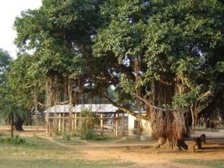
India is in a monsoon climate. There are two seasons – a wet season and dry one. They have rains from June to October (+16˚C). There is a dry season from October till May (+40˚C). There are often droughts.
India

Slide 9
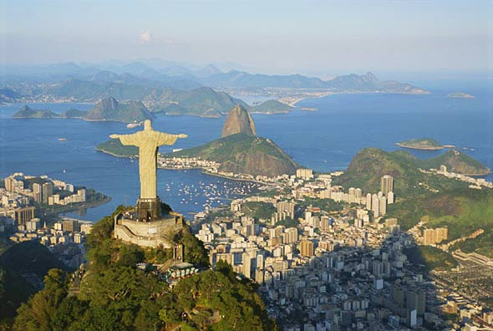
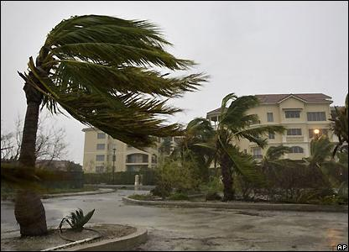
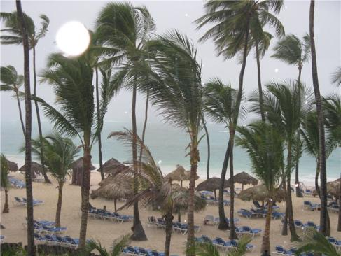
Brazil is in a tropical climate. It is always hot and wet. The temperature is usually 25˚C. There is a lot of rain all the year. Sometimes they have hurricanes.
Brazil

Slide 10
CLIMATES AND WEATHER
polar
very cold winters / dry winds / short and cool summers
cool temperate
rain / foggy and wet weather / warm summers / not cold winters / floods
warm temperate
hot and dry weather in summer / warm and wet winters / forest fires
desert
hot during the day / cold night / sand storms
monsoon
wet and dry seasons / droughts
tropical
hot and wet / a lot of rain / hurricanes

Slide 11


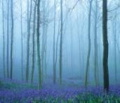
Please, make a poster about one climate with your group. Good luck!
cold
warm
rainy
sunny
snowy
wet
hot
frosty
windy
foggy
cloudy

