Slide 1
Hobbies in our life
Do we like doing the same things?

Slide 2
'' Twice happy is the man who has a hobby, for he has a hobby, for he has two worlds to live in…’’

Slide 3
g_ _ dening
r_gby
sp_ _t
d_ncing
postc_ _d
th_ _tre
r_ _ding
col_ecting
tr_velling
_inema
h_ _seracing

Slide 4
gardening
rugby
sport
dancing
postcard
theatre
reading
collecting
travelling
cinema
horseracing

Slide 5

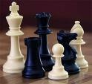
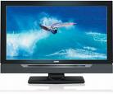

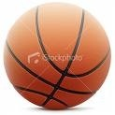
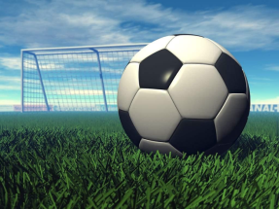

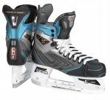
I would …….,

Slide 6
to be fond of
fit
travelling
a secret
to keep
to bed
music
to go
old letters
for a walk

Slide 7
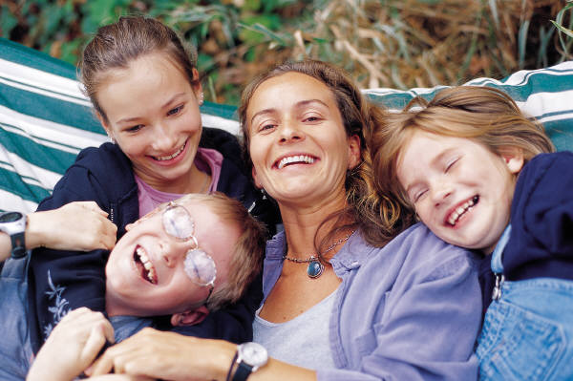
My family hobbies

Slide 8
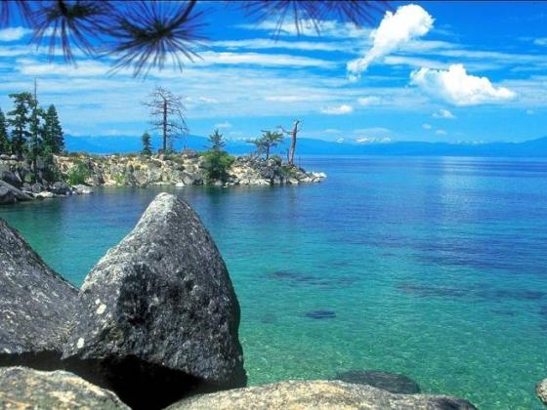
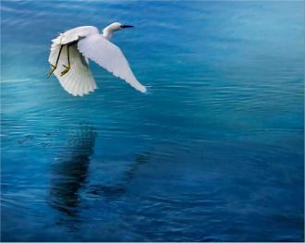
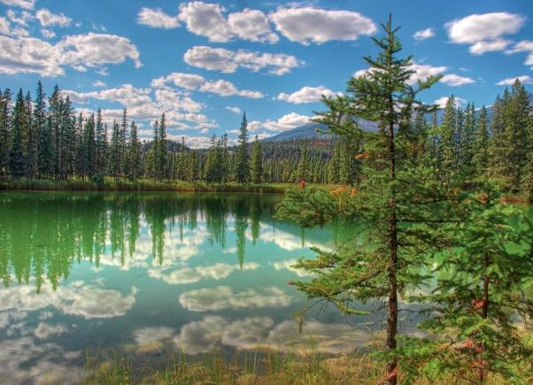

Slide 10
The most popular hobbies
1. Sport, especially football
2. Music
3. Pets
4. Collecting ……
5. TV and video

Slide 11
Are you a sport fan?
What sport are you fond of?
Do you like to watch or to play sports?

Slide 12
Collecting ……..
1.I have a big c________________ of coins
2.My f______ has done it for 20 years.
3.There are more than 200 coins from d__________ countries in our collection.
4.Collecting coins isn’t e___________, you know.
5.You should know about different c____________ and their p____________.
6.I haven’t got any m___________ Russian coins in my c_____________.

Slide 13
Homework
Ex. 10 p. 147

Slide 14
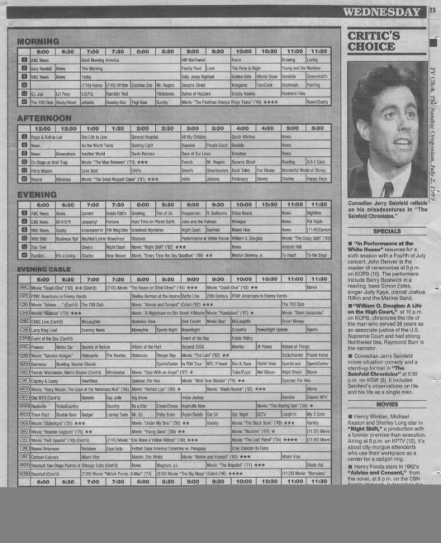
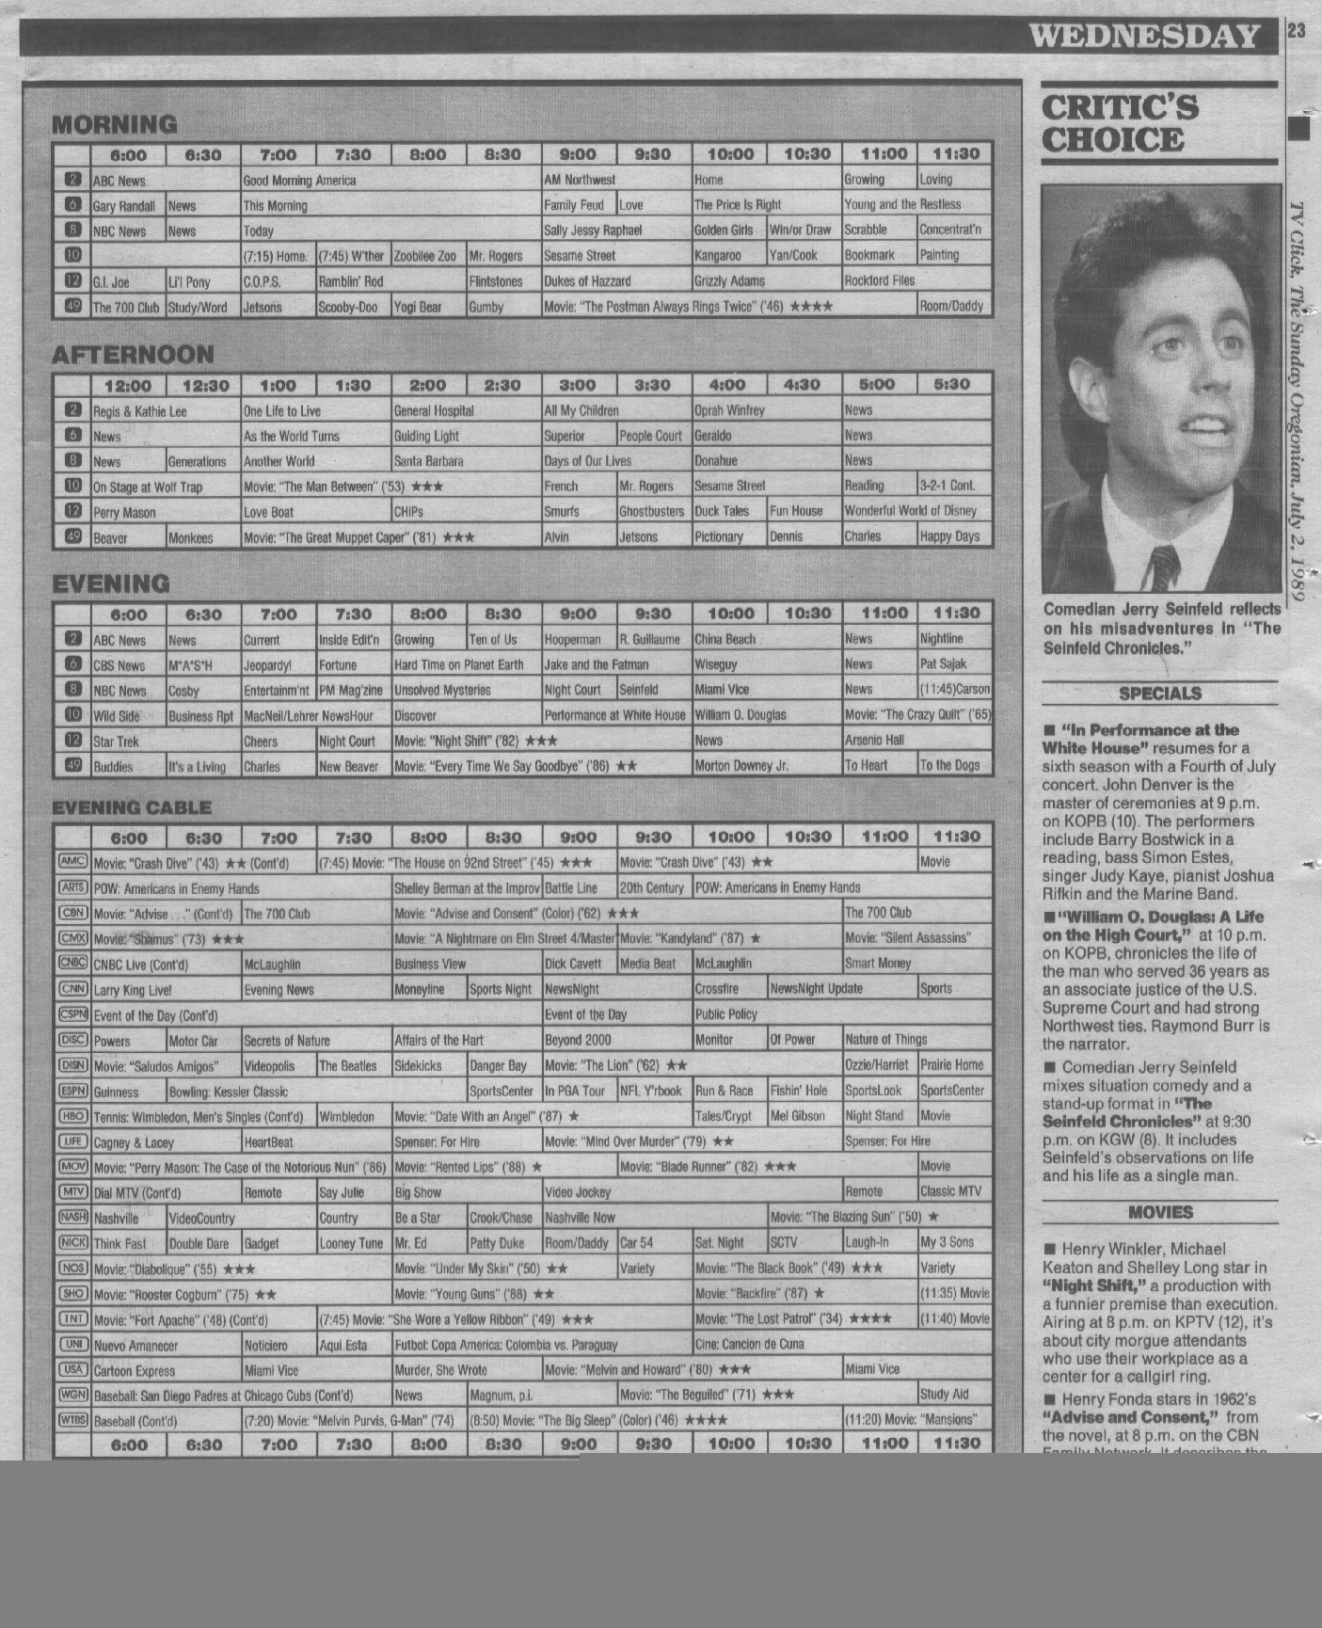
BBC 1 /TV shedule
7.00 News
9.00 All over the shop
10.30 Can’t cook, won’t cook
11.20 Skiing
12.00 Regional news
12.35 Going for a song
1.00 Sesame Street
3.30 Children’s BBC
5.35Coronation street (soap)
6.00 Weather
6.30 World Motor Sport
7.05 Panorama
8.00 Sledge Racing

