Slide 1
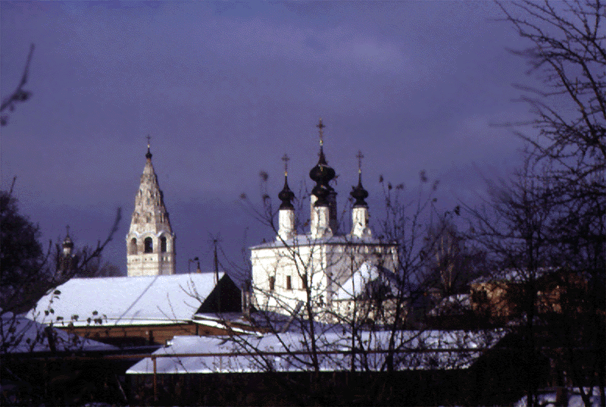
TRAVELLING. SUZDAL. HISTORICAL SIGHTS.
Peshkova Elena Vladimirovna
an English teacher Prokopievsk school № 3

Slide 2
TRAVELLING
to be impossible without travel- ling (people's life) - to go on a business trip or to travel for pleasure (thousands of people) - different ways of travelling (there are) - to travel (by air, by rail, by sea, by road, on foot) - to be the fastest and the most con- venient way of travelling (by air) - the most expensive way of trav- elling (by plane) - to have its advantages too (trav- elling by train) to make the longest journey en- joyable the main advantages of trains (speed, comfort and safety in com- fortable seats of the sleeping cars) - to prefer trains to other means of transport | - to be very popular (travelling by sea) - to go on a two-week cruise (travelling by ship) ~ to be very popular too (travel- ling by car) - to stop at any place you like - to spend at any place as much time as you like - to be very popular with young people (hiking) - to enjoy the countryside - to live in tents on the sea shore or in the forest - to breathe in fresh air and the sun all day - to play sports games and enjoy the sunset - to return home sunburnt and full of impressions

Slide 3
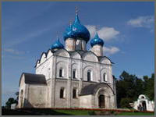
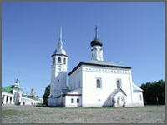
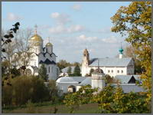
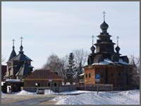
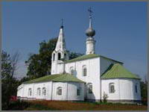
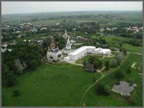
The panorama of Suzdal

Slide 4
Listening

Slide 5
When was it founded? | It`s square | It`s status | How many historicl monuments? | What is it famous for? | Where is it situated? | How can you get Suzdal from Moscow?
In 1024 | 8 km² | It`s a preservd town | 200 from 13-18 centuries | By it`s churchesconvents, wooden houses and bridges, onion domes and spire, iron sign, ancient monasteries, bell towers . | Suzdal is a district center of Vladimir region. It is located 35 km from on the Kamenka river | By train, then by bus

Slide 6
T: Let’s starts our tour to Suzdal historical sights. This ancient Russian city is an architectural jewel being one of the so-called “Golden Ring” religious of old Russia. The Intercession Cathedral (1510 - 1514) is an imposing and solemn edifice with three helmet-shaped domes. A splendid gallery with uncommonly tall arcades on short pillars runs along the first floor level. The cathedral acted as a mausoleum. The tall ground story housed a shrine for the ladies of noble families: the Polotskys, the Belskys, the Nagoys, the Skopin-Shuyskys, the Cherkasskys. To render the temple even more sumptuous in the 17th century the passages from the cathedral to the belfry were added. The Intercession Cathedral (the central edifice of the convent) became notorious as the place where women were forced to take the veil. Along with Salomonia Saburova, wives of Ivan the Terrible (Anna Vasilchakova and Praskovia Solova) took the veil in the convent, followed by Yevdokia Saburova, wife of Tsarevitch Ivan. In 1610 Tsarina Maria Petrovna, wife of the dethroned Vasily Shuisky, and his daughter Anastasia were cloistered there, then Ksenia Godunova, daughter of Tsar Boris. The last prisoner of the convent was Yevdokia Lopukhina, the first wife of Peter I who dealt with the unloved spouse following the example of his predecessors. In 1712 Yevdokia Lopukhina established an altar in the Church of St. Nicholas in the convent's suburbs in memory of her son Tsarevitch Alexei who had opposed his father's measures and methods of reforms.

Slide 7
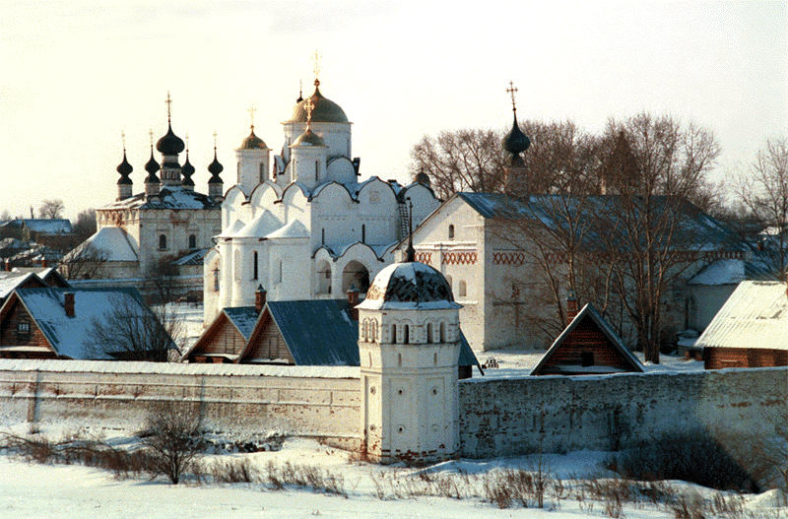
The Intercession Cathedral (1510 - 1514

Slide 8
The groundwork of the Redeemer Monastery of St. Euphimius was laid in the mid-14th century by commission of the prince of Nizhni Novgorod. The monastery protected the northern territories of the Suzdal-Nizhny Novgorod principality and served as its citadel. The mortal remains of Euphimius, the first Father-Superior of the monastery were laid to rest in the side-chapel of its main @2103403 {Transfiguration Cathedral} In 1445 by the walls of the monastery a fight between the troops of Vasily the Dark and the army of the Kazan khanate took place. The Tartars took the prince Vasily the Dark "by hands" and then let him go for a huge ransom for those days - 200 thousand rubles. In the 17th century the monastery was ravaged by Polish invaders. The hard fortress walls that are there now were put up after the liberation. Later the monastery became one of the wealthiest in the region. It had lands and villages with 7000 peasants in its possession. Moscow's tsars made rich donations to the monastery treasury. Quite a good income the cloister received from pilgrims who came to worship the remains of Father Superior Euphimius. After the secularization of the monastery made by the order of Katherine II a state @2103404 prison was founded there.

Slide 9
At the end of the 17th century the stone walls (1664) of the monastery were replaced by wooden ones. They are up to 8.5 km high (depending on the relief) stretching out for about 1200 km, with 12 towers of different shape. The Water Tower with 12 facets looks particularly severe. In the south-western tower facing the Kamenka river one will find an observation ground with a view of the town and the white @2103401 {Intercession Convent} The fortress was erected complying with all rules of fortification art by Suzdal's master whose talent can hold its own with the celebrated master of the end of the 16th century Fyodor Kon who built his fortresses in Moscow and Smolensk. The barbican in the southern wall of the fortress facing the town was executed with an outstanding artistic taste. The tower is half-turned to the road, its two upper tiers are affluently decorated with alternating protuberances and chains of tiles. The lower part of the barbican is austere and ascetic, with a somber passage under the arch pressed down under a 22-meter construction and topped by an elegant dome. Having entered the monastery under the vaults of the somber barbican one out of sudden will find himself near the pretty gate Church of the Annunciation (1628) standing separately from the gate, blessing the entrance to the monastery according to the tradition. The monastery fortress has not suffered from enemy incursions as it was built at the time when the state boundaries had moved far away from Suzdal's territory.

Slide 10
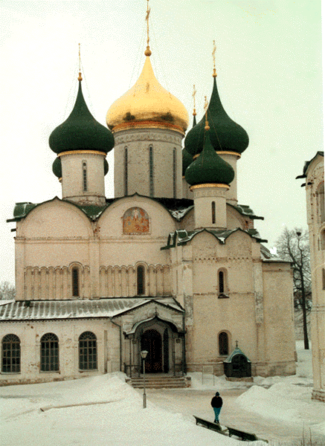

Slide 11
Prince Dmitri Pozharsky was buried on the grounds of St. Euphimius' Monastery of Our Savior. The ancestors of the great commander were the princes Starodubskys. In 1218 they founded the town of Stary Dub (Old Oak) on the Klyazma that became the center of the principality. In 1238 it was ruined by the Tartar-Mongols. Nowadays, Klyazminsky Gorodok (Klyazma Small Town) stands on its site. For a long time the burial place of Pozharsky was not known. The eminent archeologist Prince Uvarov, one of the founders of the Moscow and Russian Archeological societies, excavated and discovered in the altar of the Transfiguration Cathedral of St. Euphimius' Monastery of Our Savior a burial vault with three rows of coffins. It was the family reliquary of the Pozharskys and Khovanskys. A coffin in the third row was more imposing than the other ones. In 1852 after a lot of contemplation the coffin was opened. A skeleton of an elderly person was found there. He was dressed in a silk shroud, with remains of boyar decorations (gilded embroidery on the girdle and garment), that none other of the Pozharsky kin than Dmitri could have as he was the only boyar. After the research was over, the great commander was reburied on the monastery grounds, his grave became available for everyone's worship. In front of the entrance into the monastery a public garden with a bust of Dmitri Pozharsky was laid out.

Slide 12
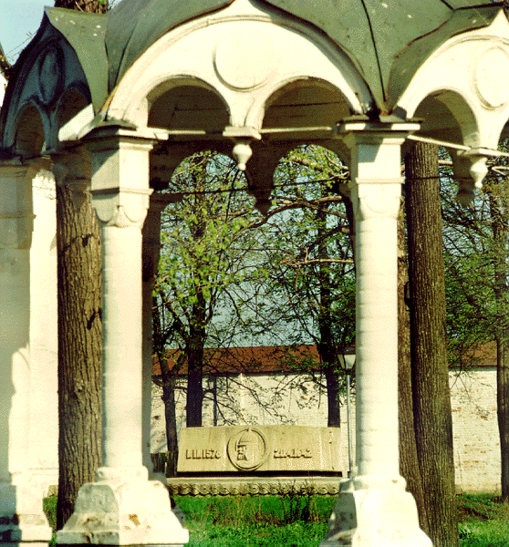

Slide 13
The Nativity Cathedral (1222-1225) is the principal edifice of ancient Suzdal. The dates of its erection accepted in literature are rather relative. The cathedral is one of the most intricate monuments of ancient Russian architecture which has absorbed architectural peculiarities of the 11th -17th centuries. Its first structure dates back to the 11th century, to the period of the princedom of Vladimir Monamachos which is evidenced by the ruins of walls and foundation, discovered during the archeological excavations in 1938. In 1222 Yuri Vsevolodovitch had the dilapidated building dismantled and replaced by a new one, built of white-stone, which existed until the 16th century. In 1528 the white-stone walls above the arcatured band with female masks were pulled down and brick walls were put up in their stead. The three-domed cathedral got a five-domed topping, its interior was ornate with murals in the 17th century. Thus, the Nativity Cathedral has gone through quite a few modifications. Its interior contains the murals of the 13th, 15th , and 17th centuries. The Nativity Cathedral became the first urban house of worship which was not exclusively intended for the noble elite. It is positioned in the center of a ring made up of bulwarks, in the curve of the Kamenka river. Throughout its history the temple was several times put on fire. Mortal remains of sons of Grand Duke Yuri Dolgoruky, the princes Shuisky and other noble persons were laid to rest in the cathedral. The Golden Gate of the southern and northern portals is the most amazing monument of the 13th century applied arts. The gate is adorned with an ornament and figures of double-headed eagles, lions and griffins. The handles in the shape of a lion head symbolizing the prince's power guard the entrance into the temple.

Slide 14
The Nativity Cathedral (1222-1225)

Slide 15
The monastery of the Deposition of the Holy Robe was founded in 1207. This ancient cloister towers up at the highest point on the area. Throughout its history it was put on fire and devastated by invaders. The earliest constructions have not survived. In 1688 Suzdal's master-craftsmen Andrei Shmakov, Ivan Mamin and Ivan Gryaznov put up a stone fence and the Holy Gate, one of the most astounding monuments of Suzdal's architecture. This picturesque and fanciful gate is inlaid with colored tiles. Pointed tent roofs were built over the two monastery passages. The big aisle is meant for ceremonies. The gate is flanked by a lodge topped by a small octahedral tower. The principal Cathedral of the Deposition of the Holy Robe was erected in 1520. In 1688 a parvis was added to it imparting more charm to the cathedral. The style of the three-domed Cathedral of the Deposition of the Holy Robe is reminiscent of churches in neighboring Intercession Monastery. Its construction could have been paid for by the boyar Ivan Shigony. He was involved in forcing Solomonia Saburova, the wife of Vasily III, to take the veil and tried to pray forgiveness by sponsoring the construction of the Nativity Monastery. The monastery belfry was put up under the supervision of Suzdal's master-craftsman Kuzmin in 1813-1819 in classical style which was then in fashion. This highest (72 m) building in town was dedicated to the victory in the Patriotic War of 1812.

Slide 16
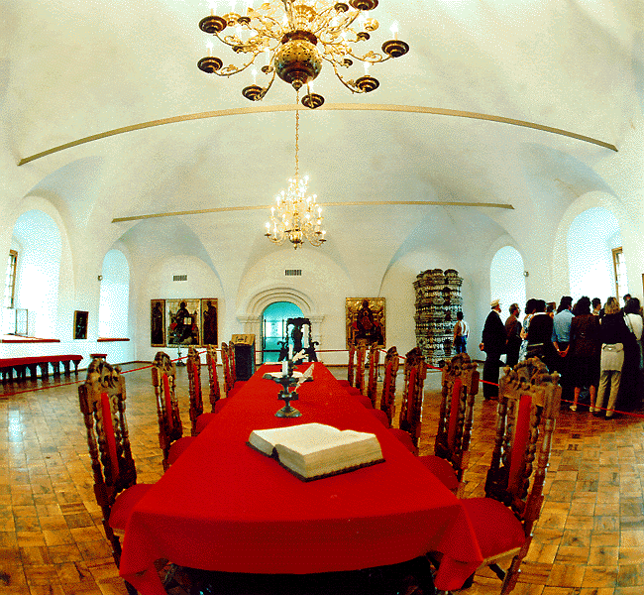
The monastery of the Deposition

Slide 17
St. Alexander's Monastery is the ancient Suzdal monastery was founded in 1240 by Alexander Nevsky. The constructions of the 17-18th centuries have survived to this day. Those are the Church of Christ's Ascension (1695), the belfry, and the Holy Gate. The earlier constructions perished in fires and numerous wars. In 1764 the monastery was abolished. The Church of Christ's Ascension, the construction of which was financed by Tsarina Natalia Kirillovna, seems to have been the central one. Its significance as a house of worship is empathized by a great volume, beautifully worked up portal, and ornamental elements in the decor of its facade. The austere belfry with a pointed tent roof deprived of any decorations heightens the festivity of the Church of Christ's Ascension by its laconic forms. The path leading up to this ensemble starts at the single-bayed Holy Gate. The walls of the monastery have not survived.

Slide 18
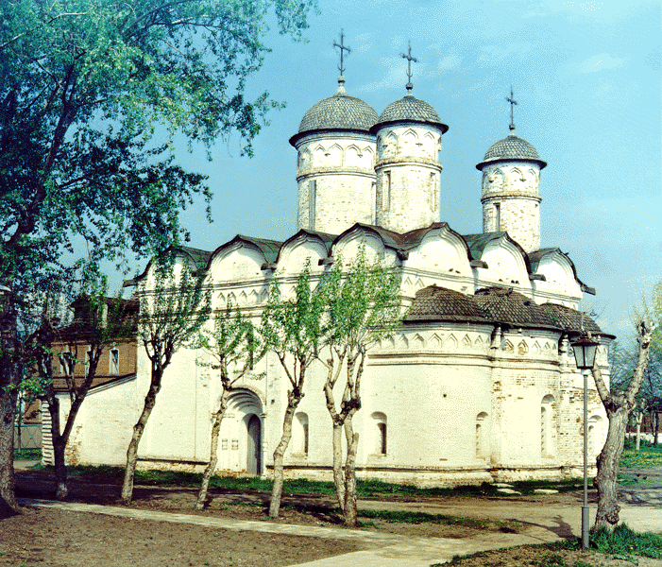
St. Alexander's Monastery

Slide 19
Task Questions 1-10 based on the topic. For questions 1-10 decide whether the statements are TRUE (A), FALSE (B). 1. The eminent Russian commander Prince Dmitri Pozharsky were laid to rest in Transfiguration Cathedral in 1642. 2. Solomonia Saburova organized the prison in Transfiguration Cathedral. 3. You can see three helmet-shaped domes on the top of Intercession Cathedral. 4. The Cathedral became notorious because it was the place where women were forsed to take the veil. 5. Gate church of the Annunciation is the tiny copy of Intercession Cathedral. 6. The architect of Conception church of Anna was Polish master because Vasilly 3 married a Polish beauty Elena Glinskya. 7. Prison of Redeemer monastery is the highest in the town. 8. Nativity Cathedral is the main and the most difficult in bilding. 9. The clock of the bell-tower famous because of big numbers. 10. St. Alexander`s monastery is a museum with a large long table which stands on oaken bricks floor.

