Slide 1
Муниципальное общеобразовательное учреждение
«Средняя общеобразовательная школа №2» г. Салехард
Тема:
«Легко ли быть молодым»
Автор работы:
Ишметова Ксения
Учитель:
Мунирова Элиза Зиевна
2009-2010 учебный год

Slide 2
TEENAGE YEARS
DO THEY BRING LUCK?

Slide 3
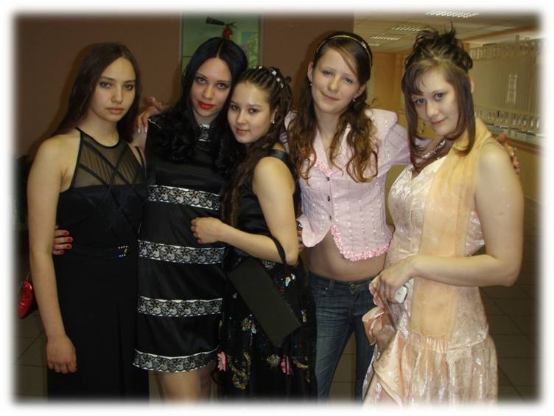
Teenage years – do they bring luck?
This question is actual for teenagers. Some think that teenagers years are hard, not easy. Others think that teenagers years are the most wonderful, fun and exciting.
THE YOUTH – THIS WONDERFUL TIME PASSES QUICKLY. WE SHOULD VALUE IT AND NOT WASTE TIME!!!

Slide 4
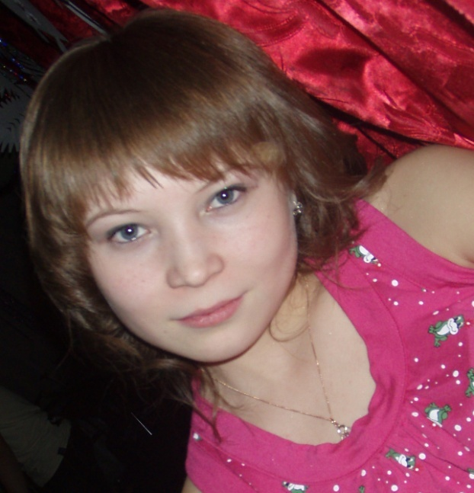
Ishmetova Kseniya, 16
I think that teen years are the happiest, the most wonderful and carefree, because teenagers do not have problems which adults have. We can go for walks with our friends, do to the discos, organize parties and enjoy ourselves.
Zhmur Anastasia, 16
In my opinion teenage years are great because teens have not much to care of. Teenage years are unforgettable and the happiest time in our life.
Ozelova Olga, 17
It seems to me that teenagers, who talk about hard teen years are mistaken, because in this period of our life we are protected from very serious problems. We have much free time and no duties. We should value each minute when we all are together.

Slide 5
TEEN PROBLEMS
Teens turning to drugs and alcohol, smoking
Sex. Teen pregnancy, abortions
Problems with school, family and friends

Slide 6
Teenagers problems
Friends. We have no time to spend time together with friends , go out with them, share our secrets. We have too much homework.
Parents. Many teens think that their parents can’t understand them. They always criticize their kids.”Don’t do this! You can’t do that!”. It’s often really hard to put up with.
School life. Teens are often under pressure in many ways at school. Some of them have problems with their studying, others with classmates or teachers.
“Problem Teenagers”. These teenagers smoke, drink alcohol or even take drugs. They often get into trouble.
Money. Many teens haven’t enough pocket money. They don’t have enough to cover their expences. They want to earn money, but don’t know how to do it.
Teens often have to deal with their problems themselves.
Notes:
T

Slide 7
CONCLUSSION
After questioning some teenagers, we came to conclusion that teenagers years are the best years in the life of any person. The Opinions can be different, but we keep this point of view, for us this is very important and dear.
Being a teenager is great fun. It allows us to do exciting and wonderful things. We should take it easy.

