Slide 1
Легко ли быть молодым?
Авторы работы:
Крайнов И., Малиновский Артем., Гунбин Д., Бусалаев А.
Учитель:
Мунирова Элиза Зиевна

Slide 2
Being a teenager

Slide 3
Is it easy to be young? It is a very interesting question because how many teenagers, so many opinions

Slide 4
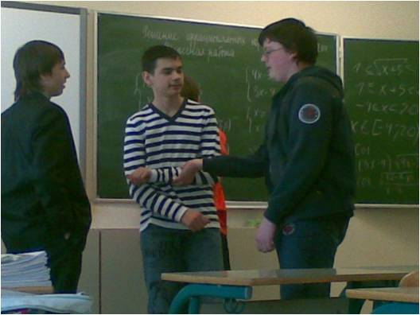
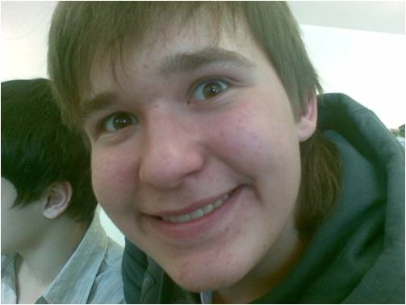
On the one hand being a teenager is great fun and interesting.
Firstly, you can cheerfully spend time with friends.
Many teenagers like to spend time in such a way: they communicate with each other all day long in the streets, at school or on the internet. For teenagers dialogue is a life.
Secondly, teenagers can visit various sports clubs. They have a good time exercising their body there. But now it is becoming not so popular …
Thirdly, teenagers now can learn the world by means of the Internet. On the Internet it is possible to learn all you want

Slide 5
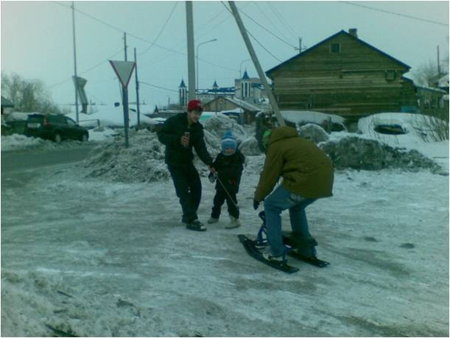
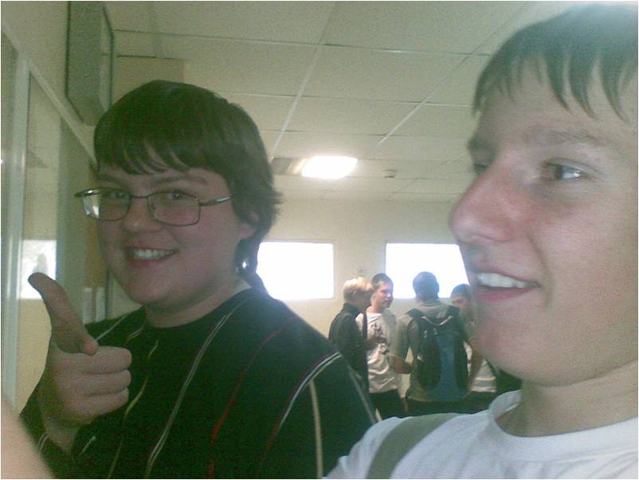
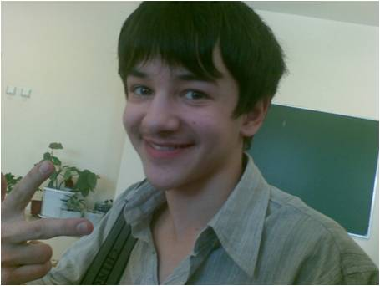
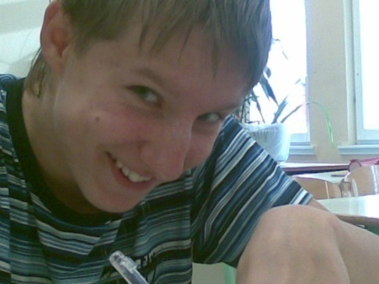
Teenagers can do what they want. They have not a lot of cares and a lot of free time. Everyone decides himself how to spent his free time. The majority of teenagers choose communication. Parents give teenagers freedom and do all for them.

Slide 6
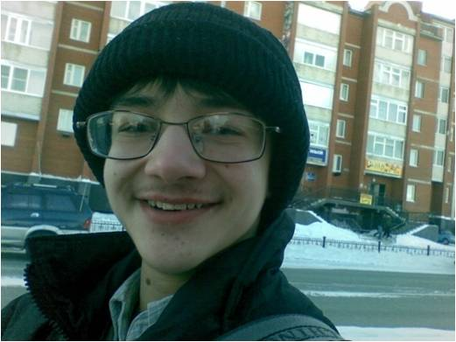
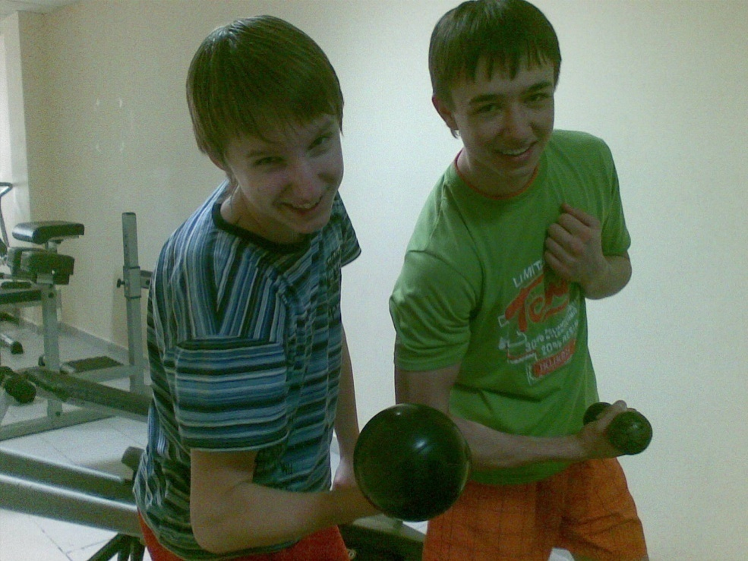
On the other hand, teenagers have some serious problems. First of all, it is drug crisis. This crisis is based on some kind of fashion for drugs. However, soft and hard drugs can easily cause addiction. Sometimes that’s enough to use drugs just once to fall seriously ill (for example, AIDS) or even to die. Another problem is smoking. It damages not only the health of the smokers, but also the heath of people around them. More over, we should mention strong drinks. They are extremely harmful for young organisms.

Slide 7
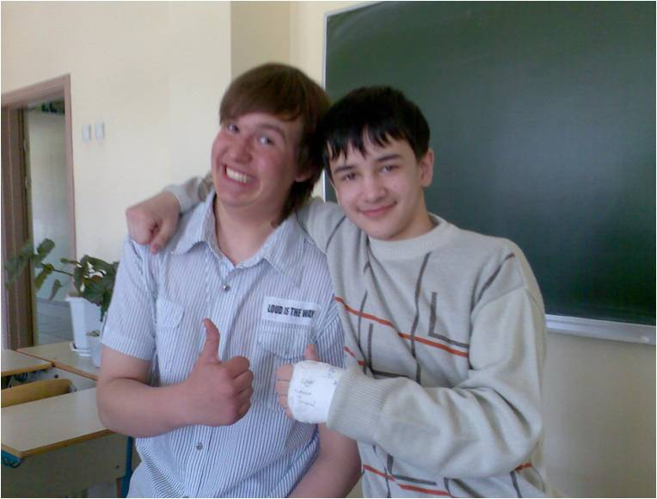
These problems are combined with problems in school or family. a lot of teenagers say that their parents let them do anything they want and are quite indifferent to their problems, and we think it is a very important problem for young people too.
To conclude we would say that it is great to be young!

