Slide 1
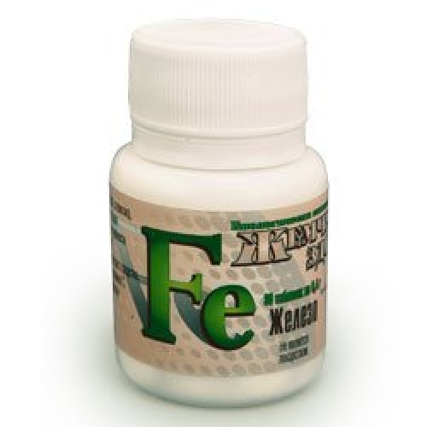
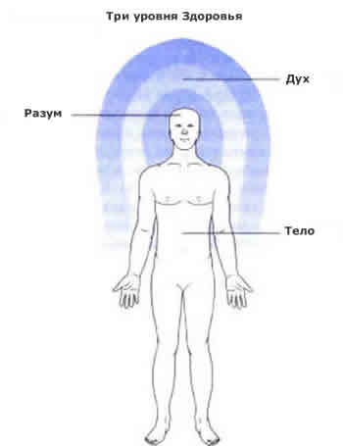
HEALTH

Slide 2
Health is the greatest wealth.
An apple a day keeps the doctor away.
Early to bed and early to rise, makes a man healthy, wealthy and wise.

Slide 3
Aims of the lesson:
to learn some new words and expressions about health;
to discuss the aspects of the topic;
to do different exercises.

Slide 4
Answer the questions:
What good and bad habits can people have?
What sports are you in for?
Are you dieting at the moment?
Is it important to care about your health?
How many hours a day do you sleep?
Do you eat a lot of sweets?
Have you had breakfast today?

Slide 5
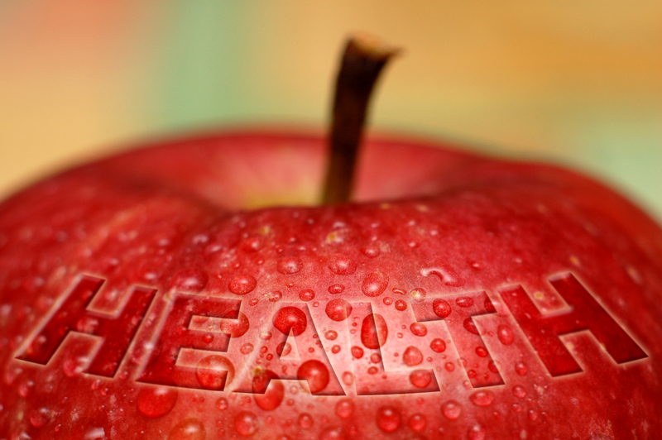
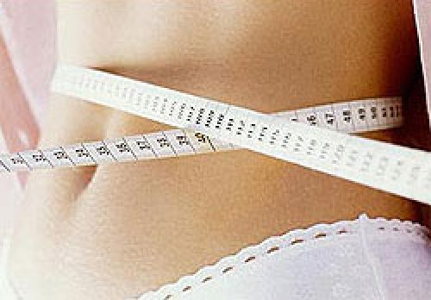
Health
dieting

Slide 6
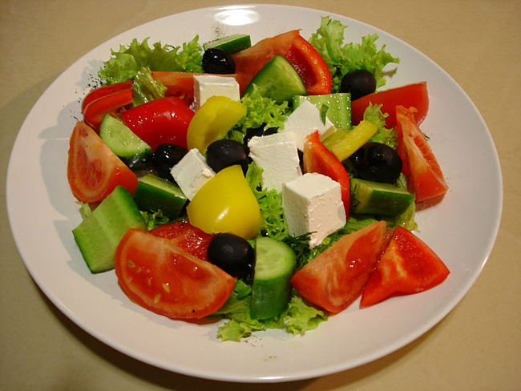
exercising
Eating low-fat food

Slide 7
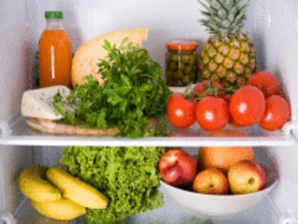
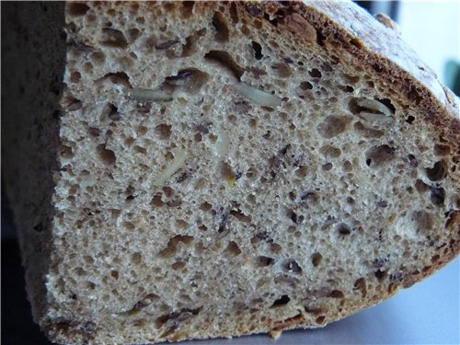
Eating high-fibre food
Eating wholemeal bread

Slide 8
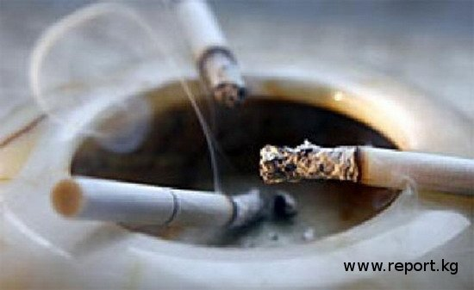
smoking
Drinking alcohol

Slide 9
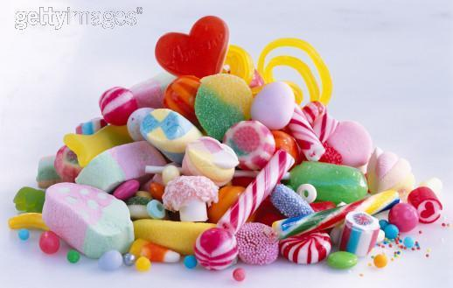
Eating sweets
Physical inactivity

Slide 10
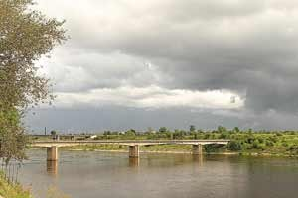
Environmental influence

Slide 13
Good health habits
exercising
dieting
eating low-fat food
eating high-fibre food
eating wholemeal bread

Slide 14
Bad health habits
smoking
drinking alcohol
physical inactivity
eating sweets
environmental influence

Slide 15
Put the missing words into the following sentences

Slide 16
Many people today think about their
health.
My friend is very fat, because he eats
sweets
My brother gave up
- now he doesn’t cough and has white teeth.
smoking

Slide 17
Eating high- fibre food
is very important for healthy nutrition.
One of the ways to lose weight is
dieting.
Environmental influence
can cause many diseases like cancer.
important - важно; nutrition – питание; way – способ; lose weight – терять вес; cause disease – вызывать болезнь; cancer – рак.

Slide 18
Match the word with its description

Slide 19
dieting
the product made from flour that contains all the grain
lack of movement, passive way of life, doing nothing
low-fat food
eating only certain food or a small amount of food
physical inactivity
the products containing less fat in comparison with the other
environmental influence
the effect caused by the surrounding conditions
wholemeal bread

Slide 20
True or False?
FALSE
Helen is going to be a supermodel.
She tries to eat only low-fat food
Helen thinks that smoking doesn’t affect other people’s life
TRUE
FALSE

Slide 21
Bob wants to be the odd-one out among
his friends.
On his opinion dieting is very dangerous.
He has some problems with his
skin and hair
FALSE
TRUE
TRUE

Slide 22
Kate believes that it is very important
how the person looks.
Her friend Willie likes sweets and
is pleasantly fat.
She wants to have only well fit people
as friends.
FALSE
FALSE
FALSE

Slide 23
Read the text, find the main idea and answer the questions

Slide 24
What are the 3 main rules for a healthy person?
What do the exercises do to our body?
What is the proper food?
Do you feel healthy?
Do you keep all these rules?

Slide 25
Homework
write an essay about health

Slide 26
THANK YOU FOR THE LESSON! GOODBYE!!!

