Slide 1
Speaking about seasons and the weather (Enjoy English) 4 класс Шафина М.П.

Slide 2
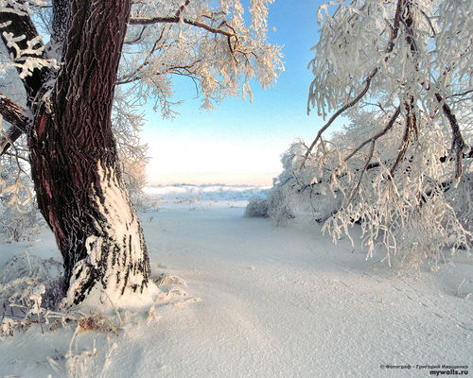
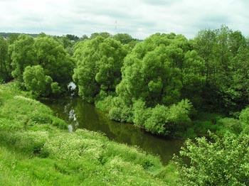
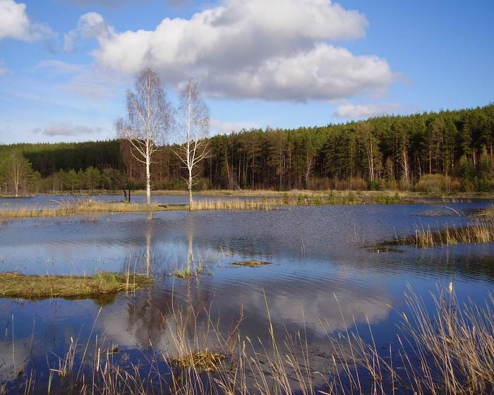
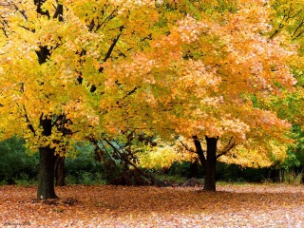
winter spring summer autumn

Slide 3
What is your favourite season? __________________________ I like ...

Slide 4
Say why you like / don’t like summer ( winter / spring / autumn ).

Slide 5
It’s
warm cold and snowy hot green sunny and fine rainy and cloudy nice snowy

Slide 6
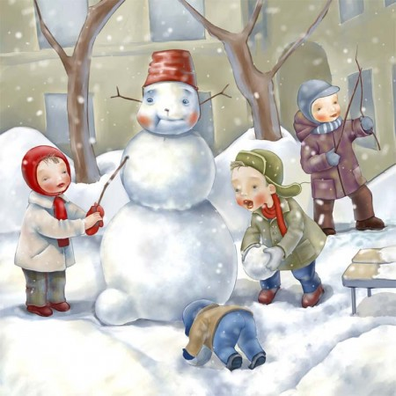
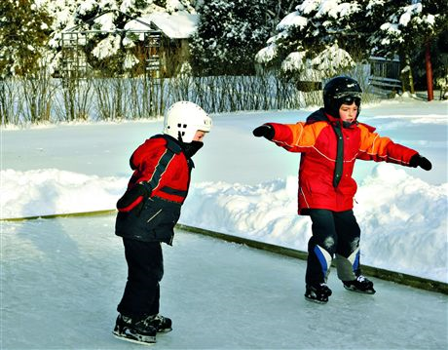
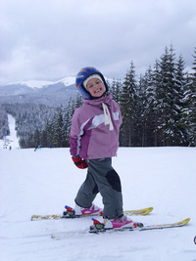
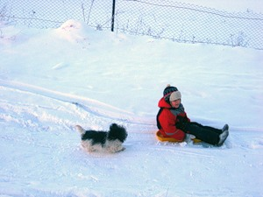
ski
toboggan
play snowballs
make a snowman
skate

Slide 7
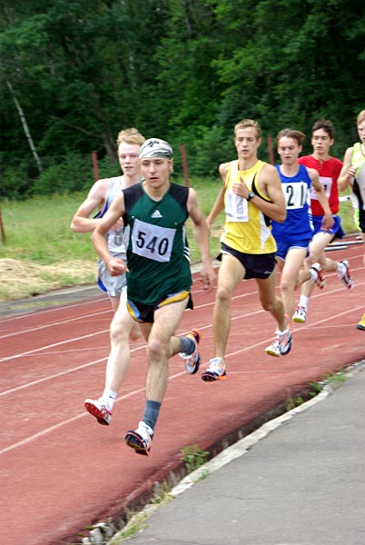
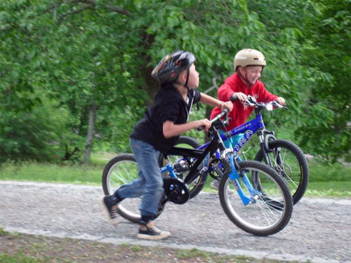
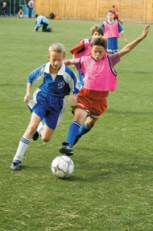
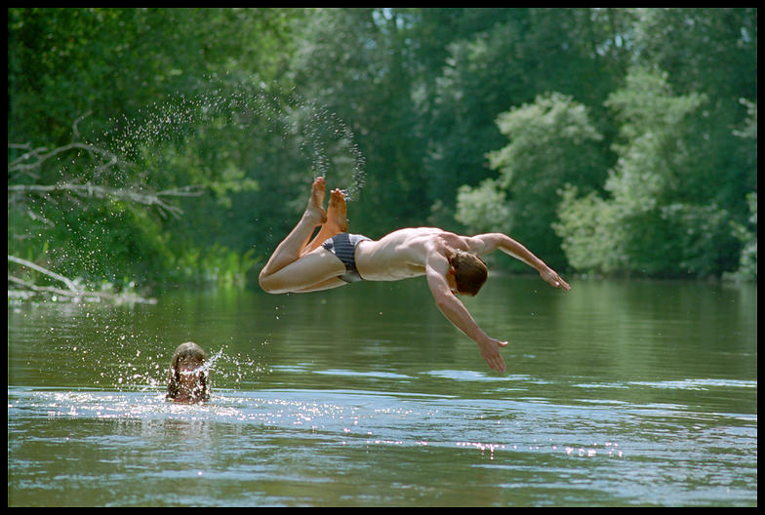
play football dive run ride a bike swim

Slide 8
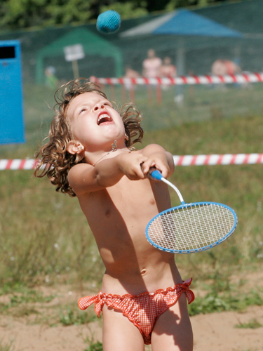
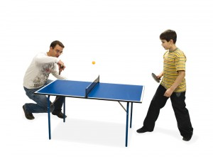
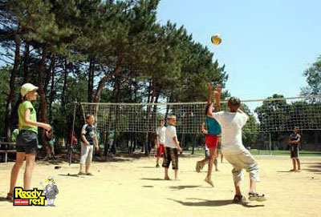
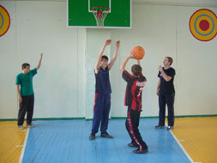
play basketball play volleyball play table tennis play badminton play hockey

Slide 9
What can you do in winter? What can you do in summer? What can you do any time?

Slide 10
In summer I can … In autumn I can … In winter I can … In spring I can … read books walk in the park play with my friends ski and skate dive and swim draw pictures

Slide 11
Translate into English. жаркое лето …………………….. играть в футбол ……………….. холодная весна………………… ветреный день ………………… нырять …………………………... снежная зима ………………….. кататься на санях …………….. теплая осень …………………... солнечный……………………… в любое время …………………

