Slide 1
Happy New Year!

Slide 5
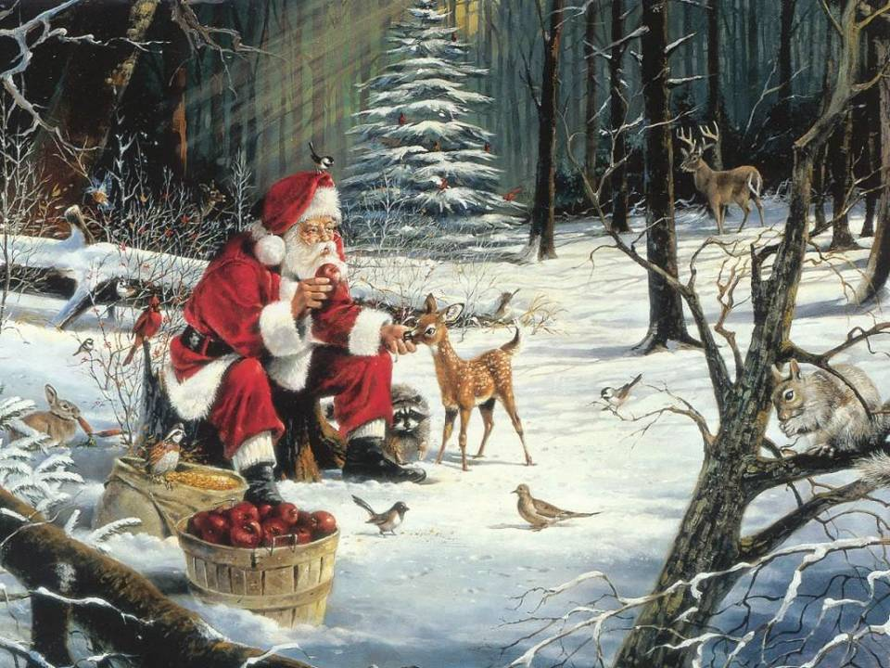

Slide 7
I’d like to decorate by …

Slide 8
I’d like to decorate by …

Slide 9
I’d like to decorate by …

Slide 10
I’d like to decorate by …

Slide 11
I’d like to decorate by …

Slide 12
I’d like to decorate by …

Slide 13
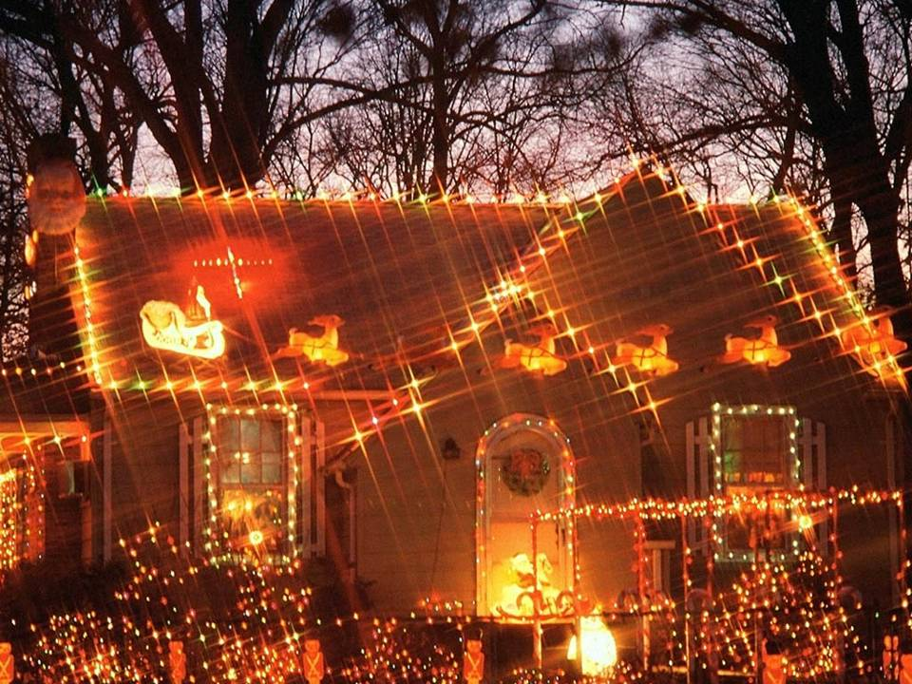
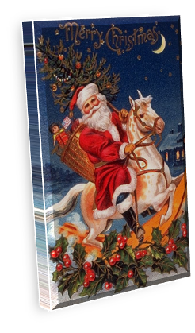
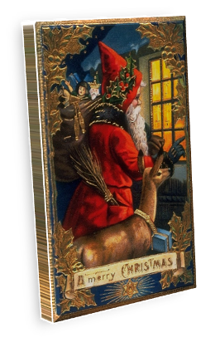
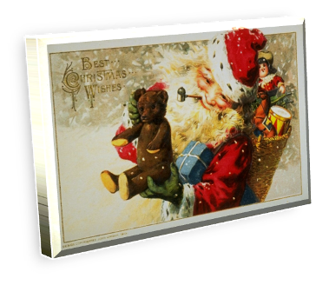

Slide 15
Merry Christmas!

