Slide 1
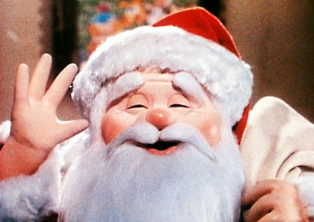
MERRY CHRISTMAS!!

Slide 4
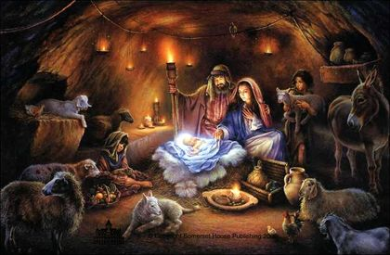

Slide 5
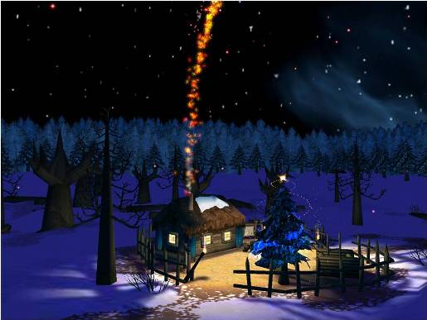

Slide 6
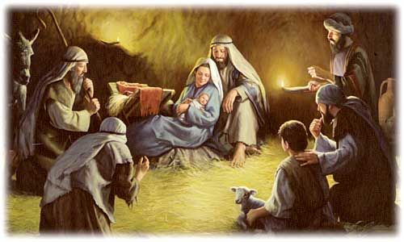

Slide 7
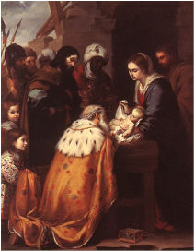

Slide 8
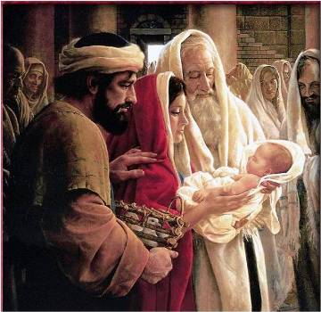

Slide 9
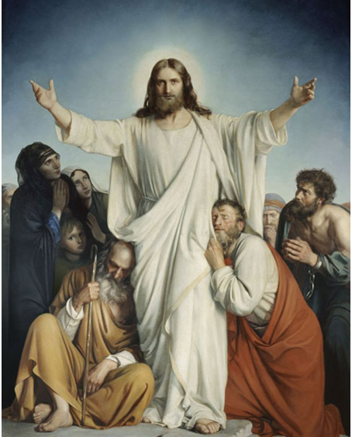

Slide 10
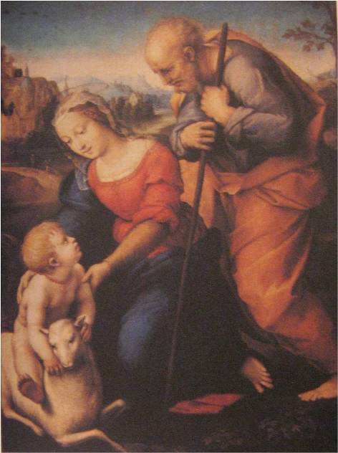

Slide 11
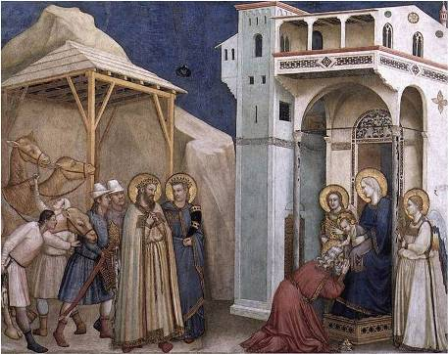
The Adoration of the Magi

Slide 13
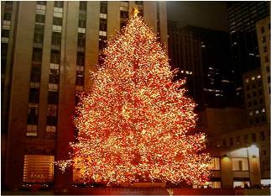

Slide 14
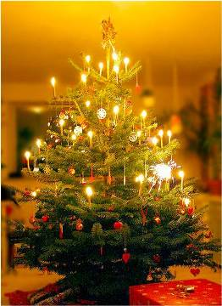
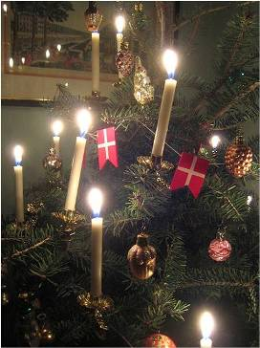

Slide 15
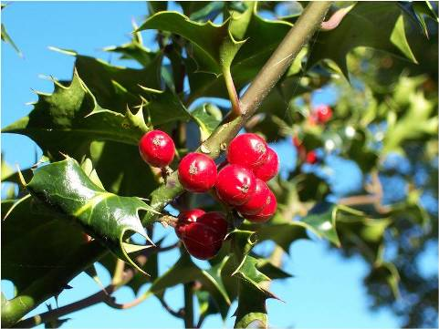

Slide 16
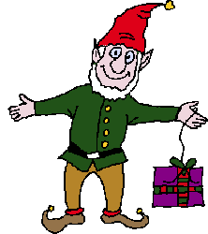
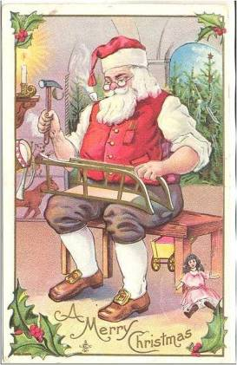
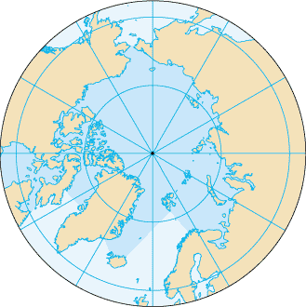

Slide 17
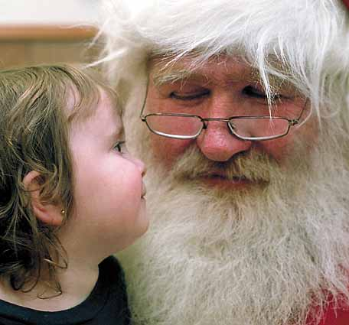

Slide 18
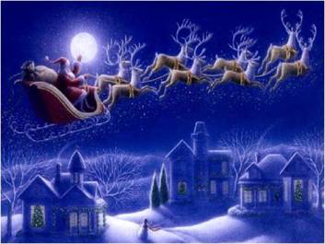

Slide 19
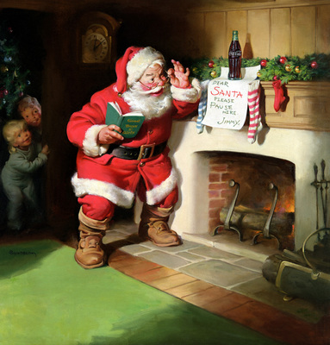

Slide 20
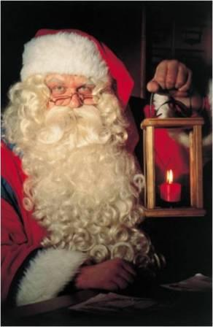

Slide 21
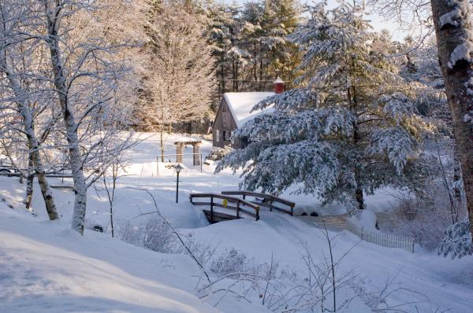

Slide 22
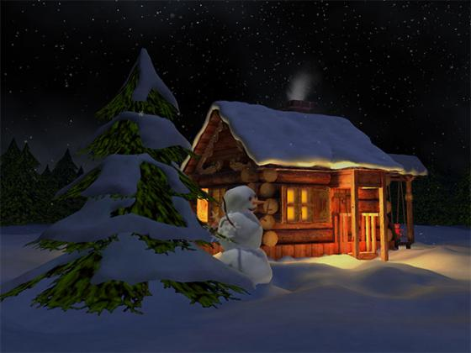

Slide 24
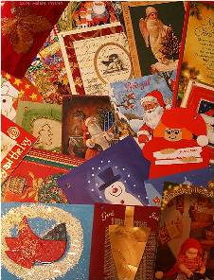
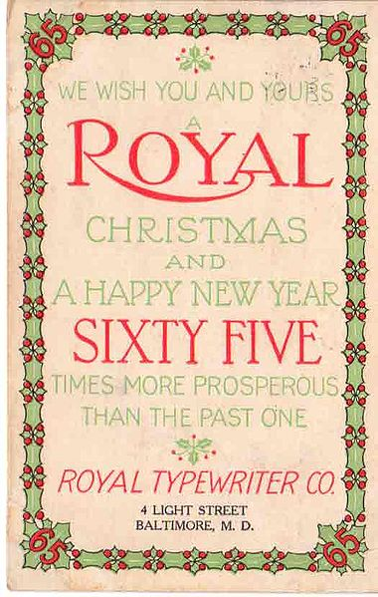

Slide 25
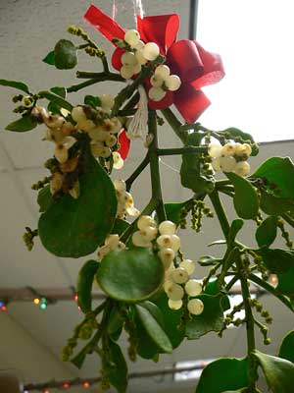
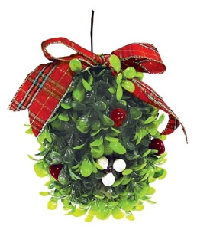

Slide 26
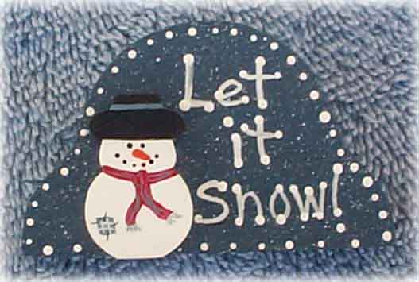

Slide 27
Oh the weather outside is
frightful,
But the fire is so delightful,
And since we've no place to go,
Let It Snow! Let It Snow!
Let It Snow!

Slide 28
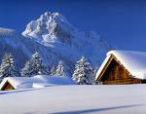
It doesn't show signs of stopping,
And I've bought some corn for popping,
The lights are turned way down low, Let It Snow! Let It Snow!
Let It Snow

Slide 29
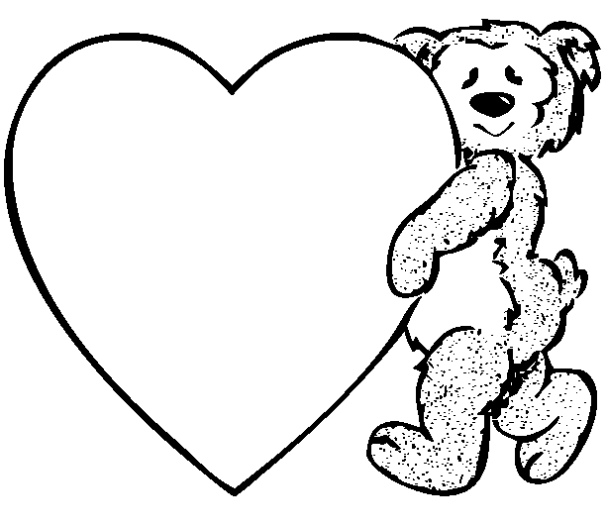
When we finally kiss goodnight,
How I'll hate going out in the storm!
But if you'll really hold me tight,
All the way home I'll be warm.

Slide 30
The fire is slowly dying,
And, my dear, we're still good-bying,
But as long as you love me so,
Let It Snow! Let It Snow!
Let It Snow!

Slide 31
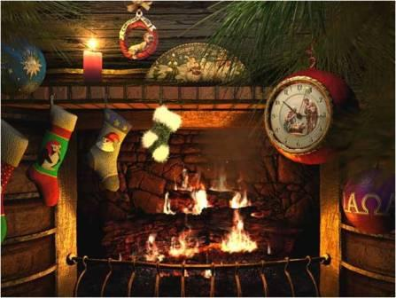

Slide 32
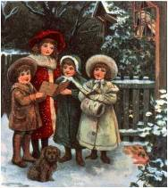
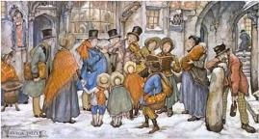
Carol singing

Slide 33
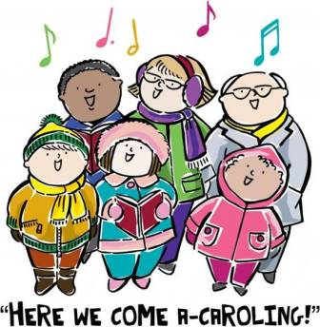

Slide 34
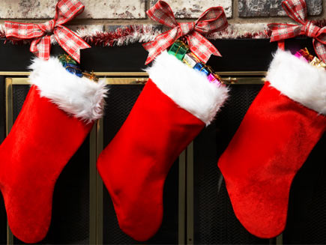

Slide 35
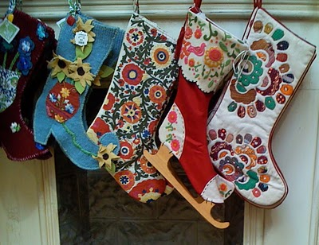

Slide 36
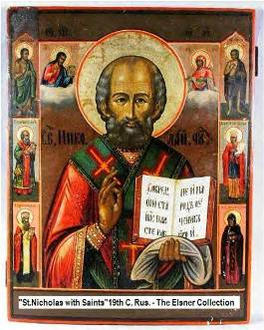

Slide 37
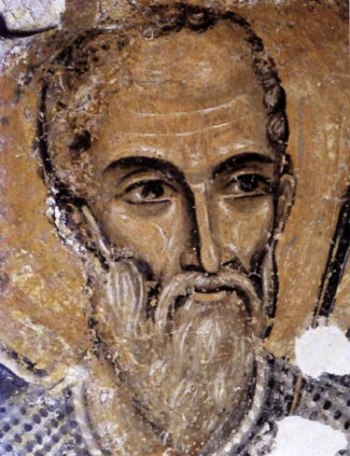

Slide 38
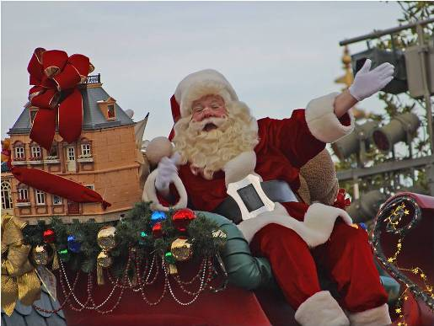

Slide 39
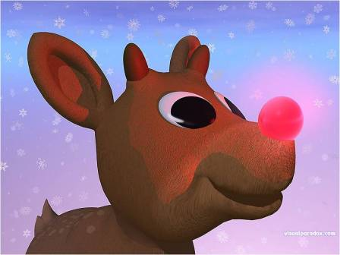

Slide 40
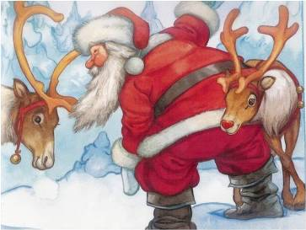

Slide 41
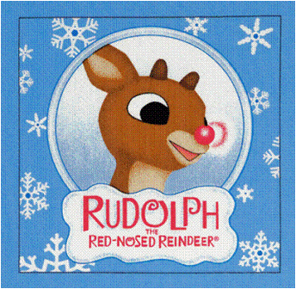

Slide 42
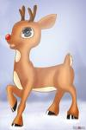
Rudolph, the red-nosed reindeer
had a very shiny nose.
And if you ever saw him,
you would even say it glows

Slide 43
All of the other reindeer
used to laugh and call him names.
They never let poor Rudolph
join in any reindeer games.

Slide 44
Then one foggy Christmas Eve
Santa came to say:
"Rudolph with your nose so
bright,
won't you guide my sleigh tonight?"

Slide 45
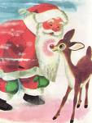
Then all the reindeer loved him
as they shouted out with glee,
Rudolph the red-nosed reindeer,
you'll go down in history!

Slide 46
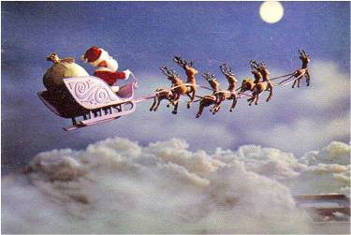

Slide 47
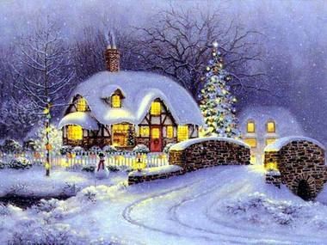

Slide 48
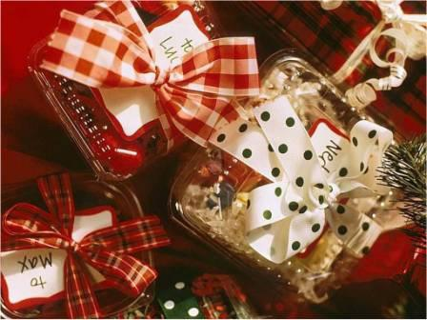

Slide 49
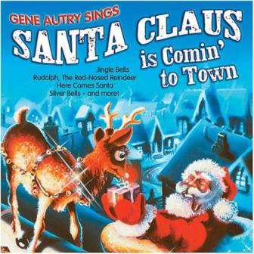

Slide 50
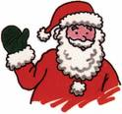
You better watch out
You better not cry
Better not pout
I'm telling you why
Santa Claus is coming to town !

Slide 51
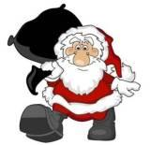
He's making a list
And checking it twice;
Gonna find out Who's
naughty and nice
Santa Claus is coming to town

Slide 52
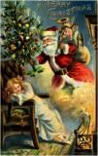
He sees you when you're sleeping
He knows when you're awake
He knows if you've been bad or good
So be good for goodness sake!

Slide 53
O! You better watch out! You better not cry
Better not pout
I'm telling you why
Santa Claus is coming to town Santa Claus is coming to town

Slide 56
We wish you a Merry Christmas;
We wish you a Merry Christmas; We wish you a Merry Christmas and a Happy New Year!!!!
Good tidings we bring to you and your kin;
Good tidings for Christmas and a Happy New Year!!!!

