Slide 1
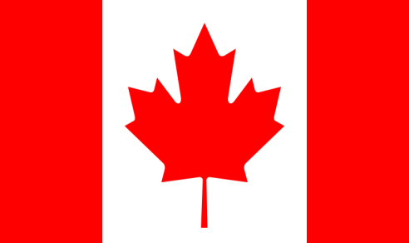
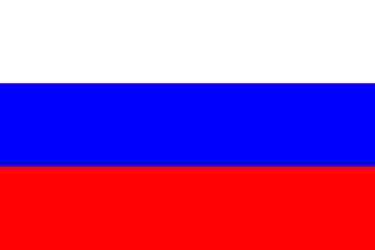
Australia
Germany
Great Britain
Italy
France
Russia
The USA
Spain
China
Canada

