Slide 1
BOOKS IN MY LIFE
Внеклассное занятие
Соболева Нина Никифоровна,
МОУООШ №2 г. Алзамай.
Иркутская область

Slide 2
Цели:
Активизировать изученный лексико-грамматический материал;
Развивать навыки самостоятельной работы;
Способствовать расширению кругозора обучающихся.

Slide 3
Dear our guests, good day.
We are glad to see you.
We are pupils of the 7th form.
I am Dina.

Slide 4
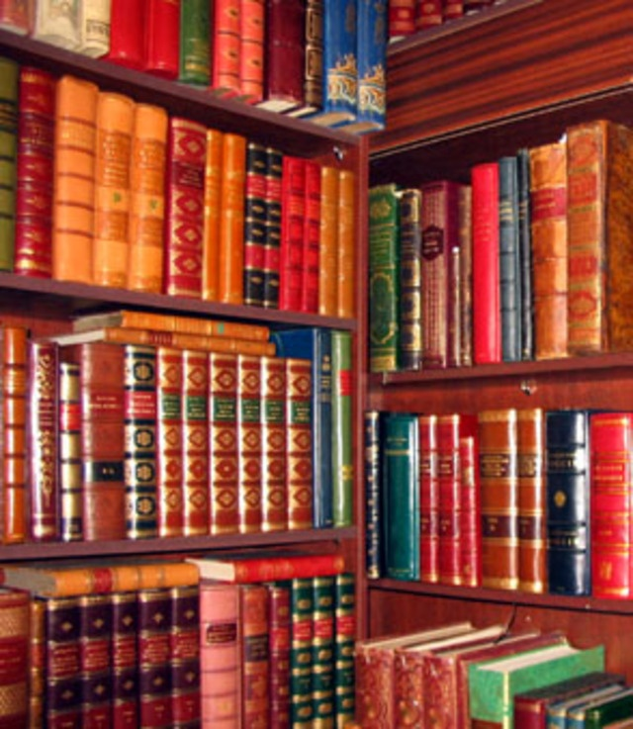
It is our school library.
It is our library. It has a large number of books by many different authors. The school library is a busy place. Children may borrow books. The librarian helps to choose books for reading. Some children like fairy-tales. Some children like adventure stories. Some like historical novels, the books on travel.

Slide 5
Our librarian is Kuznetsova L.N.

Slide 6
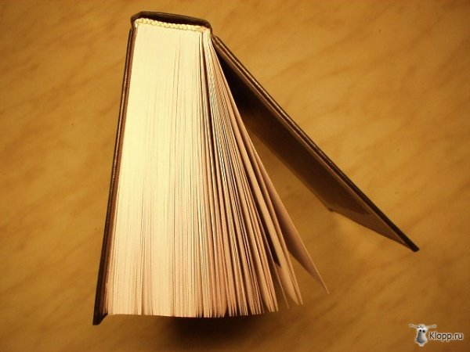
We have books. We use books in the classroom and at home.
Every book has a cover. The cover can be hard or it can be a paper cover.

Slide 7
It is often brightly coloured.
It has a picture on it.

Slide 8
The title of the book and the author`s name are in large letters on it.

Slide 9
When we begin to read, we open the corner and turn over the leaves.
There are many pages in the book.
The number on the last page of the book tells us how many pages the book has.

Slide 10
There are many books with no pictures at all, but children`s books always have a lot of pictures.
Many people work to make a book
A good
book is
a good friend.

Slide 11
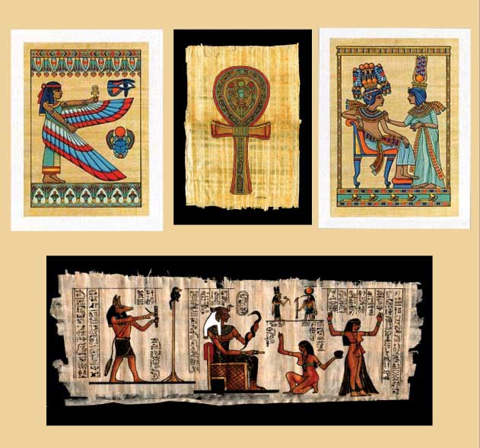
Long, long ago the people of Egypt made paper from the tall grass that grows on the banks of the river Nile.
On the stalk of this plant there grew a white skin.
People took off this and laid heavy things on it until it became dry and flat.
Then because it was white and flat.
This grass is called the papyrus.
Paper – бумага;
Heavy – тяжёлый;
Flat – ровный.

Slide 12
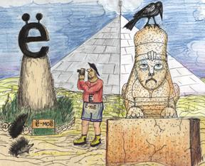
Later people used the skins of sheep and goats.
The first books were very large.
The people made books worked very slowly and very hard.

Slide 13
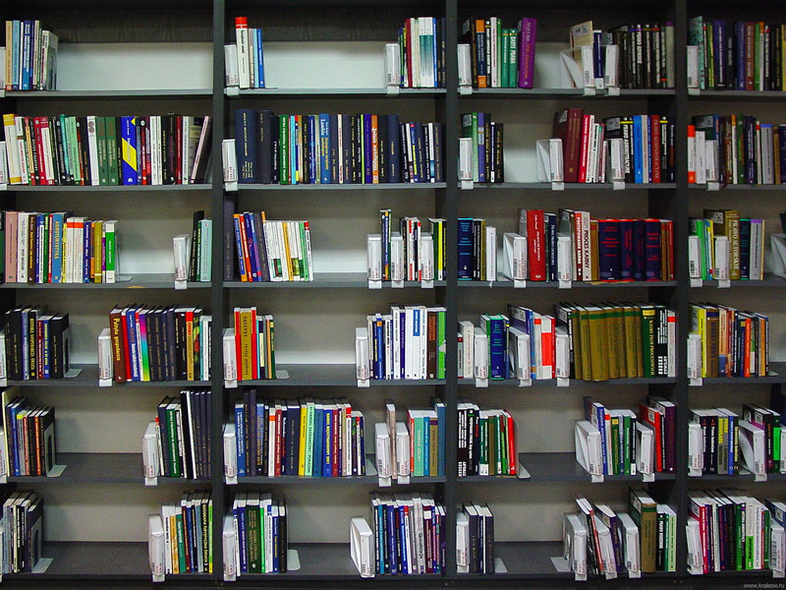
Now paper is made from many different things: silk, cotton, old ropes, straw, old paper.
Straw - солома

Slide 14
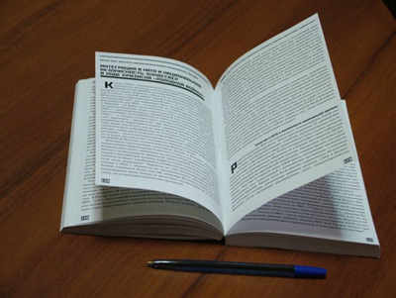
Here are some riddles.
I have many leaves,
I am not a tree.
I am something nice
Come and read me.
/a book/
I am neither a rhyme nor a song,
I can be short or very long,
I can be funny or quite sad,
To read me you will be glad.
/a story/

Slide 15
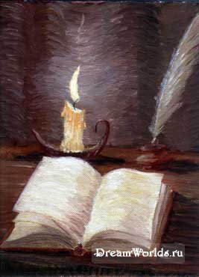
BOOKS By A. Burlakova
Books are full of many things
That I would like to know.
Books are full of greatest men
That lived long, long ago.
Books are full of countries
That I would like to see.
Books are full of people
That I would like to be.
Books are full of children
That I would like to meet.
Books are full of sweet fruit
That I would like to eat.
Books are full of mountains
That can be high or low.
Books are full of flowers
That I would like to grow.

Slide 16
Proverbs and Golden Rules
Books are our best friends.
Choose an author as you choose a friend.
Treat books with care as good friends.
Do you best not to tear, spot, mark up or damage a book in any way.
Do not turn down a page to mark the chapter where you left off reading. Use a book-mark.

Slide 17
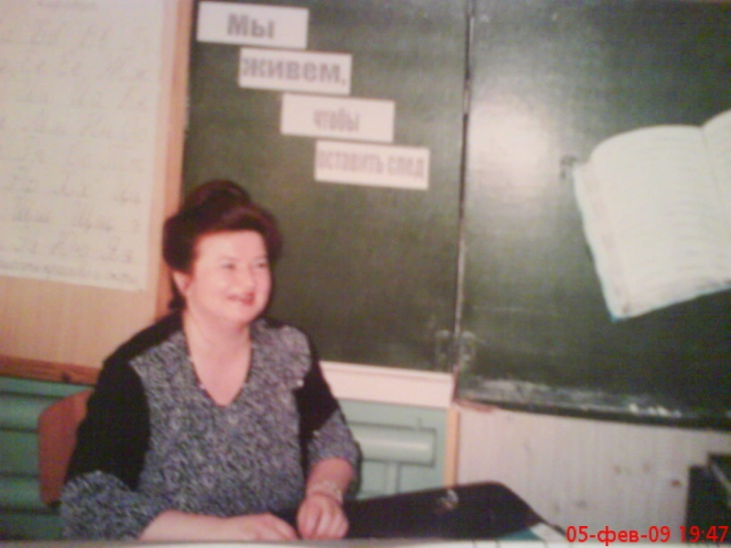
The interview with the librarian.
Do you like children?
How many children come here every day?
How many books are there in the library?

Slide 18
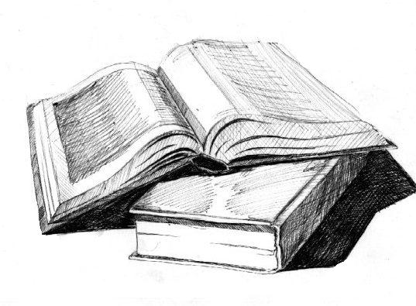
My books.
We are good friends,
My books and I.
We have such fun,
My books and I.
We are good friends,
Can you say why?

