Slide 1
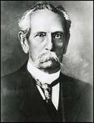
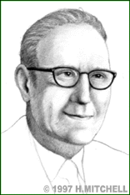
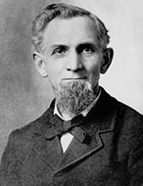
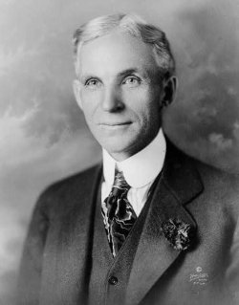
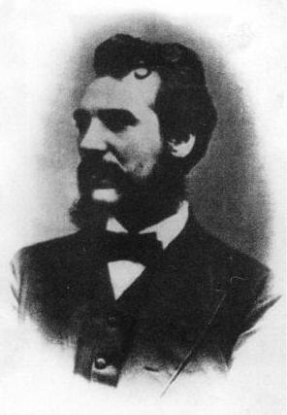
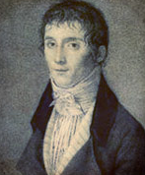
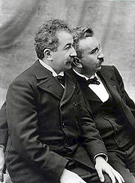
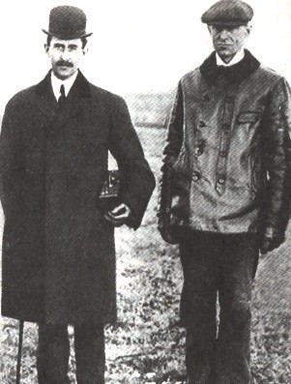

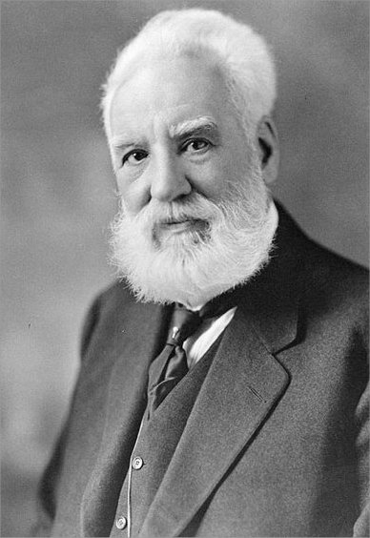
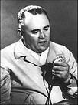
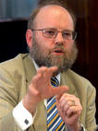
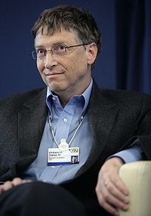

Презентация по теме
«Изобретатели и изобретения» подготовлена учителем английского языка
Моу «сош №2 г.Калининска САРАТОВСКОЙ ОБЛАСТИ»
ШОХ М.В.
INVENTIONS AND INVENTORS

Slide 2
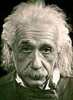
"To raise new questions, new possibilities, to regard old questions from a new angle, requires creative imagination and marks real advance".
"Imagination is more important than knowledge".
Albert Einstein

Slide 3
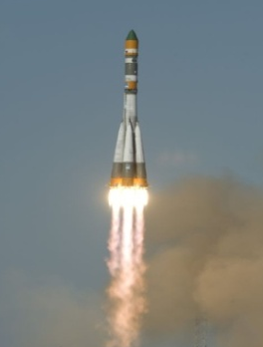

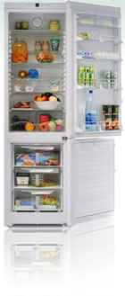
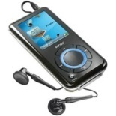
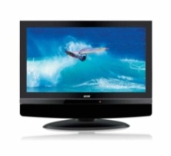
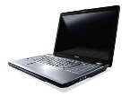
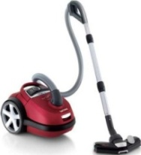
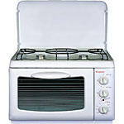
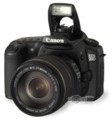
To invent is to see anew.
An invention is a new composition, device, or process. Some inventions are based on pre-existing models or ideas and others are radical breakthroughs. Inventions can extend the boundaries of human knowledge or experience.

Slide 4
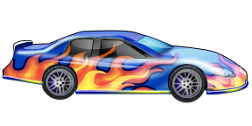
Match the words and definitions:
1. a TV set
2. a car
3. a computer
4. a video player
5. a camera
6. a vacuum cleaner
7. a fridge
8. a mobile telephone
9. a plane
10. a telephone
a. to take photographs
b. to receive or make calls around the home
c. to perform everyday cleaning tasks
d. to move fast and quick around the world
e. to watch pre-recorded videos
f. to keep food fresh for a long time
g. to have fun and to entertain
h. a system for sending or receiving speech
over long distance
i. to write programs, play games, find and
use information
j. to move wherever you want by yourself

Slide 5


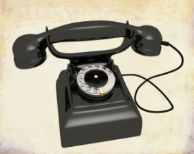

Which things are the most or least useful in the house from your point of view?
1. I think that ….. is the most important thing.
2. We can …..
3. Some of the inventions, for example …. is less important.
4. We do not often …..
5. And I’m sure we can do without …..

Slide 6
INVENTIONS:
1. Nicephore Niepce from France pioneered photography in 1829.
2. In 1876 Alexander Graham Bell, an American engineer, invented telephone.
3. Karl Benz produced the world’s first petrol-driven car in Germany in 1878.
4. In 1895 the Lumiere brothers patented their cinematography and opened the world’s first cinema in Paris.
5. The first Russia’s automobile was designed by P.A.Frez and E.A.Yakovlev. By May 1896 the car had been built.
6. Wilbur and Orville Wright built the first airplane in 1903.
7. The first ballpoint pen was produced in 1940 though it had been invented by L. Biro, a Hungarian artist and journalist, in 1905.
8. In 1908 James M. Spangler from the USA built the first vacuum cleaner.
9. In 1908 US automobile manufacturer Henry Ford created the world’s first car assembly line.
10. John Logie Baird from Scotland invented television in 1926.
11. In 1928 Richard Drew perfected the Scotch tape, which had been invented by Jim Kirst from the USA in 1923.
12. In 1945 the Nobel Prize was given to Alexander Fleming for penicillin that had been discovered in 1928.
13. Sergey Korolyev designed the first artificial satellite in 1957.
14. Akio Morita developed the first personal stereo – Sony Walkman in 1957.
15. In 1981 Bill Gates created Microsoft-DOS (Disk Operating System).
16. Scottish scientist Ian Wilmat developed the idea of cloning in 1997.

Slide 7

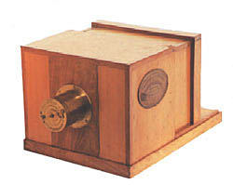
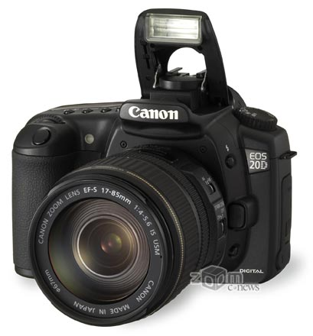

Joseph Nicéphore Niépce
(1765 – 1833)
Joseph Nicéphore Niépce was a French inventor, most noted as one of the inventors of photography and a pioneer in the field. He is well-known for taking some of the earliest photographs, dating to the 1820s. As revolutionary as his invention was, Niépce is little known even today.

Slide 8
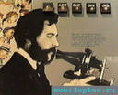
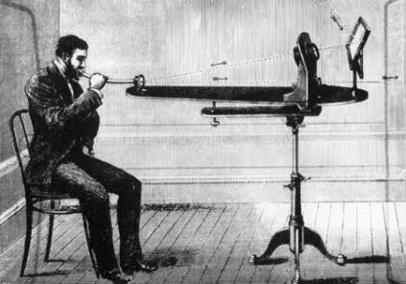


Alexander Graham Bell
(1847 – 1922)
Alexander Graham Bell was an eminent scientist, inventor, engineer and innovator who is credited with inventing the first practical telephone. His research on hearing and speech led him to experiment with hearing devices which eventually culminated in Bell being awarded the first U.S. patent for the telephone in 1876.

Slide 9
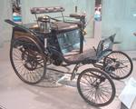
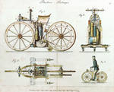

Karl Friedrich Benz
(1844 – 1929)
Karl Friedrich Benz was a German engine designer and automobile engineer, generally regarded as the inventor of the petrol-powered automobile and pioneering founder of the automobile manufacturer, Mercedes-Benz.

Slide 10
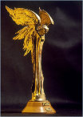

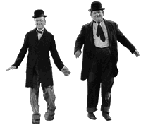
The Lumière brothers:
Auguste Marie Louis Nicolas (1862 – 1954)
Louis Jean (1864– 1948)
The Lumière brothers were among the earliest filmmakers. Louis had made some improvements to the still-photograph process, the most notable being the dry-plate process, which was a major step towards moving images. The cinematograph itself was patented on 13 February 1895 and the first footage ever to be recorded using it was recorded on 19 March 1895.

Slide 11

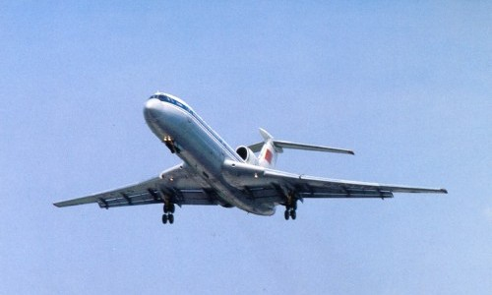
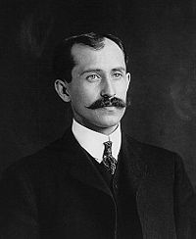
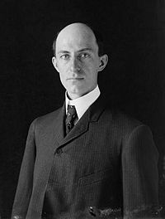
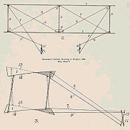
The Wright brothers:
Orville (1871 – 1948)
Wilbur (1867 – 1912)
The Wright brothers were two Americans who are generally credited with inventing and building the world's first successful airplane and making the first controlled, powered and sustained heavier-than-air human flight, on December 17, 1903. In two years afterward, the brothers developed their flying machine into the first practical fixed-wing aircraft. The Wright brothers were the first to invent aircraft controls that made fixed-wing flight possible.

Slide 12


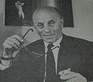
László József Bíró
(1899 – 1985)
László József Bíró was the inventor of the modern ballpoint pen.
He presented the first production of the ball pen at the Budapest International Fair in 1931. Working with his brother George, a chemist, he developed a new tip consisting of a ball that was free to turn in a socket, and as it turned it would pick up ink from a cartridge and then roll to deposit it on the paper. Bíró patented the invention in Paris in 1938.

Slide 13
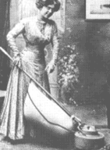
James Murray Spangler
(1848 - 1915)
In 1907, James Murray Spangler, a janitor in Canton, Ohio invented an electric vacuum cleaner from a fan, a box, and a pillowcase.

Slide 14



John Logie Baird
(1888 – 1946)
John Logie Baird was a British engineer and inventor of the world's first working television system, also the world's first fully electronic colour television broadcast. Although Baird's electromechanical system was eventually displaced by purely electronic systems his early successes demonstrating working television broadcasts and his colour and cinema television work earn him a prominent place in television's invention.

Slide 15

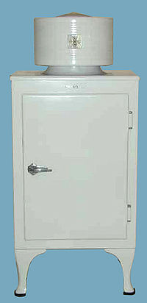
John Gorrie
(1803 – 1855)
John Gorrie was a physician, scientist, inventor, and humanitarian, is considered the father of refrigeration and air conditioning.

Slide 16

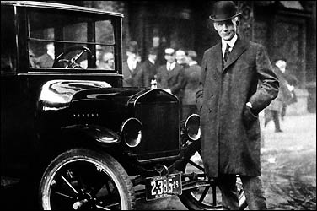
Henry Ford
(1863 – 1947)
Henry Ford was the American founder of the Ford Motor Company and father of modern assembly lines used in mass production. His introduction of the Model T automobile revolutionized transportation and American industry. He was a prolific inventor and was awarded 161 U.S. patents.

Slide 17
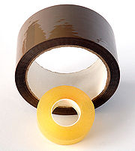
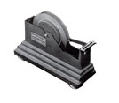
Richard G.Drew
(1886-1982)
In 1923 Richard Drew settled down on work in company Minnesota Mining and Manufacturing which concerned with the production of the sandpaper, exploratory activity in the field of watertight surfaces and experimented with cellophane. And 27 May 1930 Richard Drew patented his invention - transparent getting sticky tape.

Slide 18

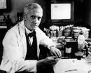
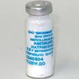

Alexander Fleming
(1881 – 1955)
Sir Alexander Fleming was a Scottish biologist and pharmacologist. His best-known achievements are the discovery of the enzyme lysozyme in 1923 and the antibiotic substance penicillin from the fungus Penicillium notatum in 1928, for which he shared the Nobel Prize in Physiology or Medicine in 1945 with Howard Walter Florey and Ernst Boris Chain.

Slide 19



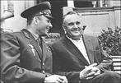
Sergey Pavlovich Korolyov
(1907 – 1966)
Sergey Pavlovich Korolyov was the head Soviet rocket engineer and designer during the Space Race between the United States and the Soviet Union in the 1950s and 1960s. He is considered by many as the father of practical astronautics.

Slide 20


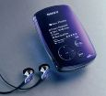
Akio Morita
(1921 — 1999)
Akio Morita was a Japanese entrepreneur, cofounder of Sony Corp. In 1949, the company developed magnetic recording tape and in 1950, sold the first tape recorder in Japan. In 1957, it produced a pocket-sized radio.

Slide 21


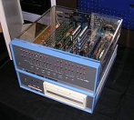


William Henry "Bill" Gates III
(born October 28, 1955)
William Henry "Bill" Gates III is an American business magnate, philanthropist, and chairman of Microsoft, the software company. During his career at Microsoft, Gates held the positions of CEO and chief software architect, and remains the largest individual shareholder. Gates is one of the best-known entrepreneurs of the personal computer revolution.

Slide 22
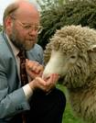

Sir Ian Wilmut
(born 7 July 1944)
Sir Ian Wilmut is an English embryologist and is currently Director of the MRC Centre for Regenerative Medicine at the University of Edinburgh. He is best known as the leader of the research group that in 1996 first cloned a mammal from an adult somatic cell, a Finnish Dorset lamb named Dolly.

Slide 23
GRAMMAR IN FOCUS
PAST PERFECT PASSIVE
HAD + BEEN + V3

Slide 24
By the end of the 19th century
invented tested improved
made discovered pioneered
.....? had been built developed produced
found created introduced
designed perfected patented

Slide 25
What inventions had been made by the end of the 19-20th century?
1. ………..….. ……………by the end of the 19th century.
2. ……….….. ……………..by the end of the 19th century.
3. ……….….. ……………..by the end of the 19th century.
4. The first …….. ………...by the end of the 19th century.
5. The first …... ..………..by the end of the 19th century.
6. The ………..….. ……….by the end of the 19th century.
invented made built found designed tested created
discovered perfected pioneered produced patented

Slide 26
HOMEWORK:
PROJECT:
«WHAT WOULD YOU LIKE TO INVENT?»

