Slide 1
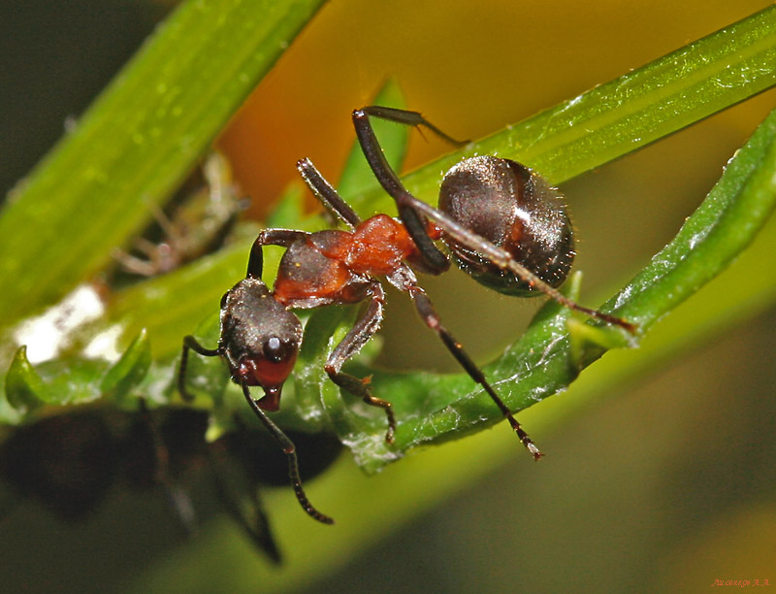

Slide 2
Ant

Slide 3
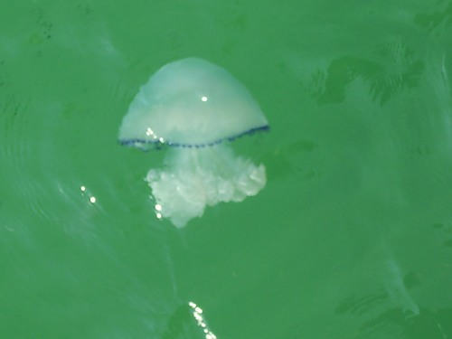

Slide 4
Nettle-fish

Slide 5
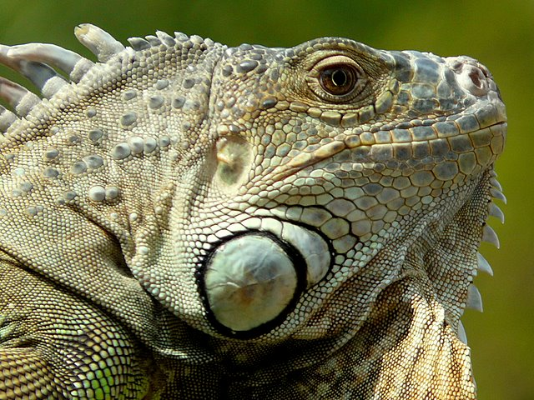

Slide 6
Iguana

Slide 7
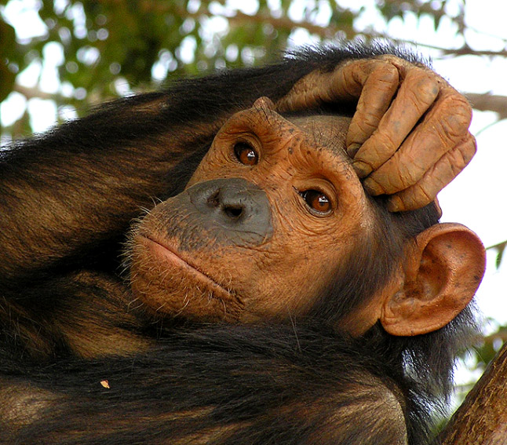

Slide 8
Monkey

Slide 9
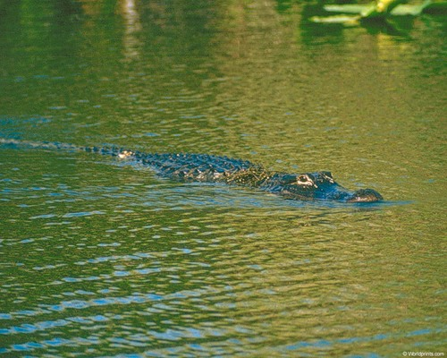

Slide 10
Alligator

Slide 11
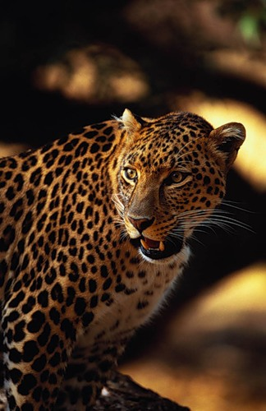

Slide 12
Leopard

Slide 13
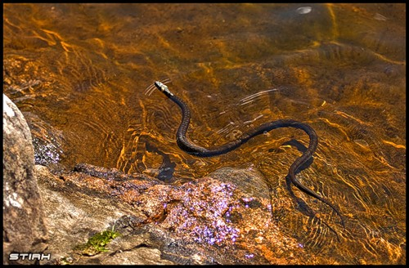

Slide 14
Snake

Slide 15
ANIMALS.

