Slide 1
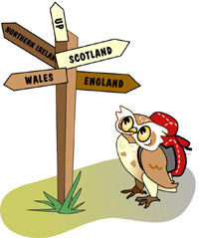


The United Kingdom of Great Britain and Northern Ireland.

Slide 2
SUMMARIZE THE TEXT USING THE CHART
Country | Geographical characteristics | Area | Population | Capital | Principal towns
The USA | in North America | 9,364,000 | about 250 million | Washington D.C | New-York, Chicago, Los-Angeles
Canada | in North America | 9,970,600 | about 30 million | Ottawa | Ottawa, Toronto
The Common-wealth of Australia | on the continent of Australia and a number of islands | 7,682,000 | about 20 million | Canberra | Sydney, Melbourne
New Zealand | on several large and many smaller islands | 268,021 | about 4 million | Wellington | Auckland, Nelson

Slide 3
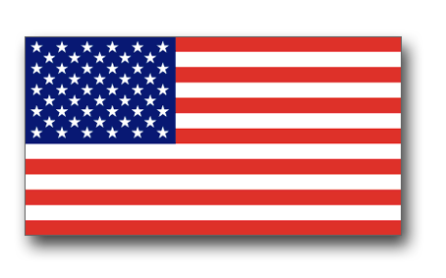



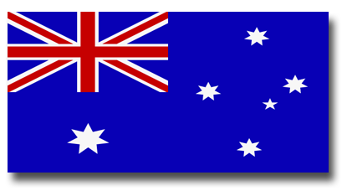
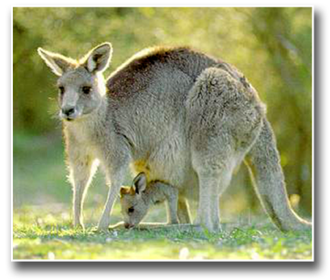
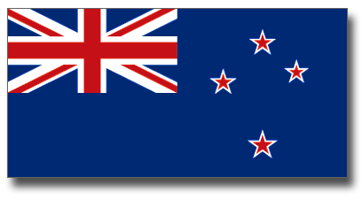
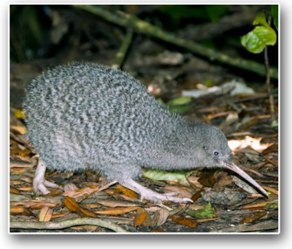
SUMMARIZE THE TEXT USING THE CHART
Country | Flag | Symbol
The USA
Canada
Commonwealth of Australia
New Zealand

Slide 4
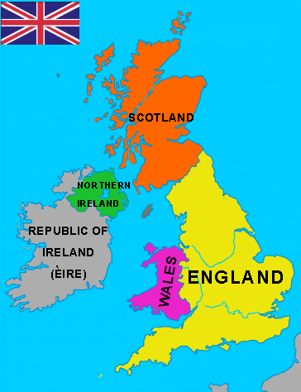

The official name for the country whose language we study is the United Kingdom of Great Britain and Northern Ireland. In everyday use, however, the word “Britain” is quite possible. The United Kingdom of Great Britain and Northern Ireland has several different names. Some people say “Great Britain”, or “Britain”, or
“the United Kingdom”, or just “the U.K.” and “G.B.”

Slide 5
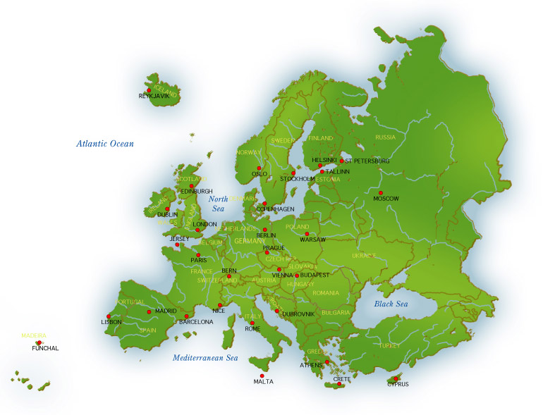
Great Britain is an island that lies off the north west of Europe. It is the largest island of Europe. It is 500 km wide and nearly 1,000 km long.

Slide 6
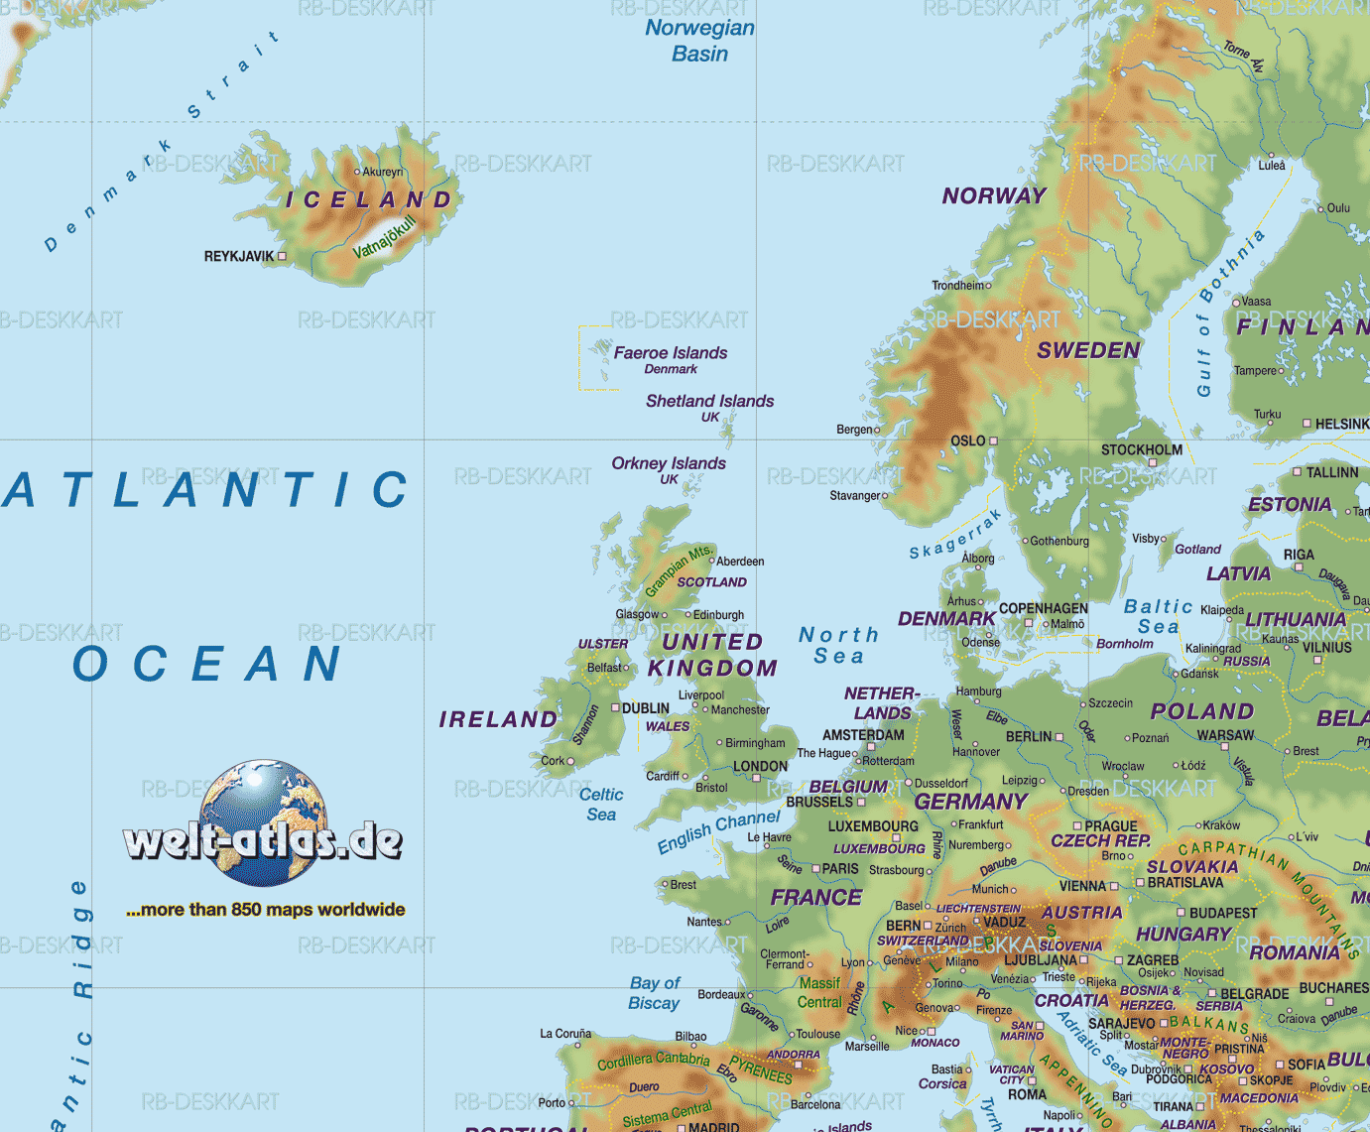
There is the Atlantic Ocean on the north of it and the North Sea on the east.
The English Channel, which is about 21 miles separates the U.K. from the continent.

Slide 7
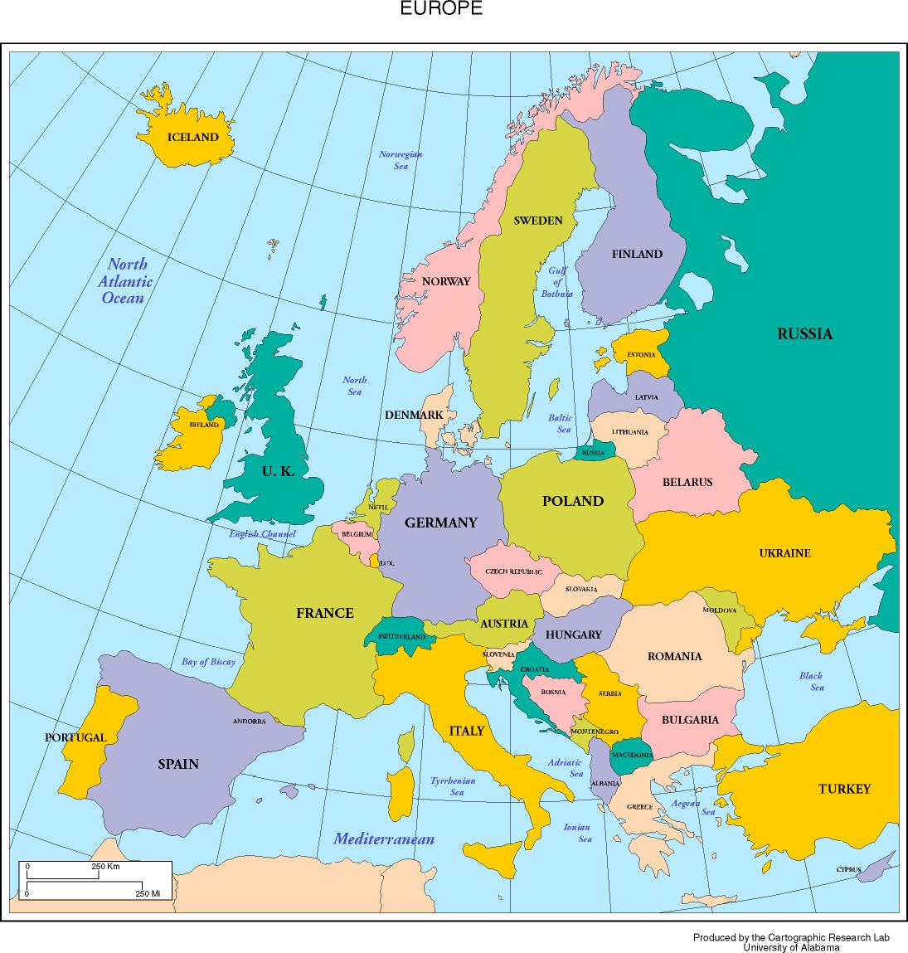
Its closest continental neighbours are France and Belgium. Recently the channel Tunnel, which links France and England, has been built.

Slide 8
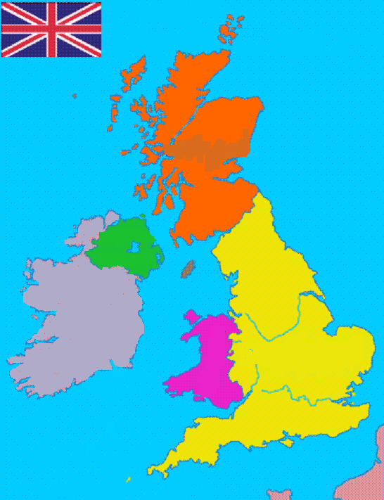
There are four countries in the United Kingdom: England, Scotland, Wales and Northern Ireland.
England, Scotland and Wales are three main parts of Great Britain.
Scotland
Northern Ireland
England
Wales

Slide 9
CAPITALS
London is the capital of the UK but also the capital of England.
Cardiff is the capital of Wales.
Edinburgh is the capital of Scotland and Belfast is the capital of Northern Ireland.
Scotland
Edinburgh
Northern Ireland
Belfast
England
Wales
London
Cardiff

Slide 10
The United Kingdom is a highly developed country. Its main cities are :
London, Birmingham, Manchester and Glasgow.
Glasgow
Manchester
Birmingham
London

Slide 11
THE POPULATION OF THE UK
NORTHERN
IRELAND
WALES
SCOTLAND
ENGLAND
The population of the United Kingdom is about 60 million people.

Slide 12
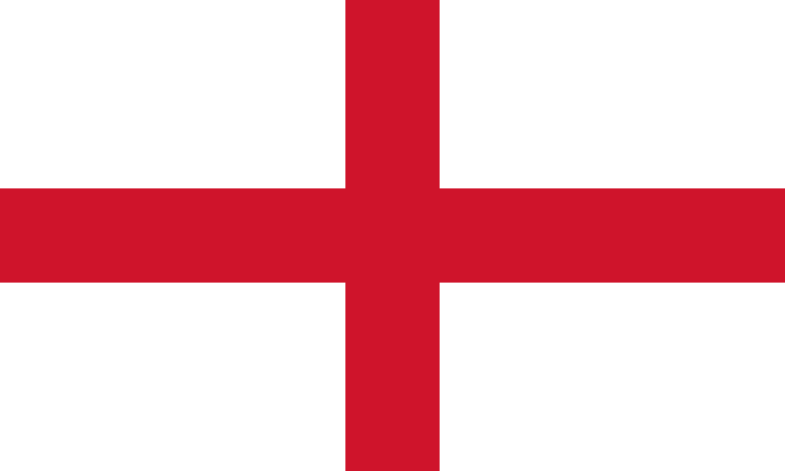

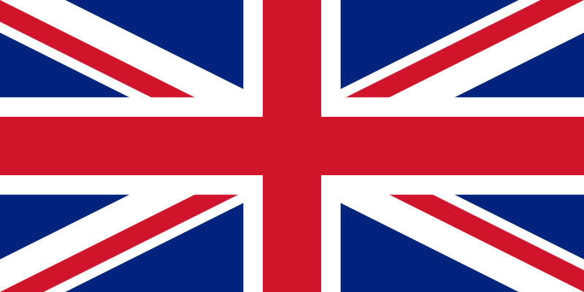
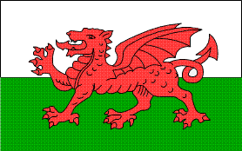
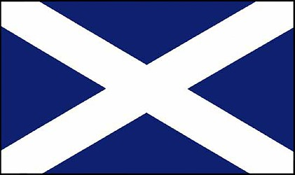

ENGLAND
NORTHERN IRELAND
The flag of the UK is called
THE UNION JACK
WALES
SCOTLAND

Slide 13
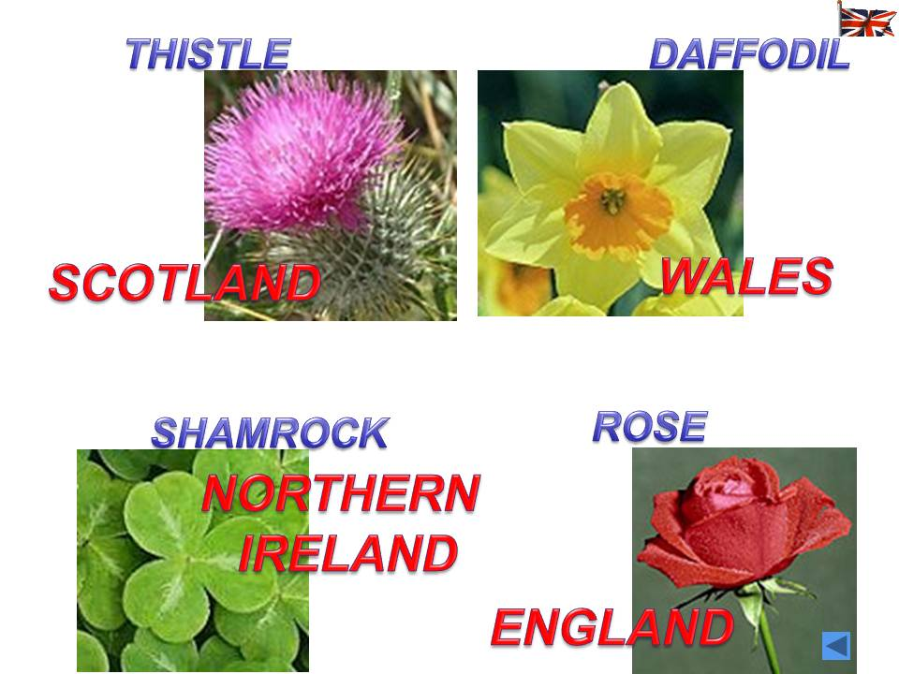

Slide 14


