Slide 1
Animals
Животные

Slide 2
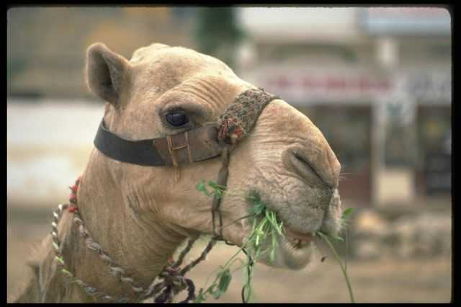
A camel
This is a camel.

Slide 3
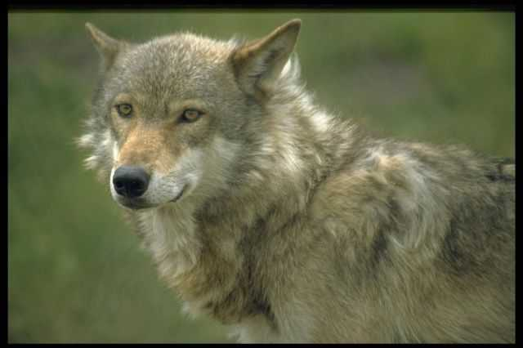
A wolf
This is a wolf.

Slide 4
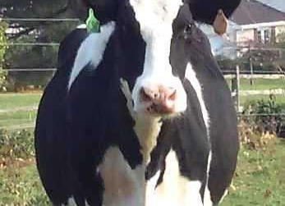
A cow
This is a cow.

Slide 5
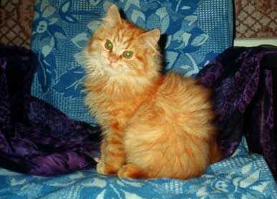
A cat
This is a cat.

Slide 6
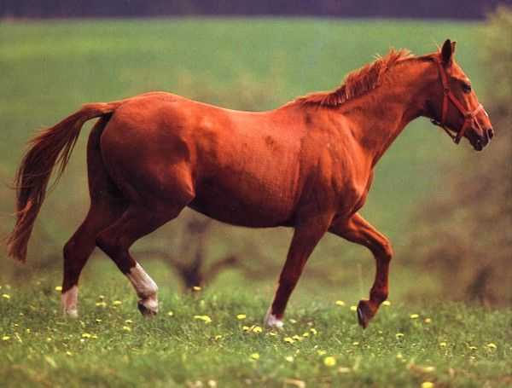
A horse
This is a horse.…

Slide 7
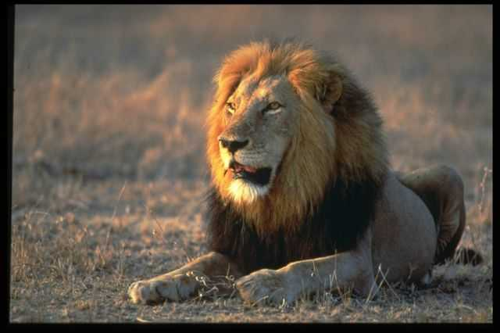
A lion
This is a lion.

Slide 8
A bear
This is a bear.

Slide 9
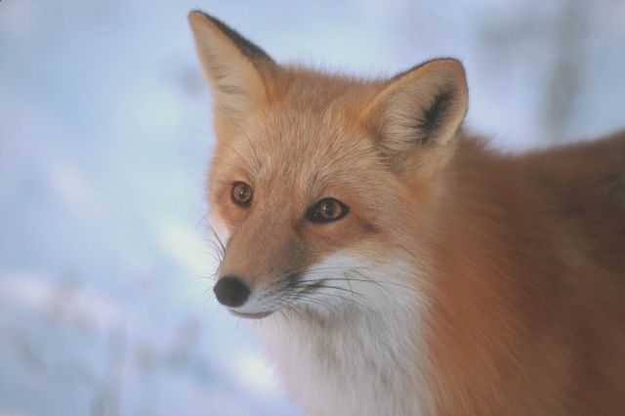
A fox
This is a fox.

Slide 10
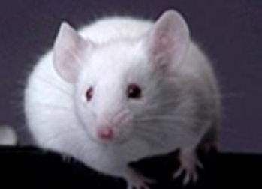
A mouse
This is a mouse.

Slide 11
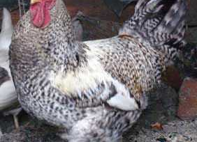
A cock
This is a cock.

Slide 12
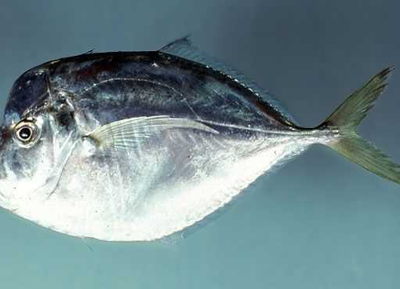
A fish
This is a fish.

Slide 13
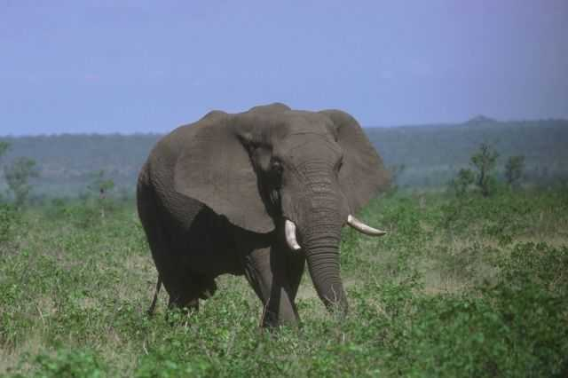
A elephant
This is a elephant.

Slide 14
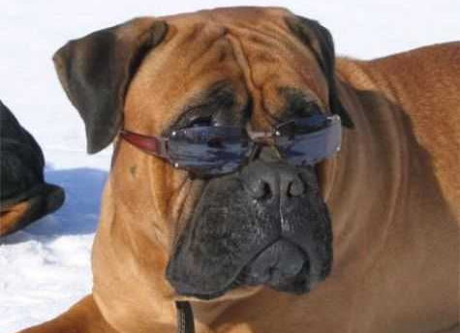
A dog
This is a dog.

Slide 15
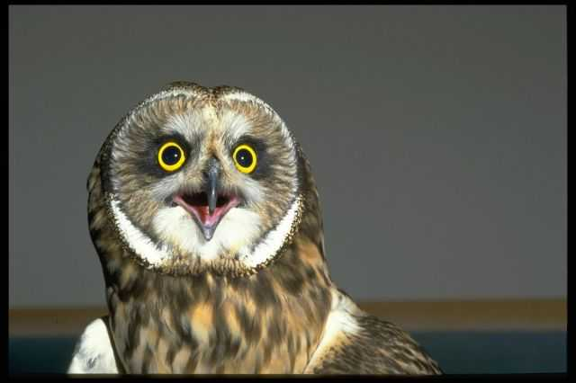
A owl
This is a owl.

Slide 16
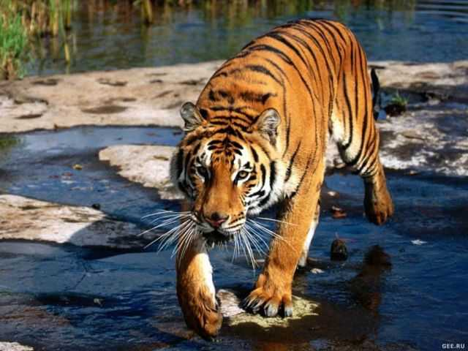
A tiger
This is a tiger.

Slide 17
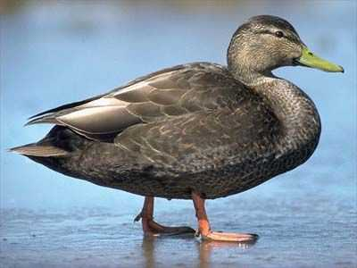
A duck
This is a duck.

