Slide 1
Our Hobbies

Slide 2
A hobby is something you enjoy doing in your free time.

Slide 3
What is a “HOBBY”?
Making things
Collecting things
Doing things

Slide 4
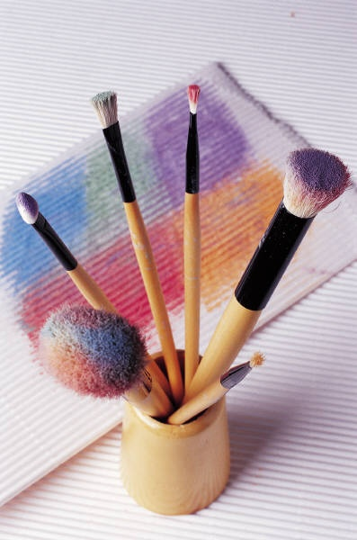
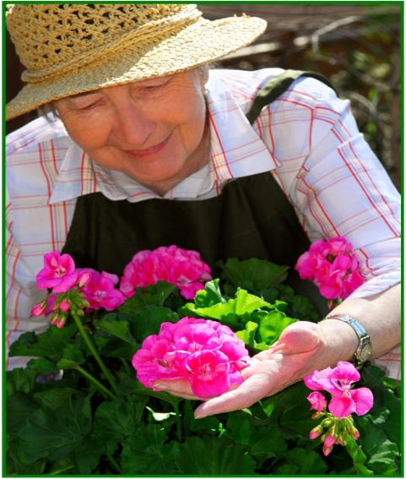
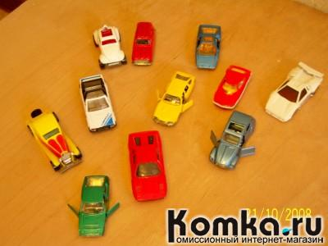
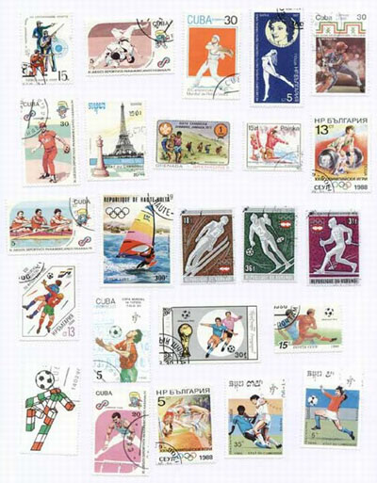
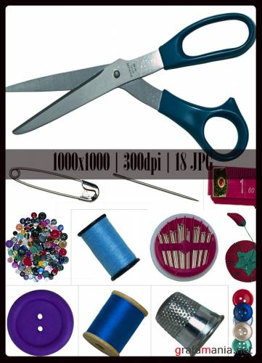
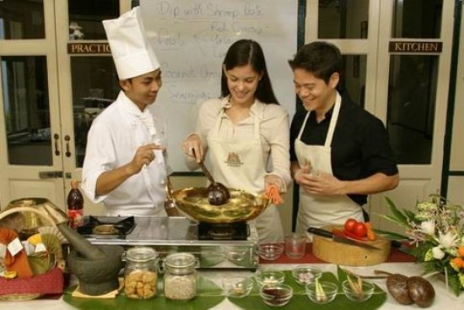

Slide 5
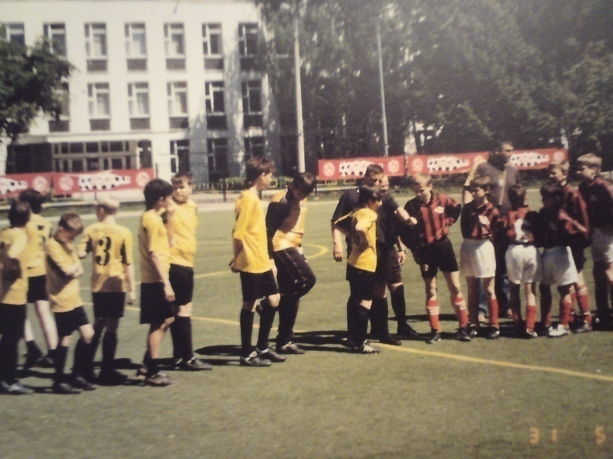
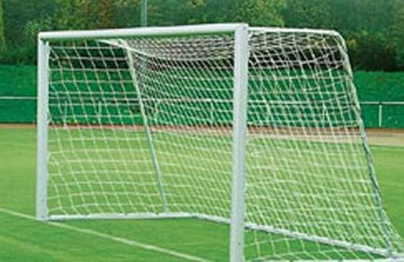
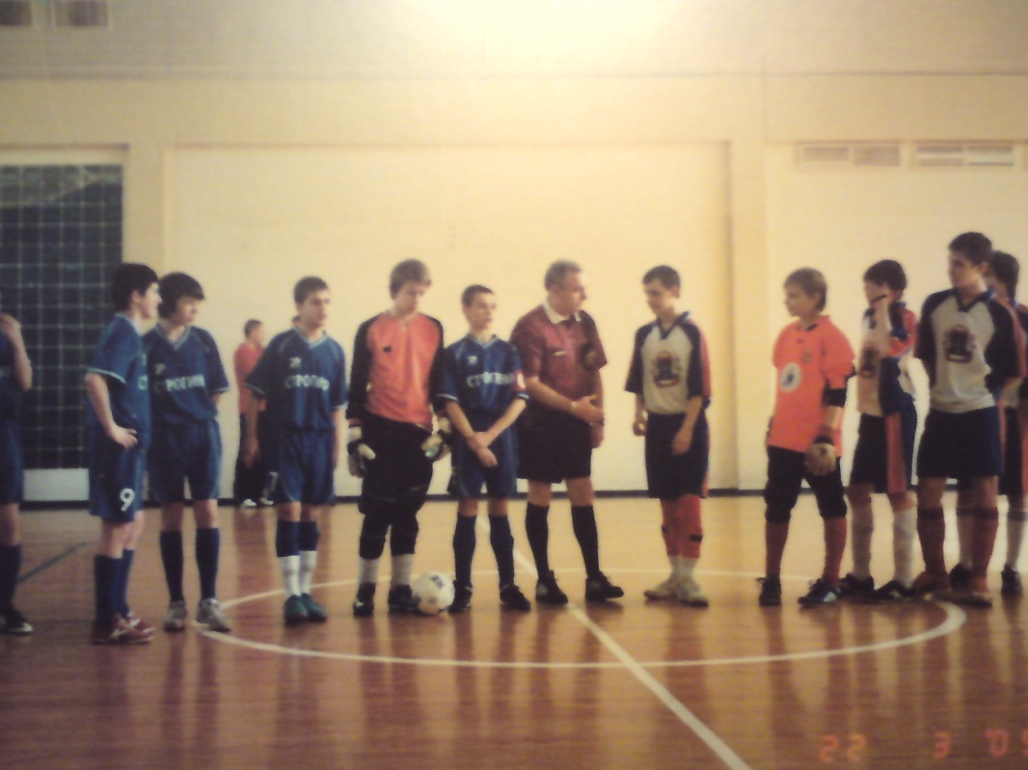
Football is great!

Slide 6
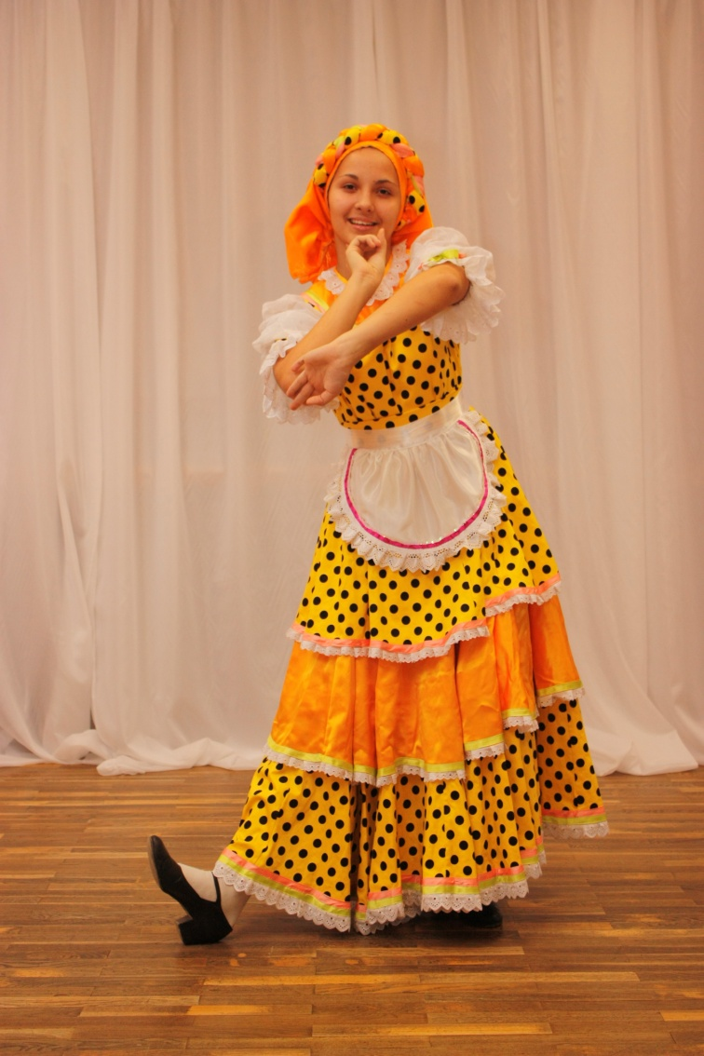
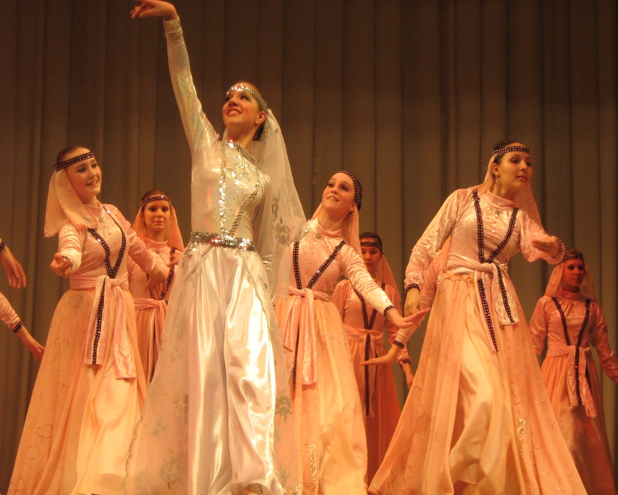
Shall we dance?

Slide 7
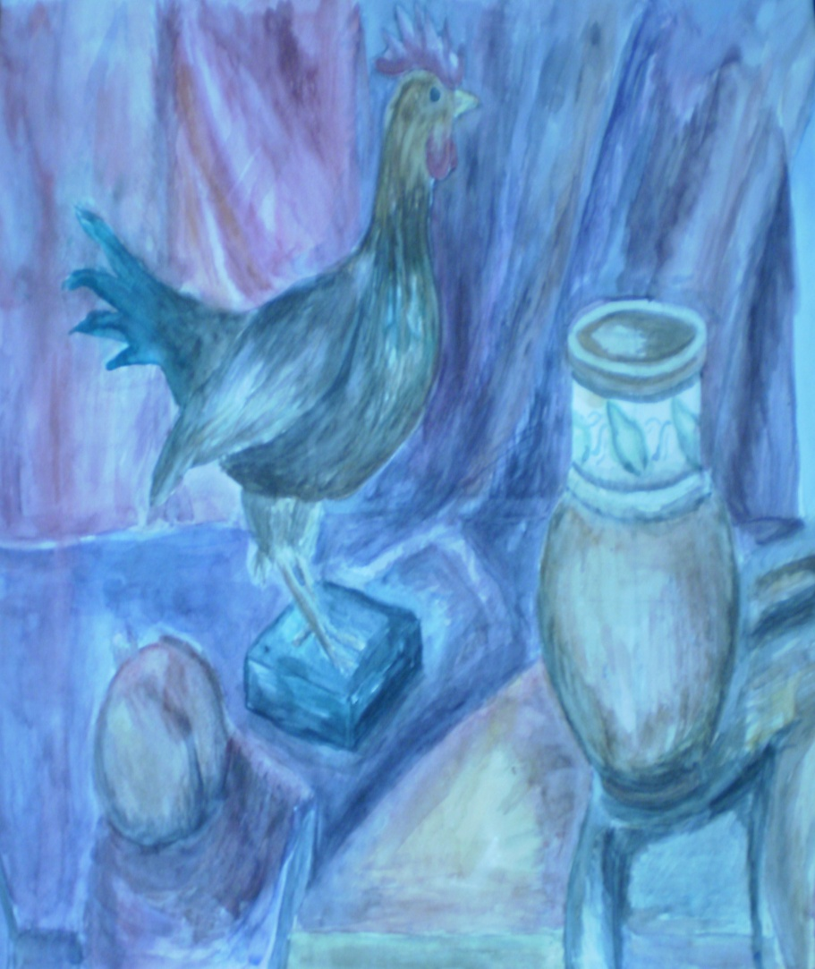
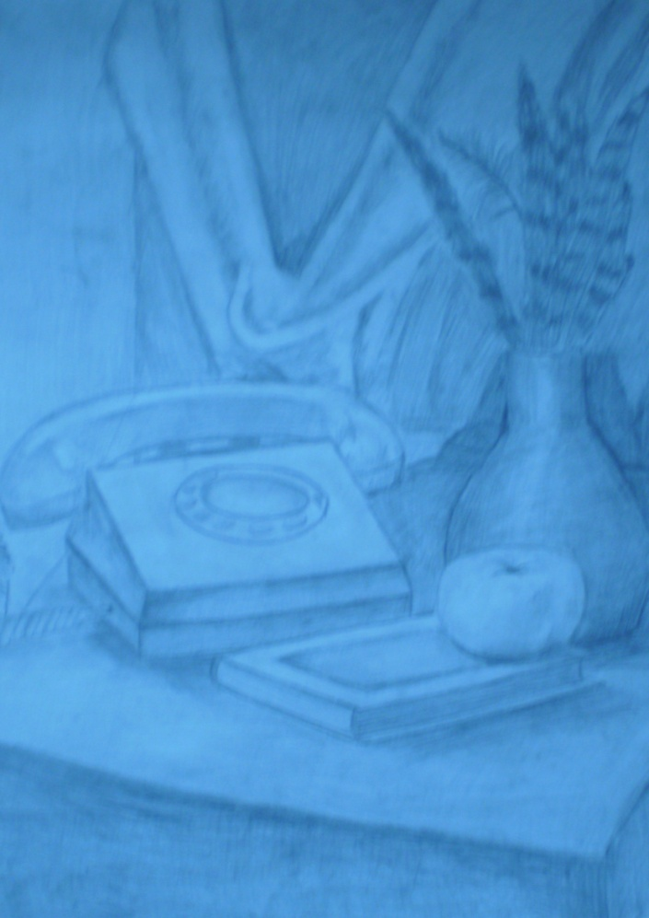
Painting & Drawing

Slide 8
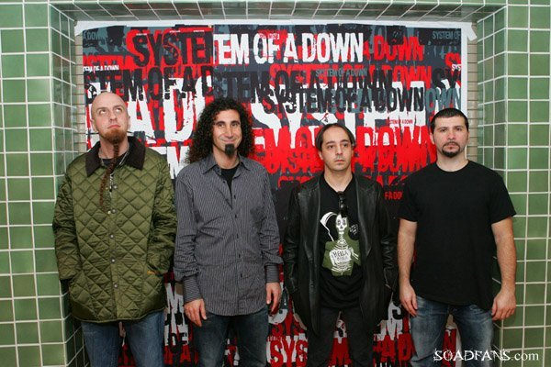
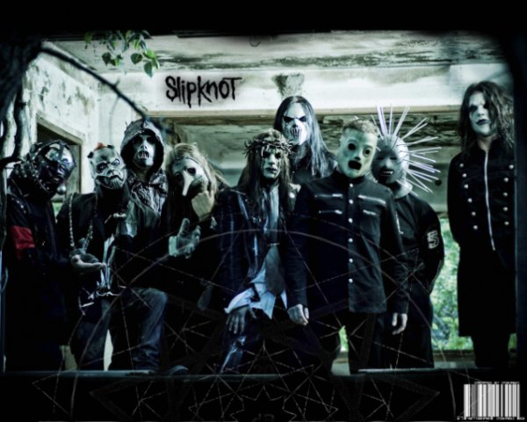
Tastes differ

Slide 9
 | Language club | Football Club | Folk Dancing Club
Can join:
only girls
Only boys
Boys and girls | V | V | V
Do exercising |  | V | V
Have studies:
inside and outside | V | V
only inside |  |  | V
in the Athletics Centre |  | V | V
At school | V
Every Saturday |  | V
Twice a week |  |  | V
Learn about culture | V |  | V

Slide 10
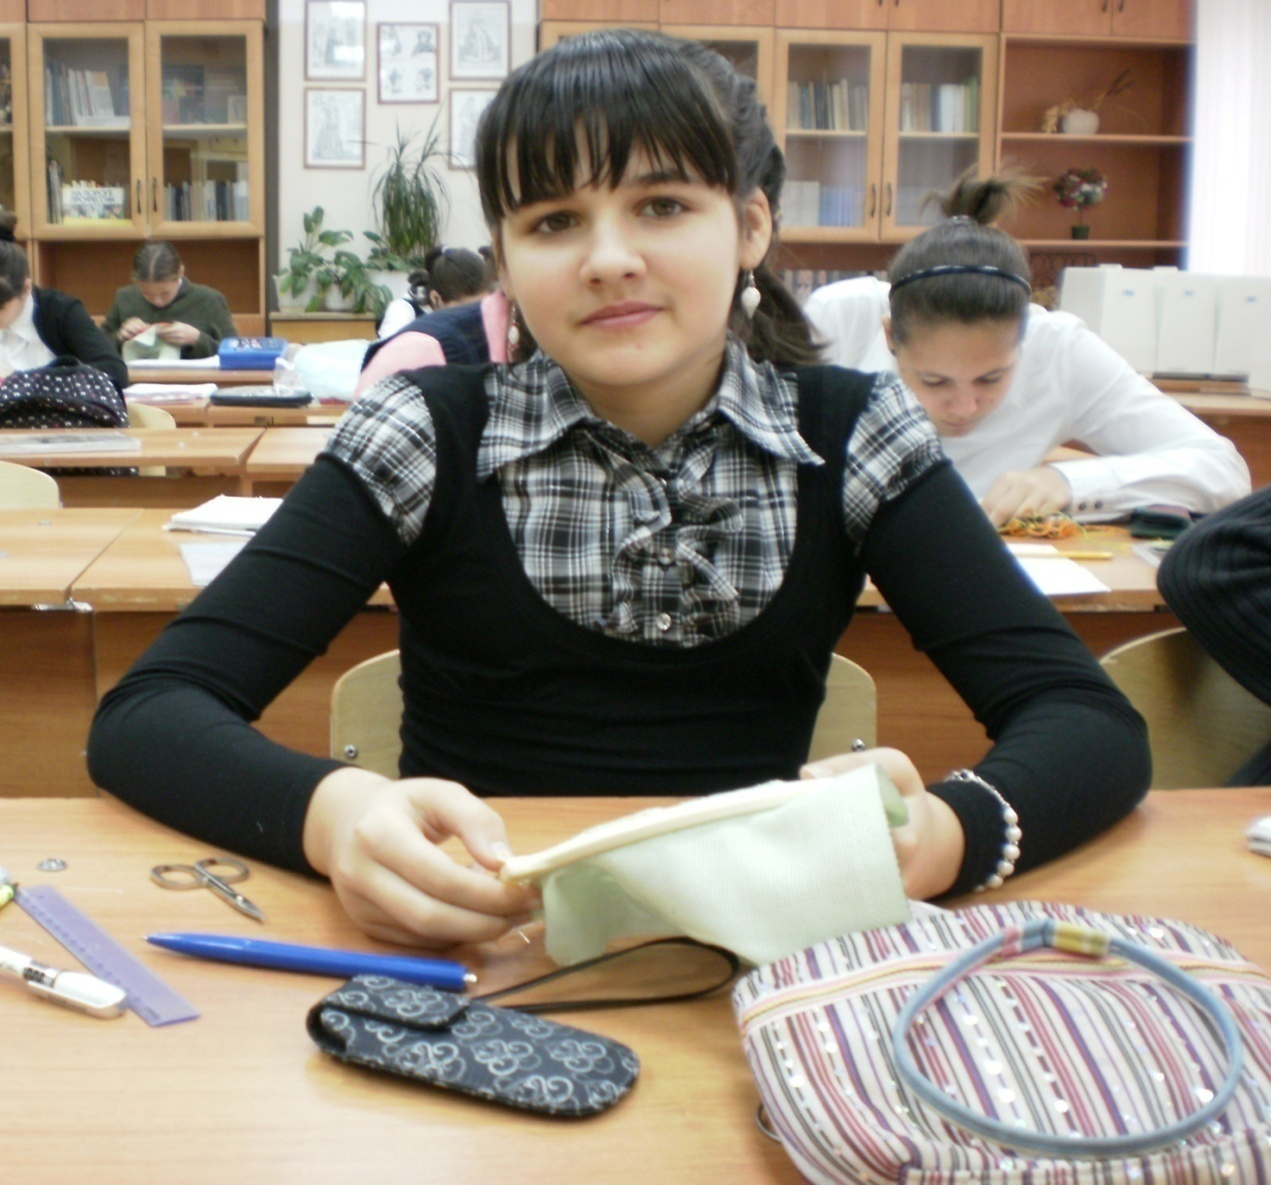
Sewing and Embroidery Club

Slide 11
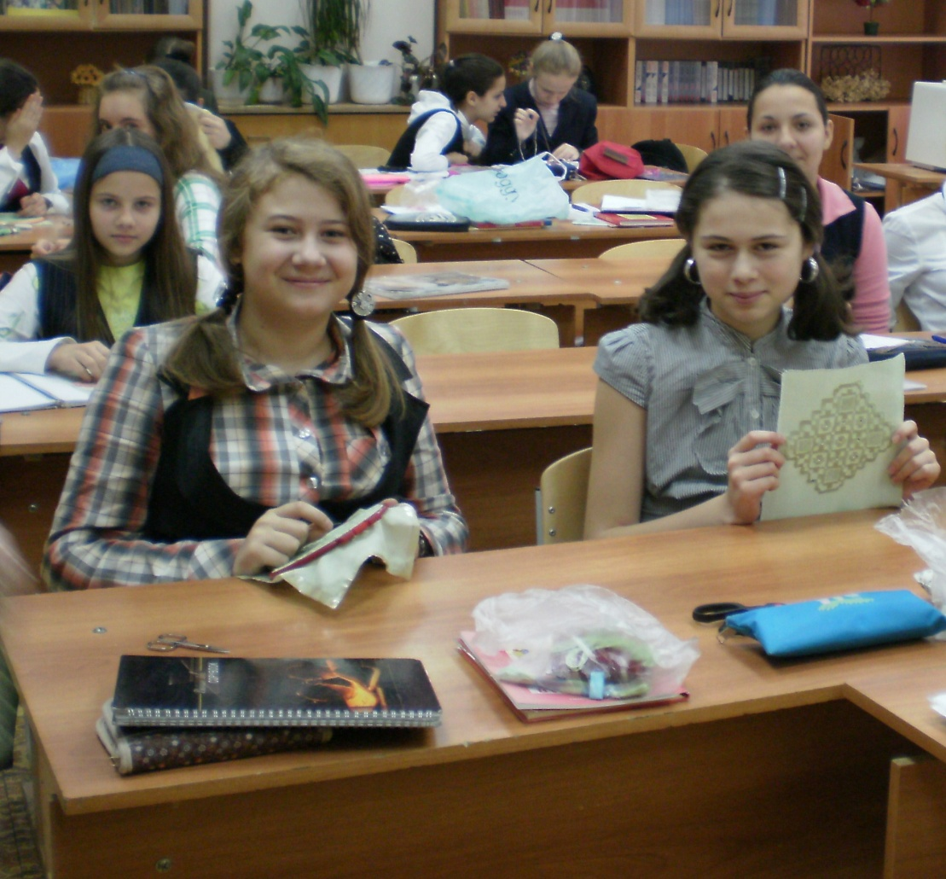
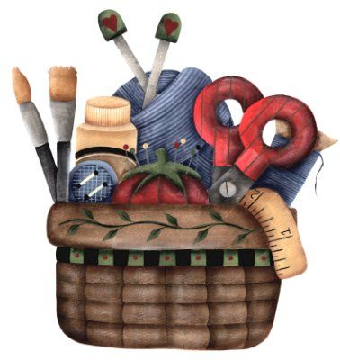

Slide 12
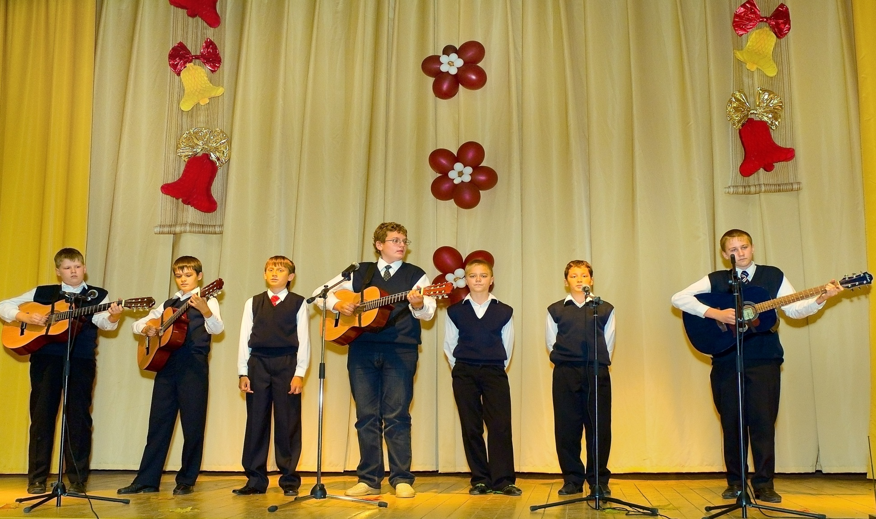
“Leisya ,pesnya!”

Slide 13
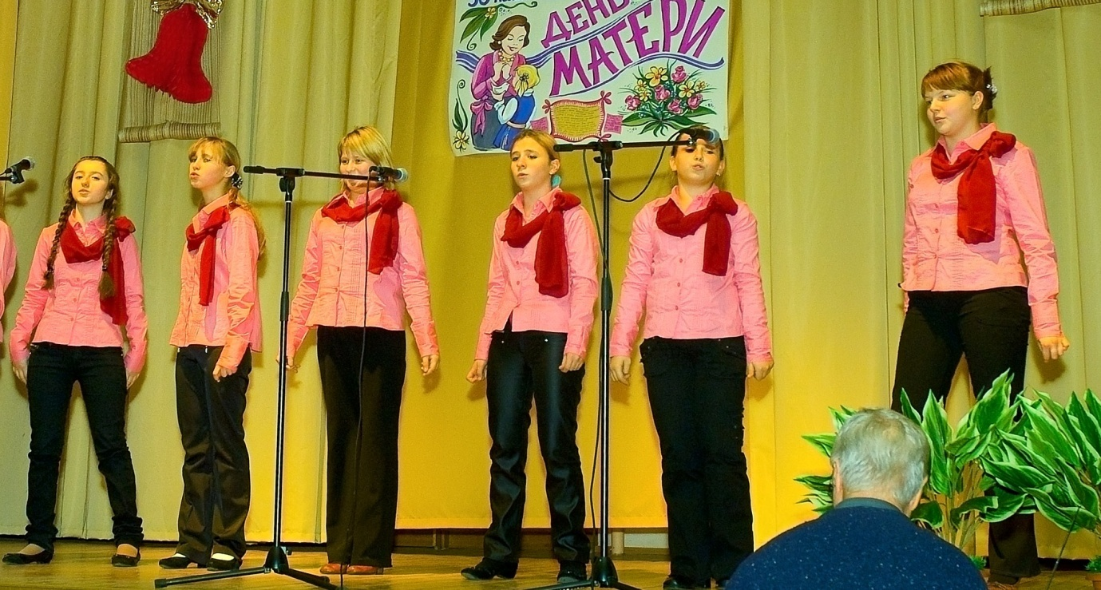
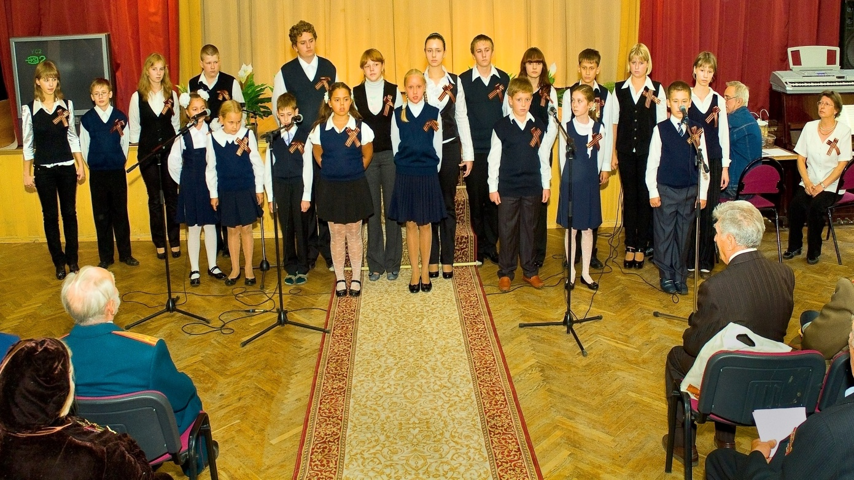

Slide 14
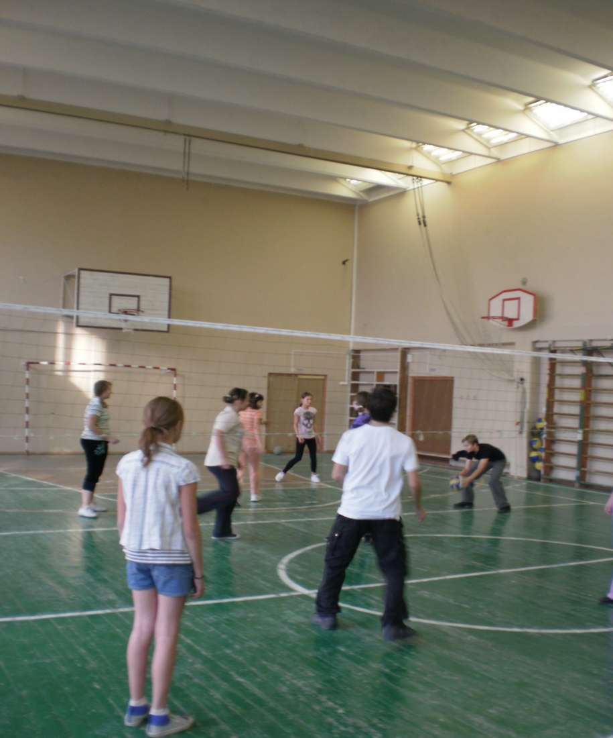
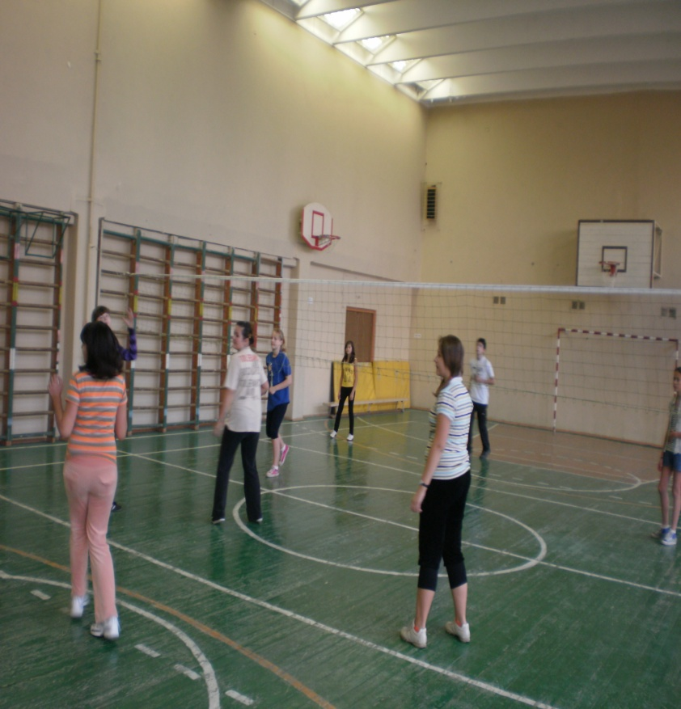
Join us if you are sporty!

Slide 15
If everything seems dull , take up a hobby !!!

