Slide 1
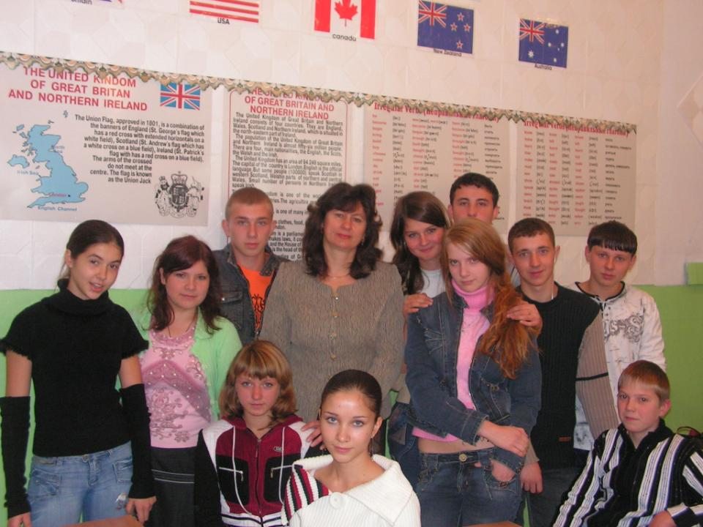


You are welcome!

Slide 2
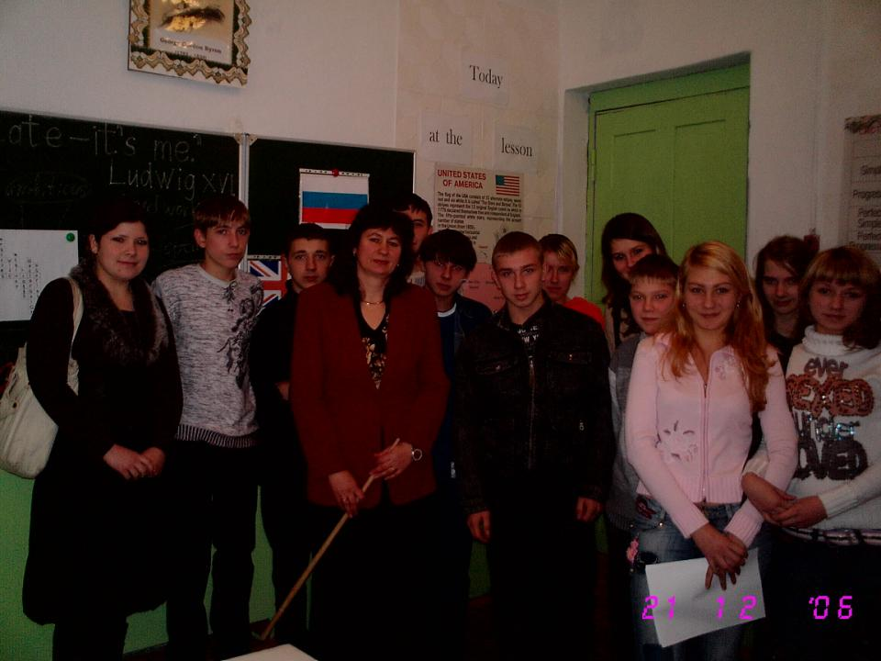
GOOD LUCK!
My support.
Just believe in yourself and do your best.

Slide 3
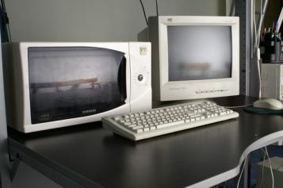
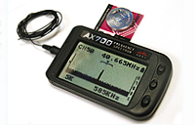



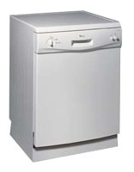
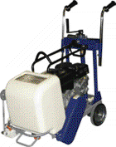

The modern inventions in our life

Slide 4
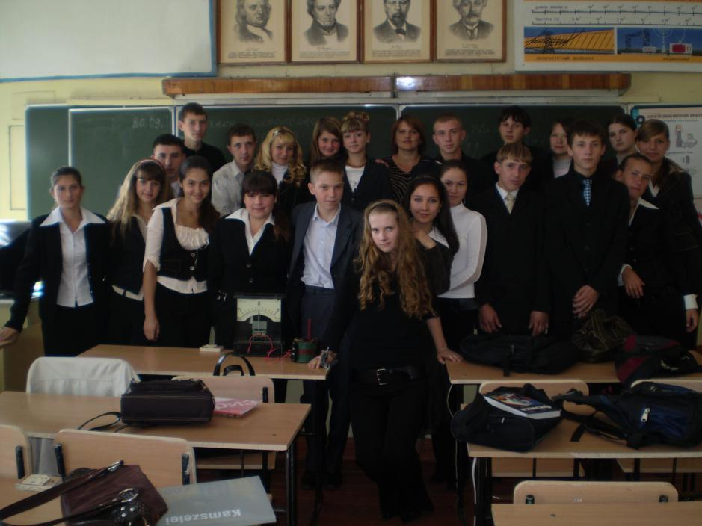
My classmates’ statements

Slide 5
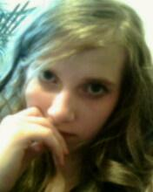
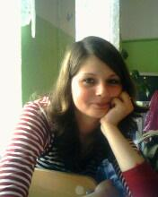
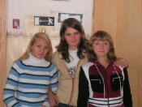

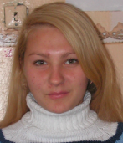
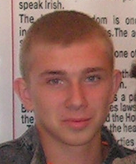
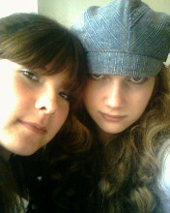
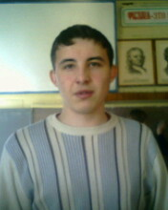
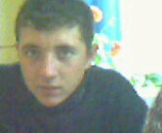
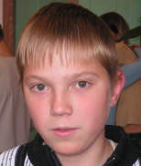
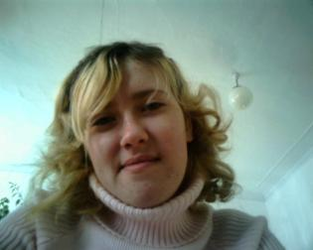
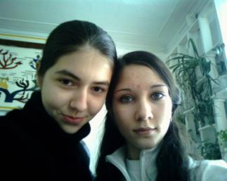
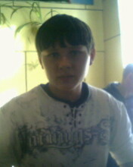
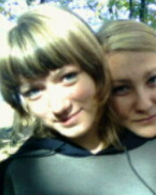
We are so different and everyone has
his own opinion

Slide 6
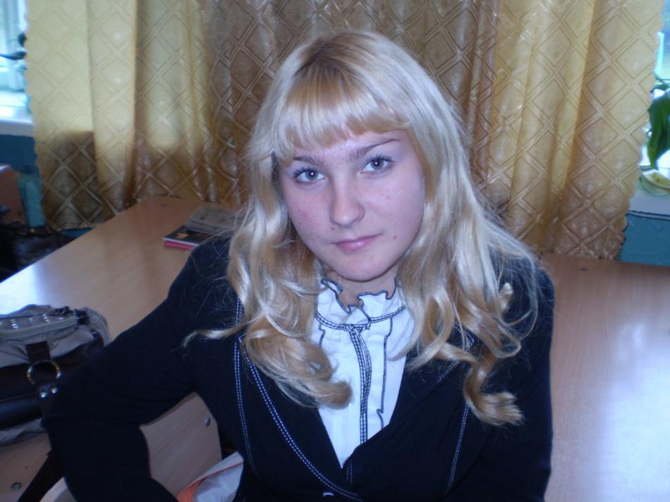

Anya:
I consider TV to be the most important invention in our life”

Slide 7
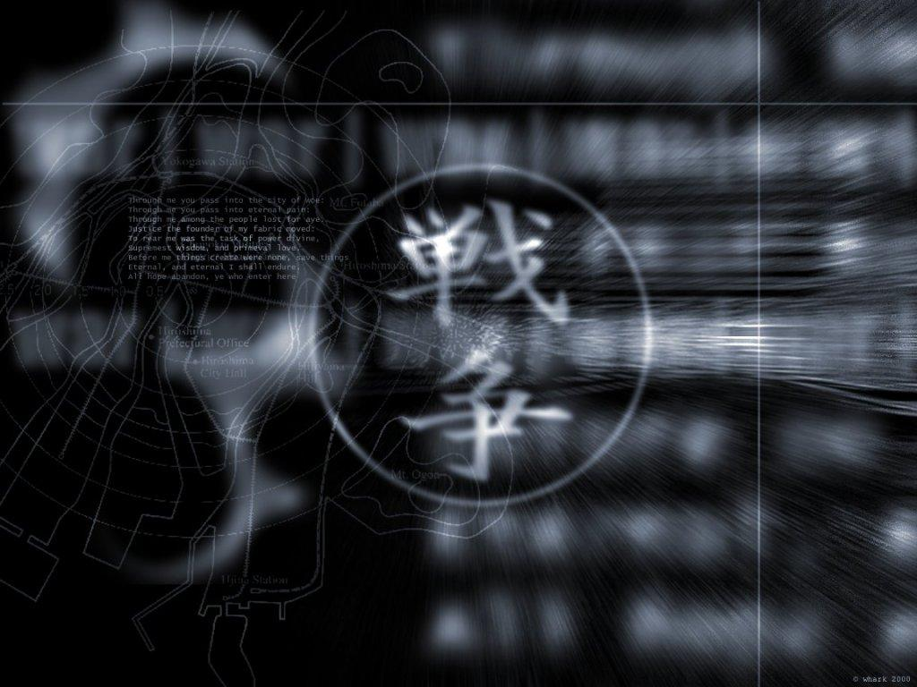
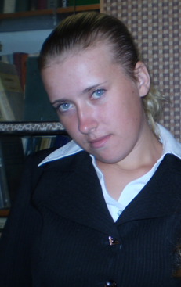
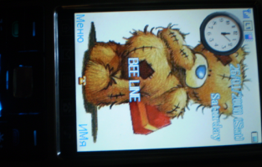
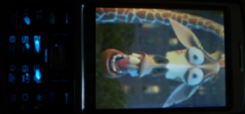
Nina: “It would be the end of the world if I lost my mobile phone”

Slide 8
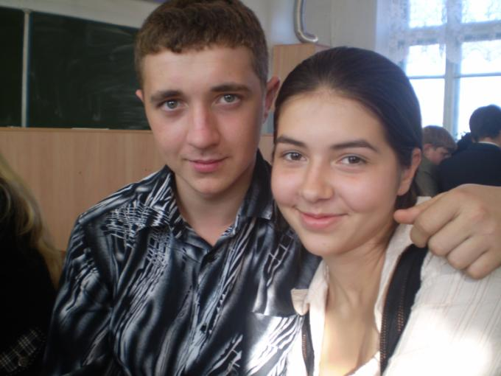
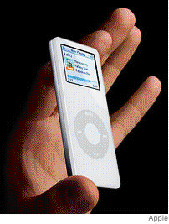
Ilya and Nastya: “We are sure IPod is a necessity rather then luxury”

Slide 9
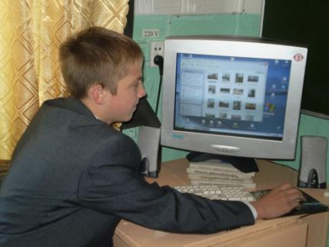
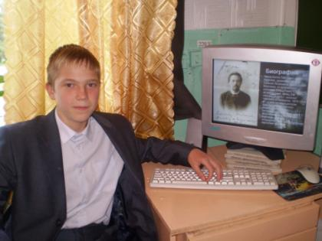
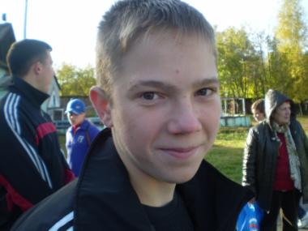
D a n I I l:
“Fasebook is the best thing ever invented ”

Slide 10


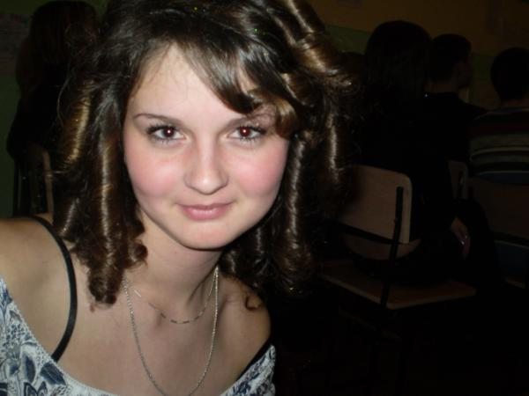




Anya:
“I would be lost, helpless and alone without the Internet”

Slide 11
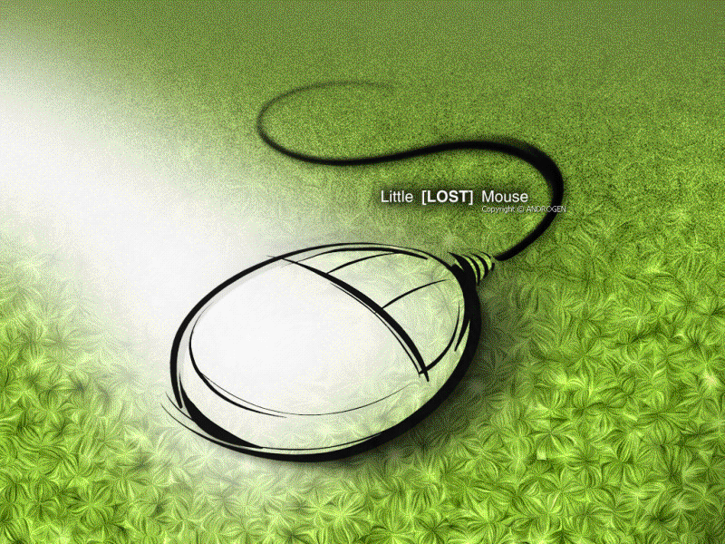
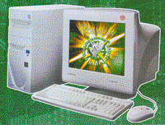

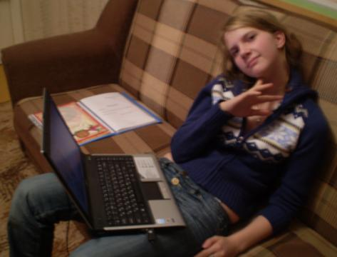
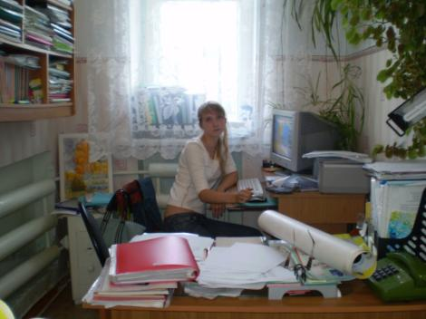
Tanya:
“I can’t live without my computer”

Slide 12
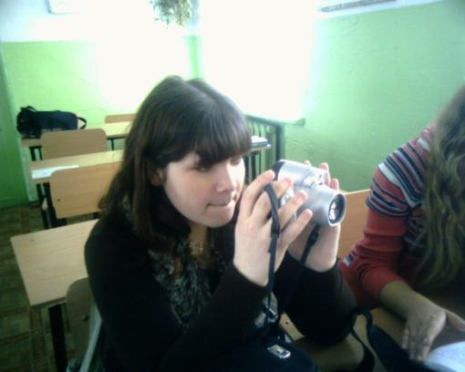
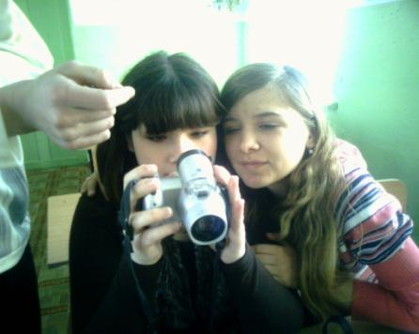
Natasha:
“I don’t know how people survived without camera. This gadget became part of my life”

Slide 13
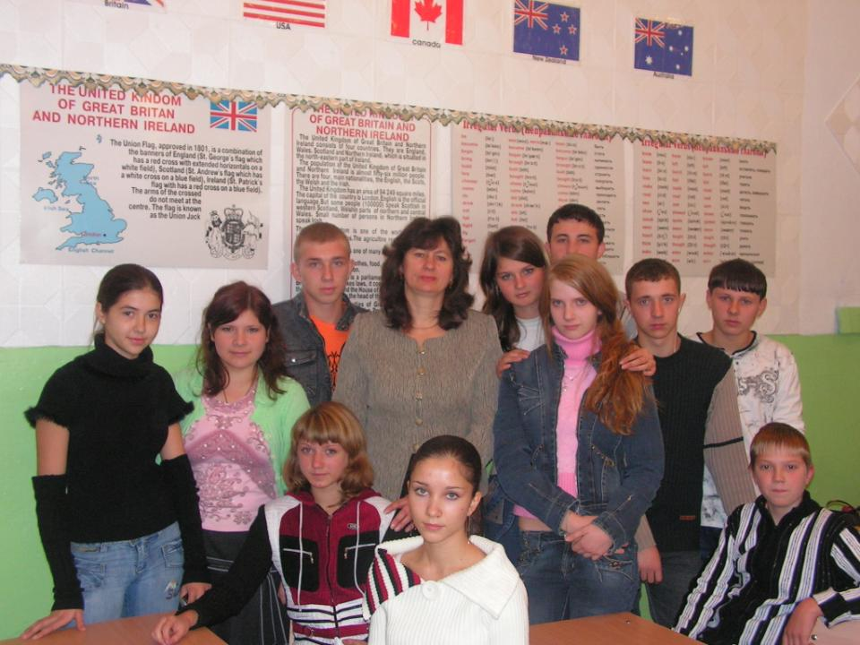
Our English group of
the 11-th form and our English teacher Starovoitova T.V.

Slide 14
Guess what I’m going to tell you about
D
V
g
I
T
A to take photographs
D
f
V
B
E
E
K
H
B to get in touch with my friends
A
C
O
M
E
S
M
F
C to cut and collect grass
C
O
M
P
U
T
E
R
D to sent and receive urgent messages
A
B
O
H
L
T
T
I
M
I
V
O
T
L
D
E to keep fit
E
L
E
N
Y
E
G
F to boil tea
R
E
R
E
G
E
A
Y
G to watch different programs
M
H to freeze food

Slide 15
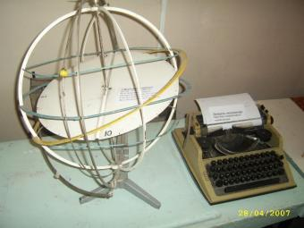
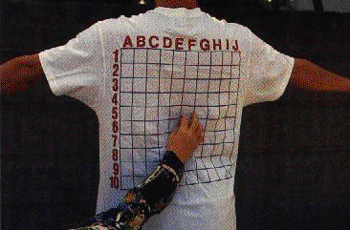
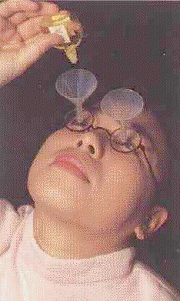
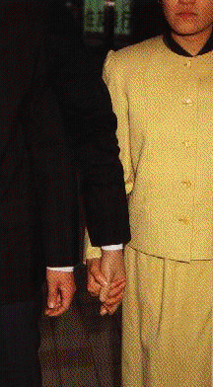

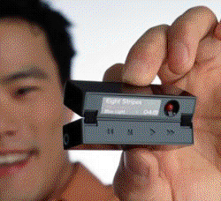
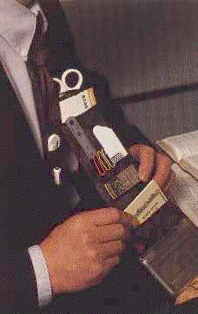
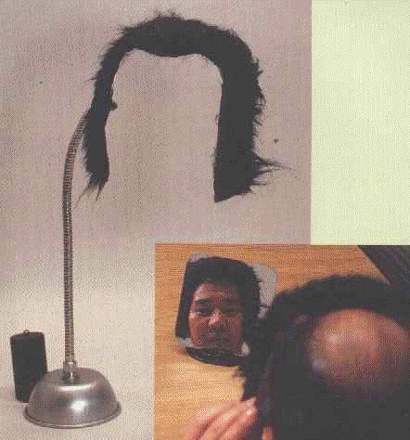
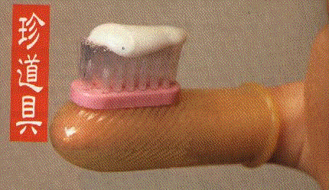
There are many inventions in our world…

Slide 16
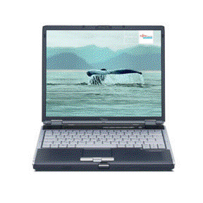
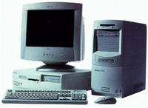
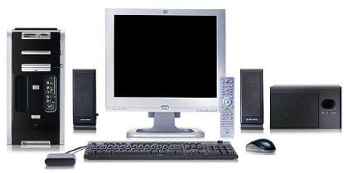
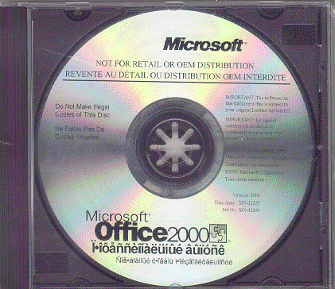
But I’d like to tell you about main gadget in our life – COMPUTER !!!

Slide 17

The project
Computers in our life
Prepared: Pavlishina Tanya,
a student of the 11th form
The teacher: Starovoitova T.V.

Slide 18



When Charles Babbage, a professor of Mathematics at Cambridge university, invented the first calculating machine in 1812 he couldn’t imagine the situation we find ourselves in today. Nearly everything we do in the world is helped, or even controlled by computers, the complicated descendants of his simple machine.

Slide 19


The history of pioneering computers is connected with the name of Bill Gates from USA, who created Microsoft – Disc Operating System in 1981.

Slide 20


And nowadays, as you know, computers are used more and more often in the world. The reason is simple they are far more efficient than human beings, because they have much better memories and can store much information. No man alive can do 500000 sums in one second, but a computer can. In fact, computers can do many of the things we do, but faster and better. They can predict weather, and ever play chess, write poetry or compose music.

Slide 21




We
can’t imagine our life without computers as at home as at schools. Computers help pupils do projects and get good marks. A lot of new information we know about computers and different programs at lessons .School computers are used not only for studying, getting information, being busy with science, but also for examinations purposes. Young people who finish the school must be trained to operate computers.

Slide 22



I consider, life is boring without computers. The main benefit is the speed with which we can do different useful for us operations. More than that it can brighten your life, because now computers have different design. It is modern. It’s interesting to note, that computer suits everyone whatever your age. Everybody can find functions by his taste.

Slide 23





Computers in medicine
No doubt, computer is one of great importance in modern hospital too. No doctor can possible keep up with all discoveries. Today there are medical computer centers where all existing knowledge of symptoms of various diseases and of their treatment is stored. Doctors have an opportunity to spend full diagnostics and put right diagnoses of patients that less the world’s death.

Slide 24

Not long ago I spent some investigations among
my classmates. As you know we are 25. And now I want to represent the results of my work.

Slide 25

HAVE YOU GOT A COMPUTER?
YES - 70%
NO - 30 %

Slide 26

Do you think it’s a useful tool?

Slide 27



How often do you operate it a day?

Slide 28
Do you think that computers are bad for health?

Slide 29





What for do you use it?

Slide 30

What do you prefer to?

Slide 31




So I made a conclusion that computers play an important role
In life of my classmates also.

Slide 32

As for me I can’t live without my computer. It helps me in self-development and self-knowledge.
I use it for achieving successes in my study, escaping everyday problems and of course relaxing.

Slide 33

But I must admit, that a computer doesn’t replace my friends, though I’m a mouse potato.

Slide 34





I don’t forget that computer is only a lifeless machine.

Slide 35

Thank you for giving up your time.
Good luck!

Slide 36
had been
…
…
…
…
..
…
…
…
…
…
improved
pioneered
produced
introduced
patented
Invented
made
build
found
designed
IN
was
tested
discovered
developed
created
perfected
by

