Slide 1
English
around the world
Заочное путешествие по англоязычным странам
Notes:
Welcome to our trip with English around the world.
First we’ll revise the mane information about English-speaking countries. Geographical position, the capital, the flag, nationalities, the places of interest.
Then you’ll try to answer the questions of the quiz.

Slide 2
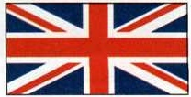
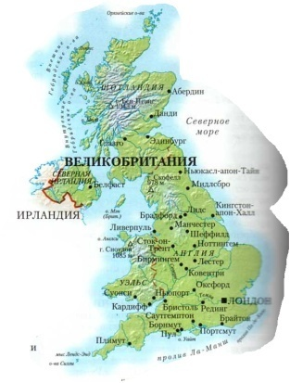
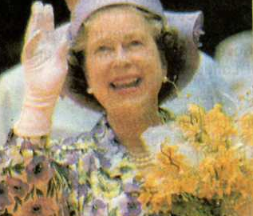
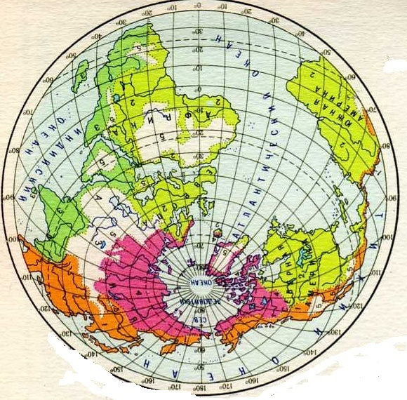
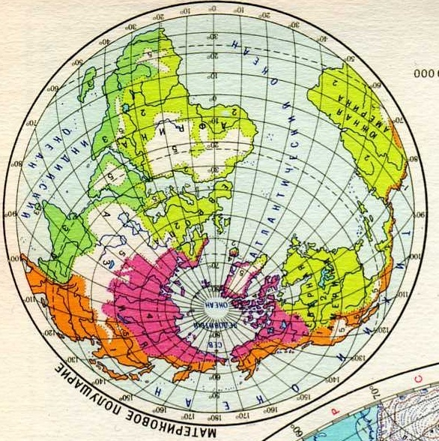
BRITAIN
London
Notes:
Britain is in Europe.
The capital of Britain is London.
This is the British flag. It is blue. It has two red and white crosses.
In London there is the big clock Big Ben. British buses are red. They are double-deckers.
The most famous British in London is the Queen Elisabeth.

Slide 3
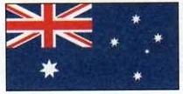
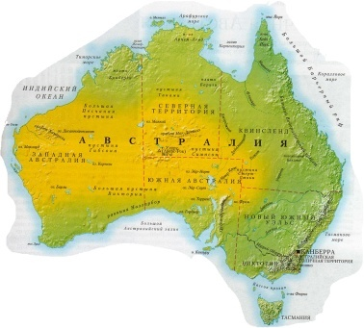
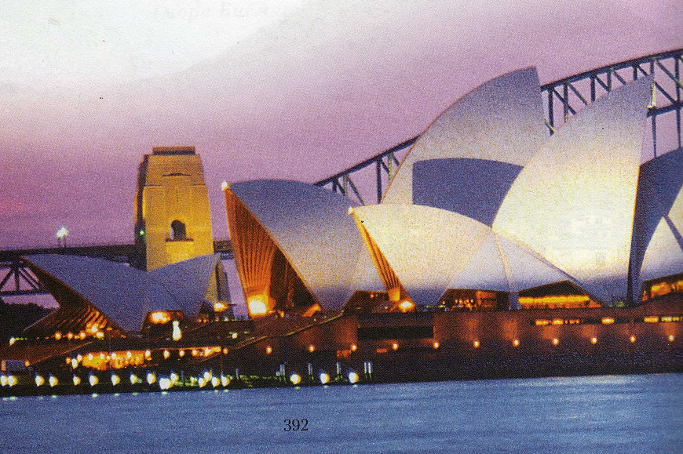
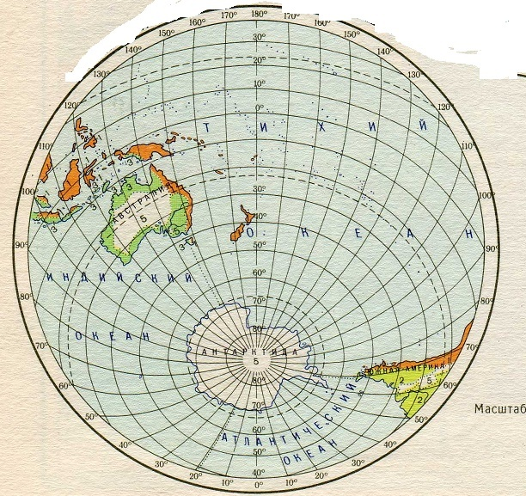
AUSTRALIA
Canberra
Notes:
Australia is the continent in the south hemisphere.
Canberra is the capital.
The Australian flag is blue. It has two red and white crosses and six white stars.
Australians are the people of this country.
Opera house is the symbol of Australia. It is in Sidney.
In the country there are lots of kangaroos.

Slide 4
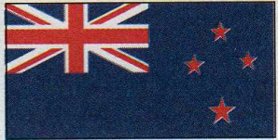
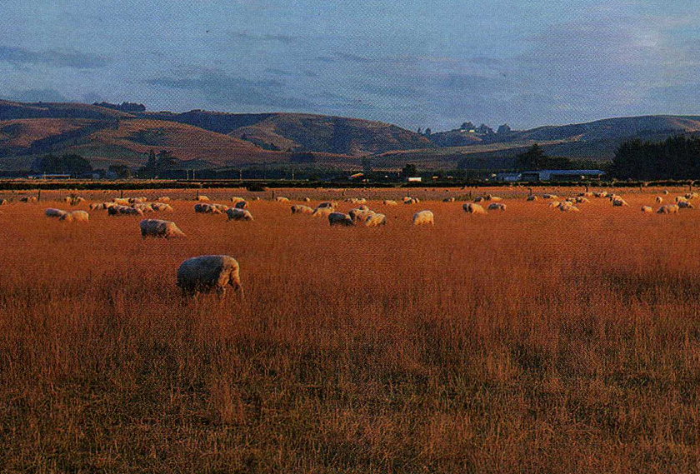
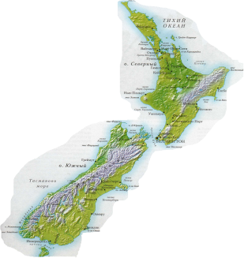
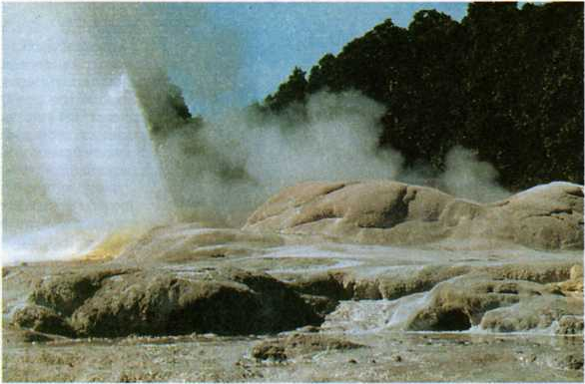
NEW ZEALAND
Wellington
Notes:
New Zealand is on some islands next to Australia.
The capital of the country is Wellington.
On the blue flag there are two red and white crosses and four red stars.
Some of New Zealanders are Maori. They draw black pictures on their bodies.
The others are farmers. They keep sheep.
There are lots of geysers and volcanoes in New Zealand.

Slide 5
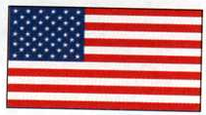
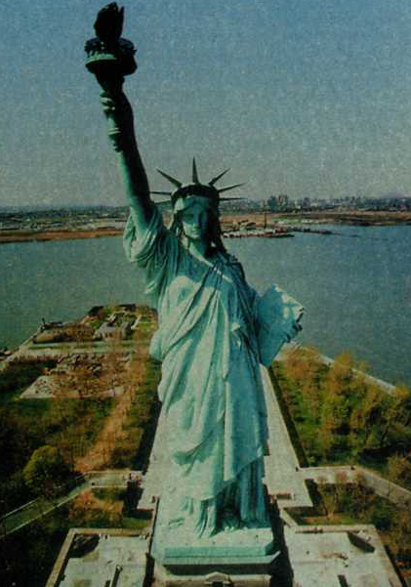
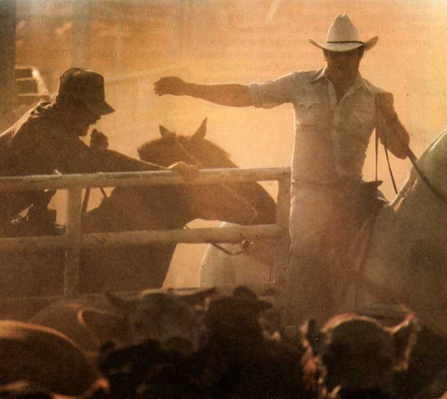
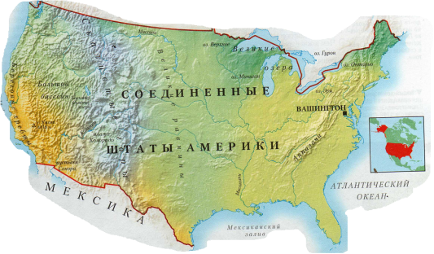
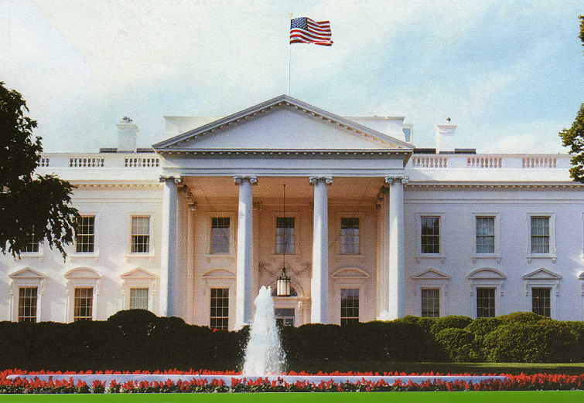
AMERICA
Washington
Notes:
The United states of America is in North America. The USA has 50 states.
Its capital is Washington.
American flag has got red and white stripes and fifty stars.
Indians and cowboys are Americans.
The most popular American is the president of the USA.
He lives in the White House.
There is the Statue of Liberty in New York.

Slide 6
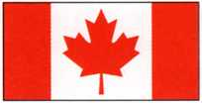
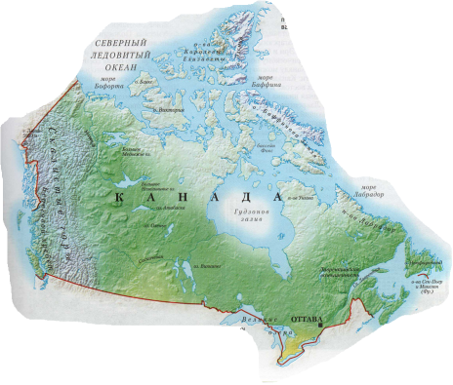
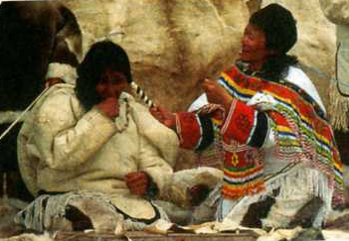
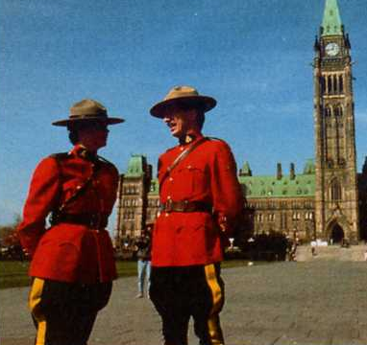
CANADA
Ottawa
Notes:
Canada is in North America.
The capital of the country is Ottawa.
There is a red leaf and two red stripes on the Canadian flag.
On the South of Canada there is the beautiful place The Niagara Falls.
The aborigines of Canada are Eskimos.
Canadian speak two language English and French.
This is the famous girl. Read about her.

