Slide 1
History of creation the personal computer

Slide 2
At that time computers did not need to be played in any game, etc. The First computers have been created on the basis of military technologies (microchips, various payments …). And only due to development of a science, economy, etc. factors - have created this surprising thing which now practically nobody manages!

Slide 3
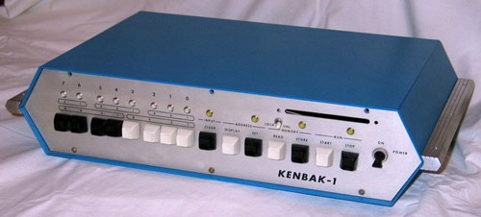
Creation of computers (i4004)
If to recollect a history of creation computers we shall see, that without occurrence of transistors and microcircuits transition from rooms of the COMPUTERS constructed on the relay or lamps borrowing(occupying) a little bit(some), to absolutely small-sized computers (during the period of time considered(examined) by us those frequently referred to as "microcomputers") could not be made. An opportunity technologically to create microchips well-known company Intel has led to to occurrence of the first processors, and nowadays Appeared as it is impossible by the way, Having declared on November, 15 1971 г.о release of The first processor i4004.

Slide 4
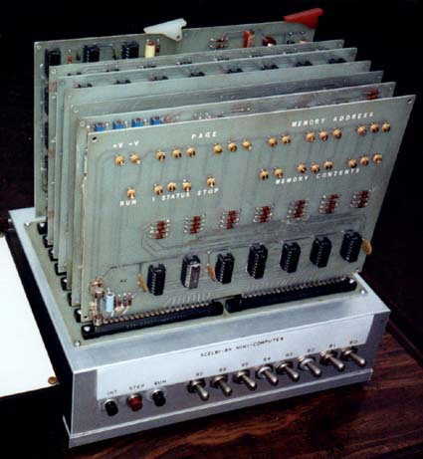
Intellec-8 (i8008)
In April, 1972 Intel has let out(has released) 8-ми the bit processor i8008 with clock frequency of 0,5 MHz which carried out 0,06 million operations a second. Intellec-8 represented the whole series of the microcomputers created as it is strange for hearing now, company Intel. For Intellec-8 programming language PL/M which has written to Fumes Kildoll, working in Intel the adviser on programming has been created, is the result of his(its) enthusiasm after work on Intellec-8 which has got to it(him) as a part of the salary was. PL/M was simplified version PL/I

Slide 5
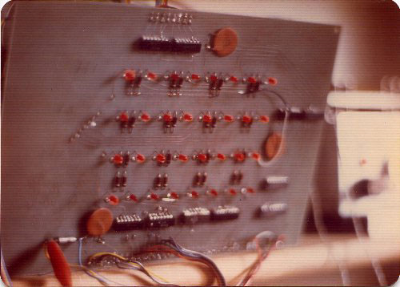
Micral 9050
To brand Micral has carried - it(he) has not remained memoirs on 70th years as the majority of others, and has vigorously stepped the next decade. Certainly, it were already other personal computers. For example, model 1982 Micral 9050 gathered on chips i8086, i8089 or Z80, possessed to two 5-inch FDD and the monochrome display (640х288 points).

Slide 6
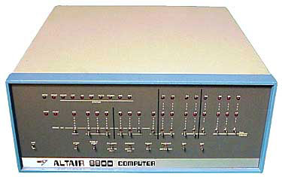
Altair 8800
As creator Altair 8800 Ed Roberts being the president of American company MITS Incorporated has acted. The destiny has smiled to Roberts already at purchase of a party(set) of processors i8080. Intel realized them on $300 for a piece fine by the gross. But Roberts has managed to find out in warehouses Intel "defective" chips which have been sold to it(him) for $75. It were quite efficient processors, but with different defects on the case. Thus, the future Altair 8800 needed to be sold approximately for $400 that who wanted to collect a computer itself.
Almost ideal personal computer has appeared in the beginning of 1975. The name to it(him) was - Altair 8800. To this, certainly, to the oustanding personal computer of time a number(line) of happy cases, as if the computer God accompanied

Slide 7
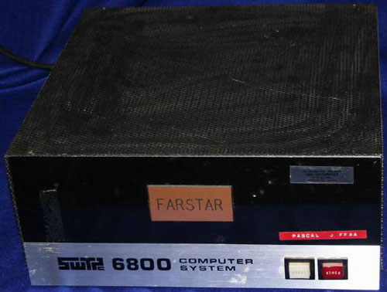
Motorola 6800
As well as today, and ten, and twenty years ago, in the middle of 70th years the market of processors belonged not to one only Intel. For construction of the personal computer chips of other manufacturers were used: Motorola 6800, Rockwell 6502, MOS MSC6502 (all with clock frequency of 1 MHz). On the first processor microcomputer SWTPC submitted by American company Southwest Technical Products Corporation in 1976 has been constructed. This type of the personal computer had the big popularity - some thousand (if no more) copies have been sold. The complete set from details cost cheaply - $400. This last microcomputer of American company Microcomputer Associates has been let out(has been released) in November, 1975 at the price of $249 (already collected cost $348). It(he) had 512 bytes of expanded memory RAM (up to 4 кб), 1 кб ROM and the terminal interface (TTY or EIA). Besides on Motorola 6800 worked Altair 680b companies MITS, but it(he) has turned out not too successful.

Slide 8
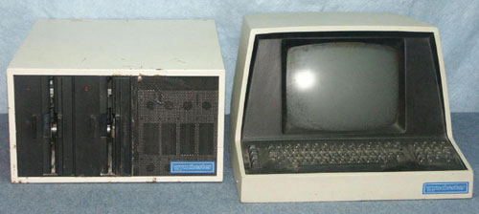
S-100
The similar open architectural concept at "Altair" originally referred to The Altair Bus, and then - S-100 Bus. System payment Altair 8800 had 12 слотов expansions where were connected the processor (yes - yes, the processor then memory, a videocard( videomap), the floppi-disk drive, the printer, the keyboard, the monitor, etc. was one of cards(maps)). Success S-100 Bus consist that accessories for it(her) could be created by various manufacturers of accessories, and foreign collectors could reproduce the trunk freely in the computers.
The big contribution to development S-100 Bus was brought by George Morrou who has headed committee on standardization of this trunk - " S-100 Bus Standards Committee " (at the end of 1983 S-100 Bus it has been standardized as trunk IEEE-696)

Slide 9
Questions. 1.What were the first computers? 2. On the basis of what technologies have the first computers been created? 3 .Was it possible to play computer games on the first computers? 4.Due to what has this surprising thing been created ? 5.What is the role of computers now ?

