Slide 1
America
April, 24

Slide 2
Compounds
when
ever mate black
stairs arm
home side chair
cup sea work
class where
up board
down

Slide 3
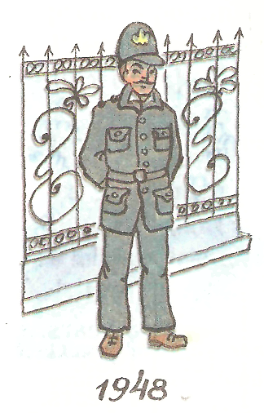
Since - For
He has been a policeman …….. 1948

Slide 4
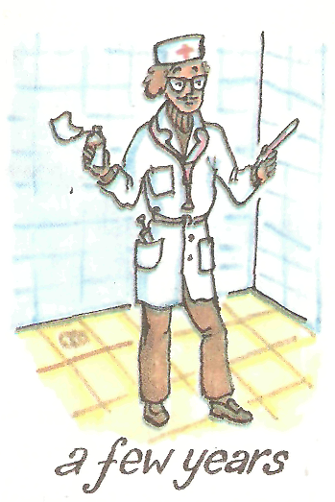
Since - For
He …….
a doctor …… a few years

Slide 5

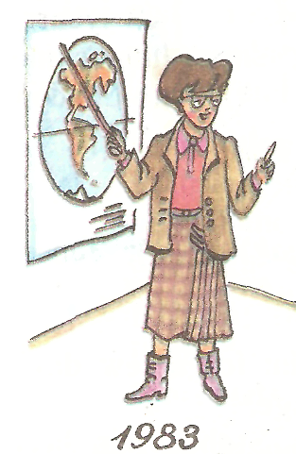
Since - For

Slide 6
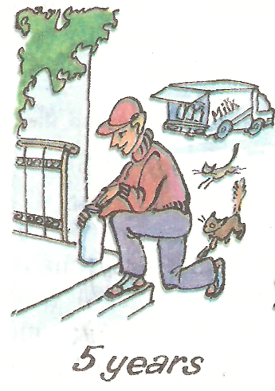
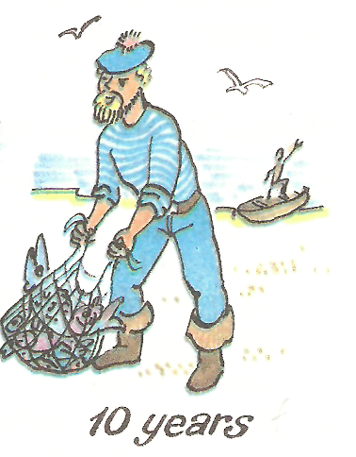
Since - For

Slide 7
Since - For
She has lived here …………... 1997.
She has lived here ………….. two years.
I have had the ball ………….. last June.
He has had the ball ………… three months.
I have liked fairy-tales ……………... I was a baby.
She has been a worker …………….. she left school.
We have had three tests …………… Monday.
They have stayed here …………….. two days.
I have had the player ……………… three weeks.
I have had the player ……………… Christmas.

Slide 8
Listening Comprehension
The average American ……………. 7,5 hours a night.
The average American goes to the cinema ……………….
The average American watches ………… four hours a day.
The average American eats ………….. hamburgers a week.
The average American drinks a cup and a half of ………… a day.
The average American lives in a ……………...
The average American goes to bed before ……………..
The average American reads the ……………….. every day.

Slide 9
Meeting with Famous people
The Conference
Krasnoznamensk
April, 24

Slide 10
Professor Smith
the Professor of Geography,
a specialist in sea voyages,
He is an author of the book
“He Discovered America”.

Slide 11
Ann Spielberg
a history teacher from California,
a director of the documentary film “The Wild West”

Slide 12
Tom Kentava
an Indian,
his parents are Native Americans

Slide 13
Julia Roberts
an American housewife

